Slide 1
Unit 3, lesson 3
Algorithms and debugging
3rd & 4th Grade
Lesson created by the GMU-ODU CSforAll Team. For more information about
this lesson and our CSforAll initiative, contact Dr. Amy Hutchison at ahutchison1@ua.edu

Slide 2
Summary and Standards
Summary:
In this lesson, students will continue planning and then animating their explanatory writing in Scratch and check for consistency.
ELA Standards
The student will write in a variety of forms to include narrative, descriptive, opinion, and expository.
a) Engage in writing as a process.
b) Identify audience and purpose.
c) Use a variety of prewriting strategies.
d) Use organizational strategies to structure writing
according to type.
g) Use transition words to vary sentence structure.
CS Standards:
The student will construct programs to accomplish tasks as a means of creative expression using a block or text based programming language, both independently and collaboratively
a. using sequencing;
b. using loops (a wide variety of patterns such as repeating patterns or growing patterns); and
c. identifying events.
The student will create a plan as part of the iterative design process, independently and/or collaboratively, using a variety of strategies (e.g., pair programming, storyboard, flowchart, pseudocode, story map).
Notes:
Today, we are going to learn some new things in Scratch, such as new commands and how to change sprites! This will help us get ready to use Coco and Scratch to animate the writing we did last time.

Slide 3
Lesson Objectives: I can…
Review Scratch blocks and Loops
Animate, and self-monitor my writing in Scratch using Coco Level 3 (Column 1, 2, 3, 4)
Review writing and animation for a match
Share my animation and writing with peers
Notes:
Let’s go over today’s lesson’s objectives: [read slide]

Slide 4
Materials and resources needed for this lesson:
Reminder:
In this lesson, every student should be assigned a story in CoCo using Level 3.
The story should be titled “Unit 3 Story.”
Each student should save their work using this naming strategy: “Student Name + Unit # + Descriptor”, for example, “Johnny Unit 3 Story”
Chromebook/Laptop
Internet Access
Link to Scratch
Link to Coco
Teacher Unit 3, lesson 3 slide deck
CoCo column one filled in (from last time)
Notes:
You will need….[read slide]

Slide 5
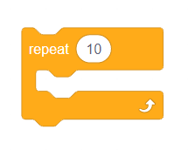
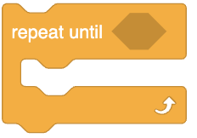
Review: Loops
Notes:
Review Loops and ask students to share with a partner or the class when they might use loops in their animation

Slide 6
Warm up: Finish filling in Coco!
Notes:
(If necessary) Have students finish completing all sections of CoCo using their paper graphic organizer from the last two lessons.

Slide 7
Before you begin to code….
Make sure you have a topic sentence
Match your animation to your writing
Be consistent
Match your visuals to your text
Notes:
In Unit 1, we learned that we want to a) match your animation to your writing, b) be consistent, and c) make sure all the visuals in the frame make sense given what you have written in your text.

Slide 8
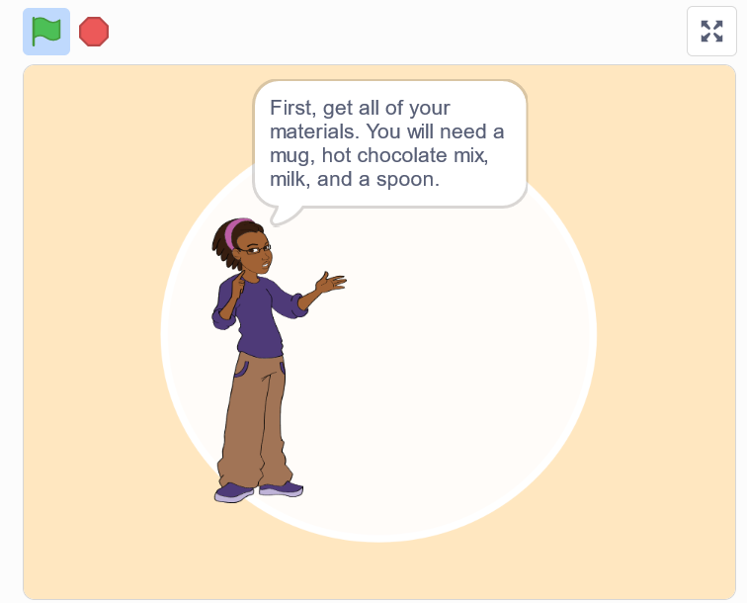
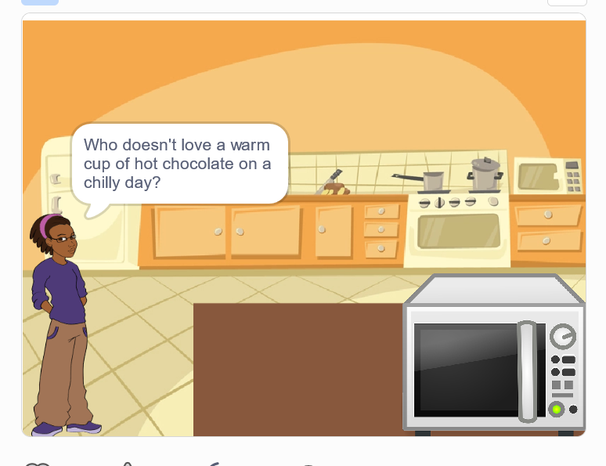
Good animations can be simple or complex!
https://www.dropbox.com/s/jlist1zaujjpc8e/Screen%20Recording%202023-09-18%20at%209.21.46%20PM.mov?dl=0
https://www.dropbox.com/s/nh93dmdkphd4n0z/Screen%20Recording%202023-09-19%20at%201.45.13%20AM.mov?dl=0
Notes:
Good animations that follow these guidelines can be as simple as https://www.dropbox.com/s/jlist1zaujjpc8e/Screen%20Recording%202023-09-18%20at%209.21.46%20PM.mov?dl=0
or as complex as https://www.dropbox.com/s/nh93dmdkphd4n0z/Screen%20Recording%202023-09-19%20at%201.45.13%20AM.mov?dl=0
so long as they clearly convey the message to the reader visually and verbally!

Slide 9
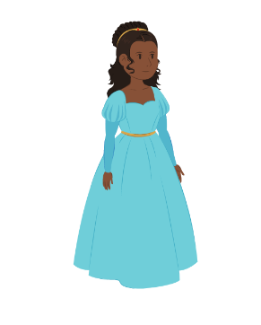
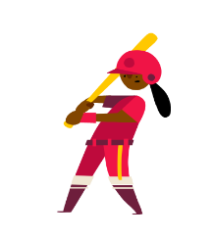
“Once upon a time there lived a princess…”
Notes:
For example, if I was writing a story about “Once upon a time there lived a princess….” which one of these sprites would make more sense?

Slide 10
“Once upon a time there lived a princess…”
Notes:
For example, if I was writing a story about “Once upon a time there lived a princess….” which one of these sprites would make more sense? Probably this one. Although, if our princess played baseball later in the story, you could switch it up!

Slide 11
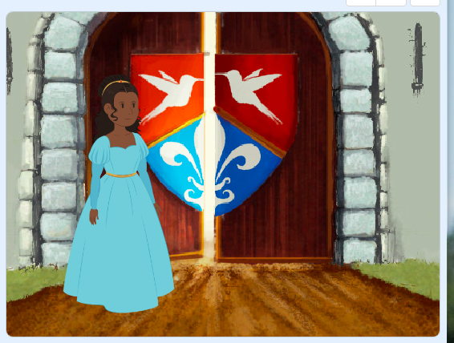
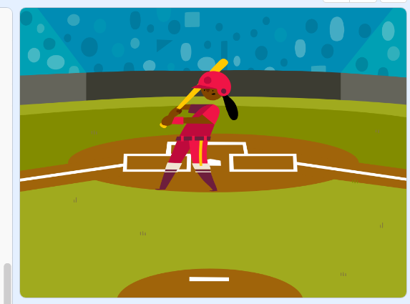
“Once upon a time there lived a princess in a castle.”
Notes:
Now, if I was writing a story about a princess who lived in a castle, this backdrop would make more sense.

Slide 12
“Once upon a time there lived a princess who played baseball.”
Notes:
But if I wrote about a princess who played baseball, this one could also work!

Slide 13
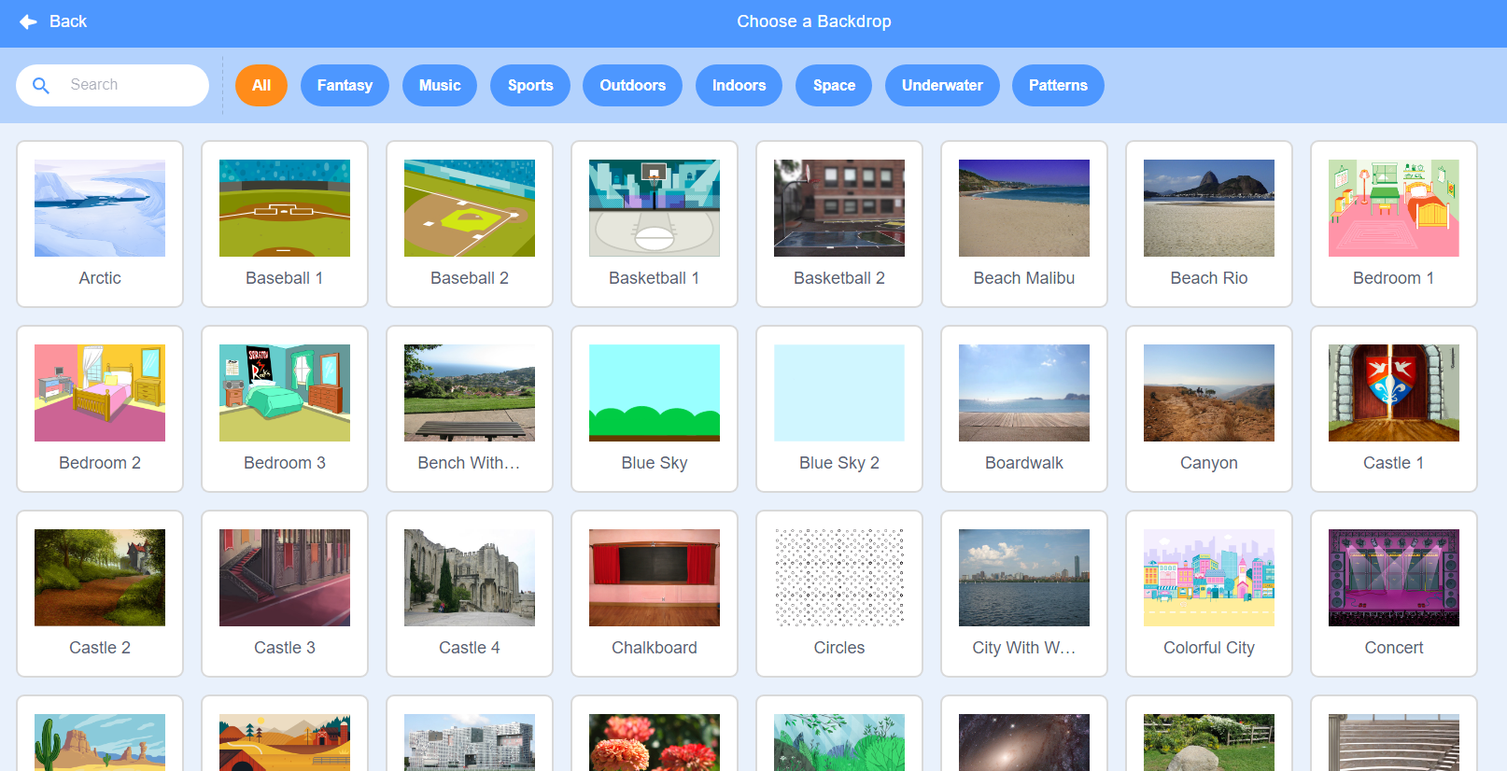
Notes:
Here’s another Scratch tip: when looking for sprites and backdrops, you can enter words into the “search” bar and see if any of the results match what you’re looking for.
If you don’t find the backdrop you’re looking for you could also search the following websites for non-copyrighted images that you can upload to Scratch
Dribble: https://dribbble.com/
Library of Congress free to use and reuse: https://loc.gov/free-to-use
Flickr: https://flickr.com/
Unsplash: https://unsplash.com/

Slide 14
You can use Scratch to enhance your animation
aLL ADDITIONAL DETAILS MUST BE RELEVANT!
Notes:
Remember how we searched for unique sprites and backdrops? And we also learned how to upload our own sprites and sounds. So there are many ways we can use Scratch to enhance our animations, or make them more exciting! We can add more details to our animations as long as we make sure that the details are relevant.

Slide 15
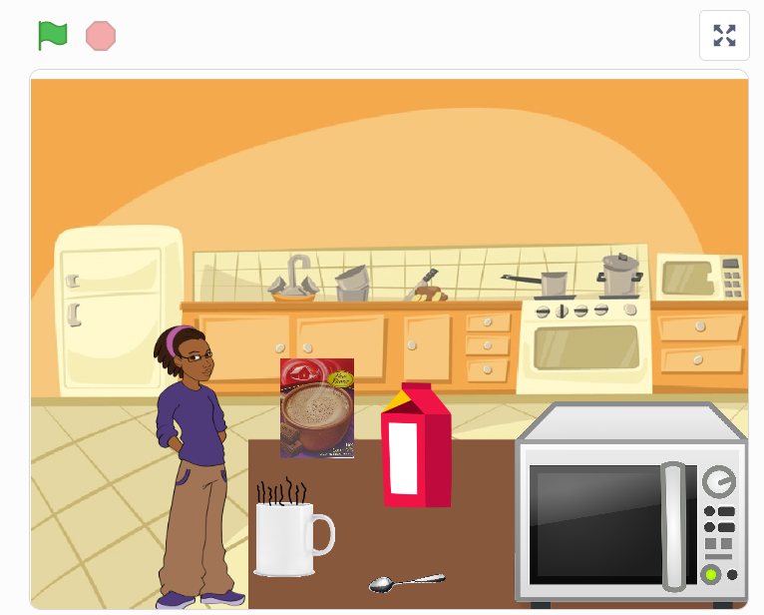
Like this:
https://www.dropbox.com/s/nh93dmdkphd4n0z/Screen%20Recording%202023-09-19%20at%201.45.13%20AM.mov?dl=0
Notes:
For example, here’s an animation of the hot chocolate recipe that does a really great job enhancing the recipe with additional details to help the viewer imagine a person actually making hot chocolate! Let’s take a look and see what they did.
[play/run scratch project]
The first thing we notice is that this computer scientist added images of real-life materials rather than cartoons. This detail enhances the animation but does not change the meaning. They also drew an arrow to show where the mix would go into the cup. FInally, they coded the objects to move and simulate the actual “making” of the drink. But nothing about the meaning changed! And it was not distracting.

Slide 16
However!
Too many visuals can be confusing
Notes:
Let’s look at another example, where the additional details were not relevant and thus confusing…..

Slide 17
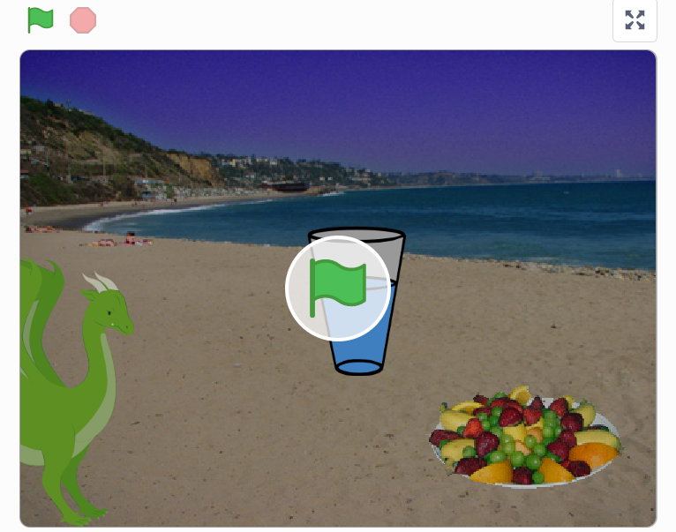
Not like this
https://www.dropbox.com/s/o7aaphbglzvswkr/Screen%20Recording%202023-09-19%20at%201.52.23%20AM.mov?dl=0
Notes:
All the written text is the same but the images don’t match the text. For example, why is there a dragon in the screen? Why are they at the beach? And why does it show a glass of water instead of hot chocolate? It may seem funny but to a new viewer, it would be very confusing. We dont want that.

Slide 18
Independent practice
Notes:
Now it is time to put it all together. You will use CoCo to help you create your animation in Scratch!

Slide 19
Independent Practice:
Open Scratch in one tab, CoCo in another
Use CoCo to code your Scratch animation
Don’t forget to self-monitor as you go!
Pause here. (10-25 minutes)

Slide 20
Wrap Up
Notes:
Great job! Now it is time to make sure your animation matches your plan.

Slide 21
Ask yourself:
Does my topic sentence orient my reader and help set the scene?
Does my animation in Scratch convey what I planned? Does it match my writing?
Have I enhanced my writing in any way in Scratch?
Is there anything distracting or unnecessary in my animation that I should remove?
Is there anything in my animation that would make it harder for a viewer to understand my purpose?

Slide 22
Swap screens with a partner

Slide 23
Sharing your .sb3 file from CS First to CoCo
Create the file in CS First
In the Scratch editor, find the word “File” in the top-left corner.
Click on “File” menu and you’ll see some choices pop down.
Choose “Save to your computer.” This will download your Scratch project.
Look in your “Downloads” folder. That’s where your saved project might be.
Go to the CoCo website and log in to your account. https://wego.gmu.edu/scratchgo/login.php
Click proceed on the correct story in CoCo.
Navigate to the section of CoCo where you can upload your project. (only sb3 type and 10Mb max).
Click “Save”.
Notes:
Model how students can share the sb3 file from CS First to CoCo

Slide 24
Here is an optional video to learn how to share your project in Scratch.
Pause here.
Notes:
Video modeling how students can share Scratch creations to their teacher’s studio
Scratch - Imagine, Program, Share

Slide 25
Scratch Checklist
I logged into scratch
I shared my project
I added my project to my teacher’s studio

Slide 26
Careers in Tech

