Slide 1
Lesson 2
Introduction to Scratch & CoCo
Grades 5 & 6
Lesson created by the GMU-ODU CSforAll Team. For more information about
this lesson and our CSforAll initiative, contact Dr. Amy Hutchison at achutchison1@ua.edu
Notes:
Welcome back to learning about computer science!

Slide 2
Summary and Standards
Summary:
In this lesson, students will review patterns and sequencing, and be introduced to algorithms, decomposition and abstraction. They will learn about the Compose and Code (CoCo) platform and use it to compose a set of written instructions (“algorithm”) to program a sprite to walk in a square.
ELA Standards:
The student will use effective communication skills in group activities.
a) Listen attentively by making eye contact, facing the speaker, asking questions, and summarizing what is said.
b) Ask and respond to questions from teachers and other group members.
c) Explain what has been learned.
d) Use language appropriate for context.
e) Increase listening and speaking vocabularies.
CS Standards:
The student will construct sets of step-by-step instructions (algorithms), both independently and collaboratively
a) using sequencing;
b) using events.
Notes:
Optional: Introduce lesson, learning goals, and resources (Slides # 2-4)
In today’s lesson, we will continue to work in Scratch. We will learn new computational thinking skills, and be introduced to an amazing graphic organizer that supports our writing AND our coding.

Slide 3
Materials and resources needed for this lesson:
Chromebook/Laptop
Internet Access
Scratch Offline Editor (app)
Teacher slides
CoCo Link
Optional: Explanatory text graphic organizer & storyboard
Notes:
Optional: Introduce lesson, learning goals, and resources (Slides # 2-4)
Does everyone have what they need today?

Slide 4
Lesson Objectives: I can…
Review the definitions of patterns, sequencing, and Scratch vocab
Define algorithms, decomposition and abstraction
Identify the purpose of CoCo
Write an algorithm for how to walk in a square
Identify the Scratch blocks used to program a sprite to walk in a square
Notes:
Optional: Introduce lesson, learning goals, and resources (Slides # 2-4)
As we go through the lesson, we will be able to….[read slide]

Slide 5
Vocabulary
Algorithm
Commands
Code
Decomposition
Abstraction
Notes:
And we’re going to learn all these new words! [read vocab words]

Slide 6
Let’s review: match each CT skill to its definition
Pattern
Sequence
Scratch Block(s)
Sprite
Backdrop
An ordered set of instructions
Background in Scratch project
Something that repeats
Commands in Scratch
Characters in Scratch
Notes:
Before we begin let's review some important vocabulary from our previous lesson. Work together to match the vocabulary term to its definition. We will share the answers next.

Slide 7
Let’s review: match each CT skill to its definition
Pattern
Sequence
Scratch Block(s)
Sprite
Backdrop
An ordered set of instructions
Background in Scratch project
Something that repeats
Commands in Scratch
Characters in Scratch
Notes:
Before we begin let's review some important vocabulary from our previous lesson. Work together to match the vocabulary term to its definition. We will share the answers next.

Slide 8
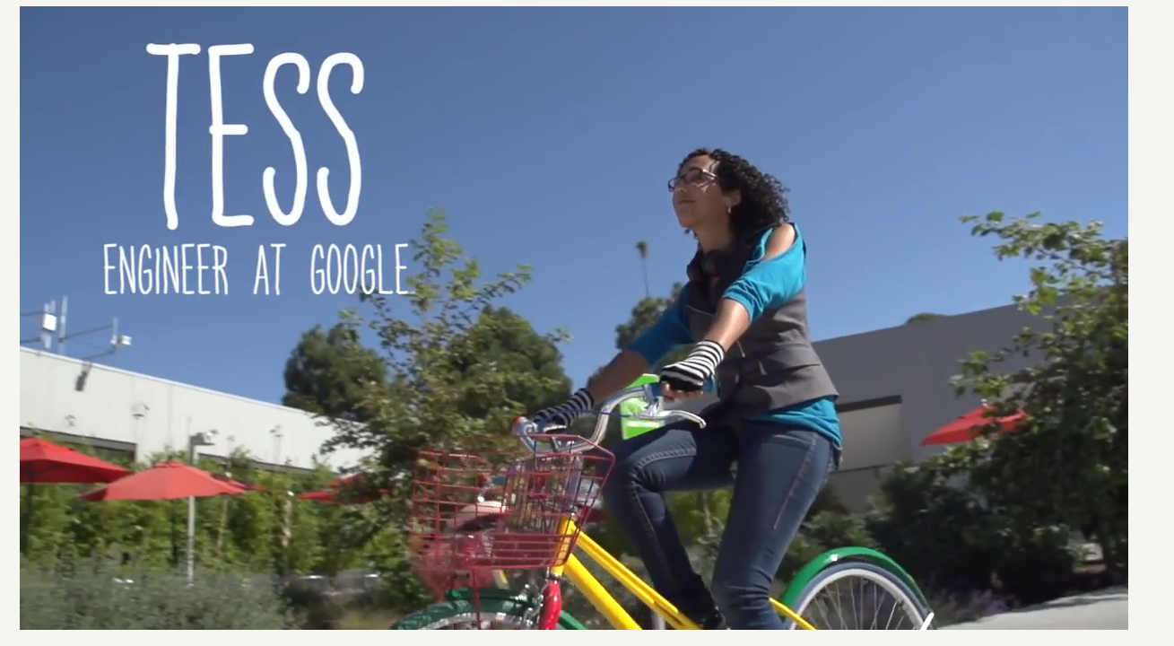
Today’s Career in Tech: Meet TESS
Notes:
Play video

Slide 9
Lesson Objectives: I can…
Review the definitions of patterns, sequencing, and Scratch vocab
Define algorithms, decomposition and abstraction
Identify the purpose of CoCo
Write an algorithm for how to walk in a square
Identify the Scratch blocks used to program a sprite to walk in a square
Notes:
Check off the objectives as the lesson proceeds.

Slide 10
How do Computer Scientists think?
Notes:
Does anyone remember the word we use to describe how computer scientists think?

Slide 11
Computer scientists use computational thinking skills
Patterns
Sequencing
Algorithms
Decomposition
Abstraction
We are going to learn how to do all of these!
Notes:
That’s right–computational thinking skills! Last time, we talked about patterns and sequencing.

Slide 12
Computer scientists use computational thinking skills
Today our focus is on
Patterns
Sequencing
Algorithms
Decomposition
Abstraction
Notes:
Today, we’re going to discuss creating algorithms, decomposing, and abstracting.

Slide 13
Algorithm: A list of steps to finish a task
Notes:
An Algorithm is a list of steps or commands to finish a task.

Slide 14
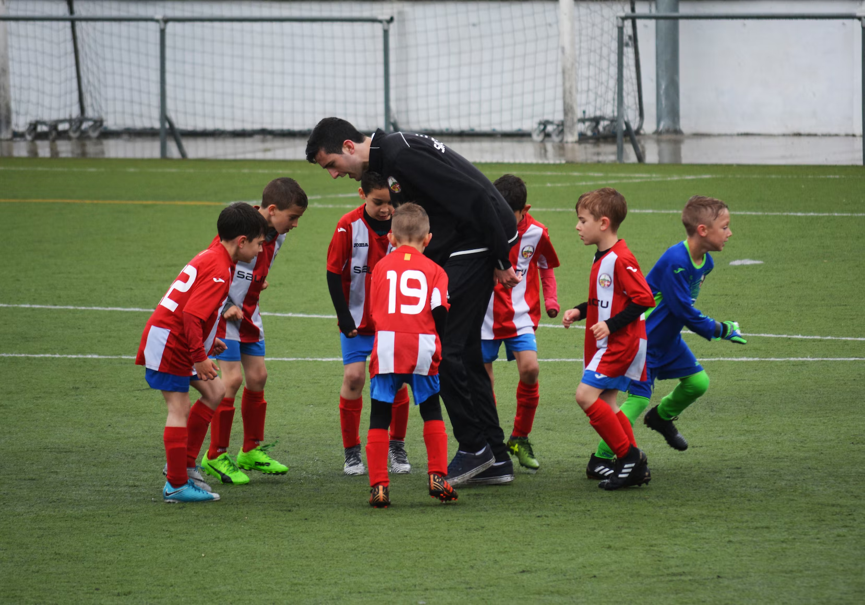
Turn & Talk
Think about the algorithms in your life.
What are steps you complete every day, week, or even month?
Are there certain activities you do, for example, every day or every weekend?
Notes:
[read slide]

Slide 15
Coding an algorithm
This algorithm tells the computer to make the sprite say “Hi!” for 2 seconds then turn right 90 degrees.
Hi!
2
Notes:
Here’s an example of an algorithm. We’ve taken Scratch commands and put them in the correct order from top to bottom you have created a sequence of instructions. This would tell the computer to say Hi for 2 seconds then turn right 90 degrees.

Slide 16
Commands:
tell a person or computer what to do
Notes:
Introduce vocabulary slides: Commands
Commands tell a person or a computer what to do. “I command you to give yourself a pat on the back” (pat my own back).
An Algorithm is a list of steps or commands to finish a task. So if I told you to pat yourself on the back, then wiggle your ears, I am putting two commands together in a particular sequence I want you to follow. This is a really simple example of an algorithm. (Model, pat back, wiggle ears)

Slide 17
Code:
The language that computer scientists create and use to tell a computer what to do.
Notes:
Introduce vocabulary slides: Code
So a command is an instruction and we can create commands for the computer. When you put commands together you create an algorithm or a list of steps. But how do you give computers instructions?
We use code! Code is the instruction that computer scientist create and use to tell a computer what to do.
Writing code is like writing the commands for a computer. When you know how to write code, you can tell computers what to do. We'll learn how to write code in Scratch.

Slide 18
Commands must be in the correct sequence
Notes:
So remember: When we write instructions or when we write code, the order in which we put the commands is called the sequence. It is important that you put your commands in the correct order. Just like when you get ready for school. It is important that you put on your socks BEFORE you put on your shoes. It would not look quite right (and be very uncomfortable) if you put your shoes on THEN put on your socks! The same is true when we give computers commands in code. Putting commands in the correct sequence is VERY IMPORTANT!”

Slide 19
Why do patterns and sequences matter when coding?
Notes:
Ask the class to respond: “Why do patterns and sequences matter when coding?”
“Let’s think of a cooking example. If you do not follow the correct sequence of commands for making a cake, your recipe will not turn out correct.
The same thing happens when you don’t identify patterns and follow the correct sequence when writing a code...things will not turn out like you wanted them to!
When you write a set of instructions or a procedure, you have to be very clear so that others can follow your instructions without getting confused. This is a lot like what computer scientists do: they write instructions for computers. They have to be very clear and careful, because a computer is just a machine and will do exactly what it is told. No matter if you’re writing for a human or a computer, the instructions have to be in the right order, or the right sequence, or else they would make no sense!

Slide 20
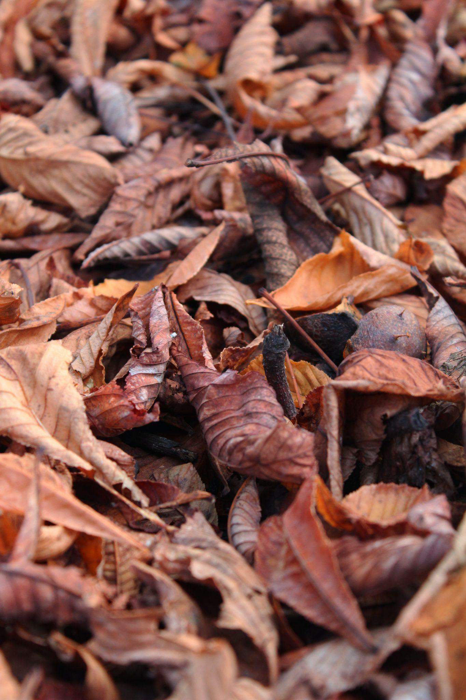
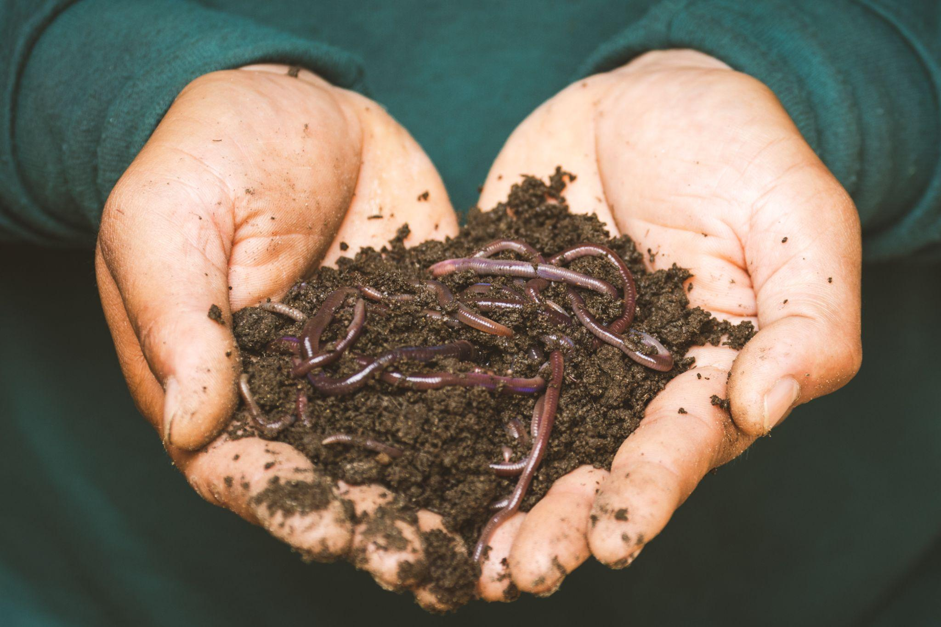
Decompose
Notes:
Have you ever heard the word decompose? Or even decomposition? In science you may have learned about decomposers, those organisms that break things down. Well, today we are going to learn about how we can decompose in both computer science and in our writing and literacy!

Slide 21
Decompose: to Break a problem down into smaller pieces
Decomposition (dee-comp–uh-zi–shun): breaking a large problem into smaller parts
Notes:
Computer scientists have to solve coding problems and need to make think about what steps they need to take and what order to do them in.
Sometimes the problem is so big or complex, it can be hard to know where to start.
Decomposition is when we break a problem down into smaller parts to make it easier to tackle.
It has many advantages. It helps us manage large projects and makes the process of solving a complex problem less scary and much easier to take on.
This Unit, we’re going to learn more about decomposition, our final computational thinking concept. Decomposition is going to be key in helping us to animate our new stories in Scratch with more Scratch blocks.”

Slide 22
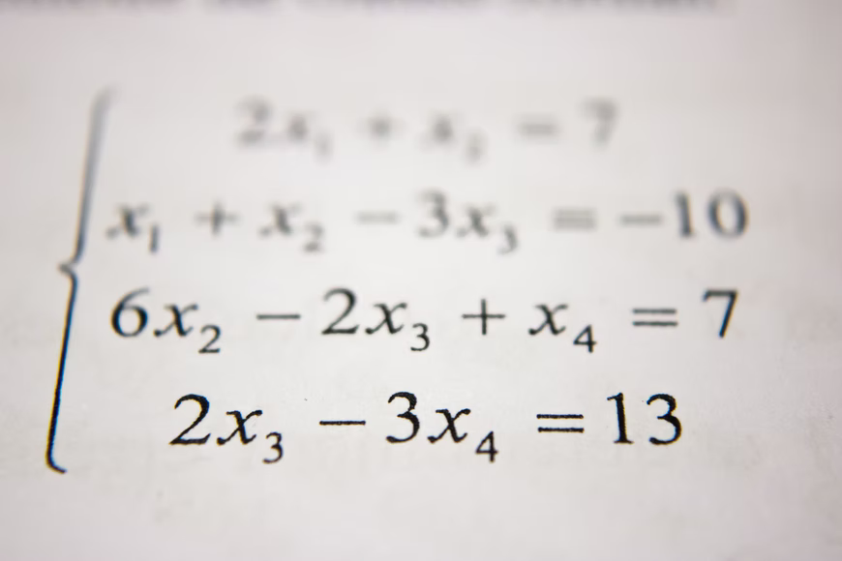
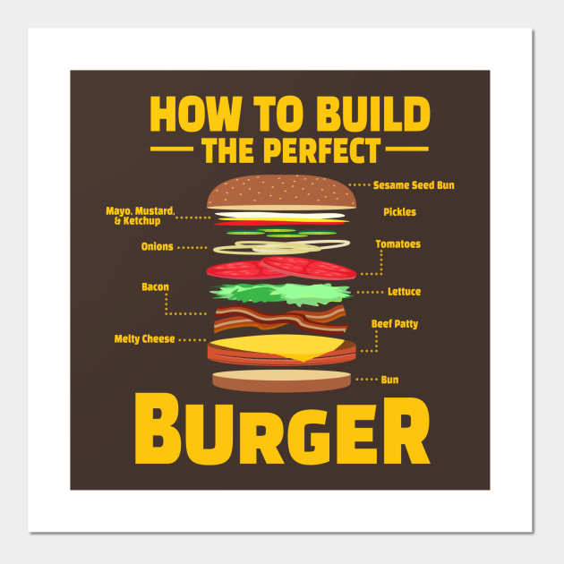
we can decompose more than just Computer science problems!
Notes:
According to code.org: “Decompose—To break a hard problem up into smaller, easier ones” Decomposition is going to be key in helping us to animate our new stories in Scratch with more Scratch blocks.”

Slide 23
Can you think of more examples?
Pause Here
Notes:
When do you break things down?
Break down a recipe, a workout, picking out your outfit, ex

Slide 24
Decomposition
In literacy, we use decomposition quite often:
When we sound words out (mis-com-mu-ni-cate)
When we edit and fix mistakes
When we create a set of instructions
When we share the main idea
When we summarize of a story
Notes:
We actually use the skill of decomposition quite often in literacy. We decompose when we break down a word or sentence into small parts, like sounding a word we don’t know in a sentence. We decompose when we break down our writing to look for errors, like debugging. We decompose and abstract when we break down a series of steps, like a set of instructions, into the most important parts. We also decompose when we break a story down into the main idea or try to provide a summary.

Slide 25
Abstraction
Notes:
Now that we have reviewed sequencing and coding, let’s learn about a new word in computer science. Abstraction! We can use abstraction to “work smarter” when writing code.

Slide 26
abstraction (Ab-Strac-SHUN) is identifying what
is important and leaving out information we do not need.
Notes:
Abstraction sounds like a really big word, but it just means identifying what is important and leaving out information that we do not need. Computer scientists are efficient, which means they look for the simplest solutions to problems.

Slide 27
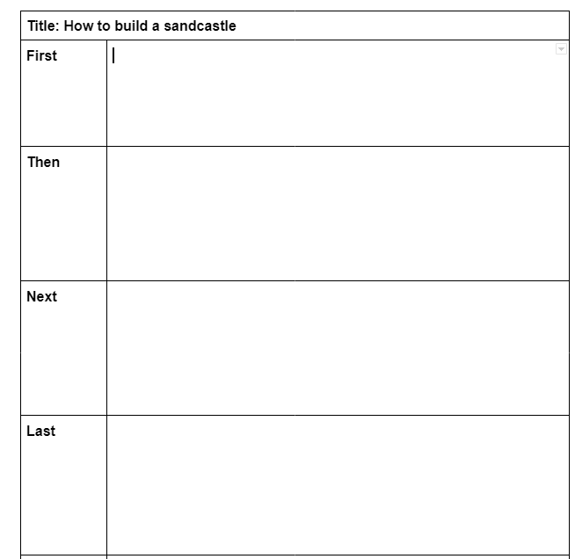
Notes:
Another common example of abstraction is in our writing when we plan our writing with an outline or a graphic organizer. In order to write clearly, we have to identify the most important details BEFORE we start writing.

Slide 28
Optional: play Video on Abstraction Found HERE
Notes:
Video link: https://www.dropbox.com/s/6nkvpaowwwok268/Abstraction.mp4?dl=0

Slide 29
Notes:
Remember that graphic organizers are examples of abstraction. Graphic organizers are templates we often use to help us organize our writing. This helps us to plan our writing more efficiently. We can use these words for a variety of different types of writing and purposes. This helps us be more efficient.
For example, even though we filled in this graphic organizer for “how to build a sandcastle” we could use it to write a set of instructions for…..

Slide 30
Lego starship
Notes:
How to build something OTHER than a sandcastle. Like a Lego star ship! Nothing else about the graphic organizer needs to change but your instructions would be very different.

Slide 31
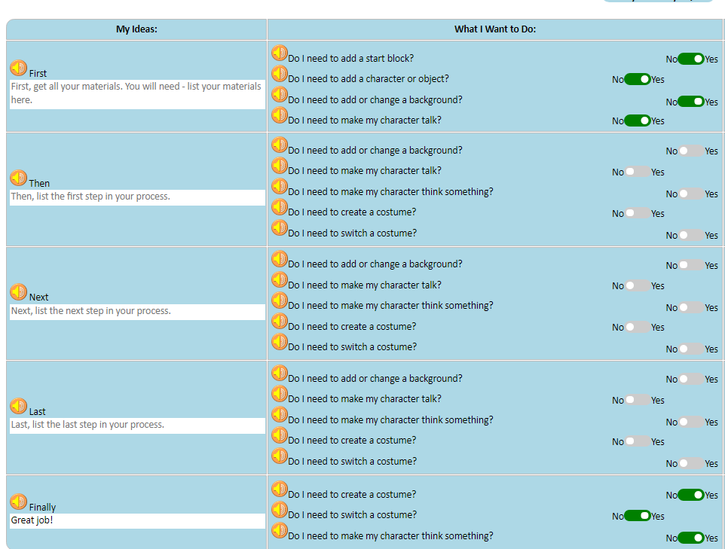
Notes:
Soon, you will be introduced to another graphic organizer that is also abstraction in action!

Slide 32
Lesson Objectives: I can…
Review the definitions of patterns, sequencing, and Scratch vocab
Define algorithms, decomposition and abstraction
Identify the purpose of CoCo
Write an algorithm for how to walk in a square
Identify the Scratch blocks used to program a sprite to walk in a square
Notes:
Check off the objectives as the lesson proceeds.

Slide 33
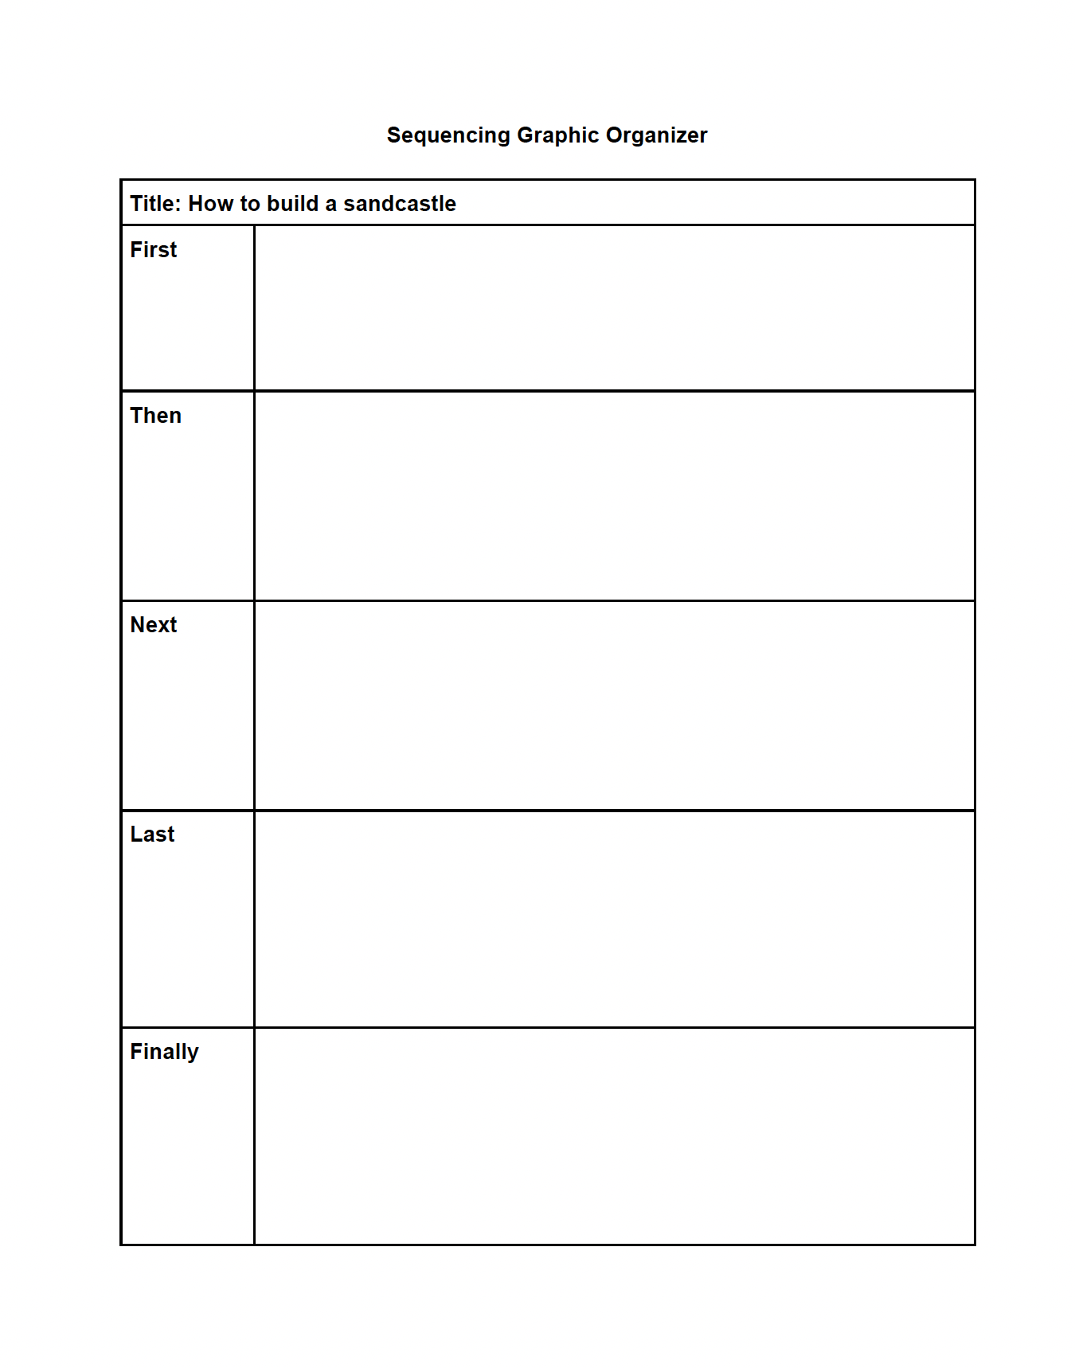
Graphic Organizers for writing
Notes:
Explain that when you are planning to code or to write, there are certain pattern of steps that we may follow each time.
We can use a graphic organizer to help us.
The graphic organizers you have used before helped you brainstorm and eventually write. But now you are going to use a graphic organizer to help take your writing one step further to the final step of the writing process: to present and publish your writing with Scratch! Using Scratch to animate your writing is one way to publish, or share, your work.

Slide 34
Meet CoCo the “compose and code” platform
Notes:
The name of our graphic organizer is CoCo, which stands for Compose and Code! Today you are going to learn how to use Coco, a new graphic organizer to organize your thoughts, write instructions, and present your ideas in a coding project.

Slide 35
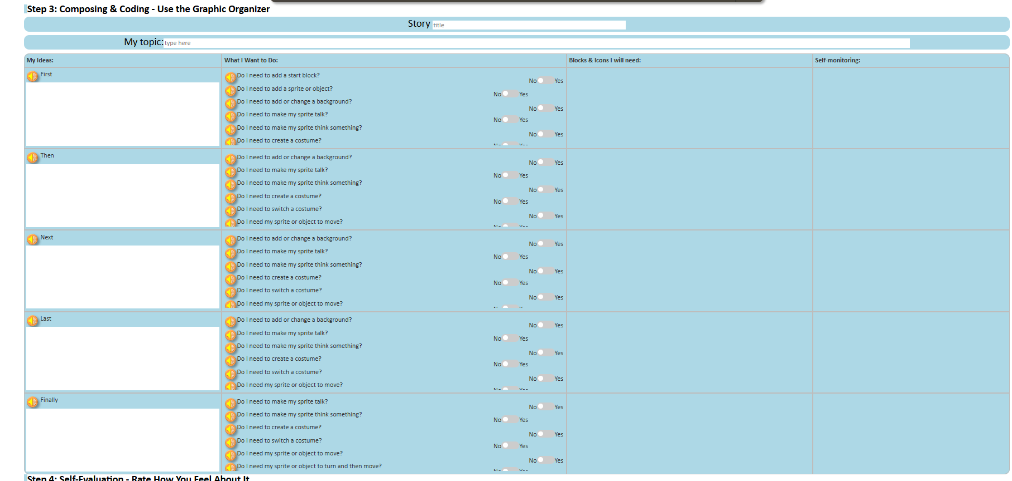
Notes:
Coco looks a lot like other graphic organizers we’ve used. Before Coco is filled in with your writing and ideas, it will look like this.

Slide 36
Remember to always include a topic sentence!
Notes:
My ideas is where your writing will go. Remember to always include a topic sentence. Including a topic sentence will help orient your reader towards your topic and it will help you set the scene for your Scratch animation.

Slide 37
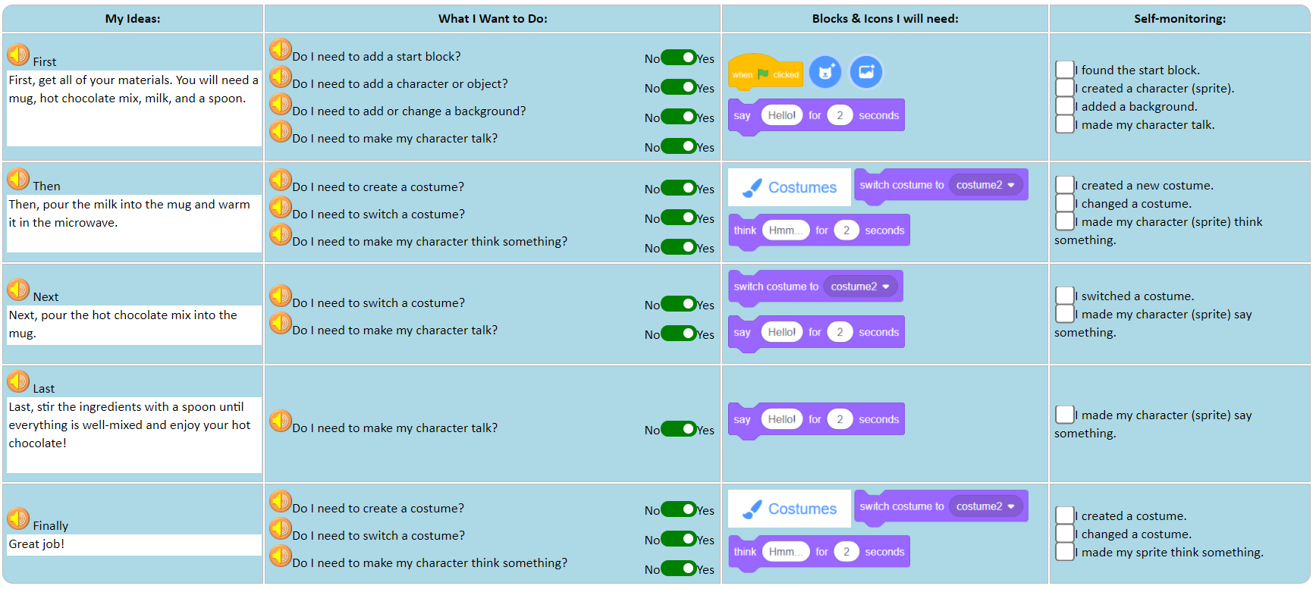
Notes:
In the column, “What i want to do” You will be asked a number of questions about what you want to do in scratch based on your writing. You can respond to each question with either “yes” or “no”

Slide 38
Notes:
In column 3, called blocks and icons I will need, you will see the blocks you need in scratch based on the decisions you made in column 2.

Slide 39
Notes:
In the final column called self-monitoring, you will see a list of statements that you need to check before you move on. These statements will help you check and make sure that you have found everything you need to code in scratch.

Slide 40
Notes:
And when you’re all done, you will have a filled out graphic organizer that looks something like this.
Let’s look at an example to see how we would publish our writing as an animation. This one is called “How to Make Hot Chocolate.”

Slide 41
How to make hot chocolate story:
Simple example:
https://www.dropbox.com/s/jlist1zaujjpc8e/Screen%20Recording%202023-09-18%20at%209.21.46%20PM.mov?dl=0
More complex example:
https://www.dropbox.com/s/nh93dmdkphd4n0z/Screen%20Recording%202023-09-19%20at%201.45.13%20AM.mov?dl=0
Notes:
Here is an example of a recipe written using CoCo and animated in Scratch! Two examples, both are great. One is simple: https://www.dropbox.com/s/jlist1zaujjpc8e/Screen%20Recording%202023-09-18%20at%209.21.46%20PM.mov?dl=0 and one is complex: https://www.dropbox.com/s/nh93dmdkphd4n0z/Screen%20Recording%202023-09-19%20at%201.45.13%20AM.mov?dl=0

Slide 42
Lesson Objectives: I can…
Review the definitions of patterns, sequencing, and Scratch vocab
Define algorithms, decomposition and abstraction
Identify the purpose of CoCo
Write an algorithm for how to walk in a square
Identify the Scratch blocks used to program a sprite to walk in a square
Notes:
Check off the objectives as the lesson proceeds.

Slide 43
Writing (& Coding) ALgorithms
Notes:
Next, we’re going to use CoCo to write and code algorithms!

Slide 44
We can write algorithms in code using Scratch
Notes:
Remember Scratch? Re-introduce Scratch - Explain that Scratch is a program that you can use to code and create interactive stories, games, and animations.

Slide 45
Introducing Move, turn, & Wait blocks
Notes:
Today, we’re going to learn about some new blocks in Scratch!

Slide 46
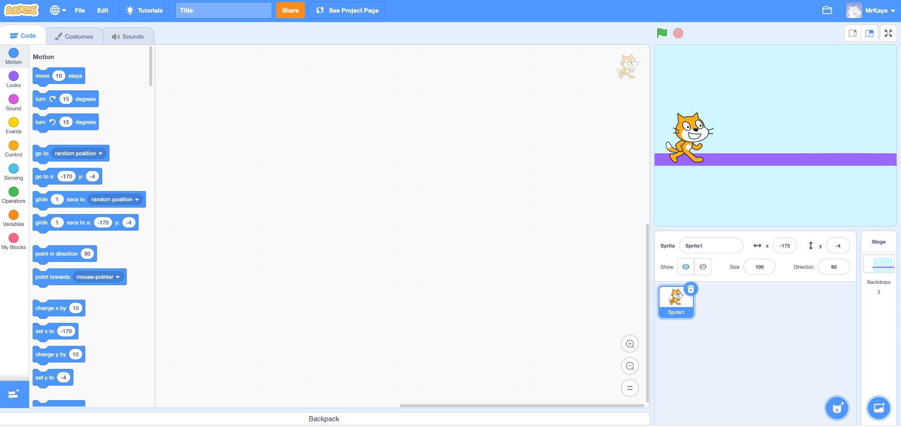
Remember…
Block categories
Notes:
Remember that on the far left hand side of our page, we see a color palette. Each color corresponds to a different type of block. Today, we’ll focus on motion blocks, which are BLUE, and control blocks, which are YELLOW.

Slide 47
Motion blocks
Notes:
There are lots of motion blocks. We’re going to learn about two of them today. One you’ve already seen in lesson 1 and one is new.

Slide 48
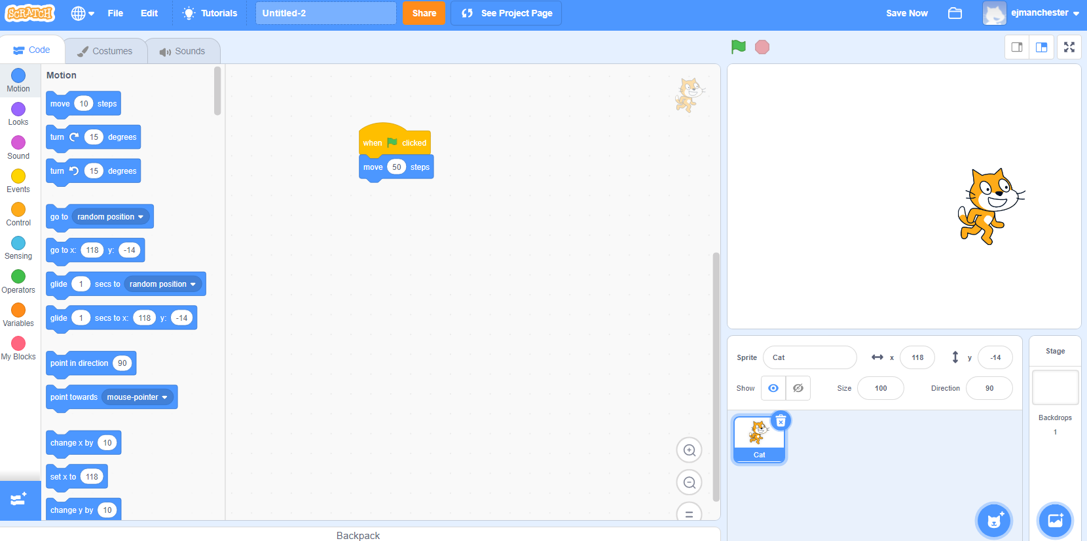
Move block (explainer Video)
Moves your sprite a certain number of steps.
Notes:
It may not be obvious but this cat looks different from the one automatically in scratch. This one looks like it’s running.

Slide 49
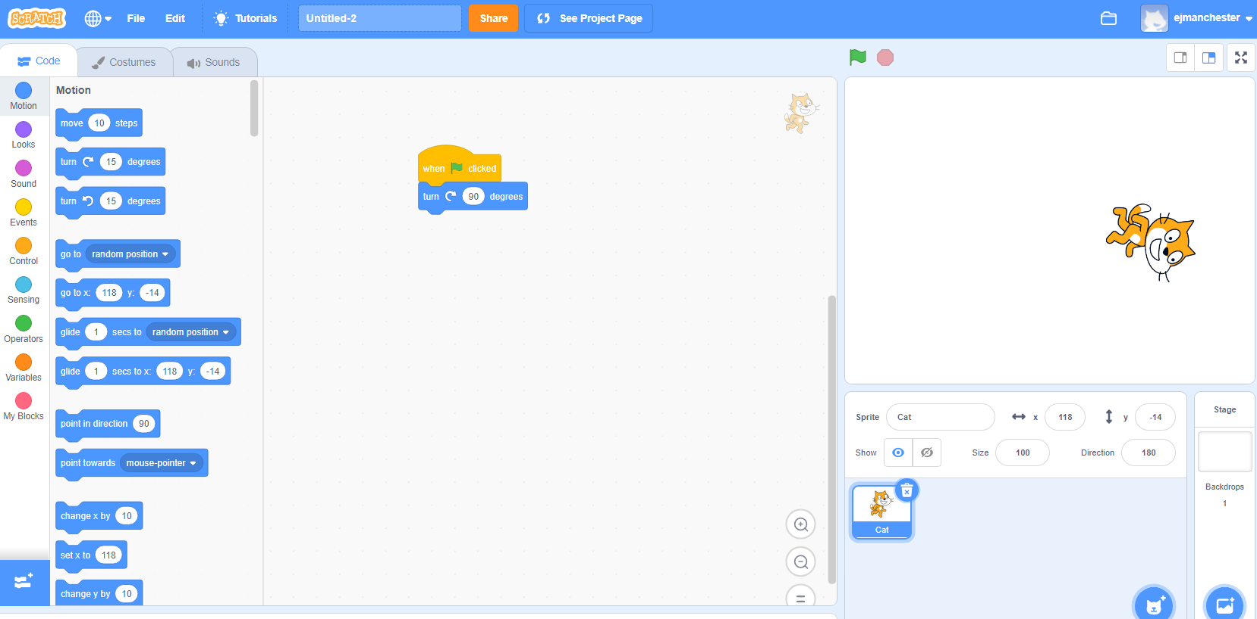
Turn block (Explainer Video)
Turns your sprite right or left by a matter of degrees.
Notes:
It may not be obvious but this cat looks different from the one automatically in scratch. This one looks like it’s running.

Slide 50
Control blocks
Notes:
The yellow blocks are our control blocks. You already know one of them: the start block. Today you will learn about the wait block.
The wait block simply codes the sprite to wait a set number of seconds before executing the next command.

Slide 51
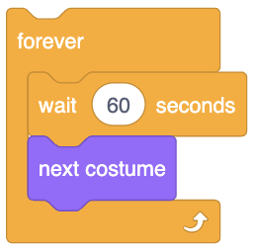
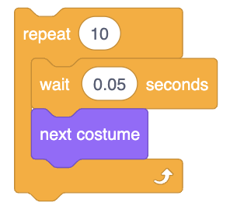
Wait Block (Explainer Video)
Your Sprite will PAUSE or wait for a specified amount of time.
Notes:
Play video and explain:

Slide 52
New ways to change Costume

Slide 53
Other ways of changing costume
→ Upload: a file saved on your computer
→ “Surprise” : the computer chooses a random costume for you
→ Paint: draw your own sprite!
Notes:
Scratch comes with a preset sprite and backdrop. However, it is also possible to upload your OWN costume by using a photo you already have saved on your computer.

Slide 54
Independent practice

Slide 55
Write An “algorithm” in Coco
Pretend you have a robot.
Write a set of instructions (also know as an algorithm) instructing your robot to walk in a square.
Use CoCo to guide you:
First
Next
Then
Last
Finally
Read aloud your algorithm to a partner. See if they can follow your instructions!
Reflect: did they walk in a square? If not, where did your algorithm go wrong?
Notes:
Let’s practice using CoCo and Scratch with an activity. [read instructions on slide]
Option to use the explanatory text graphic organizer template as additional scaffolding for the initial writing prompt.

Slide 56
Optional Extension ACtivity- only use if adding extension
Use CoCo columns 2-3 to begin planning your Scratch animation!
Code your sprite to walk in a square in Scratch
Notes:
Option for early finishers: have them begin planning an animation in Scratch using CoCo and THEN move into Scratch

Slide 57
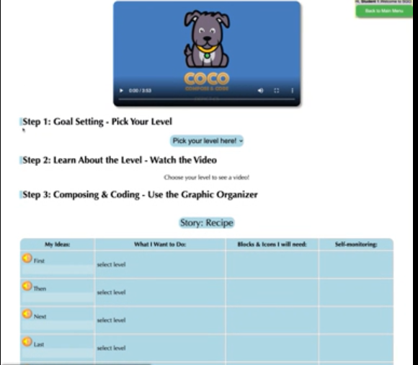
Optional Videos- only use if adding extension activity
Overview of CoCo level 4: https://www.dropbox.com/s/2lsly3hgelvw3hg/Review%20of%20level%204.webm?dl=0
Adding our text to CoCo: https://www.dropbox.com/s/h0yeiv8ckvghmjk/Adding%20Our%20Text%20to%20Coco.webm?dl=0
Notes:
Optional support videos

Slide 58
Lesson Objectives: I can…
Review the definitions of patterns, sequencing, and Scratch vocab
Define algorithms, decomposition and abstraction
Identify the purpose of CoCo
Write an algorithm for how to walk in a square
Identify the Scratch blocks used to program a sprite to walk in a square
Notes:
Check off the objectives as the lesson proceeds.

Slide 59
How would our instructions look in code?
Notes:
Okay, did the “algorithms” we wrote using words make sense? How would they look in code?

Slide 60
Commands for our computer (robot)
Notes:
I want to use my scratch blocks to instruct our robot to walk in a square. But wait! I can’t find a block with the command that says walk in a square. What do you think I should do? I think I first need to make my robot walk forward. Can you find a block that would command the robot walk forward? Hmmm, which of these blocks might be the correct command? When you think you know, tell your teacher.

Slide 61
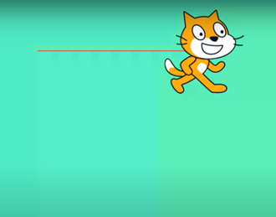
Commands fOr Walking in a square
Step 1 (First): Walk forward 2 steps
2
Notes:
If you choose this block, you would be correct. This block says “Move ___ steps”.
I want my robot to move 2 steps, so that would go in this blank. CLICK
This means our robot should move directly forward 2 steps. If you are the robot, move forward 2 steps.

Slide 62
Commands for our computer (robot)
Notes:
Ok, we want our robot to move in a square, What should I do next? Which way does my robot need to go and which command do I need to use to make the robot go that way? Pause for a moment to choose the next command block we need.

Slide 63
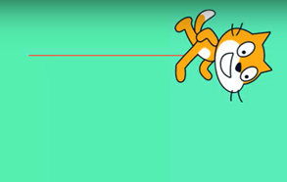
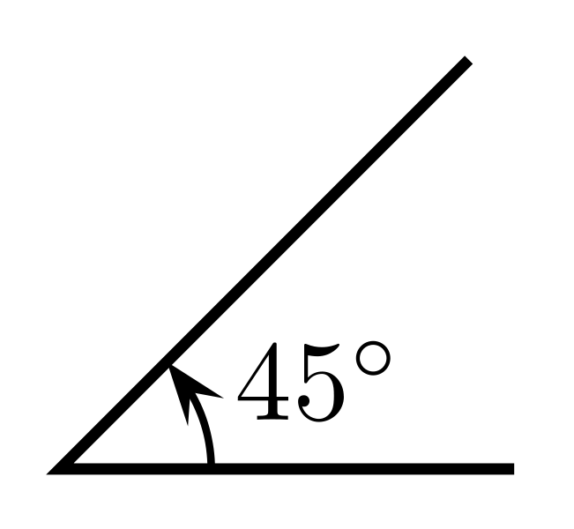
Commands fOr Walking in a square
Step 2 (Then): Turn right
Notes:
We need our robot to TURN. This common block commands the robot to turn right 90 degrees, which is like turning one corner of our square. Go ahead robot, turn right 90 degrees or one of our corners.

Slide 64
Commands for our computer (robot)
Notes:
My robot has turned, but now what does the robot need to do? Take a moment to think and choose. What should we command the robot to do next?
(PAUSE)
Think about the shape of a square. Are the sides all the same length or different?

Slide 65
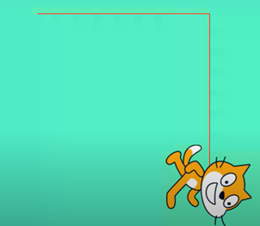
Commands fOr Walking in a square
Step 3 (Next): Walk 2 steps
2
Notes:
The sides of a square are equal, so we need our robot to walk to same number of steps as it did the first time, 2! So now our robot needs to take two steps. Things should start to get a little easier now.

Slide 66
Commands for our computer (robot)
Notes:
What next? We need our robot to complete the square.

Slide 67
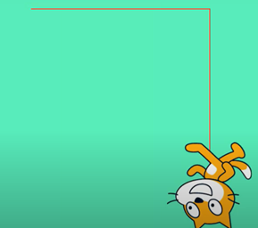
Commands fOr Walking in a square
Step 4 (Then): Turn right
Notes:
You got it! The robot turns right again 90 degrees! Go ahead robot, turn.

Slide 68
Commands for our computer (robot)
Notes:
Ok, the robot now needs to….

Slide 69
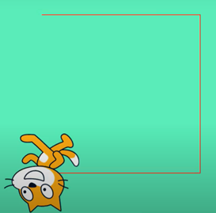
Commands fOr Walking in a square
Step 5 (Next): Walk 2 steps
2
Notes:
Move 2 steps! Go ahead robot, move two steps again!

Slide 70
Commands for our computer (robot)
Notes:
Now our robot needs to…..

Slide 71
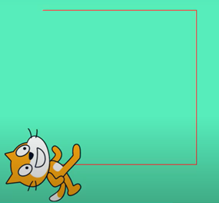
Commands fOr Walking in a square
Step 6 (Last): Turn right
Notes:
Turn right 90 degrees again. Go ahead robot!

Slide 72
Commands for our computer (robot)
Notes:
We are almost done with our square, what is last?

Slide 73
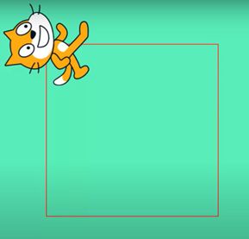
Commands fOr Walking in a square
Step 7 (Finally): Walk 2 steps
2
Notes:
Finally, our last step is to take 2 steps and complete our square. How did your robot do?

Slide 74
Commands fOr Walking in a square
Written commands | Computer commands (code)
Walk forward 2 steps
Turn right
Walk 2 steps
Turn right
Walk 2 steps
Turn right
Walk 2 steps
2
2
2
2
Notes:
Let’s review the commands we gave the “robot” using code. We told our robot to walk forward 2 steps, turn right, forward 2 steps, turn right, forward 2 steps, turn right...until we completed our square. We had to put our commands in the correct sequence or our robot would not create a square! Think if we had put them out of order, what would our robot had done?
When you look at the code you created, you can see how these blocks would fit together. This is your algorithm, or your list of commands!

Slide 75
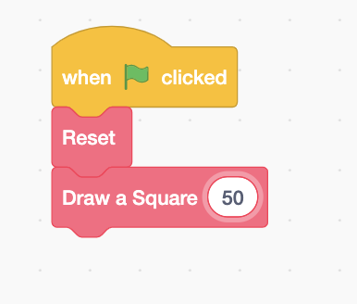
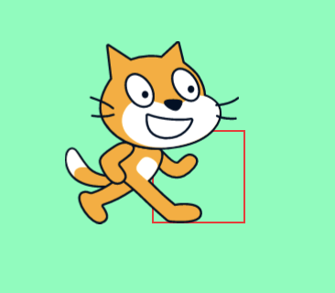
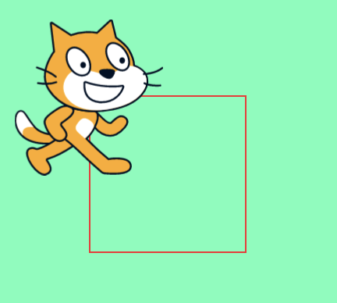
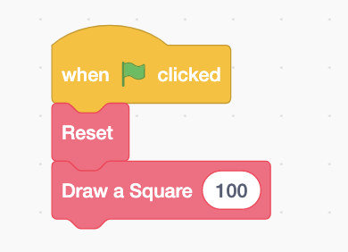
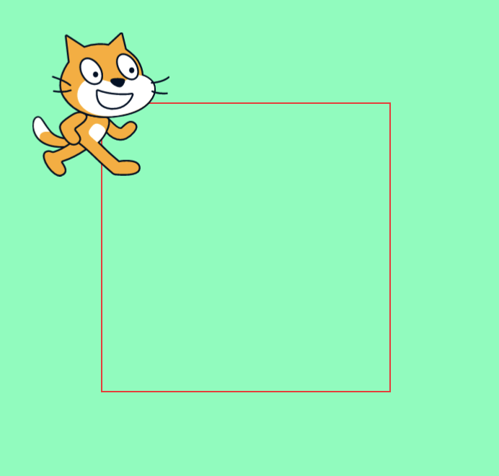
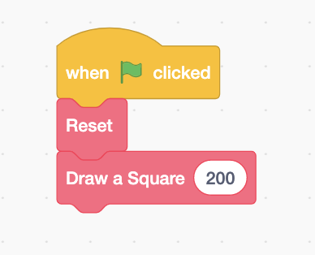
Small square
Big square
Notes:
We could’ve used abstraction here!
In computer science, we use abstraction when we create code that we can reuse and when that code is written in the most efficient way possible. Remember when we tried to draw a square? We had your classmate take two steps each time. Well, we can use abstraction to reuse that pattern efficiently. We can just change the number of steps and create different size squares.
The same is true in Scratch. Do you see how the first the first square says 50, 100, and then 200. This would create different size squares using the same sequence. We only have to change the number of steps and our square can change size!
Scratch link: https://scratch.mit.edu/projects/599143669

Slide 76
Lesson Objectives: I can…
Review the definitions of patterns, sequencing, and Scratch vocab
Define algorithms, decomposition and abstraction
Identify the purpose of CoCo
Write an algorithm for how to walk in a square
Identify the Scratch blocks used to program a sprite to walk in a square
Notes:
Check off the objectives as the lesson proceeds.

Slide 77
And remember….ANYone in the world can be a computer scientist!

