Slide 1
Lesson 1
Introduction to Computer Science
Grades 3 & 4
Lesson created by the GMU-ODU CSforAll Team. For more information about
this lesson and our CSforAll initiative, contact Dr. Amy Hutchison at achutchison1@ua.edu
Notes:
Hi, everyone, and welcome to our first class on computer science.

Slide 2
Summary and Standards
Summary:
In this lesson, students will explore what Computer Science is and be introduced to the computational thinking skills of patterns and sequencing. They will also learn how coding and writing processes mirror one another and be introduced to Scratch.
ELA Standards:
The student will use effective communication skills in group activities.
a) Listen attentively by making eye contact, facing the speaker, asking questions, and summarizing what is said.
b) Ask and respond to questions from teachers and other group members.
c) Explain what has been learned.
d) Use language appropriate for context.
e) Increase listening and speaking vocabularies.
CS Standards:
The student will construct sets of step-by-step instructions (algorithms), both independently and collaboratively
a) using sequencing;
b) using events.
Notes:
Optional: Introduce lesson, learning goals, and resources (Slides # 2-4)
Today, we are going to be introduced to what computer science is, and learn some strategies to think like computer scientists! We’ll end on exploring how coding and writing are actually quite similar. Let’s get started!

Slide 3
Materials and resources needed for this lesson:
Chromebook/Laptop
Internet Access
Scratch Offline Editor (app)
Teacher slides
Hard copies of the printable Scratch blocks
Notes:
Optional: Introduce lesson, learning goals, and resources (Slides # 2-4)
Does everyone have their chromebook, internet, and Scratch?

Slide 4
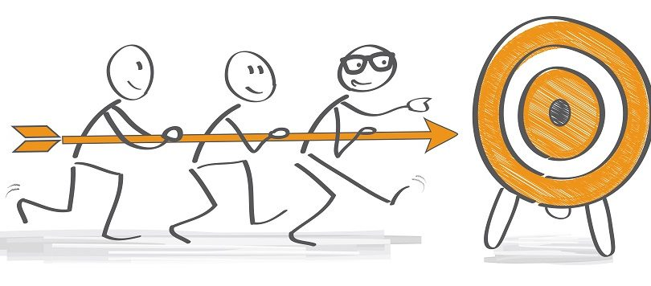
Lesson Objectives: I can…
Describe characteristics of Computer Science (CS)
Define the computational thinking skills of patterns and sequencing
Describe a pattern I follow in my own life
Change my sprite and backdrop in Scratch
Identify and understand the purpose of the start, speak/say, and switch costume blocks in Scratch
Believe anyone can be a computer scientist!
Notes:
Optional: Introduce lesson, learning goals, and resources (Slides # 2-4)
As we go through the lesson, we will be able to….[read slide]

Slide 5
Vocabulary
Computer Science
Coding
Computer Scientists
Patterns
Sequencing
Notes:
And we’re going to learn all these new words! [read vocab words]

Slide 6
Computer Science?
What do you know about…
Notes:
Ask students to share what they know about the following words: Computer Science

Slide 7
Coding?
What do you know about…
Notes:
Ask students to share what they know about the following words: Coding

Slide 8
We are going to learn more about computer science!
Notes:
Next, explain that we are going to be learning more about Computer Science and share the video (Watch until 1:09) (slide #9)

Slide 9
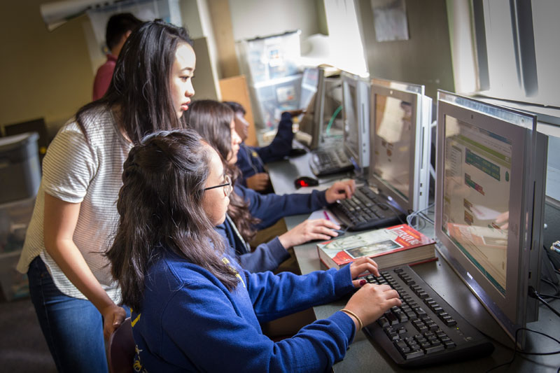
Computer Scientists
Computer scientist (n): a person who studies computers and how they can be used to solve problems.
Notes:
Introduce what a computer scientist does (slide 10)

Slide 10
Lesson Objectives: I can…
Describe characteristics of Computer Science (CS)
Define the computational thinking skills of patterns and sequencing
Describe a pattern I follow in my own life
Change my sprite and backdrop in Scratch
Identify and understand the purpose of the start, speak/say, and switch costume blocks in Scratch
Believe anyone can be a computer scientist!
Notes:
Check off learning objectives as the lesson proceeds.

Slide 11
How do Computer Scientists think?
Notes:
Okay, now that we’ve learned what a computer scientist DOES, let’s learn about how they THINK. Learning about how computer scientists approach problems, helps us see that they are not so different from some of the problem-solving strategies we use every day!

Slide 12
Computer scientists use computational thinking skills
Patterns
Sequencing
Algorithms
Decomposition
Abstraction
We are going to learn how to do all of these!
Notes:
There are five main skills that computer scientists use to solve problems. They are often called “computational thinking” skills—an easy way to remember this word is that “computational” sounds a lot like “computer.” Okay the core concepts are: recognizing patterns, using sequencing, creating algorithms decomposing, and abstracting. Dont worry, we will learn how to do all of these!

Slide 13
Computer scientists use computational thinking skills
Today our focus is on
Patterns
Sequencing
Algorithms
Decomposition
Abstraction
Notes:
Today’s focus is on pattern recognition and sequencing.

Slide 14
Patterns & Sequencing

Slide 15
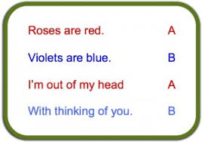
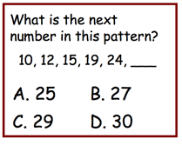
Pattern: a repeated way in which something happens
Notes:
Today we are going to learn more about how patterns are used in nearly everything we do. A pattern is a thing that repeats, or a repeated way in which something happens.
Patterns can be found in many places in our lives. For example, there are patterns in weather such as seasons, days of the week, months of the year, moon cycle, and patterns on a leaf. [You can provide familiar everyday patterns that YOUR students may be familiar with!]. We even use patterns in our writing.

Slide 16
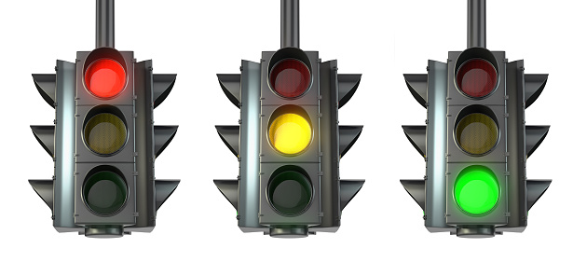
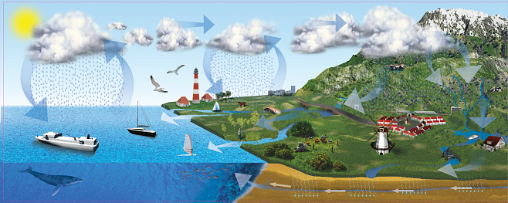
Introduction: examples of patterns --things that repeat--in real life
Notes:
Read slide

Slide 17
Sequence: an ordered set of instructions
Notes:
Another new vocabulary word is sequence: it refers to an ordered set of instructions. In order for a pattern to make sense, it must be in the correct sequence.

Slide 18
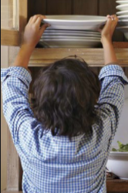
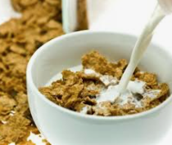
Sequence for making a bowl of cereal
1
2
3
Notes:
For example, here’s a sequence for making a bowl of cereal. If we did these steps out of order, we would not be happy!

Slide 19
Patterns in writing
Notes:
Patterns exist everywhere, not just in computer science. There are often many patterns found in writing!

Slide 20
Examples of Patterns in our writing
BEGINNING
MIDDLE
END
END
Notes:
Can you think of any patterns you see in books or stories you’ve read? (if needed, prompt students with patterns such as beginning, middle, and end; characters, setting, and plot; etc.)

Slide 21
Guided Practice: Example A
Daquan was watching TV and saw a commercial for pizza and that gave him a great idea! “I’ll just make my own pizza here at the house!,” he thought. He found his mom’s recipe, which said:
“First, roll out the squishy pizza dough with the rolling pin. Then, use a spoon to spread on the red pizza sauce on top of the dough. Next, add shredded cheese all over the top. Last, top it with pepperoni slices, covering the whole pizza. Finally, put the pizza in the oven at 425 degrees.”
After about 15 minutes in the oven, his homemade pizza was ready to eat!
DO YOU NOTICE A PATTERN?
Notes:
Read slide and ask students if they can identify a pattern.

Slide 22
For both Writing & Computer science, Patterns & Sequencing are very important!
Notes:
Transition words help us to put our writing in the correct sequence–it’s just as important for human readers as it is for computers!

Slide 23
Turn & Talk
What patterns do you typically follow when getting ready for school?
What activities do you do in order to get ready? What is their sequence?
Notes:
Read slide

Slide 24
Lesson Objectives: I can…
Describe characteristics of Computer Science (CS)
Define the computational thinking skills of patterns and sequencing
Describe a pattern I follow in my own life
Change my sprite and backdrop in Scratch
Identify and understand the purpose of the start, speak/say, and switch costume blocks in Scratch
Believe anyone can be a computer scientist!
Notes:
Check off learning objectives as the lesson proceeds.

Slide 25
There are many connections between writing & Coding!tory in your own words
Notes:
See, there are many connections between writing and coding. The fact that we use patterns and sequences in both is just the beginning.

Slide 26
We can code using Scratch
Notes:
We can use a program called Scratch to write code and tell our computer what to do. We can use it to creative interactive stories, games, and animations.

Slide 27
Please watch a quick video to learn about Scratch.
It’s okay to skip this video if you are using CS First and cannot open Scratch
Pause here.
Notes:
First, let’s learn a little more about Scratch
Scratch - Imagine, Program, Share

Slide 28
Coding in Scratch
Notes:
Before we can start coding in Scratch, we need to review a few things.

Slide 29
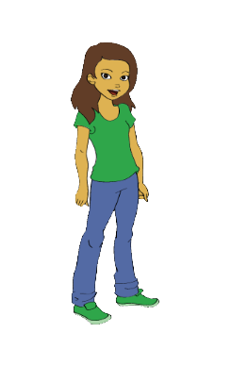
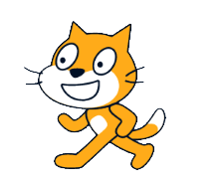
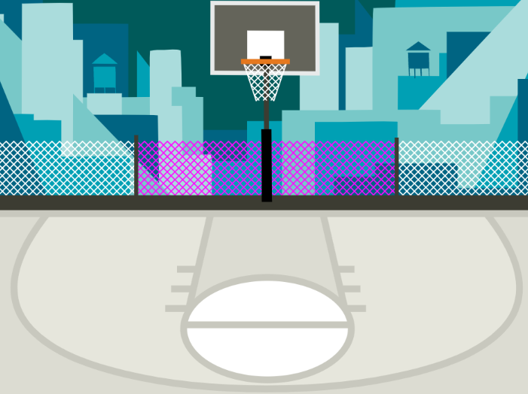
Terms used in Scratch
Block(s): commands in Scratch
Sprite: characters in Scratch
Backdrop: background
Notes:
These three terms are very important in Scratch. They are: [read slide]

Slide 30
Computer commands
Notes:
“Has anyone seen these types of pieces anywhere before? (from warm up) These pieces are actually computer “commands.” Commands tell a person or a computer what to do.

Slide 31
Computer commands
Notes:
Lets look closely at these blocks again and what they say-
Click "switch,
Click “think,
Click “turn
“these are commands" written in Scratch code, which is the kind we will be working with. We put these commands together in Scratch by snapping the together the blocks so they hook onto each other like puzzle pieces. This allows us to code multiple commands in a single set of instructions.

Slide 32
Computer commands
Hi!
2
Notes:
For example, these Scratch commands have been put in the correct order from top to bottom you have created a sequence of instructions. This would tell the computer to say Hi for 2 seconds then turn right 90 degrees.

Slide 33
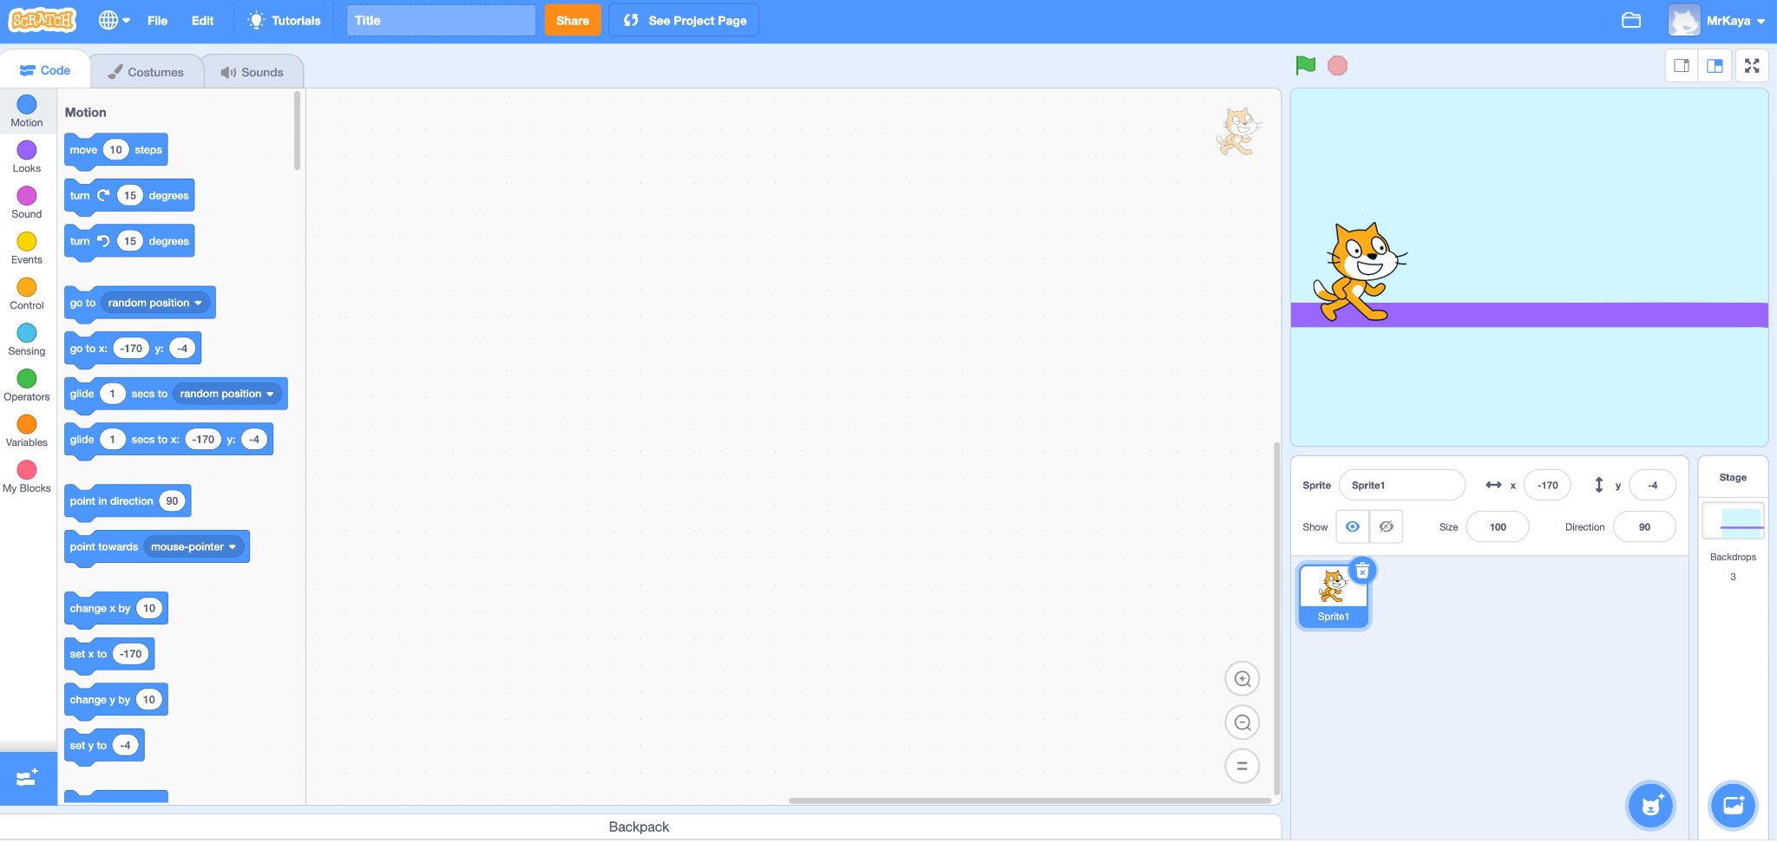
Notes:
Guide Students through the main areas of the Scratch page
“When you open Scratch, your screen should look like this.”

Slide 34
Script Area
Notes:
Guide Students through the main areas of the Scratch page
“This main area in the center of your screen is the script area. This is where you drag you command block and join them to build your algorithm. You will find your command blocks on the left side of the screen and drag them to the center. If you decide that you do not want a certain block, drag it back to the left. We will learn more about this in a moment.”

Slide 35
Sprite
Notes:
Introduce and explain to create/add Sprites and Backdrops
“In SCRATCH, an object, author, or character in a story is called a Sprite. The sprite you can see right now is Scratch the cat. The box here is blue because this is the sprite that is currently being coded. If this box is not blue, you will not be able to add any command blocks for your sprite.”

Slide 36
Choose a Sprite
Notes:
Introduce and explain to create/add Sprites and Backdrops
“If you want to add another sprite or change sprites, you can click here, the small circle with the cat image and plus sign. The new sprites you add will appear in this box. But you can only add code for the sprite that is selected and is in the blue box.”

Slide 37
Stage
Notes:
Introduce and explain to create/add Sprites and Backdrops
“You can see scratch the cat here on the stage. When you run your code, this is where you can see the action.”

Slide 38
Choose a backdrop
Notes:
Introduce and explain to create/add Sprites and Backdrops
“If you want to change your background or your backdrop, as it is called in scratch, you can click here. It looks like a small picture with a plus sign.”

Slide 39
Code, Costumes, and Sounds
Notes:
Guide Students through the main areas of the Scratch page
“In the upper left, you can see three different tabs. Code, Costumes, Sounds. Choose the code tab to build code from command blocks. Choose the costumes tab to change how your sprite looks. Or you can add new sounds to sprites here.”

Slide 40
Block categories
Notes:
Guide Students through the main areas of the Scratch page
“Let’s look closer at the code blocks. On the far left you can see several colored dots (some also call it categories palette). These are the different types of code you might want. You can choose motion, looks, sound, events..they are all different colors to help you. You can choose just one block category.”

Slide 41
Code Blocks
Notes:
Guide Students through the main areas of the Scratch page
“Once you choose your category, the code blocks will appear here and you can find the specific command that you would like to give your sprite. Once you drag your code to the stage and click them together, you are ready to try it out.”

Slide 42
Changing sprites & Backdrops
Notes:
Scratch comes with a preset sprite and backdrop. Let’s look at how you’d change those to one of your choosing

Slide 43
Sprite
Notes:
Okay, remember that in SCRATCH, an object, author, or character in a story is called a Sprite. The sprite you can see right now is Scratch the cat. What if we wanted to change our sprite to another animal?

Slide 44
Notes:
Okay, remember that in SCRATCH, an object, author, or character in a story is called a Sprite. The sprite you can see right now is Scratch the cat. What if we wanted to change our sprite to another animal?
First, we would click on the sprite icon.

Slide 45
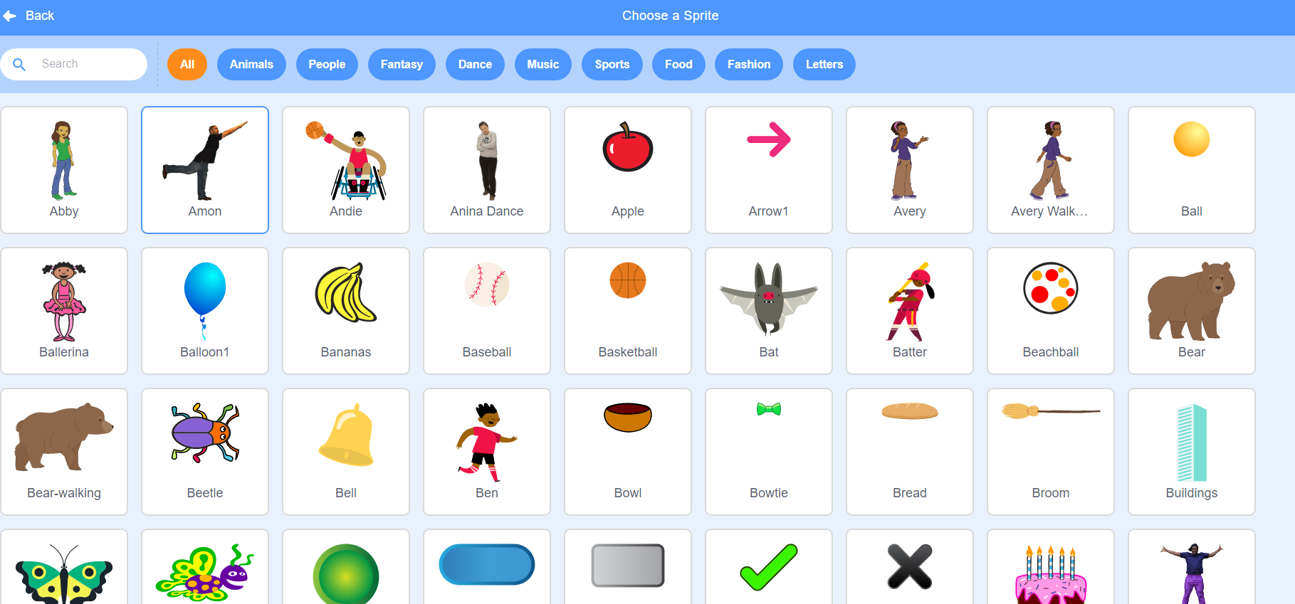
Notes:
Then, we would have ALL these sprites to choose from.

Slide 46
Notes:
We change our sprite by clicking the one we want.

Slide 47
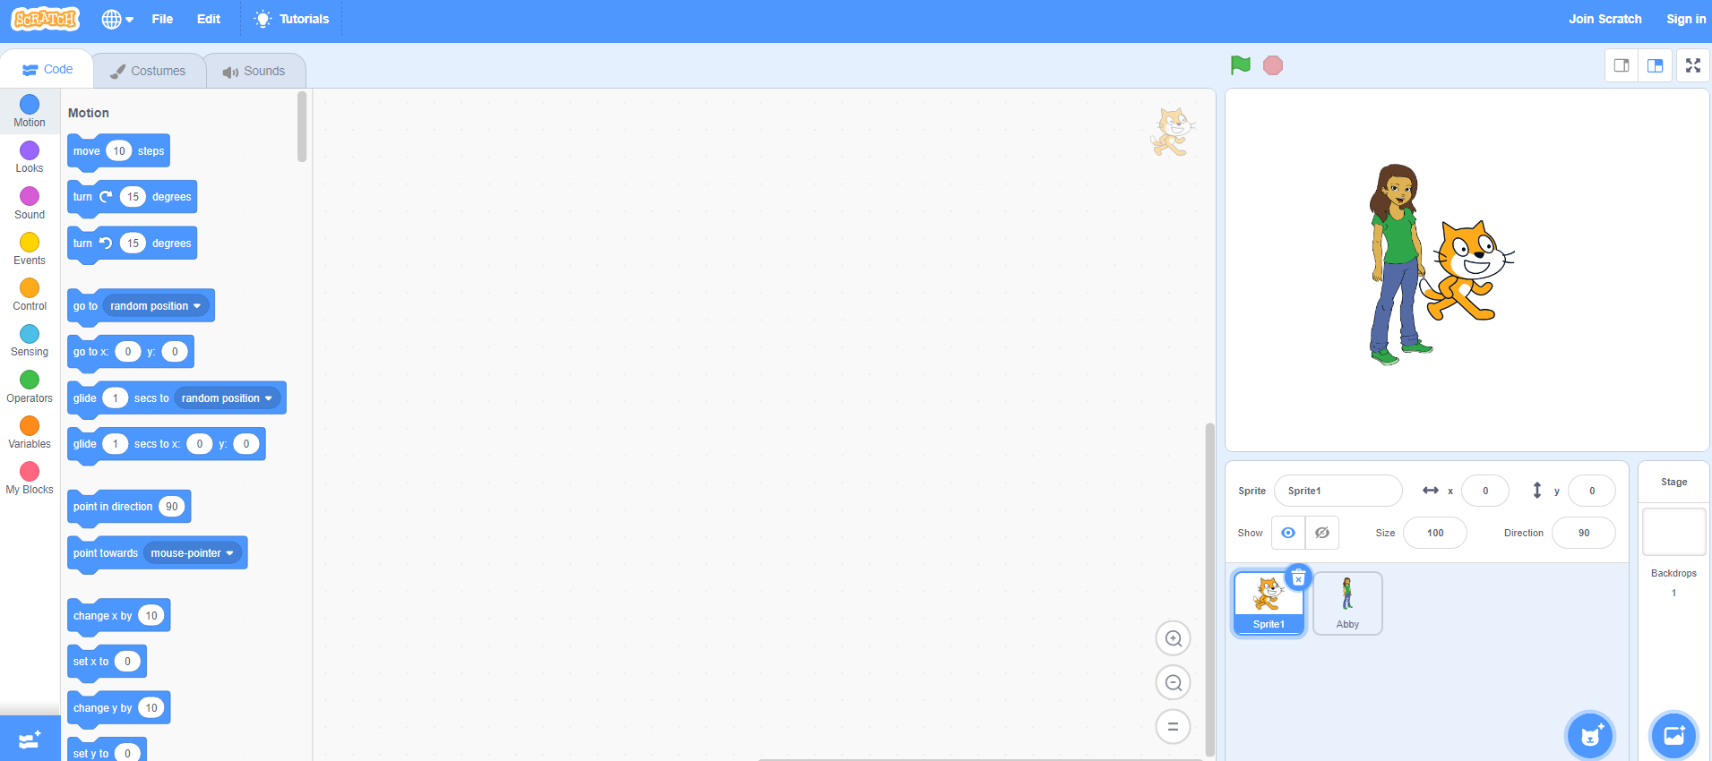
Notes:
But don’t forget to delete the other sprite! So you have only the one you want.

Slide 48
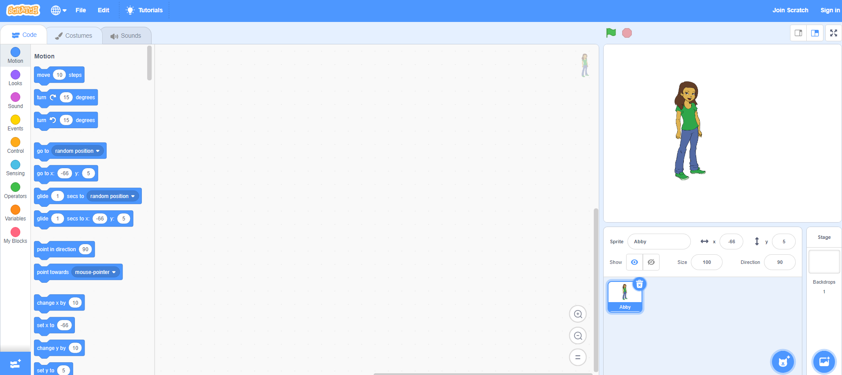
Notes:
But don’t forget to delete the other sprite! So you have only the one you want.

Slide 49
Notes:
To add your own backdrop, follow the same steps but click this icon instead. You’ll see lots of options to choose from appear.

Slide 50
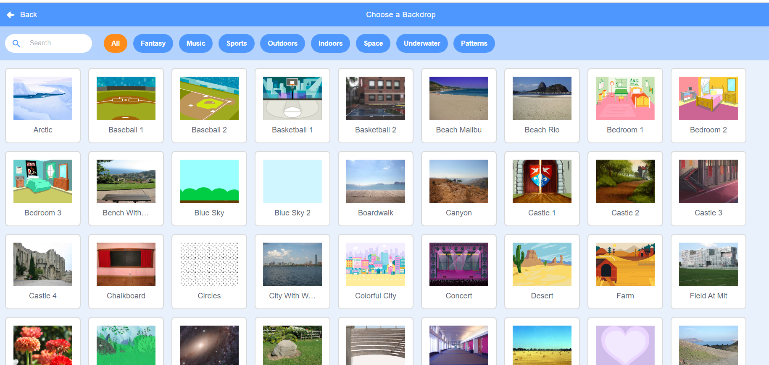
Notes:
To add your own backdrop, follow the same steps but click this icon instead. You’ll see lots of options to choose from appear.

Slide 51
Try it out!
Open Scratch
Change your sprite
Change your backdrop
Questions?
Pause and work (5 minutes)
Notes:
This is just to get familiar with scratch, so don’t worry about making mistakes. Just try a few things and see what happens! If you get stuck, take a deep breath and try again. You can do it!

Slide 52
Lesson Objectives: I can…
Describe characteristics of Computer Science (CS)
Define the computational thinking skills of patterns and sequencing
Describe a pattern I follow in my own life
Change my sprite and backdrop in Scratch
Identify and understand the purpose of the start, speak/say, and switch costume blocks in Scratch
Believe anyone can be a computer scientist!
Notes:
Check off learning objectives as the lesson proceeds.

Slide 53
We can write code in Scratch
Pause and share
(2-5 minutes)
Notes:
Again, Scratch allows us to write code using these block-based commands. These command blocks should be familiar by now. What do you think these blocks might do? Pause here and share with your teacher.
Let’s find out more!

Slide 54
Start Block (explainer video)
Tells your code to run when you click the green flag in Scratch.
Notes:
[read slide and play video if desired]

Slide 55
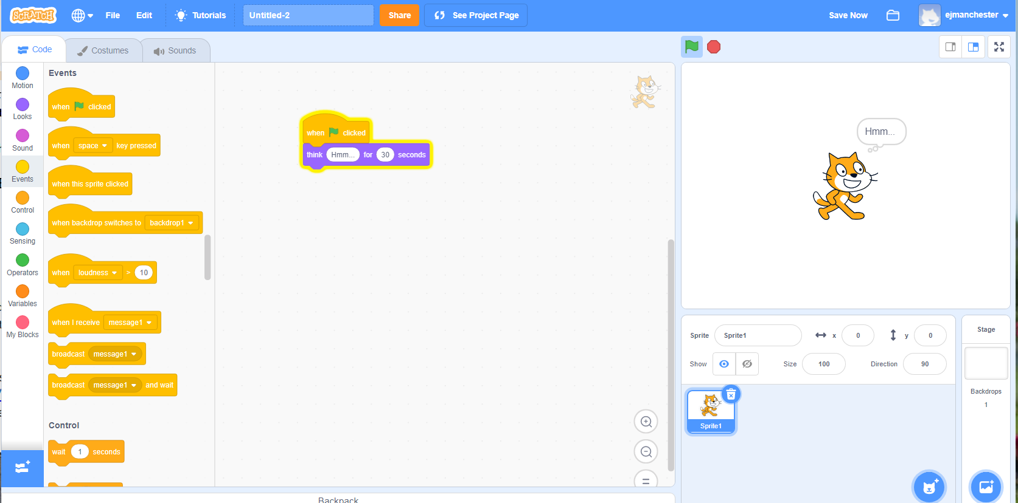
Think block (explainer video)
Makes your sprite “think” something
Notes:
[read slide and play video if desired]

Slide 56
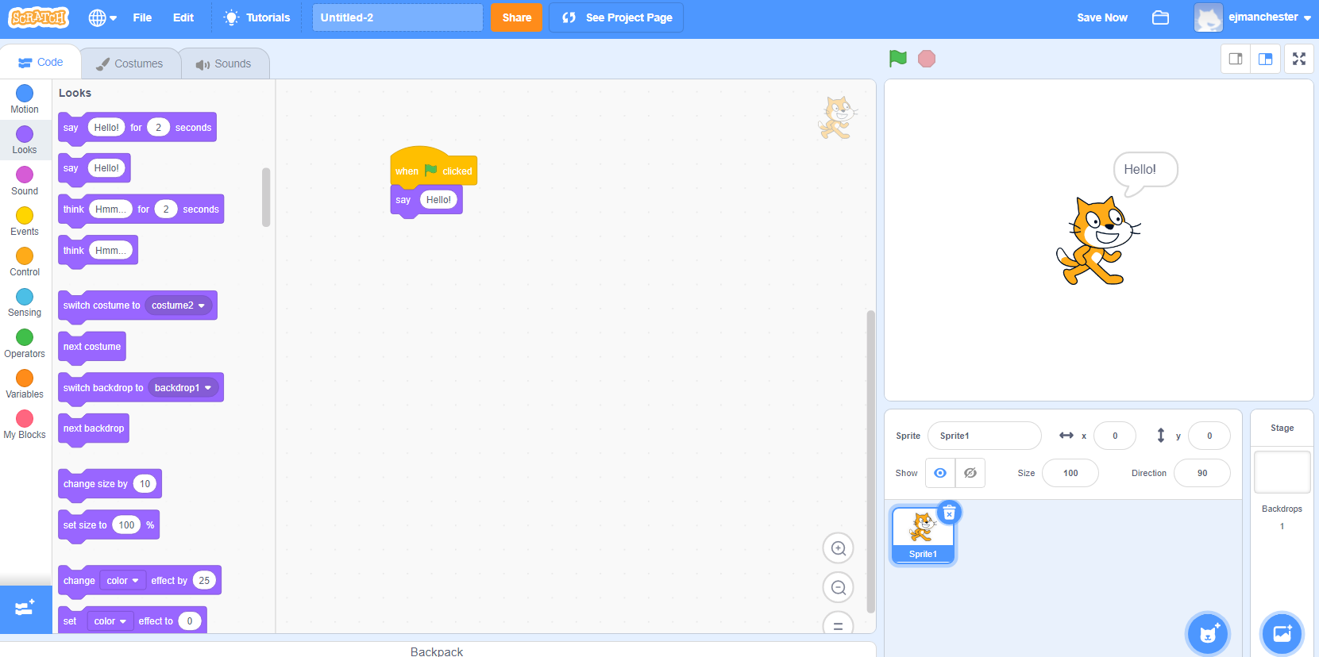
Speak/Say block (explainer video)
Codes your sprite to say something
Notes:
[read slide and play video if desired]

Slide 57
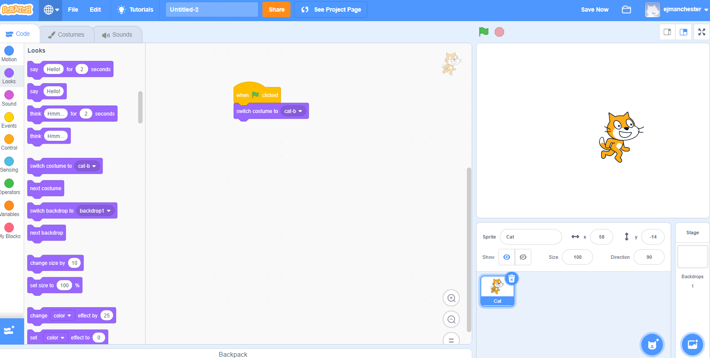
Switch costume block (explainer video)
Changes the appearance of your sprite.
Notes:
Play Video, and explain: It may not be obvious but this cat looks different from the one automatically in scratch. This one looks like it’s running. The “change costume” block in Scratch changes the appearance of your sprite. You can use it to change the appearance of your sprite. This block makes things simpler because we want have to use as many sprites in our project.
Video link: https://www.dropbox.com/s/jdt70o0l0neyk8c/SwitchCostumeCoCo_Nov16.mp4?dl=0

Slide 58
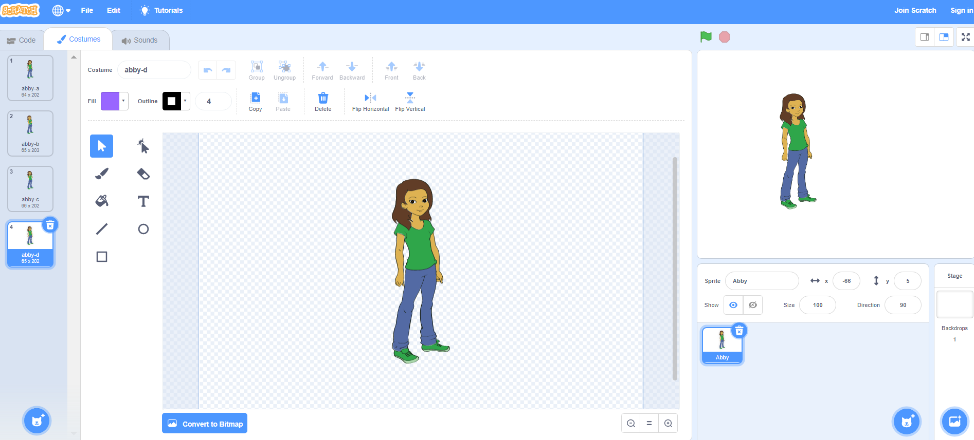
Notes:
Lots of sprites in Scratch come pre-loaded with multiple costumes. So changing the costume is as easy and choosing one of these four looks.

Slide 59
Independent practice

Slide 60
Try it out!
We are going to create a pattern with the blocks we just learned.
Remember, a pattern is something that repeats, like a design or sequence.
Consider designing your pattern around: the color of the blocks, the shape and size of the blocks, or the words in the blocks.
Notes:
For the teacher: print and cut hard copies of the Scratch block handout

Slide 61
Try it out!
Open Scratch
Add the “when green flag clicked” block
Code a pattern using the think, say, turn and switch costume Scratch blocks
Run your code!
Pause and work (10-15 minutes)
Notes:
Ok, let’s get started. Pause here and leave this screen up so that you can check on your goals. Please navigate to Scartch.mit.edu in your web browser.
This is just to get familiar with scratch, so don’t worry about making mistakes. Just try a few things and see what happens! If you get stuck, take a deep breath and try again. You can do it!
Note to teacher: as students are working, Review how Scratch blocks can be used to create a pattern and sequence.

Slide 62
Lesson Objectives: I can…
Describe characteristics of Computer Science (CS)
Define the computational thinking skills of patterns and sequencing
Describe a pattern I follow in my own life
Change my sprite and backdrop in Scratch
Identify and understand the purpose of the start, speak/say, and switch costume blocks in Scratch
Believe anyone can be a computer scientist!
Notes:
Check off learning objectives as the lesson proceeds.

Slide 63
Wrap up
Computational thinking means “thinking like a computer scientist.”
We’ve learned about these computational thinking skills:
Pattern recognition
Sequencing
Pick one of these skills and share with a small group for a few minutes about how this skill helps you think like a computer scientist.
Notes:
[read slide]

Slide 64
Lesson Objectives: I can…
Describe characteristics of Computer Science (CS)
Define the computational thinking skills of patterns and sequencing
Describe a pattern I follow in my own life
Change my sprite and backdrop in Scratch
Identify and understand the purpose of the start, speak/say, and switch costume blocks in Scratch
Believe anyone can be a computer scientist!
Notes:
Check off learning objectives as the lesson proceeds.

