Slide 1
Change Size
Play the video on the left by right-clicking the link and pasting it into your browser.
Go to the next slide
Place the blocks under the green flag in the correct order by moving them from left to right.
Once the code matches the video, you are done!
You can check your answer by seeing the solution image or clicking the solution link.

Slide 2
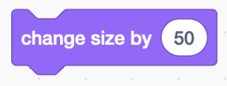
Mixed Code
Your Answer

Slide 3
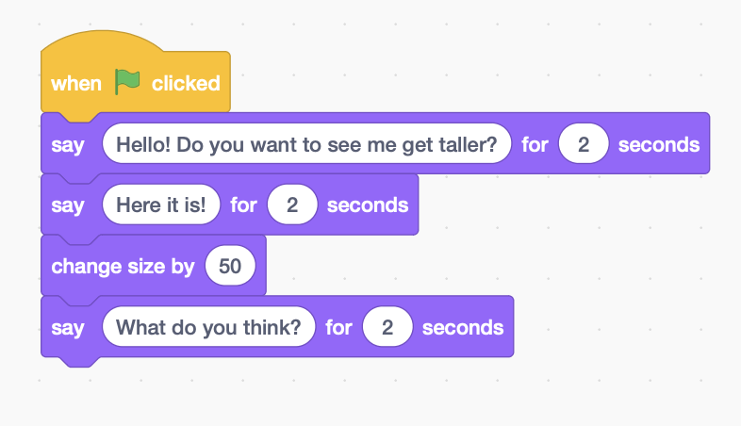
Change Size - Possible Solution

