Slide 1


Unit 3, lesson 2
Algorithms and debugging
5th & 6th grade
Lesson created by the GMU-ODU CSforAll Team. For more information about
this lesson and our CSforAll initiative, contact Dr. Amy Hutchison at ahutchison1@ua.edu

Slide 2
Summary and Standards
Summary:
In this lesson, students will continue planning their explanatory writing in CoCo and learning new Scratch features.
ELA Standards
The student will write in a variety of forms to include narrative, descriptive, opinion, and expository.
a) Engage in writing as a process.
b) Identify audience and purpose.
c) Use a variety of prewriting strategies.
d) Use organizational strategies to structure writing according
to type.
g) Use transition words to vary sentence structure.
CS Standards:
The student will construct programs to accomplish tasks as a means of creative expression using a block or text based programming language, both independently and collaboratively
a. using sequencing;
b. using loops (a wide variety of patterns such as repeating patterns or growing patterns); and
c. identifying events.
The student will create a plan as part of the iterative design process, independently and/or collaboratively, using a variety of strategies (e.g., pair programming, storyboard, flowchart, pseudocode, story map).
Notes:
Today, we are going to learn some new things in Scratch, such as new commands and how to change sprites! This will help us get ready to use Coco and Scratch to animate the writing we did last time.

Slide 3


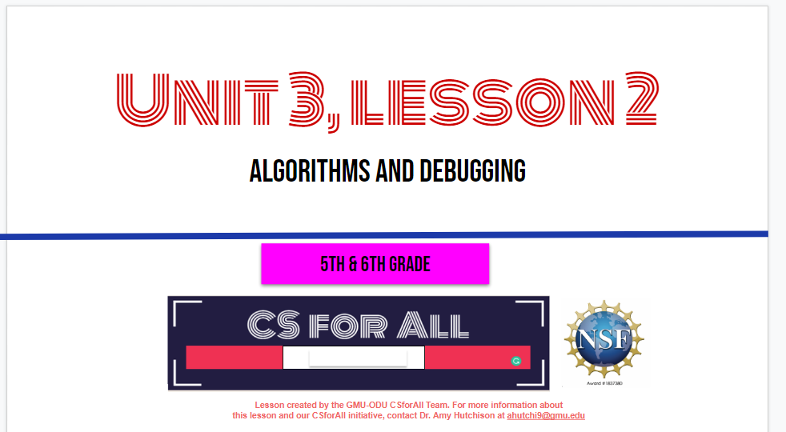
Materials and resources needed for this lesson:
Reminder:
In this lesson, every student should be assigned a story in CoCo using Level 3.
The story should be titled “Unit 3 Story.”
Each student should save their work using this naming strategy: “Student Name + Unit # + Descriptor”, for example, “Johnny Unit 3 Story.”
Chromebook/Laptop
Internet Access
Link to Scratch
Link to Coco
Teacher Unit 3, lesson 2 slide deck
Students’ completed explanatory writing piece and graphic organizer
Notes:
You will need….[read slide]

Slide 4
Lesson Objectives: I can…
Review Algorithms and Explanatory Writing
Plan my writing and animation for Scratch using Coco Level 3 (Column 1, 2, 3)
Identify and use Control Blocks and Loops with a partner
Notes:
Let’s go over today’s lesson’s objectives: [read slide]

Slide 5
Remember
Explanatory writing:
Explains something to someone or helps them understand how to do something. So it is important to provide many details!
Is written in a specific order or sequence
  A sequence is a set of things that follow each other in a particular order, where order matters!
Often uses sequencing words such as first, then, next, and last to communicate the correct order of steps, also known as their sequence
Notes:
Today we are going to be using CoCo to continue planning for animation!

Slide 6
Guided practice: CoCo
Notes:
Now, let’s think about other types of explanatory writing together.

Slide 7
Finish Planning with COCO
You will need your completed graphic organizer from last time!
Notes:
Students should retrieve their completed Graphic Organizer from last lesson.

Slide 8
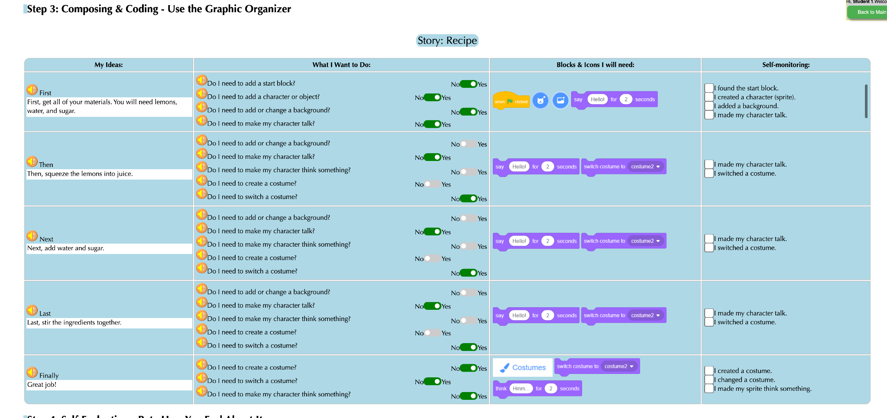
Notes:
Remember, there are four columns in CoCo to complete. For now, we are going to add our writing into Column 1. Under, “My Ideas”

Slide 9
Complete Column 1 in CoCo
Make sure you are using CoCo!
Notes:
Pause here and students should fill in CoCo with their writing in CoCo Column 1 from their paper graphic organizer from last time

Slide 10
Notes:
Next, students should use the paper graphic organizer to plan and select blocks for Scratch in CoCo columns 2 & 3, based on their planned animation

Slide 11
Complete Columns 2 & 3 in CoCo
Make sure you are using CoCo!
Notes:
Pause here and students should fill in CoCo with their writing in CoCo Columns 2 & 3from their paper graphic organizer from last time

Slide 12
Great job!
Notes:
Great job, next time we will use Scratch to animate our writing. But first, let’s learn some new features in Scratch.

Slide 13
Guided practice: Scratch
Notes:
Let’s learn some new things in Scratch that we may want to use in our animations.

Slide 14
Algorithm: A list of steps to finish a task
Notes:
Remember: An Algorithm is a list of steps or commands to finish a task. Today we are going to learn about a new block in scratch that can be really helpful when we code!

Slide 15
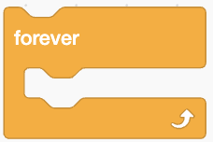
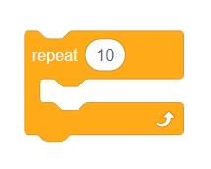
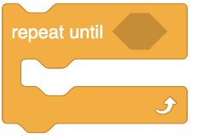
Control blocks & Loops
Notes:
In Scratch, the yellow blocks are our control blocks. You already know one of them: the start block. Today you will learn about several types of repeat blocks. We use this to create loops, or algorithms that repeat. Loops are great tools to use within code and projects to repeat an action multiple times. In the 'Control' section of block code, we can use these loops:
Repeat x number of times: The Repeat Until () block is a Control block. Blocks held inside this block will loop until the specified event happens, in which case the code beneath the block (if any) will execute.
Repeat until: The Repeat () block is a Control block. Blocks held inside this block will loop a given amount of times, before allowing the script to continue.
Forever: Blocks held inside this block will be in a loop — just like the Repeat () block and the Repeat Until () block, except that the loop never ends (unless the stop sign is clicked, the Stop All block is activated, or the stop script block is activated within the loop). Due to this infinite loop, the block has no bump at the bottom; having a bump would be pointless, as the blocks below it would never be activated.

Slide 16
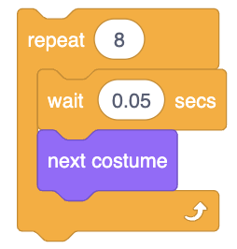
Repeat X number of times (Video)
Repeats an action a certain # of times
When you place other blocks inside this block, it will loop for a specified number of times.
Notes:
Watch Video Here: https://www.dropbox.com/s/jiiknq8vobh5l1l/repeat%20%28%29.mp4?dl=0

Slide 17
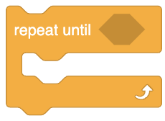
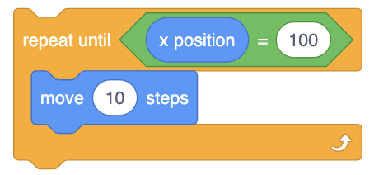
Repeat Until (Video)
Repeats until another command ends the action.
Notes:
Watch Video Here: https://www.dropbox.com/s/jiiknq8vobh5l1l/repeat%20%28%29.mp4?dl=0

Slide 18
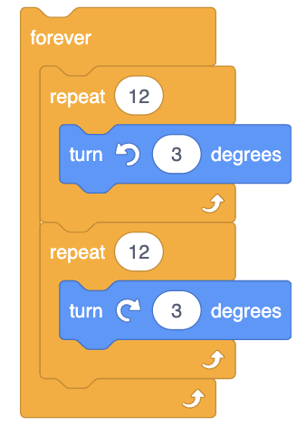
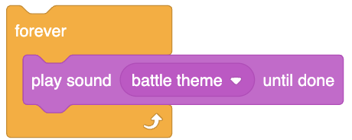
Repeat forever (Video)
Repeats forever.
Blocks held inside this block will be in a loop — just like the Repeat () block and the Repeat Until () block, except that the loop never ends (unless the stop sign is clicked, the Stop All block is activated, or the stop script block is activated within the loop).
Notes:
Watch Video Here: https://www.dropbox.com/s/jjd1b22i1permk0/forever.mp4?dl=0
Due to this infinite loop, the block has no bump at the bottom; having a bump would be pointless, as the blocks below it would never be activated.

Slide 19
Independent Practice:
Navigate to scratch.mit.edu
Create a new project
Choose a Sprite
Animate a dance with five or more moves
Using the loop function, have the sprite dance using both “Repeat until” and “Repeat __ Number of times” and “Forever”
Pause here. (10 minutes)

Slide 20
Wrap up: Share your animation!
Notes:
Great job! Share your animation with your teacher or a partner

Slide 21
next time…
Notes:
Next time we will complete the final step and code our animation in Scratch!

