Slide 1
Unit 1 Lesson 3
Patterns and Sequences in Writing
3rd & 4th Grade
Lesson created by the GMU-ODU CSforAll Team. For more information about
this lesson and our CSforAll initiative, contact Dr. Amy Hutchison at achutchison1@ua.edu

Slide 2
Summary and Standards
Summary:
In this lesson, students will identify and create patterns and sequences in writing and also code a pattern and sequence.
ELA Standards:
The student will read and demonstrate comprehension of nonfiction texts.
The student will write in a variety of forms to include narrative, descriptive, opinion, and expository.
a)Engage in writing as a process.
c) Use a variety of prewriting strategies.
d) Use organizational strategies to structure writing according to type
g)Use transition words to vary sentence structure
CS Standards:
The student will construct sets of step-by-step instructions (algorithms), both independently and collaboratively
a) using sequencing;
b) using events.

Slide 3
Materials and resources needed for this lesson:
Teacher slide deck
Student slide deck
Chromebook/Laptop
Internet Access
Drink recipe graphic organizer:

Slide 4
Warm up

Slide 5
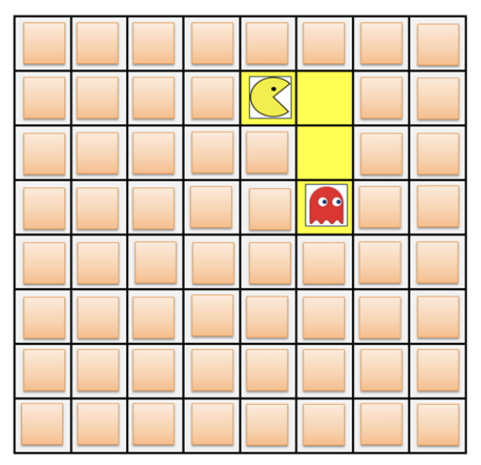
Patterns & sequencing review activity
Open your student slides
Click on the link to the warm up
Answer each question
Review answers as a class!
Notes:
Explain: In this activity you will need to identify the pattern and sequence needed to move objects around on a grid similar to this one. You will need to figure out the best and most efficient way to solve these puzzles. For example, to get the pacman to the red ghost, you would move right, down, down.

Slide 6
Lesson Objectives
Create a pattern and sequence a set of written instructions (Whole group)
Identify patterns found in writing (EXPLANATORY)
Participate in Pair Programming
Identify and Operate Scratch blocks to create a sequence, using Move and Wait Blocks (Create a square)

Slide 7
Introducing Move, turn, & Wait blocks

Slide 8
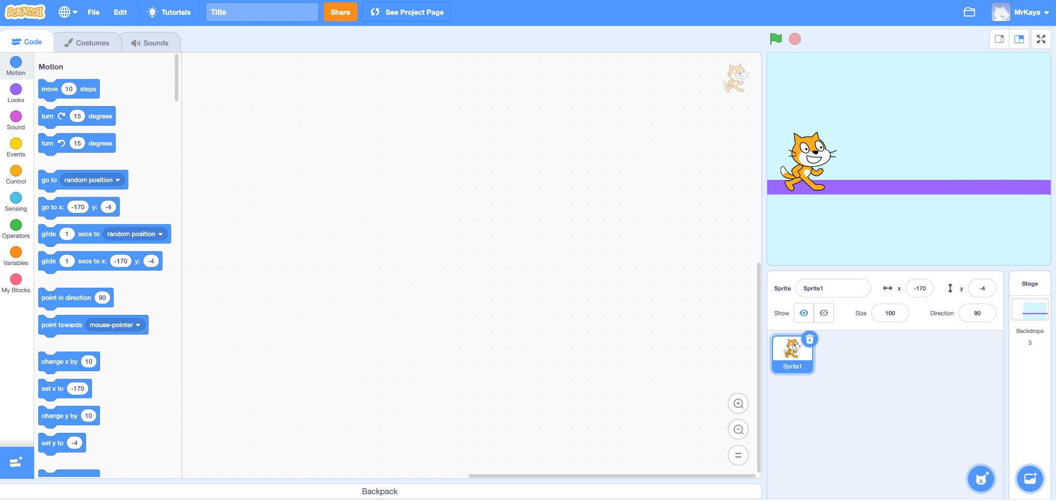
Remember…
Block categories
Notes:
Remember that on the far lefthand side of our page, we see a color palette. Each color corresponds to a different type of block. Today, we’ll focus on motion blocks, which are BLUE, and control blocks, which are YELLOW.

Slide 9
Motion blocks
Notes:
There are lots of motion blocks. We’re going to learn about two of them today.

Slide 10
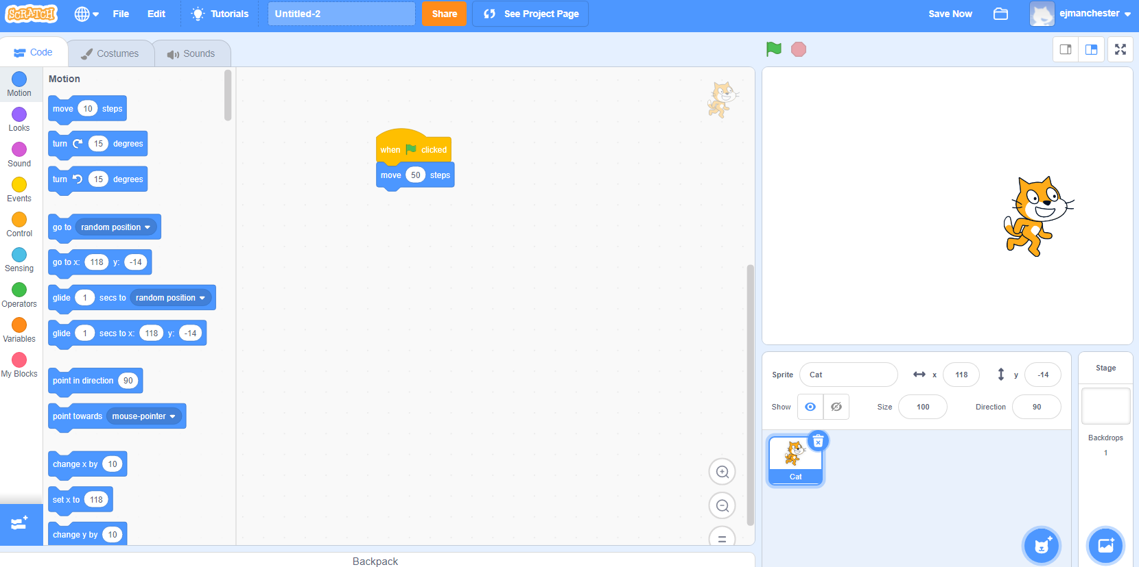
Move block (explainer Video)
Moves your sprite a certain number of steps.
Notes:
It may not be obvious but this cat looks different from the one automatically in scratch. This one looks like it’s running.

Slide 11
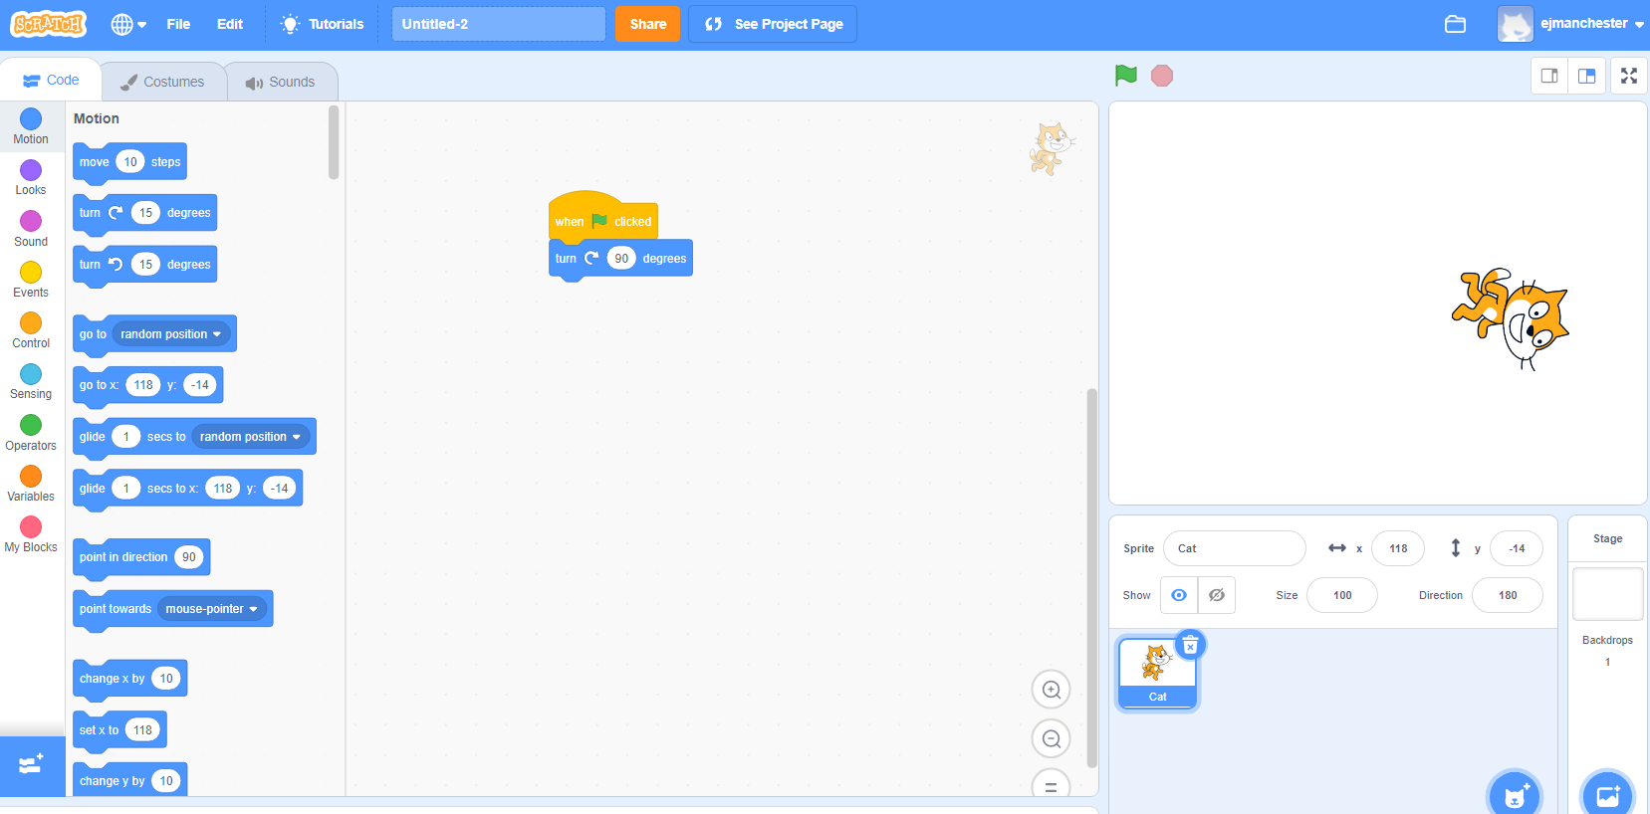
Turn block (Explainer Video)
Turns your sprite right or left by a matter of degrees.
Notes:
It may not be obvious but this cat looks different from the one automatically in scratch. This one looks like it’s running.

Slide 12
Control blocks
Notes:
The yellow blocks are our control blocks. You already know one of them: the start block. Today you will learn about the wait block.
The wait block simply codes the sprite to wait a set number of seconds before executing the next command.

Slide 13
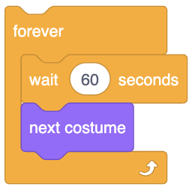
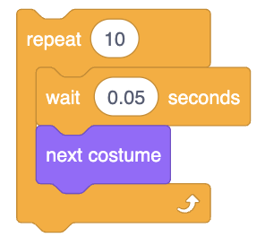
Wait Block (Explainer Video)
Your Sprite will PAUSE or wait for a specified amount of time.
Notes:
Play video and explain:

Slide 14
Activity: Walk in a square

Slide 15
In scratch, program your sprite to walk in a square
Use the new move, turn, and wait blocks we just learned to program your sprite to walk in a square.
Notes:
“I am going to use my command blocks to program our robot to walk in a square. But wait! I can’t find a block that says walk in a square. What do you think I should do? I think I first need to make my robot walk forward. Can you find a block that would make the robot walk forward?” (prompt students to identify the forward block and consider how many steps the robot should walk).

Slide 16
Solution
Notes:
Now, let’s look at one solution for this activity. There are many possible solutions, so yours may be different.

Slide 17
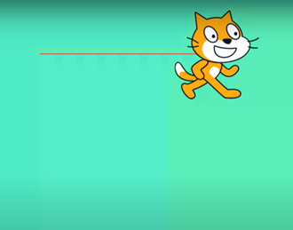
Commands fOr Walking in a square
Step 1 (First): Walk forward 2 steps
2
Notes:
If you choose this block, you would be correct. This block says “Move ___ steps”.
I want my robot to move 2 steps, so that would go in this blank. CLICK
This means our robot should move directly forward 2 steps. If you are the robot, move forward 2 steps.

Slide 18
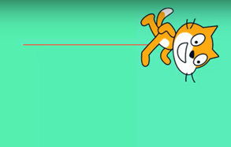
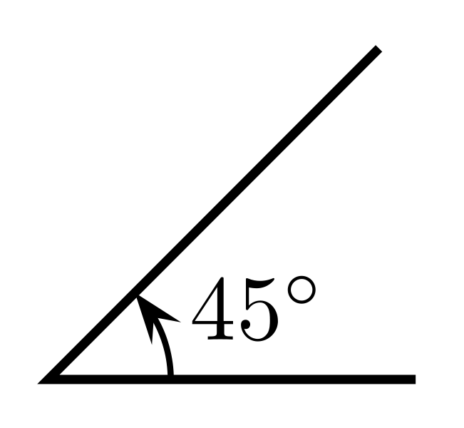
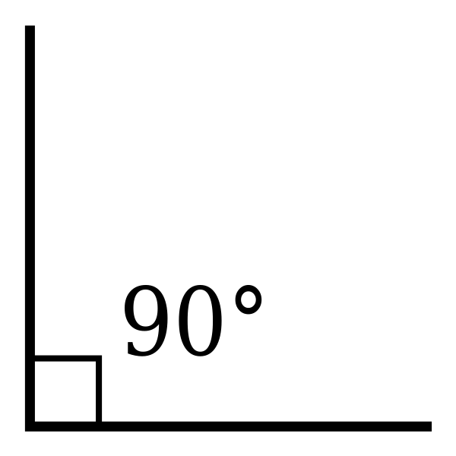
Commands fOr Walking in a square
Step 2 (Then): Turn right
Notes:
We need our robot to TURN. This common block commands the robot to turn right 90 degrees, which is like turning one corner of our square. Go ahead robot, turn right 90 degrees or one of our corners.

Slide 19
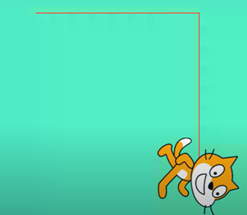
Commands fOr Walking in a square
Step 3 (Next): Walk 2 steps
2
Notes:
The sides of a square are equal, so we need our robot to walk to same number of steps as it did the first time, 2! So now our robot needs to take two steps. Things should start to get a little easier now.

Slide 20
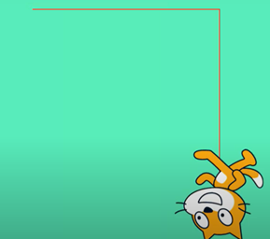
Commands fOr Walking in a square
Step 4 (Then): Turn right
Notes:
You got it! The robot turns right again 90 degrees! Go ahead robot, turn.

Slide 21
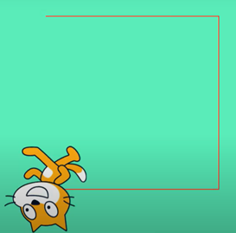
Commands fOr Walking in a square
Step 5 (Next): Walk 2 steps
2
Notes:
Move 2 steps! Go ahead robot, move two steps again!

Slide 22
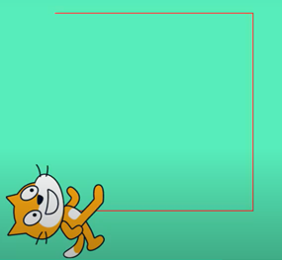
Commands fOr Walking in a square
Step 6 (Last): Turn right
Notes:
Turn right 90 degrees again. Go ahead robot!

Slide 23
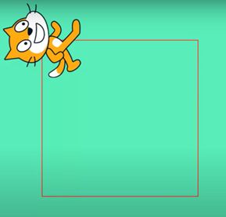
Commands fOr Walking in a square
Step 7 (Finally): Walk 2 steps
2
Notes:
Finally, our last step is to take 2 steps and complete our square. How did your robot do?

Slide 24
Commands fOr Walking in a square
Written commands | Computer commands (code)
Walk forward 2 steps
Turn right
Walk 2 steps
Turn right
Walk 2 steps
Turn right
Walk 2 steps
2
2
2
2
Notes:
Let’s review the commands we gave the “robot” using code. We told our robot to walk forward 2 steps, turn right, forward 2 steps, turn right, forward 2 steps, turn right...until we completed our square. We had to put our commands in the correct sequence or our robot would not create a square! Think if we had put them out of order, what would our robot had done?
When you look at the code you created, you can see how these blocks would fit together. This is your algorithm, or your list of commands!

Slide 25
Patterns
2
Notes:
You may have noticed walking forward and turning left are the two repeating commands; move, turn, move, turn...

Slide 26
Patterns in writing

Slide 27
Examples of Patterns in our writing
BEGINNING
MIDDLE
END
END
Notes:
Ask students if they can think of any patterns they see in books or stories they read (if needed, prompt students with patterns such as beginning, middle, and end; characters, setting, and plot; etc.)

Slide 28
Guided Practice: Example A
Daquan was watching TV and saw a commercial for pizza and that gave him a great idea! “I’ll just make my own pizza here at the house!,” he thought. He found his mom’s recipe, which said:
“First, roll out the squishy pizza dough with the rolling pin. Then, use a spoon to spread on the red pizza sauce on top of the dough. Next, add shredded cheese all over the top. Last, top it with pepperoni slices, covering the whole pizza. Finally, put the pizza in the oven at 425 degrees.”
After about 15 minutes in the oven, his homemade pizza was ready to eat!
DO YOU NOTICE A PATTERN?
Notes:
Read slide and ask students if they can identify a pattern.

Slide 29
What is explanatory writing?
Explanatory writing:
Explains something to someone or helps them understand how to do something. So it is important to provide many details!
Is written in a specific order or sequence
A sequence is a set of things that follow each other in a particular order, where order matters!
Often uses sequencing words such as first, next, then and last to communicate the correct order of steps, also known as their sequence
Notes:
These transition words are especially important when we’re giving instructions to someone. We call this type of writing, explanatory writing. Explanatory writing….[read slide]

Slide 30
First
Then
Next
Last
Finally

Slide 31
For both Writing & Computer science, Sequence is very important!
Notes:
Transition words help us to put our writing in the correct sequence–it’s just as important for human readers as it is for computers!

Slide 32
Independent practice

Slide 33
Independent practice
Open your student slides.
Write a recipe for making a drink.
You may choose to write about lemonade, Koolaid, or another drink of your choice!
https://www.dropbox.com/scl/fi/qf1j67ajoq6tu0gacc460/Lemonade-or-Koolaid-recipe.docx.docx?dl=0&rlkey=4vm66w2jppnter0oqmgmw8i2t
Notes:
In a moment, you will navigate to your student slide deck. In the deck is an outline for you. You will choose whether you want to write instructions for making lemonade or tea. Then you will type you instructions in. There is also a link to this document in the handouts, for the option to hand write your instructions. Your teacher will let you know what to do next.

Slide 34
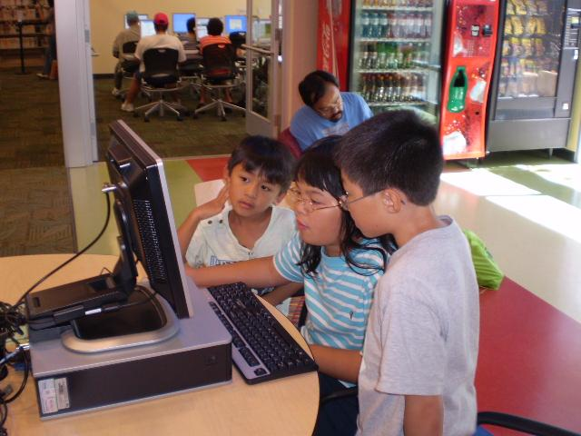
Wrap up
Can anyone share at least one “tip” for finding and using patterns in our writing or our code?
And remember: anyone can be a computer scientist!

Slide 35
Optional

Slide 36
Sharing your .sb3 file from CS First to CoCo
Create the file in CS First
In the Scratch editor, find the word “File” in the top-left corner.
Click on “File” menu and you’ll see some choices pop down.
Choose “Save to your computer.” This will download your Scratch project.
Look in your “Downloads” folder. That’s where your saved project might be.
Go to the CoCo website and log in to your account. https://wego.gmu.edu/scratchgo/login.php
Click proceed on the correct story in CoCo.
Navigate to the section of CoCo where you can upload your project. (only sb3 type and 10Mb max).
Click “Save”.
Notes:
Model how students can share Scratch creations to their teacher’s studio

Slide 37
Here is an optional video to learn how to share your project in Scratch.
Pause here.
Notes:
Video modeling how students can share Scratch creations to their teacher’s studio
Scratch - Imagine, Program, Share

Slide 38
Scratch Checklist
I logged into scratch
I shared my project
I added my project to my teacher’s studio

