Slide 1
Unit 4, lesson 1
Decomposition
5th & 6th grade
Lesson created by the GMU-ODU CSforAll Team. For more information about
this lesson and our CSforAll initiative, contact Dr. Amy Hutchison at ahutchison1@ua.edu

Slide 2
Summary and Standards
Summary:
In this lesson, students will use a summary strategy to decompose a story in Coco.
ELA Standards
The student will write in a variety of forms to include narrative, descriptive, opinion, and expository.
a) Engage in writing as a process.
b) Identify audience and purpose.
c) Use a variety of prewriting strategies.
d) Use organizational strategies to structure writing
according to type.
e) Use transition words to vary sentence structure.
CS Standards:
The student will break down (decompose) a larger problem into smaller sub-problems, independently or collaboratively.

Slide 3
Materials and resources needed for this lesson:
Chromebook/Laptop
Internet Access
Teacher Unit 4, Lesson 1 slide deck
Coco Link
Read aloud or story of your choice to summarize using SWBST
Practice Summary SWBST graphic organizer
Reminder:
In this lesson, every student should be assigned a story in CoCo using Level 5.
The story should be titled “Unit 4 Summary.”
Each student should save their work using this naming strategy: “Student Name + Unit # + Descriptor”, for example, “Johnny Unit 4 Summary.”
Notes:
You will need….[read slide]

Slide 4
Lesson Objectives: I can…
Review CS Vocabulary
Identify features in Coco Level 5 Identify other types of writing (SUMMARIES) that could be used in Coco Level 5
Identify and use NEW BLOCKS
Brainstorm new writing ideas with a partner
Notes:
Let’s go over today’s lesson’s objectives: [read slide]

Slide 5
Warm up
Computational thinking means “thinking like a computer scientist.”
We’ve learned about these computational thinking skills:
Pattern recognition
Sequencing
Creating algorithms
Abstraction
Debugging
Pick one of these skills and write for 5 minutes about how this skill helps you think like a computer scientist.

Slide 6
Introduction
Notes:
Today we are going to start with a new vocabulary word!

Slide 7
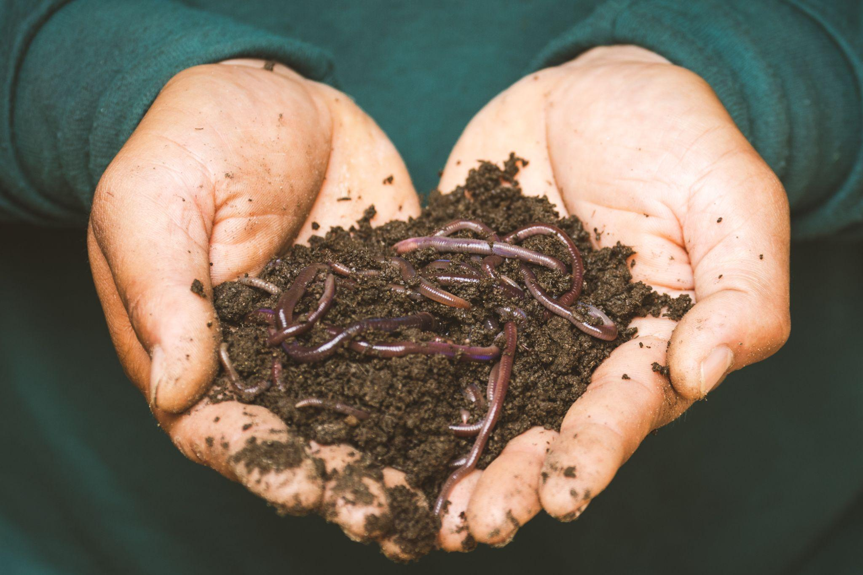
Decompose
Notes:
Have you ever heard the word decompose? Or even decomposition? In science you may have learned about decomposers, those organisms that break things down. Well, today we are going to learn about how we can decompose in both computer science and in our writing and literacy!

Slide 8
Decompose: to Break a problem down into smaller pieces
Decomposition (dee-comp–uh-zi–shun): breaking a large problem into smaller parts
Notes:
Computer scientists have to solve coding problems and need to make think about what steps they need to take and what order to do them in.
Sometimes the problem is so big or complex, it can be hard to know where to start.
Decomposition is when we break a problem down into smaller parts to make it easier to tackle.
It has many advantages. It helps us manage large projects and makes the process of solving a complex problem less scary and much easier to take on.
This Unit, we’re going to learn more about decomposition, our final computational thinking concept. Decomposition is going to be key in helping us to animate our new stories in Scratch with more Scratch blocks.”

Slide 9
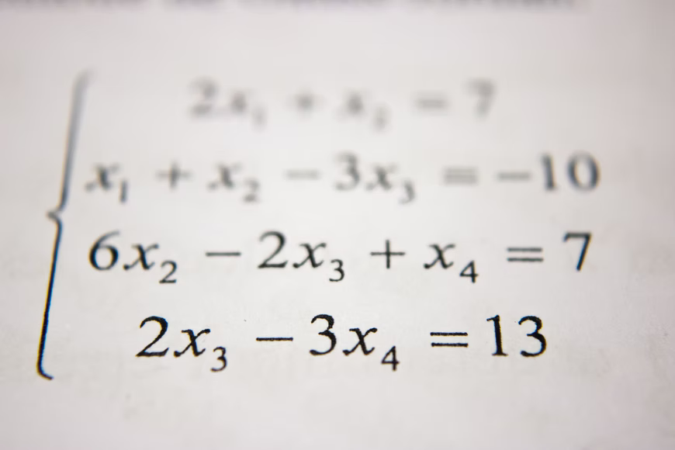
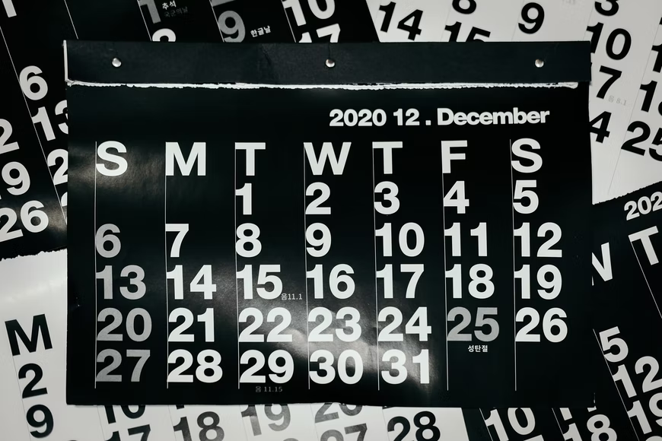
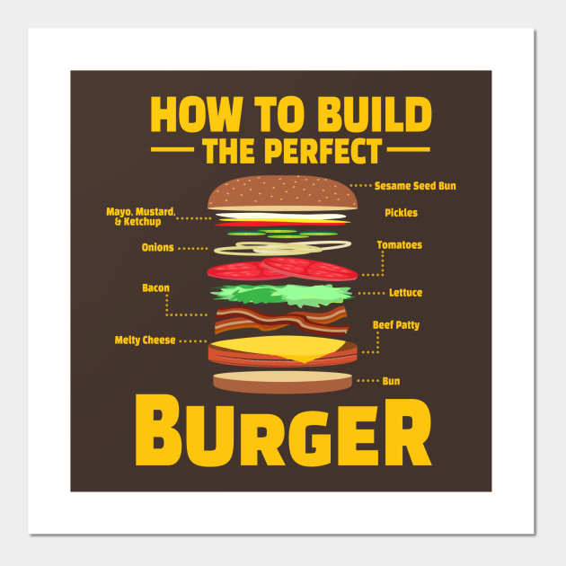
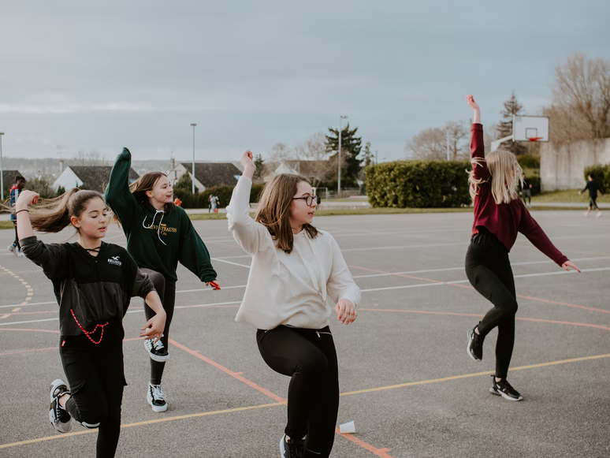
we can decompose more than just Computer science problems!
Notes:
According to code.org: “Decompose—To break a hard problem up into smaller, easier ones”
This Unit, we’re going to learn more about decomposition, our final computational thinking concept. Decomposition is going to be key in helping us to animate our new stories in Scratch with more Scratch blocks.”

Slide 10
Can you think of more examples?
Pause Here
Notes:
When do you break things down?
Break down a recipe, a workout, picking out your outfit, ex

Slide 11
Decomposition
In literacy, we use decomposition quite often:
When we sound words out (mis-com-mu-ni-cate)
When we edit and fix mistakes
When we create a set of instructions
When we share the main idea
When we create a summary of a story
Notes:
We actually use the skill of decomposition quite often in literacy. We decompose when we break down a word or sentence into small parts, like sounding a word we don’t know in a sentence. We decompose when we break down our writing to look for errors, like debugging. We decompose and abstract when we break down a series of steps, like a set of instructions, into the most important parts. We also decompose when we break a story down into the main idea or try to provide a summary. Today, we are going to talk more about summarizing!

Slide 12
SUMMARY: restates the main ideas of a story in your own words
Notes:
A summary restates the main ideas of a story in your own words. You have probably done this quite often after you have read or listened to a story. We don’t want to retell everything that happens in the story, we just want to share the main idea

Slide 13
We decompose when we summarize!
A summary restates the main ideas of a story in your own words.
Ask yourselves these questions while summarizing:
What are the main ideas of the story I just read?
What details from the story are important to include in my summary?
What details from the story are not that important to the main idea?
Notes:
{Read questions}
You’re decomposing because you’re breaking down the entire story and identifying its most important parts.

Slide 14
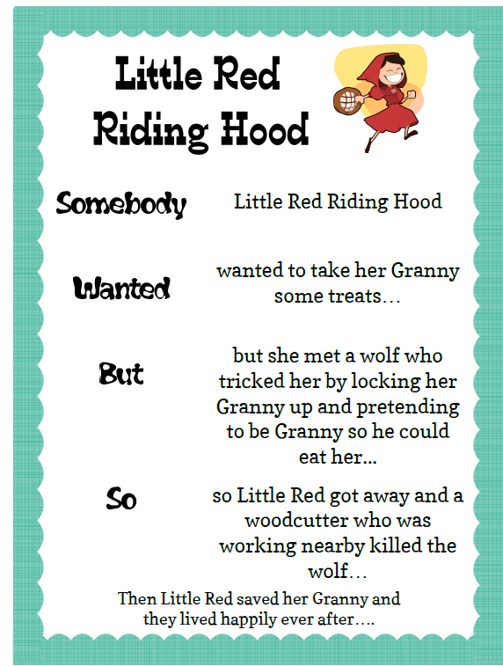
Somebody… wanted…but….so…. Then
Somebody: Character
Wanted: Goal/motivation
But: Conflict/problem
So: Resolution
Then: How does it end?
Here is a link to a YouTube video of the story of Little Red Riding Hood that you can use to remind yourselves of the story if you would like!
Notes:
There are several ways that we can decompose a story, but Today, we’re going to review one great strategy for summarizing. This strategy uses these anchor words to help us create a summary: “Somebody Wanted But So Then” {Read Slide}
Let’s see how this strategy can help use decompose the familiar story of Little Red Riding Hood. To do this, we can use Coco, our favorite graphic organizer, to help us. Today, we are briefly going to be introduced to Level 4 of Coco, where we can record our summaries. Let me show you how.

Slide 15
Coco, Level 5
Can write in ANY kind of story
New questions for animating your story
New motion blocks
New sound blocks
New look blocks
New control blocks
Coco still helps you decompose your coding!
Notes:
First, let’s take a quick look at Coco, Level 4. In this level:
Boxes are completely empty, no suggested text. To write a story, to summarize, to write a set of instructions, etc.
You will also see many new questions in Column 2. These questions will prompt you to use new blocks in Scratch. There are blocks that move your sprite, create sound, change looks and also blocks to control your code and create loops.
Even though there are some new features in this level, Coco is still a great way for you to break down each step of your code and prepare for creating a scratch animation
The other two columns remain the same, when you say yes to any of the questions, the block you need will appear in the 3rd column. Remember, if you click on the block a video will appear to show you how the block works.

Slide 16
Video Model
Somebody Wanted But So Then Tutorial Link
Notes:
Introduction to Level 4: Explain you can now write anything in the boxes. We will explain new blocks next lesson.

Slide 17
Your turn! Practice summarizing with a partner.
Notes:
With a partner, practice summarizing a familiar story using the graphic organizer provided by your teacher.
Link Here: https://www.dropbox.com/scl/fi/jm43x1gqg71rq204yk4cq/SWBST_Practice-graphic-organizer.docx?dl=0&rlkey=bni0elmi28e8ikw8hwfovryzr

Slide 18
New scratch blocks

Slide 19
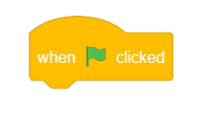
Event Blocks
Notes:
Another category of Scratch block is the ‘Event blocks.” These blocks are yellow where control blocks are more orange in color.
Events in computer science are the triggers for making action happen, like selecting the play button on any screen.
Events in Scratch are represented by the yellow codes including: when flag clicked, when sprite clicked, when key pressed. You’ve already seen the “when flag clicked” event block so today we will review the “when sprite clicked” and “when key pressed” blocks.

Slide 20
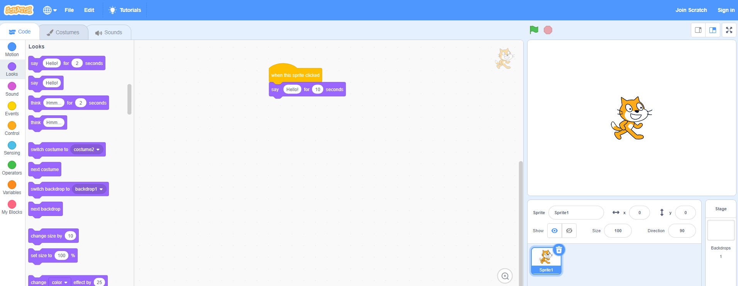
When This sprite clicked block (VIDEO)
Instead of the green flag.
Click the sprite
Starts the animation by clicking the sprite on the screen.

Slide 21
When any key pressed block (VIDEO)
Click the sprite
Starts the animation by pressing any key on your keyboard.
Notes:
But be careful! The block’s default is set to “when space key pressed” which would only start the animation by pressing the space key. (review space key if students are unfamiliar)
Instruct students to create an animation of a sport or outside activity they like to do with two Sprites. Use one of the new event blocks for each Sprite. Share with a partner!

Slide 22
Introducing conditionals
If
When
Until
Notes:
Discuss conditionals: In computer science, a condition is something that must be true in order for something to happen. A condition is said to "evaluate to true" or "evaluate to false." In Scratch, any block whose label says "if," "when," or "until" is a sort of conditional construct.

Slide 23
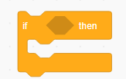
Conditional control blocks
Notes:
Today, we will learn about the “if/then” block
The if () then block is a control block in Scratch. If the condition written inside the block is true, the blocks inside it will run. If the condition is false, the blocks inside the block will be ignored. The condition is only checked once; if the condition turns to false while the script inside the block is running, it will keep running until it has finished.

Slide 24
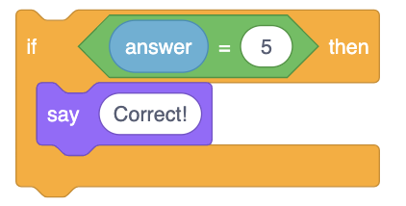
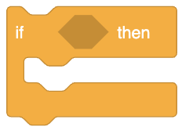
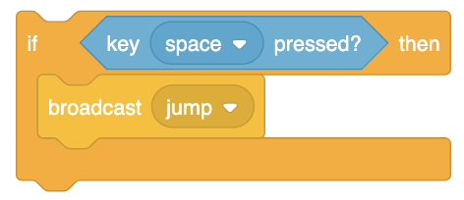
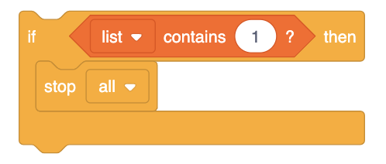
If/then block (Video)
If the condition inside is true, the blocks inside it will run. If the condition is false, the blocks inside the block will be ignored.
Notes:
There are many ways to use the if/then block. If the condition inside is true, the blocks inside it will run. If the condition is false, the blocks inside the block will be ignored.
Watch or share this video

Slide 25
Your turn: Pause here and Try out The “if/Then” block
Notes:
Create an animation using the “If/Then” block. Have your sprite as question. Using “If/Then” change the backdrop to green if the answer was correct. Once you are done coding, have a partner try your animation and answer the question!

Slide 26
Turn & Talk
Notes:
Have students get with a partner or small group and discuss when they may want to use an if/then block in their coding.

Slide 27
Next time…
Notes:
In our next lesson, we will be summarizing and planning how we will animate our summaries in Scratch!

