Slide 1
Unit 1 Lesson 5
Animate and Debug
5th & 6th grade
Lesson created by the GMU-ODU CSforAll Team. For more information about
this lesson and our CSforAll initiative, contact Dr. Amy Hutchison at ahutchison1@ua.edu

Slide 2
Summary and Standards
Summary:
In this lesson, students will plan and code their animation for their written instructions on making a drink. Students will also edit and debug their code and make sure their animation matches their writing and planning in CoCo level 2.
Content Standards:
The student will
Use organizational strategies to structure writing according to type.
Write a clear topic sentence focusing on main idea.
Elaborate writing by including supporting details.
Use transition words to vary sentence structure.
Revise writing for clarity of content using specific vocabulary and information.
CS Standards:
The student will construct sets of step-by-step instructions (algorithms), both independently and collaboratively
a) using sequencing;
b) using events.

Slide 3
Materials and resources needed for this lesson:
Teacher slide deck
Chromebook/Laptop
Internet Access
Link to CoCo
Reminder:
In this lesson, every student should be assigned a story in CoCo using Level 1 or Level 2.
The story should be titled “Unit 1 Drink Recipe”
Each student should save their work using this naming strategy: “Student Name + Unit # + Descriptor”, for example, “Johnny Unit 1 Drink Recipe”

Slide 4
wARM UP

Slide 5
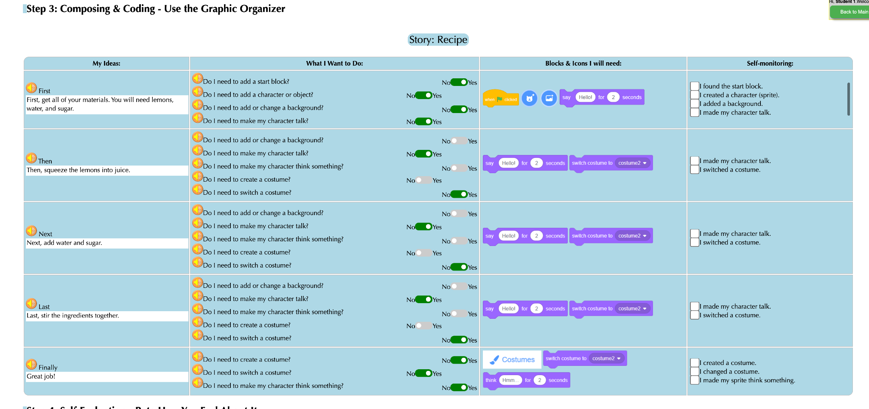
Reviewing CoCo level 2
Notes:
Review CoCo Level 2 briefly, highlighting the planning and self-monitor features
We’ve already filled in column 1 with our drink recipe! Today we are going to focus on using CoCo to plan our Scratch animation, find those blocks in Scratch, and then use the self-monitoring column AFTER we’ve successfully found our blocks in Scratch. Sound good?

Slide 6
Brainstorm with a partner: How will you animate your recipe in scratch?

Slide 7
Lesson objectives
Review Scratch Blocks and features of Coco Level 2
Describe steps of debugging
Set up all sections in Coco Level 2
Code the animation for written instructions in Scratch
Participate in pair programming to debug (run the code and use self-monitor check list)

Slide 8
Direct instruction & Guided practice

Slide 9
Bugs: An error in a code that prevents the program from running as expected.
Notes:
Remember, A bug is an error or mistake in your code that prevents the program from running as expected.

Slide 10
Debugging: looking for and fixing the errors in your code
Notes:
When you need to fix your error in your code we call that debugging. This means you are looking for your mistake and then fixing it. Debugging can happen at anytime while you are coding. Maybe you debug at the end when you realize your sequence isn’t correct, or it could happen at the very beginning, maybe you forgot your start block!

Slide 11
To debug an algorithm, we…
Describe the problem.
Hunt for bugs (what is it in our code causing the problem).
Try out some solutions and test.
Remember what we learned from the bug.
Notes:
Whenever we realize that we have a bug, here are the steps for debugging. We [read slide]. Debugging happens all the time while we are coding!
Debugging Recipe from Code.org: https://code.org/curriculum/docs/k-5/DebuggingTeacher.pdf
Let’s try this out!

Slide 12
Video: How to Debug
Notes:
Play video and remind students to use debugging as they work on planning and animating their writing

Slide 13
Debugging Activity (Optional)
Students should access the debugging activity in their student slide decks to try and debug several coding projects. Link to the activity here.
Notes:
https://www.dropbox.com/scl/fi/nthuf6q3mzvvx84r3wd4a/lesson4_Debugging_Kaya-updated.pptx?rlkey=x402sas5z51nds5hiwkqp4041&dl=0

Slide 14
Independent practice

Slide 15
CoCo continues to help us!
Today, you will use Coco to help you code your instructional animation in Scratch!
Open a tab with Coco project from last time
Open a tab with Scratch
Use column 3 of Coco to find the blocks in Scratch we need for each step.
After you’ve found the blocks in Scratch, check off each row’s self-monitoring before moving to the next step.
Notes:
Instruct students to open CoCo Level 2 project from last lesson

Slide 16
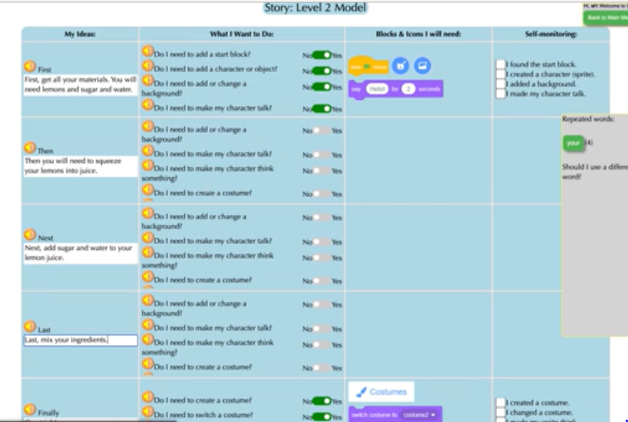
Video Model
How to Choose Animation Blocks in Scratch Tutorial

Slide 17
log into Coco and complete columns 2 & 3

Slide 18
Before you begin to code in Scratch….
Make sure you have a topic sentence
Match your animation to your writing
Be consistent
Match your visuals to your text
Notes:
Okay! Have we all finished answering the questions in CoCo? Good job.
Well, there’s one more step we need to take before we can start working in Scratch. CoCo has helped us find the blocks for adding characters, adding backgrounds, making them say or think something. But! Choosing the kind of sprite and backdrop is still up to us. I’ve got a few tips to share with you as you’re coding in Scratch.
You want to a) include a topic sentence, b) match your animation to your writing, c) be consistent, and d) make sure all the visuals in the frame make sense given what you have written in your text.

Slide 19
Good animations can be simple or complex!
Simple Example:
https://www.dropbox.com/s/jlist1zaujjpc8e/Screen%20Recording%202023-09-18%20at%209.21.46%20PM.mov?dl=0
More Complex Example:
https://www.dropbox.com/s/nh93dmdkphd4n0z/Screen%20Recording%202023-09-19%20at%201.45.13%20AM.mov?dl=0
Notes:
Good animations that follow these guidelines can be as simple as https://www.dropbox.com/s/jlist1zaujjpc8e/Screen%20Recording%202023-09-18%20at%209.21.46%20PM.mov?dl=0 or as complex as https://www.dropbox.com/s/nh93dmdkphd4n0z/Screen%20Recording%202023-09-19%20at%201.45.13%20AM.mov?dl=0 so long as they clearly convey the message to the reader visually and verbally!

Slide 20
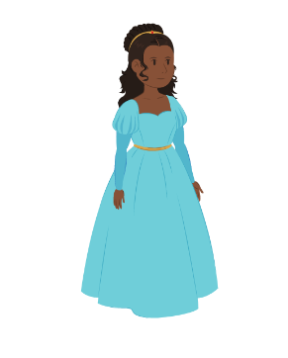
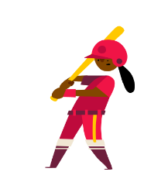
“Once upon a time there lived a princess…”
Notes:
For example, if I was writing a story about “Once upon a time there lived a princess….” which one of these sprites would make more sense?

Slide 21
“Once upon a time there lived a princess…”
Notes:
For example, if I was writing a story about “Once upon a time there lived a princess….” which one of these sprites would make more sense? Probably this one. Although, if our princess played baseball later in the story, you could switch it up!

Slide 22
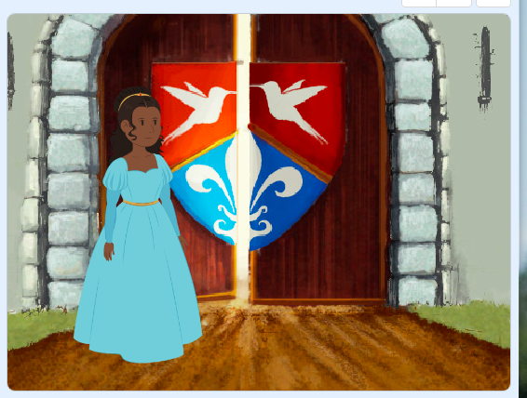
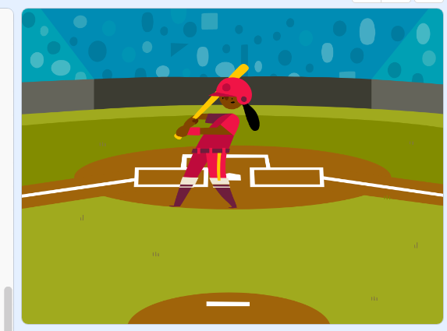
“Once upon a time there lived a princess in a castle.”
Notes:
Now, if I was writing a story about a princess who lived in a castle, this backdrop would make more sense.

Slide 23
“Once upon a time there lived a princess who played baseball.”
Notes:
But if I wrote about a princess who played baseball, this one could also work!

Slide 24
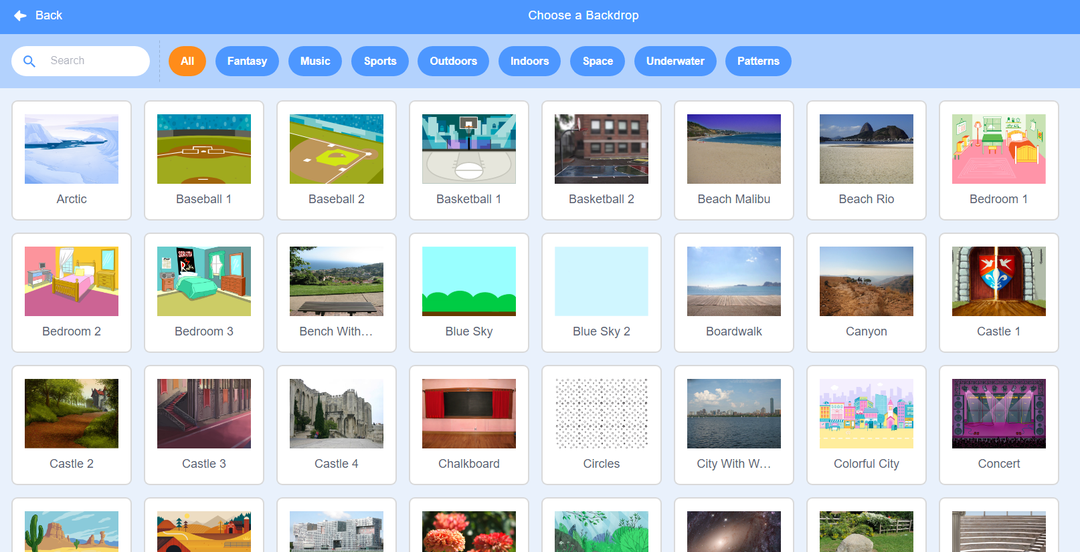
Notes:
Here’s another Scratch tip: when looking for sprites and backdrops, you can enter words into the “search” bar and see if any of the results match what you’re looking for.

Slide 25
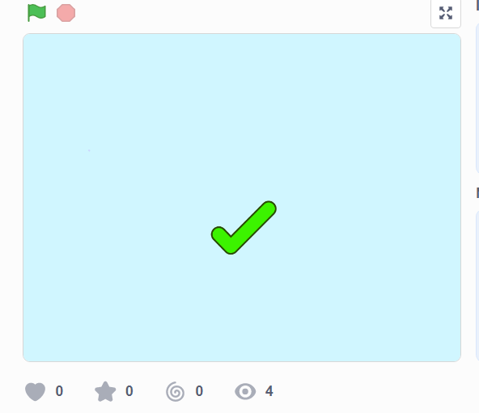
Like
this
https://www.dropbox.com/s/o7aaphbglzvswkr/Screen%20Recording%202023-09-19%20at%201.52.23%20AM.mov?dl=0
Notes:
Let’s look at this example of a scratch project that is consistent, matches its text, and whose visuals make sense. This is using the “how to make hot chocolate” recipe we’ve seen before.

Slide 26
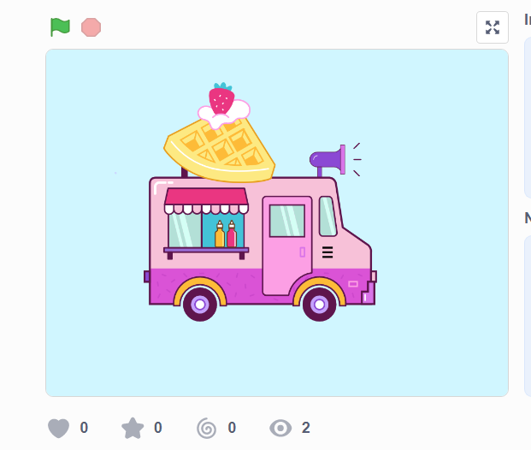
Not like this
https://www.dropbox.com/s/jlist1zaujjpc8e/Screen%20Recording%202023-09-18%20at%209.21.46%20PM.mov?dl=0
Notes:
Now, let’s look at the same video but where the visuals don’t match the text. Hmm, what went wrong here?

Slide 27
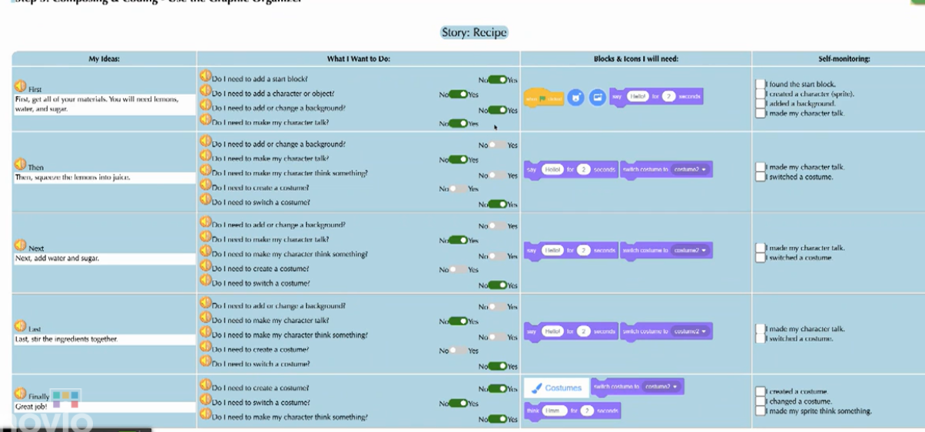
Video Model
Video on how to add content from first row to CoCo to Scratch
Notes:
Okay! Now that we’ve thought carefully about how we will match our Scratch visuals to our writing in CoCo, we’re ready to start coding! Let’s watch this short video on how to move between CoCo and Scratch. Remember we will be toggling back and forth!
Let’s make sure we all get the hang of it by starting with adding the blocks from ONLY OUR FIRST ROW into Scratch. Pause and look at me when you’re done.

Slide 28
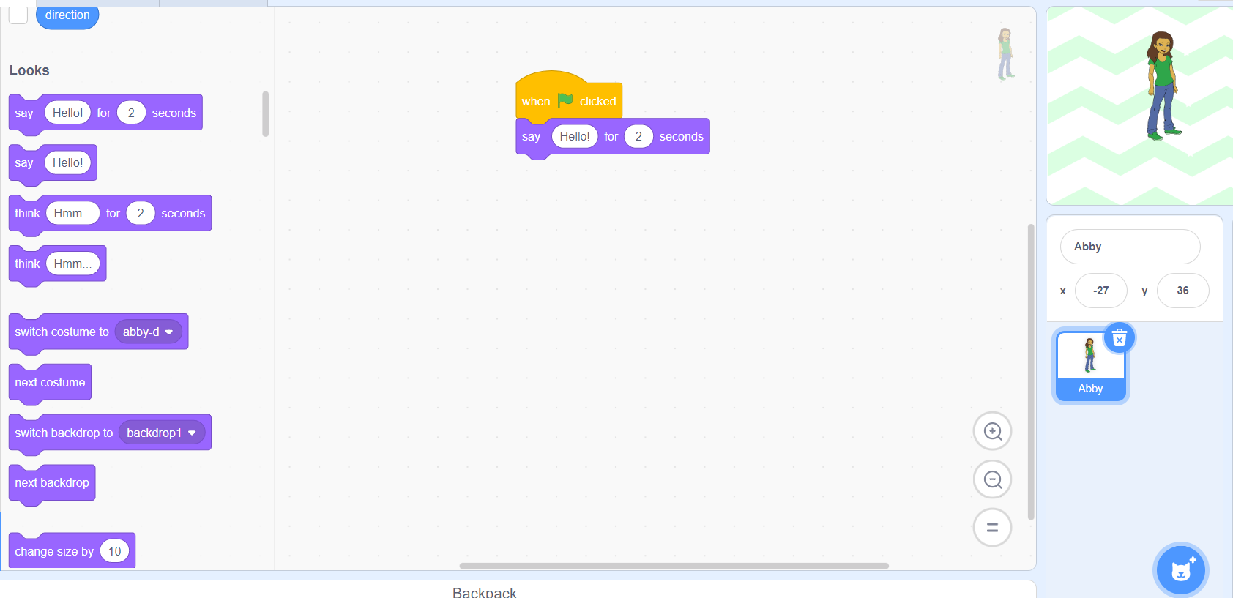
Video Model
Video on transferring the rest of your work from CoCo to Scratch and monitoring your progress
Notes:
Once you get the hang of it

Slide 29
Pause here and Code in Scratch,
check your self Monitor

Slide 30
But wait!
Did you debug any errors?
Does your Scratch animation match what you planned and wrote in CoCo?
Notes:
In pairs (or independently), ask students to review and debug their code, making sure their animation matches what they planned and wrote in CoCo.

Slide 31
Last step, Self Evaluation

Slide 32
Video Model
Self-Evaluation Tutorial

Slide 33
Sharing your .sb3 file from CS First to CoCo
Create the file in CS First
In the Scratch editor, find the word “File” in the top-left corner.
Click on “File” menu and you’ll see some choices pop down.
Choose “Save to your computer.” This will download your Scratch project.
Look in your “Downloads” folder. That’s where your saved project might be.
Go to the CoCo website and log in to your account. https://wego.gmu.edu/scratchgo/login.php
Click proceed on the correct story in CoCo.
Navigate to the section of CoCo where you can upload your project. (only sb3 type and 10Mb max).
Click “Save”.
Notes:
Model how students can share Scratch creations to their teacher’s studio

Slide 34
Here is an optional video to learn how to share your project in Scratch.
Pause here.
Notes:
Video modeling how students can share Scratch creations to their teacher’s studio
Scratch - Imagine, Program, Share

Slide 35
Share your work:
Find a partner and share your animation.
Share what you learned and something you might want to try differently.
Pause and share

Slide 36
By receiving feedback on your Explanatory Writing Scratch project, you can make it better.
A. Share your screen with your elbow partner.
B. Ask them to name two things they about your Explanatory Writing project.
The part I liked best was…
I like the way... because...
You should
keep doing...
C. Request feedback on one aspect of your Scratch project you could improve
How about if you…
You might want to consider…
You might want to try…
D. Switch Roles
Pause here (10 minutes)
Notes:
Here are some suggestions for sharing your work and getting feedback. Feedback can help us learn and make our work better in the future. [Read Slide]
Adapted from Getting Unstuck

