Slide 1
Unit 2, lesson 2
CoCo Level 3, Look Blocks
3rd & 4th Grade
5th & 6th grade
Lesson created by the GMU-ODU CSforAll Team. For more information about
this lesson and our CSforAll initiative, contact Dr. Amy Hutchison at ahutchison1@ua.edu

Slide 2
Summary and Standards
Summary:
In this lesson, students will use the CoCo graphic organizer to begin animating a set of instructions in Scratch.
2017 VDOE ELA Standards
The student will write for a variety of purposes.
d) Use strategies for organization of information and elaboration according to the type of writing.
CS Standards:
The student will construct sets of step-by-step instructions (algorithms), both independently and collaboratively
a) using sequencing;
b) using events.
Notes:
Today, we are moving on to Unit 2, where we will learn about something called abstraction, a key process you will use in both computer science and writing.

Slide 3
Materials and resources needed for this lesson:
Reminder:
In this lesson, every student should be assigned a story in CoCo using Level 3.
The story should be titled “Unit 2 Story.”
Each student should save their work using this naming strategy: “Student Name + Unit # + Descriptor”, for example, “Johnny Unit 2 Story”
Personal Computer
Access to the Internet
Teacher slide deck
Student Unit 2 Slide Deck
Your written instructions (in the sequencing graphic organizer) from last time
Coco Link
Scratch link
Notes:
You will need….[read slide]

Slide 4
Writing in Coco: Adding Text to Coco
Steps:
Log In to CoCo
Select “level 3” from the drop-down menu
Type your instructions into the text boxes provided.
Notes:
In a moment, we will log into CoCo level 3.
We already know how to do this but, as a reminder, here are the steps (read slide)

Slide 5
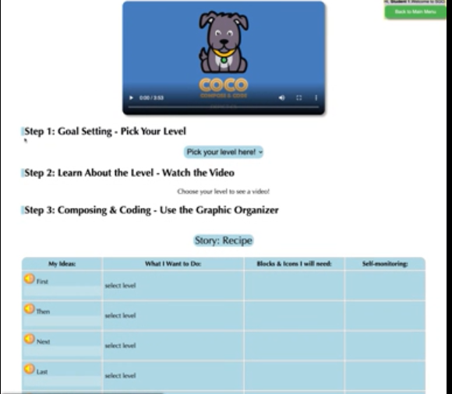
Video Model
Coco Level 3, column 1 tutorial

Slide 6
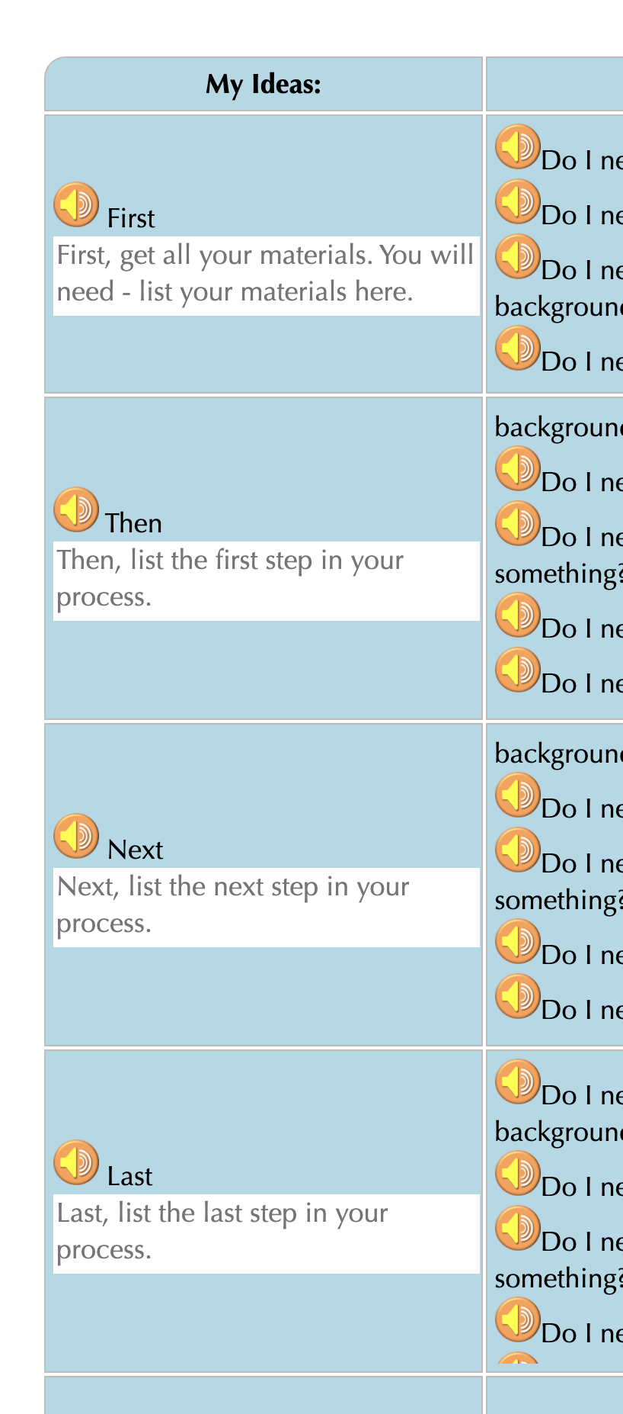
Modeling Coco
Steps:
Log In to CoCo
Select “level 3” from the drop-down menu
Type your instructions in the text boxes provided

Slide 7
Pause to Work in CoCo
Make sure you are using CoCo!

Slide 8
Look Blocks
Do I need to hide my character?
Do I need to show my character?
Do I need my character to appear in a particular size?
Do I need to change the color of my character?
Notes:
The next few questions you see in Coco as {read questions}
These all have to do with the appearance or look of your sprite, so they are the purple look blocks. Let’s learn how they work….

Slide 9
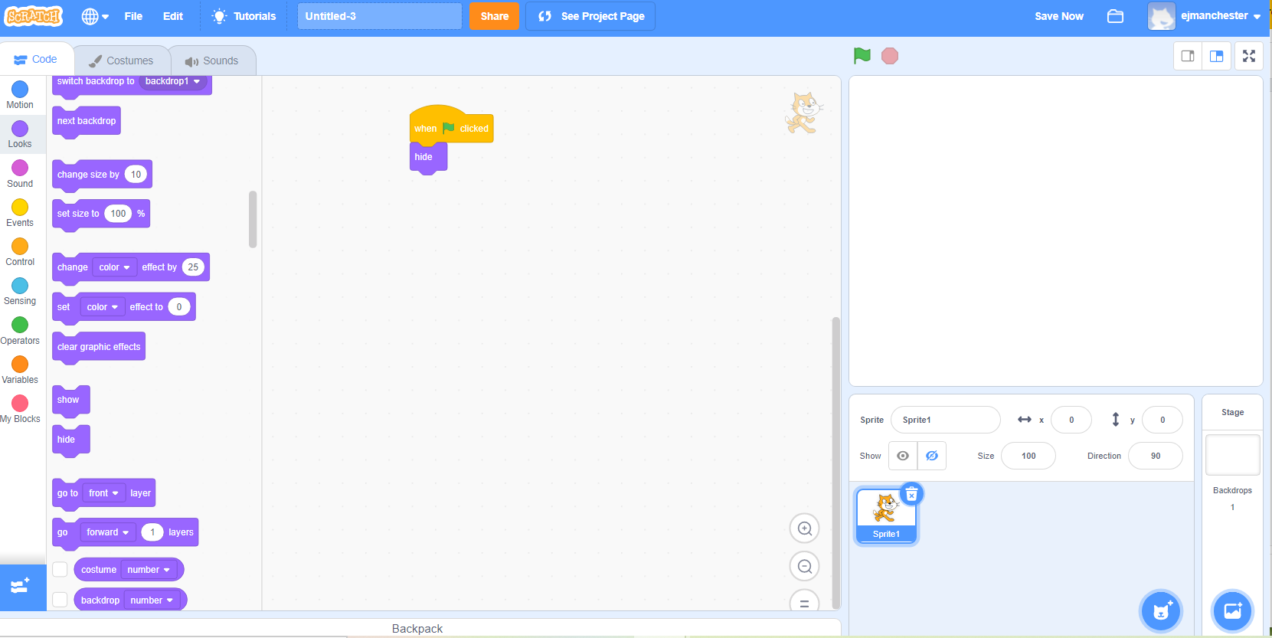
HIde character block (explainenr video)
Hides your sprite from view.
Notes:
Play Video by clicking on “Explainer Video” on the slide.

Slide 10
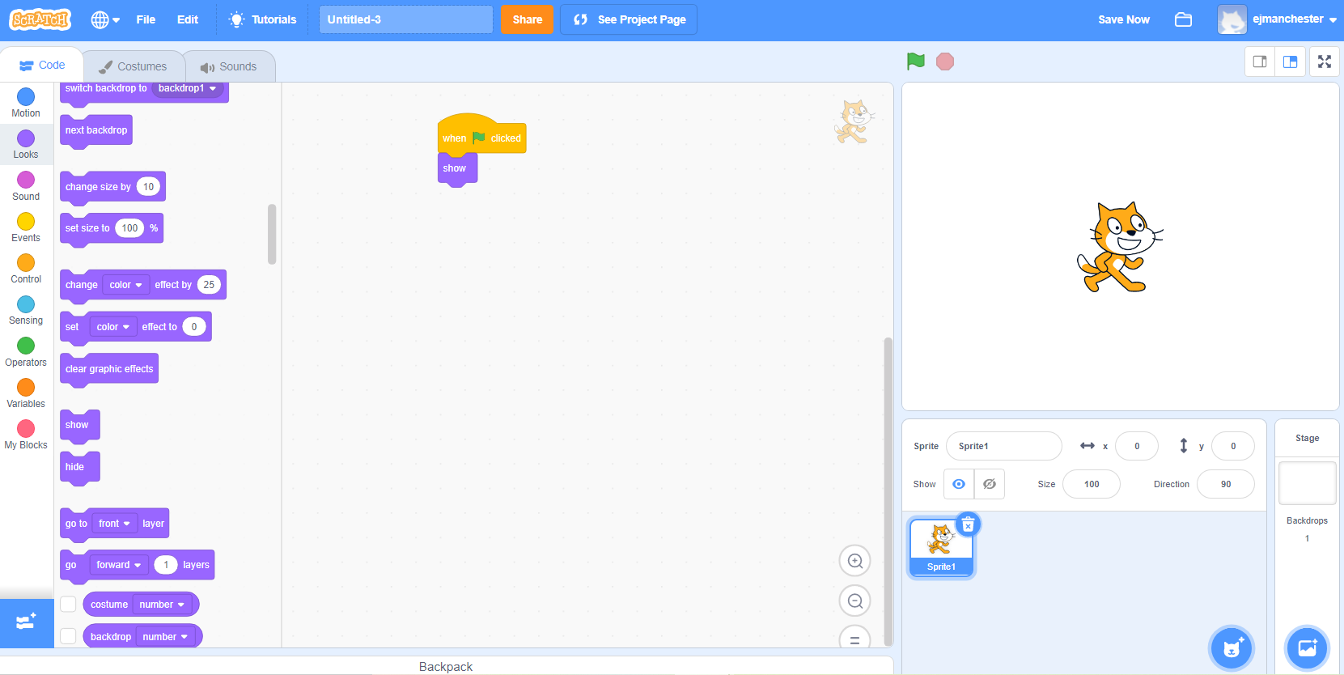
Show character block (explainer video)
Makes your sprite visible.
Notes:
Play Video by clicking on “Explainer Video” on the slide.

Slide 11
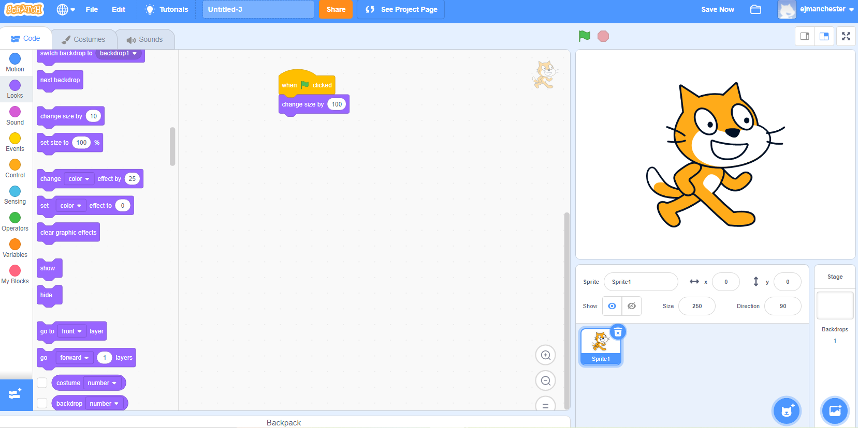
Change size (Explainer video)
Changes the size of your sprite.
Notes:
Play Video by clicking on “Explainer Video” on the slide.

Slide 12
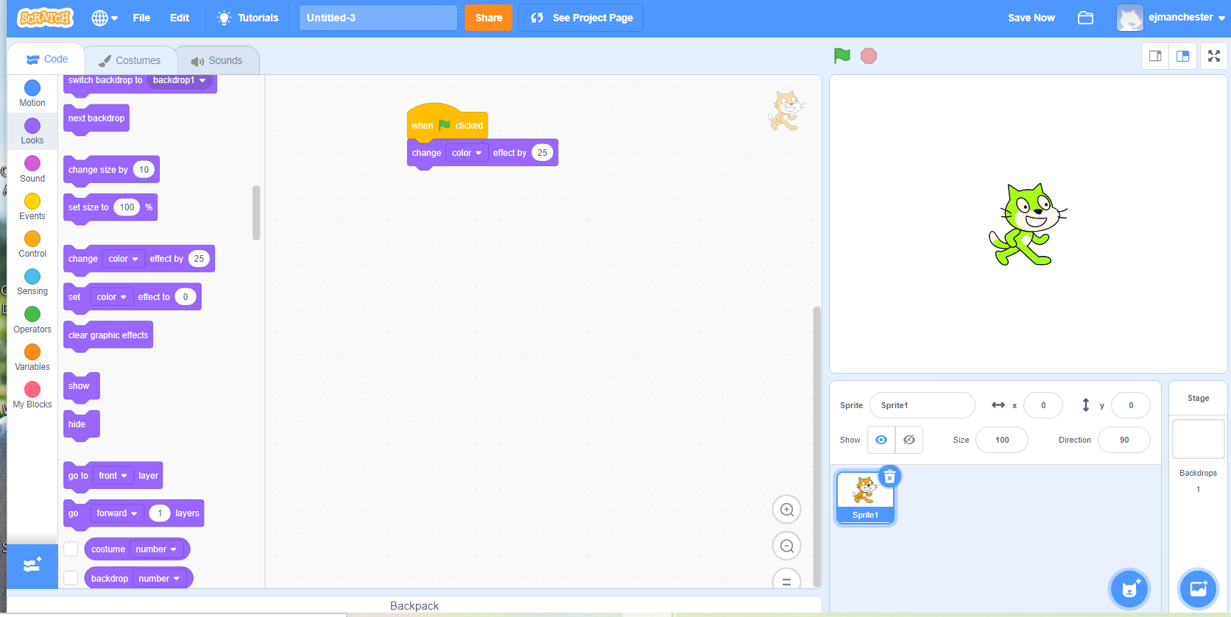
Change color (explainer video)
Changes the color of your sprite.
Notes:
Play Video by clicking on “Explainer Video” on the slide.

Slide 13
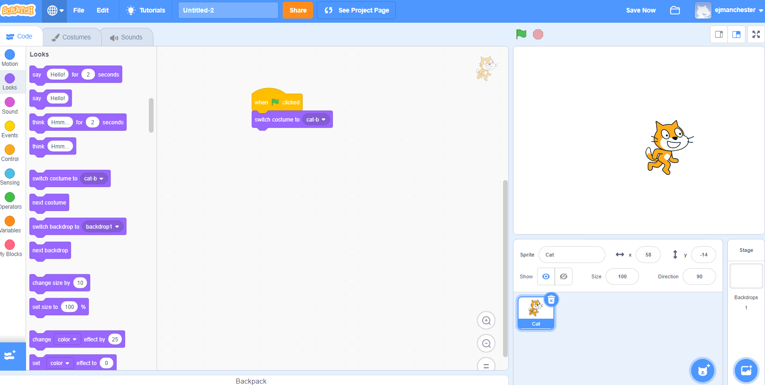
Remember: Switch costume block (explainer video)
Changes the appearance of your sprite.
Notes:
If needed, remind students they learned how to switch their sprite’s costume in U1L2.
Play Video, and explain: It may not be obvious but this cat looks different from the one automatically in scratch. This one looks like it’s running. The “change costume” block in Scratch changes the appearance of your sprite. You can use it to change the appearance of your sprite. This block makes things simpler because we want have to use as many sprites in our project.
Video link: https://www.dropbox.com/s/jdt70o0l0neyk8c/SwitchCostumeCoCo_Nov16.mp4?dl=0

Slide 14
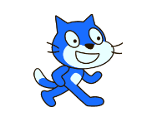
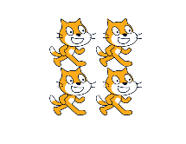
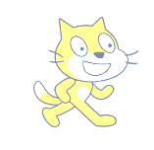
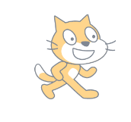
Remember: you can change by multiple effects!
Change whirl effect
Change color effect
Change fisheye effect
Change pixelate effect
Change ghost effect
Change mosaic effect
Change brightness effect
Notes:
If needed, remind students they learned how to switch their sprite’s visual effect in U1L4.
There are many ways we can use this effect. For each of these, the number corresponds to the lowest intensity of each effect. And there are 7 effects to choose from!
Color changes the color.
Fisheye warps the sprite to look like this (point to screenshot)
Whirl warps the sprite another way.
Pixelate makes the sprite look like a video game character.
Mosaic multiples the sprite
Brightness changes the brightness
Ghost

Slide 15
Code an animation of a word
Steps:
Choose your backdrop
Remove the cat sprite
Add the letters of your initials, word, or name–one sprite per letter!
Pick a sound and look block for each letter
Challenge: change the pitch effect on at least ONE of your letters
Optional tutorial video: https://scratch.mit.edu/projects/editor/?tutorial=name

Slide 16
ANy volunteers to share their animations?

Slide 17
Optional “Change sIZE” activity

Slide 18
Change Size
Play the video on the left by right-clicking the link and pasting it into your browser.
Go to the next slide
Place the blocks under the green flag in the correct order by moving them from left to right.
Once the code matches the video, you are done!
You can check your answer by seeing the solution image or clicking the solution link.

Slide 19
Mixed Code
Your Answer

Slide 20
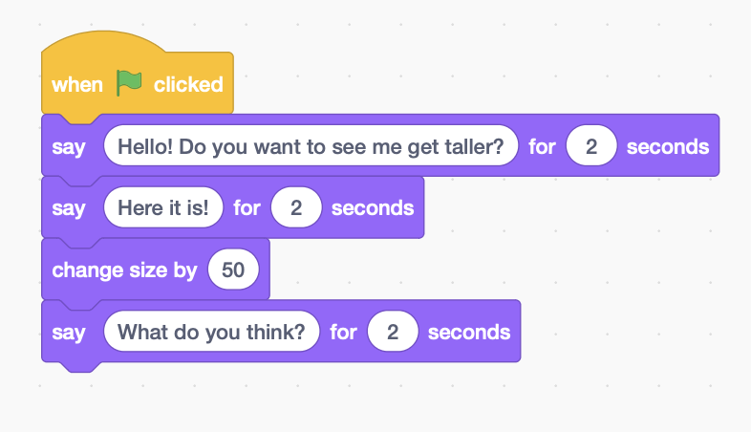
Change Size - Possible Solution

