Slide 1
Lesson 3
Planning & Writing
Grades 5 & 6
Lesson created by the GMU-ODU CSforAll Team. For more information about
this lesson and our CSforAll initiative, contact Dr. Amy Hutchison at achutchison1@ua.edu
Notes:
Good job using CoCo last time! Today, we are each going to write our own recipes and begin planning an animation along with it.

Slide 2
Summary and Standards
Summary:
Students will be introduced to explanatory writing. They will use CoCo to write an original recipe and begin planning how to animate their writing using Scratch.
ELA Standards:
The student will:
Use organizational strategies to structure writing according to type
Use transition words to vary sentence structure
CS Standards:
The student will construct sets of step-by-step instructions (algorithms), both independently and collaboratively
a) using sequencing;
b) using events.
Notes:
Optional: Introduce lesson, learning goals, and resources (Slides # 2-4)

Slide 3
Materials and resources needed for this lesson:
Reminder:
In this lesson, every student should be assigned a story in CoCo using Level 4.
The story should be titled “Lesson 3 Story.”
Each student should save their work using this naming strategy: “Student Name + Lesson # + Descriptor”, for example, “Johnny Lesson 3 Story”
Chromebook/Laptop
Internet Access
Scratch Offline Editor (app)
Teacher slides
CoCo Link
Optional lemonade/Koolaid recipe graphic organizer: https://www.dropbox.com/scl/fi/gr6kvzfrccgeu0zecfyuk/Lemonade-or-Koolaid-recipe.docx?dl=0&rlkey=5sawf7zzyvoovr7p75qi79ka4
Hard copies of the Scratch storyboard/planning document: https://www.dropbox.com/scl/fi/s22kuh51cngvm6b0s991d/Storyboard-for-Scratch-Animation.docx?dl=0&rlkey=4oogl2vwb6mcixdpzed77wu8h
Notes:
Optional: Introduce lesson, learning goals, and resources (Slides # 2-4)
Does everyone have what they need?

Slide 4
Lesson Objectives: I can…
Review familiar Scratch blocks and Computer Science (CS) vocabulary
Identify the purpose and features of explanatory writing
Write a recipe using First, Then, Next, Last, Finally transition words
Add my writing to CoCo
Begin planning my animation
Notes:
Optional: Introduce lesson, learning goals, and resources (Slides # 2-4)

Slide 5
Vocabulary
Explanatory writing
Notes:
And we’ve got one more new vocab word! [read slide]

Slide 6
wARM UP: Review Scratch blocks & vocab
Notes:
Let’s warm-up with a scavenger hunt in Scratch to remember some things in scratch. You will use your student slide deck to work on this while you are looking for things in scratch.

Slide 7
Review Scratch Blocks
Notes:
Lets look closely at these blocks again and what they say-
Click "switch,
Click “think,
Click “turn
“these are commands".

Slide 8
Which command means “go” or “start”?
?
1
2
3
4
hmmm
5
6
Notes:
Look at the blocks on the bottom of the screen, which block is the command that means GO or start in Scratch?
(Read out blocks?)

Slide 9
Which command means “go” or “start”?
?
1
2
3
4
hmmm
5
6
Notes:
Right! The orange block that has a green flag and says “when ‘green flag’ clicked.” This will start or run our code!

Slide 10
Which command would make our sprite move?
?
1
2
3
4
hmmm
5
6
Notes:
Which command will make our sprite MOVE?

Slide 11
Which command would make our sprite move?
?
1
2
3
4
hmmm
5
6
Notes:
Correct, the blue block that says, “move ___ Steps” You would enter a number in the blank white oval to tell the sprite how many steps to move!

Slide 12
Which command would make our sprite talk or make noise?
?
1
2
3
4
hmmm
5
6
Notes:
Which command would make our sprite talk or make noise?

Slide 13
Which command would make our sprite talk or make noise?
?
1
2
3
4
hmmm
5
6
Notes:
Right! The purple “Say ____ for ____ secs” will tell your sprite to “say something. You would need to type in the text you want your sprite to say in the first space and the amount of “seconds” you want the sprite to speak in the next space.

Slide 14
Which command would make our sprite think?
?
1
2
3
4
hmmm
5
6
Notes:
Which command would make our sprite talk or make noise?

Slide 15
Which command would make our sprite think?
?
1
2
3
4
hmmm
5
6
Notes:
Right! The purple “Say ____ for ____ secs” will tell your sprite to “say something. You would need to type in the text you want your sprite to say in the first space and the amount of “seconds” you want the sprite to speak in the next space.

Slide 16
Let’s review: match each vocab word to its definition
Code
Algorithm
Commands
Decomposition
Abstraction
Tell a person or a computer what to do.
identifying what is important and leaving out information we do not need.
breaking a large problem into smaller parts
Computer scientists write these instructions to tell a computer what to do.
A list of steps to finish a task
Notes:
Let’s review vocab from last lesson.

Slide 17
Let’s review: match each vocab word to its definition
Code
Algorithm
Commands
Decomposition
Abstraction
Tell a person or a computer what to do.
identifying what is important and leaving out information we do not need.
breaking a large problem into smaller parts
Computer scientists write these instructions to tell a computer what to do.
A list of steps to finish a task
Notes:
Here are the answers!

Slide 18
Lesson Objectives: I can…
Review familiar Scratch blocks and Computer Science (CS) vocabulary
Identify the purpose and features of explanatory writing
Write a recipe using First, Then, Next, Last, Finally transition words
Add my writing to CoCo
Begin planning my animation
Notes:
Check off objectives as lesson proceeds.

Slide 19
Coco helps us plan our writing & our code
Notes:
Today you are going to be using CoCo again to help plan your writing and your code.

Slide 20
What is explanatory writing?
Explanatory writing:
Explains something to someone or helps them understand how to do something. So it is important to provide many details!
Is written in a specific order or sequence
A sequence is a set of things that follow each other in a particular order, where order matters!
Often uses sequencing words such as first, next, then and last to communicate the correct order of steps, also known as their sequence
Notes:
Specifically, we are all going to write a piece of explanatory writing. Explanatory writing….[read slide]

Slide 21
First
Then
Next
Last
Finally
Notes:
It uses transition words that help the reader understand the sequence of commands. Where have you seen these before? [pause] That’s right! In CoCO!

Slide 22
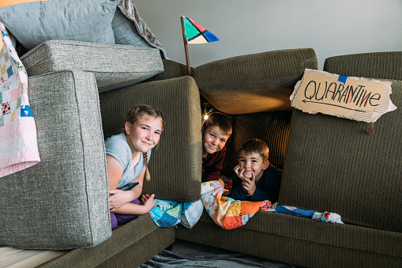
Can you think of other examples of explanatory writing?
We may wish to write about how to….
Get somewhere (directions)
To the cafeteria
The park in your neighborhood
Do something (instructions)
Build a fort in your living room
Do a dance
Shoot a basketball or kick a soccer ball
Create a craft
Explain something
How your family celebrates the holidays
About someone important to you or someone famous
How something happens, such as photosynthesis or the water cycle
Notes:
There are lots of times when you may wish to explain something to someone! [read slide]

Slide 23
How to write an explanatory text
Brainstorm: What do you want to share?
Plan: What does your reader need to know? How should you organize your information?
Graphic Organizers can help (Coco)
Write!
Be clear and specific
Use transition words
Debug and Edit
Look for mistakes or things that don’t make sense.
Fix your mistakes
Notes:
And there are series of steps we want to follow when writing [read slide]

Slide 24
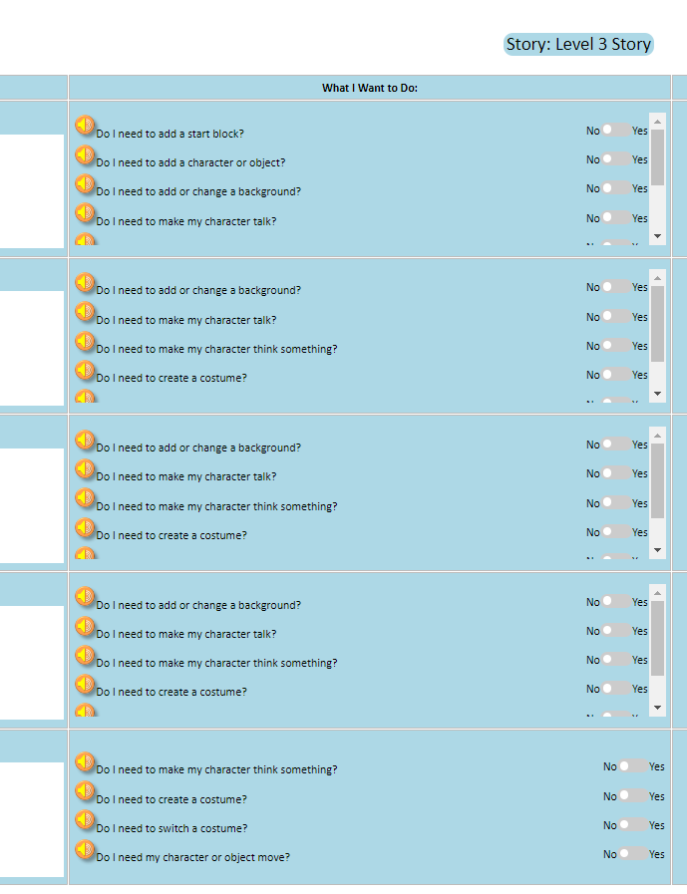
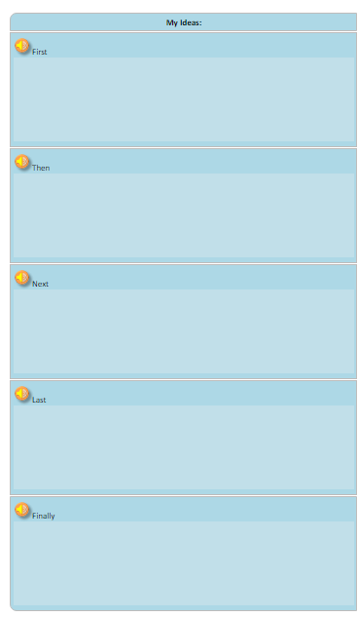
CoCo is a graphic Organizer
CoCo helps us organize our writing and plan out our animation in Scratch.
Notes:
One great graphic organizer that helps us with this process is Coco. Coco is also helpful because it not only helps us plan our writing but also how we are going to share our writing virtually in a Scratch animation!

Slide 25
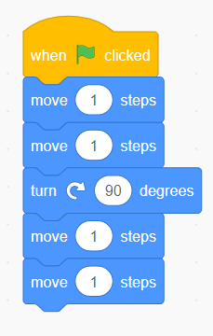
Algorithms and Explanatory Writing
Use the correct sequence
Be clear and precise
Just like an algorithm, explanatory writing explains the steps or instructions for doing something.
Explanatory writing is also written in a specific order or sequence, just like an algorithm.
First
Next
Notes:
Remember: Algorithms and explanatory writing are very similar. They both explain a sequence of steps or events. And they both need to be clear so that others, people or computers, can follow those steps.

Slide 26
Lesson Objectives: I can…
Review familiar Scratch blocks and Computer Science (CS) vocabulary
Identify the purpose, features, and process of explanatory writing
Write a recipe using First, Then, Next, Last, Finally transition words
Add my writing to CoCo
Begin planning my animation in CoCo
Notes:
Check off objectives as lesson proceeds.

Slide 27
Independent practice

Slide 28
Independent practice
Write a recipe for making a drink either by using the template provided by your teacher or directly in CoCo.
You may choose to write about lemonade, Koolaid, or another drink of your choice!
https://www.dropbox.com/scl/fi/qf1j67ajoq6tu0gacc460/Lemonade-or-Koolaid-recipe.docx.docx?dl=0&rlkey=4vm66w2jppnter0oqmgmw8i2t
Notes:
In a moment, you will navigate to your student slide deck. In the deck is an outline for you. You will choose whether you want to write instructions for making lemonade or tea. Then you will type you instructions in. There is also a link to this document in the handouts, for the option to hand write your instructions. Your teacher will let you know what to do next.

Slide 29
Remember!
Recipes are a type of explanatory writing.
Pay close attention to your transition words:
First
Then
Next
Last
Finally
Make sure your directions are in the correct sequence.
Notes:
Remind students of explanatory writing and the sequence of transition words we have used

Slide 30
Lesson Objectives: I can…
Review familiar Scratch blocks and Computer Science (CS) vocabulary
Identify the purpose, features, and process of explanatory writing
Write a recipe using First, Then, Next, Last, Finally transition words
Add my writing to CoCo
Begin planning my animation in CoCo
Notes:
Check off objectives as lesson proceeds.

Slide 31
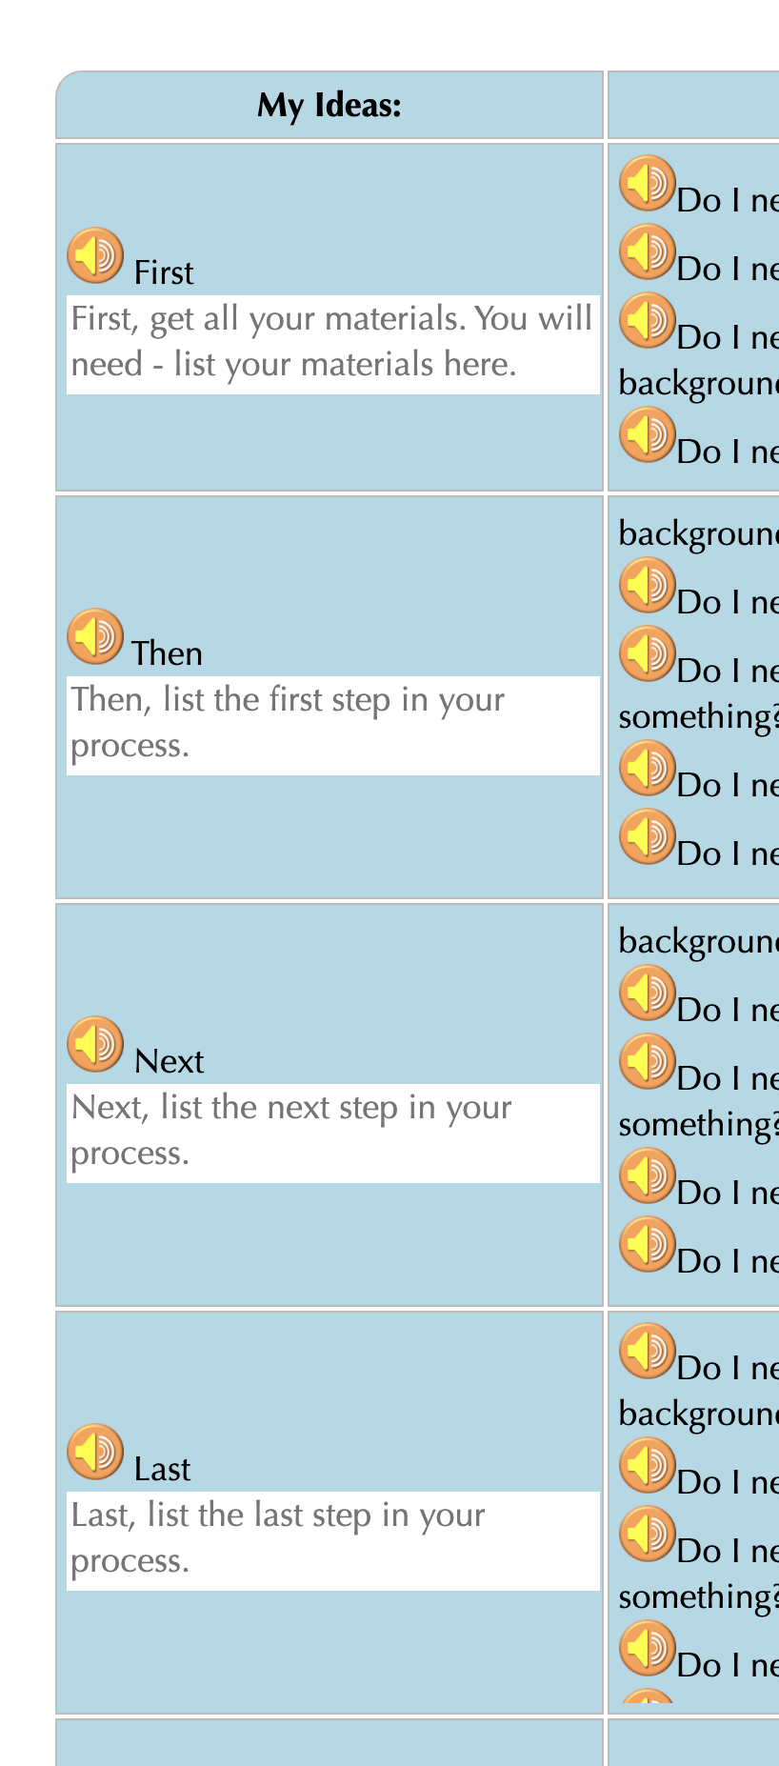
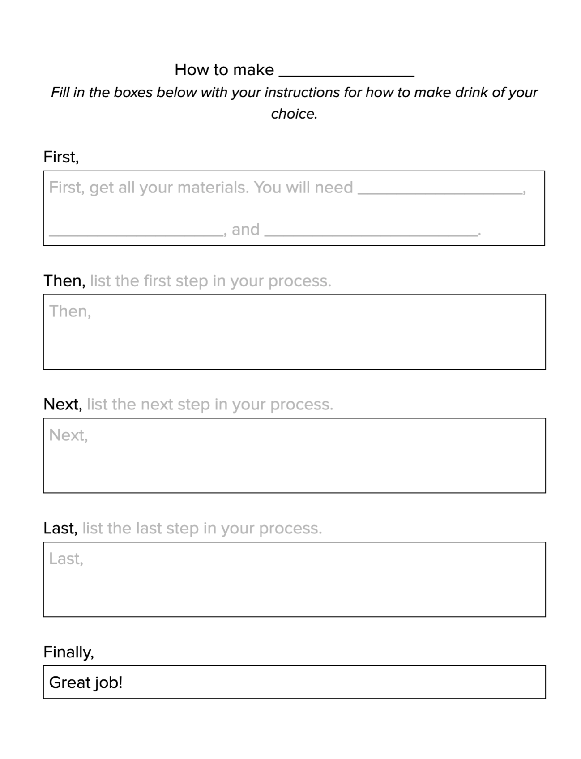
Add Your writing to coco
Steps:
Log In to CoCo
Select “level 4” from the drop-down menu
Type your recipe into the text boxes provided under First, Then, Next, Last
Notes:
Now you will log into CoCo and select Level 4 from the drop-down menu. Then, type your recipe into the text boxes.
CoCo link: https://wego.gmu.edu/scratchgo/login.php

Slide 32
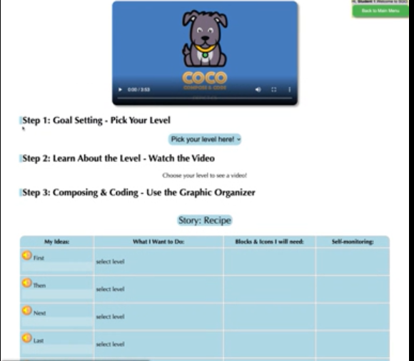
Optional Videos
Overview of CoCo level 4: https://www.dropbox.com/s/2lsly3hgelvw3hg/Review%20of%20level%204.webm?dl=0
Adding our text to CoCo: https://www.dropbox.com/s/h0yeiv8ckvghmjk/Adding%20Our%20Text%20to%20Coco.webm?dl=0
Notes:
Optional support videos

Slide 33
Pause here and Add your Writing to Coco
Notes:
Alright class, pause here and add your recipe to CoCo.

Slide 34
Instructions
Add your writing to CoCo column 1
Plan your animation
Use CoCo to pick Scratch blocks for your animation
Notes:
Next we will plan our animation and use CoCo to pick the correct Scratch blocks.

Slide 35
PLan your animation
Notes:
Now that you’ve got more Scratch commands in your toolkit, we are going to start planning out what we are going to do in Coco and, eventually Scratch, to animate our explanatory writing from last time. We are going to use another graphic organizer to plan.
In a moment, your teacher will give you a planning document to start planning out each step. It includes a list of the options in CoCo’s “What I want to do” column because this tool will help you keep track of your commands as you begin working in Scratch.

Slide 36
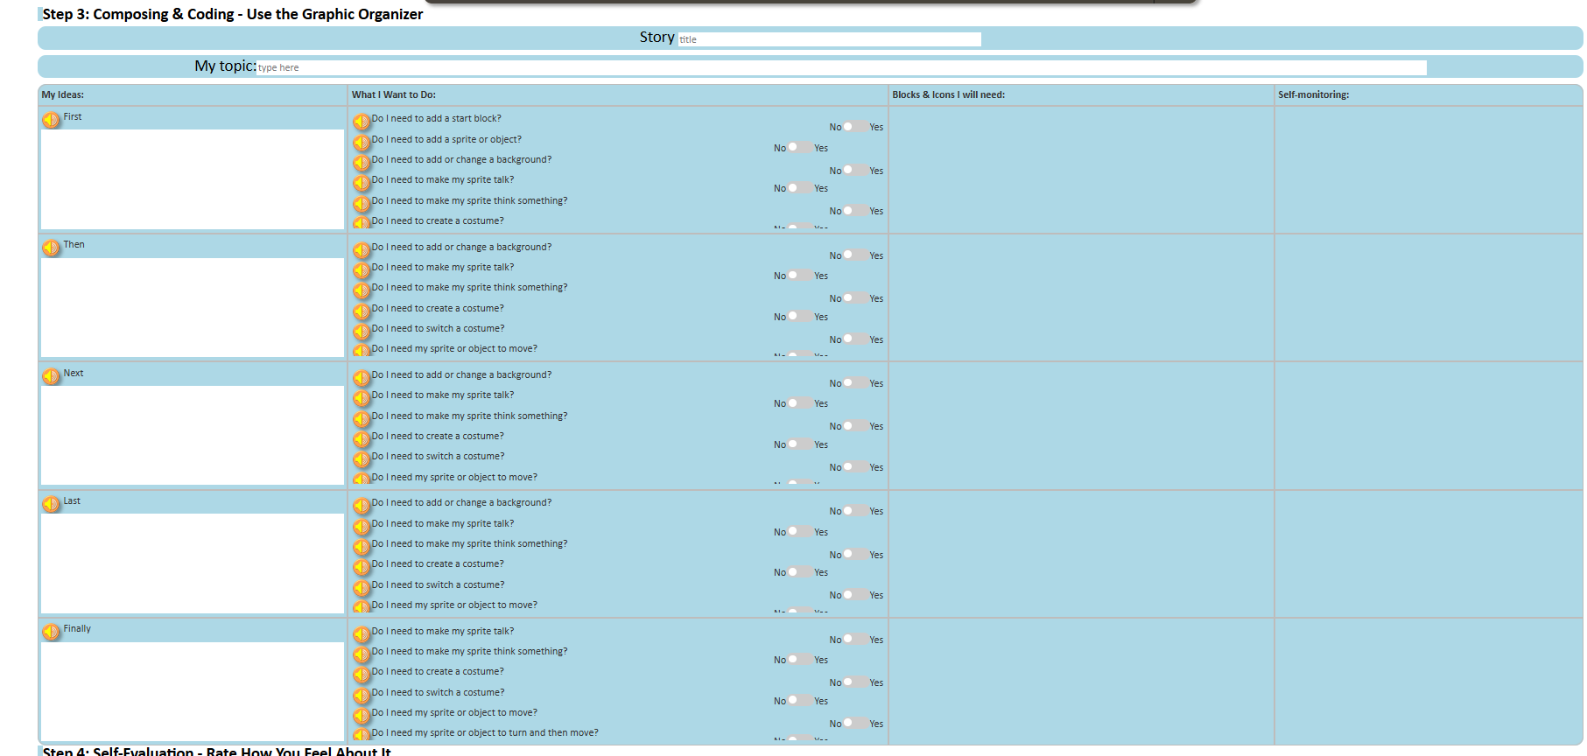
Remember Coco’s four columns!
Always include a topic sentence!
Can write any kind of ordered story–not just recipes! Many Scratch block options!
Notes:
Remind students of CoCo’s four columns and their purposes.

Slide 37
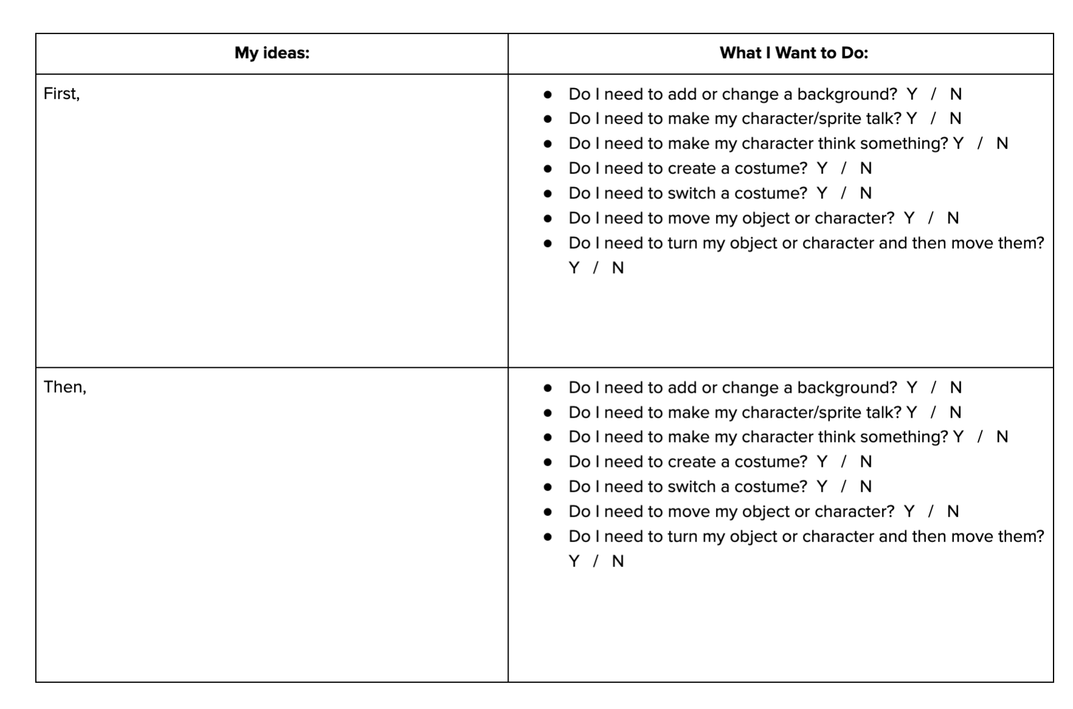
How to use the Planning Document
Instructions
Use this document to plan your Scratch animation.
In each box below, draw a picture of how you’d like to illustrate each part of the story you’ve written.
But remember: use only the Scratch blocks in CoCo. They are:
Add or change a background
Make my character/sprite talk
Make my character think something
Create a costume
Switch a costume
Move my object or character
Turn my object or character and then move them
Notes:
To use the planner, you will draw out what you want to happen in each step of your writing. Then, think about what you will need to accomplish this step.
Link: https://www.dropbox.com/s/i8e3s7zz5e01a88/U3L2_Storyboard%20for%20Scratch%20Animation.docx?dl=0

Slide 38
Lesson Objectives: I can…
Review familiar Scratch blocks and Computer Science (CS) vocabulary
Identify the purpose, features, and process of explanatory writing
Write a recipe using First, Then, Next, Last, Finally transition words
Add my writing to CoCo
Begin planning my animation
Notes:
Check off objectives as lesson proceeds.

Slide 39
Wrap up
Computational thinking means “thinking like a computer scientist.”
We’ve learned about these computational thinking skills:
Pattern recognition
Sequencing
Creating algorithms
Abstraction
Decomposition
Which one of these is your favorite?
Notes:
[read slide]

