Slide 1
Unit 1 Lesson 4
Planning and Writing with CoCo Level 2
3rd & 4th Grade
5th & 6th grade
Lesson created by the GMU-ODU CSforAll Team. For more information about
this lesson and our CSforAll initiative, contact Dr. Amy Hutchison at ahutchison1@ua.edu

Slide 2
Summary and Standards
Summary:
In this lesson, students will In this lesson, students will add their instructions for making a drink to CoCo and revise their writing based on peer feedback.
ELA Standards:
The student will:
Use organizational strategies to structure writing according to type
Use transition words to vary sentence structure
CS Standards:
The student will construct sets of step-by-step instructions (algorithms), both independently and collaboratively
a) using sequencing;
b) using events.

Slide 3
Materials and resources needed for this lesson:
Teacher slide deck
Student slides: https://www.dropbox.com/scl/fi/de1z03f9c70noewlruvvm/Student-Copy-Unit-1-slides.pptx?dl=0&rlkey=w9yoeuxwm5aojjbhw6jteslja#slide=id.g126585dc664_2_259
Chromebook/Laptop
Internet Access
Link to CoCo: https://wego.gmu.edu/scratchgo/login.php
Link to Scratch: https://scratch.mit.edu/
Reminder:
In this lesson, every student should be assigned a story in CoCo using Level 2.
The story should be titled “Unit 1 Drink Recipe”
Each student should save their work using this naming strategy: “Student Name + Unit # + Descriptor”, for example, “Johnny Unit 1 Drink Recipe”

Slide 4
wARM UP: Scratch Scavenger HUnt
Notes:
Let’s warm-up with a scavenger hunt in Scratch to remember some things in scratch. You will use your student slide deck to work on this while you are looking for things in scratch.

Slide 5
Warm up
Open your slide deck and navigate to the last slide.
Visit scratch.mit.edu to figure out how to do each task.
Drag the blue box to the correct item.
Pause here (10 minutes)
Notes:
Ok, so you will [read slide]
Pause here while you work

Slide 6
Supercoders, move the blue boxes to the right answer.
Which one of these is the start block?
Which one of these is the wait block?
Is the think block purple?
True
False
Which one of these is the choose a sprite block?
Is the move block colored yellow, purple, or blue?
yellow
purple
blue
Which block allows you to switch to a new costume?
Notes:
In a moment, I will share the slide deck with you and you will see a screen like this. You will drag the blue box to the correct answer. You may also want to navigate to Scratch on your device if you can’t remember how to do some of these things in Scratch. Once you are done, we will go over the answers together!
Acknowledgments: Adapted from CS+Fables

Slide 7
Answer Key:
Which one of these is the start block?
Which one of these is the wait block?
Is the think block purple?
True
False
Which one of these is the choose a sprite block?
Is the move block colored yellow, purple, or blue?
yellow
purple
blue
Which block allows you to switch to a new costume?
Notes:
Check to see if your answers were correct.

Slide 8
Lesson Objectives
Review planning tools (graphic organizers) and their purpose
Locate features in Coco Level 2
Review my writing with a partner and revise my writing, as needed

Slide 9
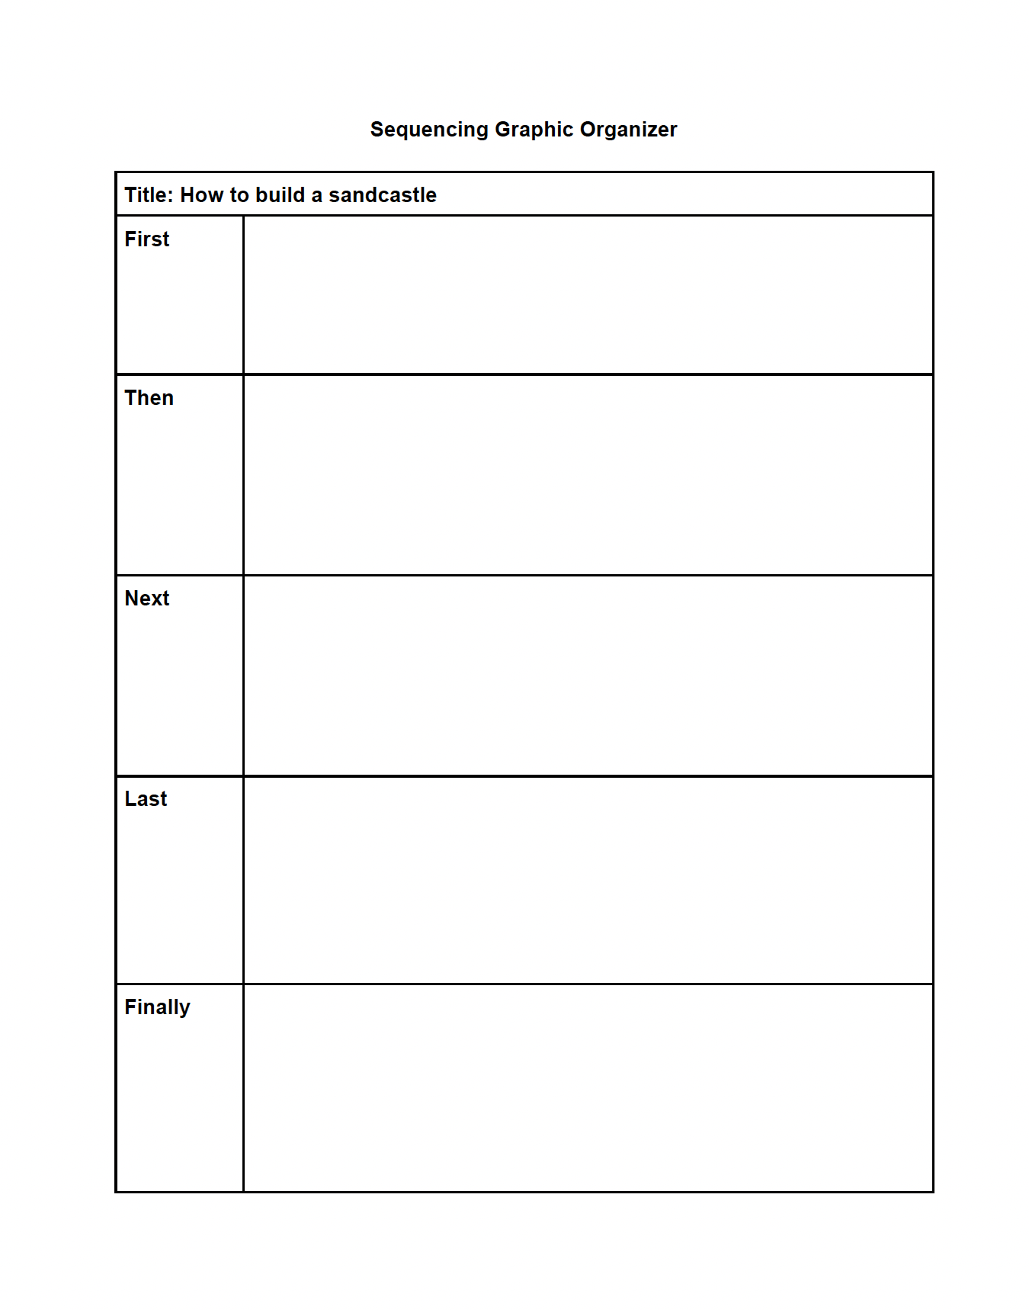
Graphic Organizers for writing
Notes:
The graphic organizers you have used before helped you brainstorm and eventually write. But now you are going to use a graphic organizer to help take your writing one step further to the final step of the writing process: to present and publish your writing with Scratch! Using Scratch to animate your writing is one way to publish, or share, your work.

Slide 10
Coco helps us plan our writing & our code
Notes:
Today you are going to be using CoCo again to help plan your writing and your code.

Slide 11
Introducing “Change effect” Block
Notes:
But first, we are going to learn a new block.

Slide 12
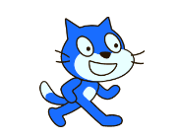
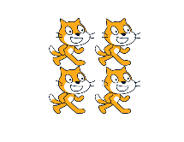
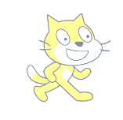
Change ___________ effect
Change fisheye effect
Change whirl effect
Change color effect
Change pixelate effect
Change ghost effect
Change mosaic effect
Change brightness effect
Notes:
There are many ways we can use this effect. For each of these, the number corresponds to the lowest intensity of each effect. And there are 7 effects to choose from!
Color changes the color.
Fisheye warps the sprite to look like this (point to screenshot)
Whirl warps the sprite another way.
Pixelate makes the sprite look like a video game character.
Mosaic multiples the sprite
Brightness changes the brightness
Ghost

Slide 13
Practicing using change effect block
Imagine your sprite going through a time warp. How does its appearance change?
Change the effect by a minimum intensity of 50
Use at least 4 different effects on your sprite. This means you need to use at least 4 change effect blocks in your code.
(Optional) You may also include speech or thought bubbles to represent your sprite’s thoughts as it goes through the time warp!

Slide 14
Introducing CoCo level 2

Slide 15
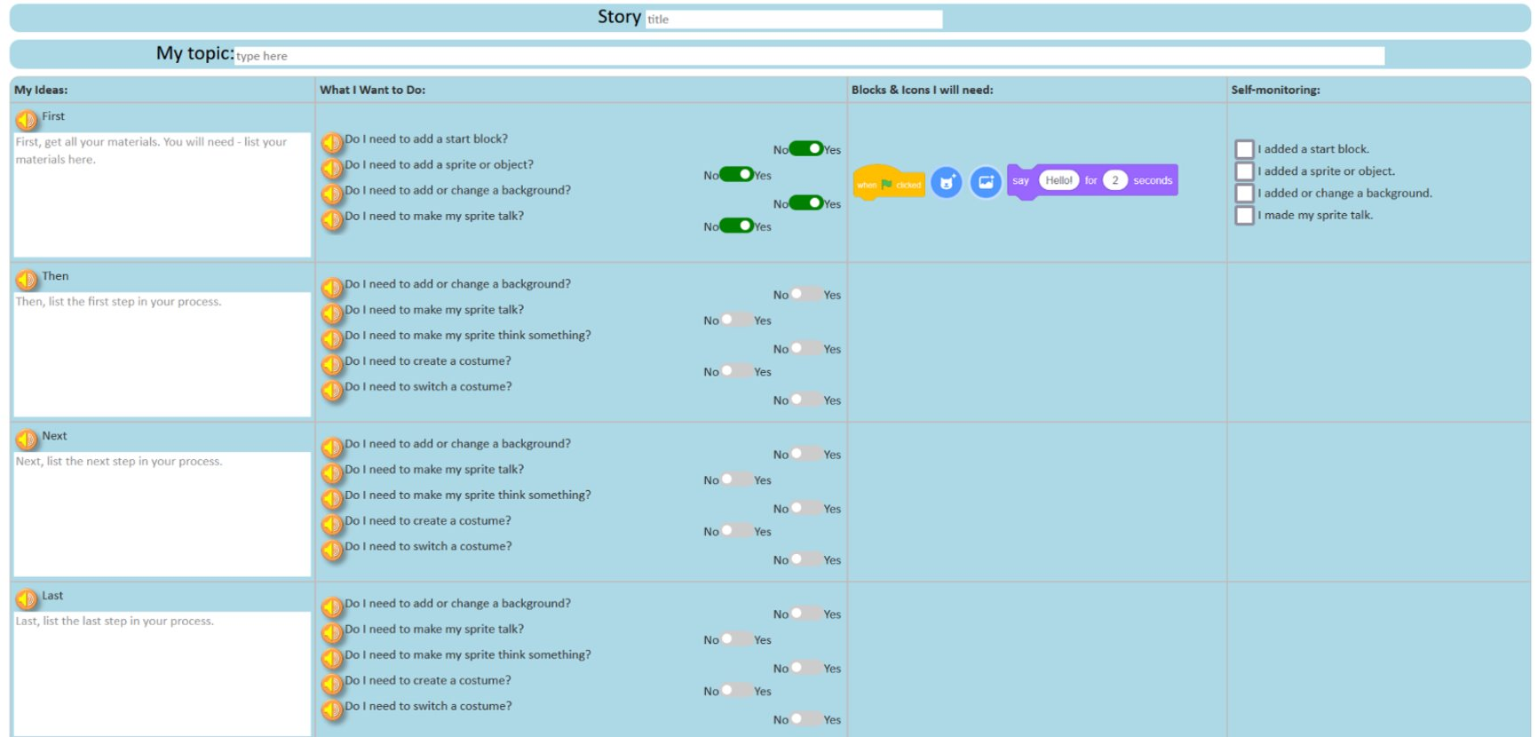
What’s in level 2?
Don’t forget to add a topic sentence introducing your topic to the reader!
Note: Just start typing in the white text boxes! No need to delete anything, the grey text will disappear when you start to type.
Notes:
In level 2 of CoCo, you are able to fill in column 1 with your OWN writing. You also have more options in the middle for choosing your Scratch blocks. We’ll learn more about each of these.
Also, when you are ready to add your text. You do not need to delete the grey text. It will go away once you begin typing.
Let’s start by watching a video on how we can fill in column one with our own writing.

Slide 16
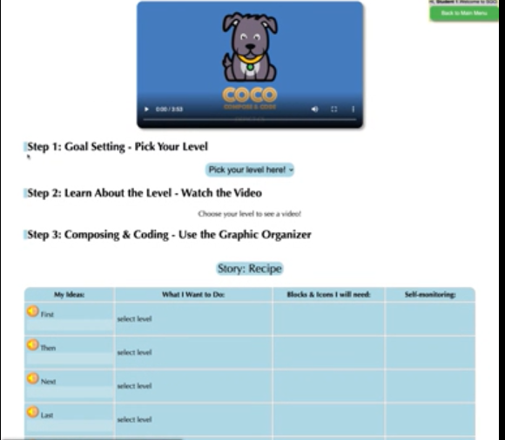
Video Model: https://www.dropbox.com/s/ie4npcoul3pg30c/Adding%20Our%20Text%20to%20Coco.webm?dl=0
Notes:
Play video: https://www.dropbox.com/s/vnsxt5jedaudl79/Adding%20Our%20Text%20to%20Coco.webm?dl=0

Slide 17
Modeling Coco
Today, you will use CoCo to animate your drink recipe you wrote last time.
Our first step is to fill in CoCo level two with the text of our recipe.
Notes:
You will need your recipe from last time for our next step. If you are not sure where your recipe is from last time, pause here to get it ready.
CoCo link: https://wego.gmu.edu/scratchgo/login.php

Slide 18
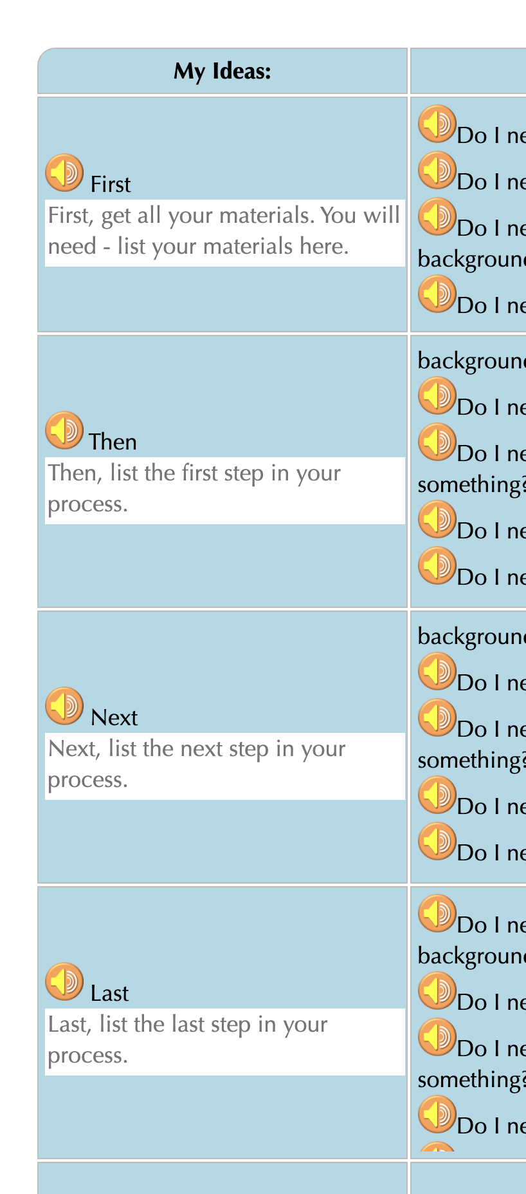
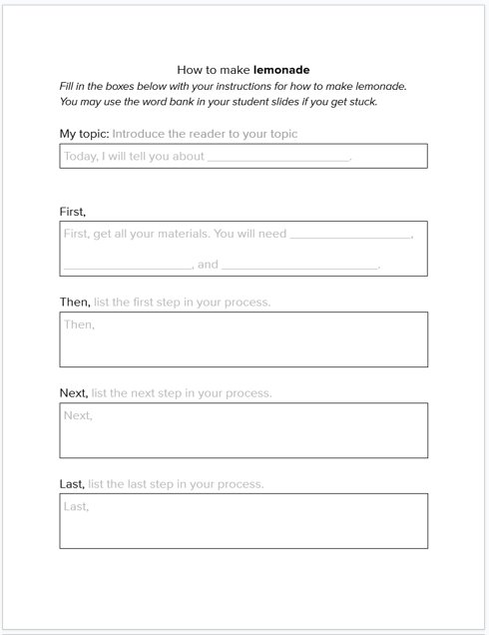
Add Your writing to coco
Steps:
Log In to CoCo
Select “level 2” from the drop-down menu
Type your recipe into the text boxes provided under First, Then, Next, Last
Notes:
Now you will log into CoCo and select Level 2 from the drop-down menu. Then, type your recipe into the text boxes.

Slide 19
Remember!
Recipes are a type of explanatory writing.
Pay close attention to your transition words:
First
Then
Next
Last
Finally
Make sure your directions are in the correct sequence.
Notes:
Remind students of explanatory writing and the sequence of transition words we have used

Slide 20
Pause here and Add your recipe instructions in Coco Level 2.

Slide 21
Turn & Talk:
Read your instructions out loud to a partner. Is anything unclear? Revise if necessary.

Slide 22
Next time...
Notes:
Great job today! Next time, we will go back into Coco and Scratch to finish animating our drink recipe instructions. Thanks for learning with me today!

