Slide 1
Unit 2 Lesson 3
PLanning and writing with Coco level 3
3rd & 4th Grade
Lesson created by the GMU-ODU CSforAll Team. For more information about
this lesson and our CSforAll initiative, contact Dr. Amy Hutchison at achutchison1@ua.edu

Slide 2
Summary and Standards
Summary:
In this lesson, students will be using Coco, the graphic organizer, to code an animation in Scratch of their instructional writing.
2017 VDOE ELA Standards:
The student will continue to read and demonstrate comprehension of nonfiction texts
The student will write for a variety of purposes.
e) Use strategies for organization of information and elaboration according to the type of writing.
The student will use available technology for reading and writing.
CS Standards:
The student will construct sets of step-by-step instructions (algorithms), both independently and collaboratively
a) using sequencing;
b) using events.
The student will break down (decompose) a larger problem into smaller subproblems, independently or collaboratively.
Notes:
Today we are going to use Coco, the graphic organizer, to help guide us in animating our instructional writing in Scratch.

Slide 3
Materials and resources needed for this lesson:
Personal Computer
Access to the internet
Scratch
Coco
CoCo level 3, column one (filled in)
Reminder:
In this lesson, every student should be assigned a story in CoCo using Level 3.
The story should be titled “Unit 2 Story.”
Each student should save their work using this naming strategy: “Student Name + Unit # + Descriptor”, for example, “Johnny Unit 2 Story”
Notes:
In order to do today’s lesson, you will need..

Slide 4
CoCo continues to help us!
Today, you will use Coco to help you code your instructional animation in Scratch!
Open a tab with Coco
Open a tab with Scratch
Use column 3 of Coco to find the blocks in Scratch we need for each step.
Check off the self-monitoring before we move to next step.
Notes:
[Read slide] Let’s look at the first two steps now...

Slide 5
Pause here and log into Coco and Scratch

Slide 6
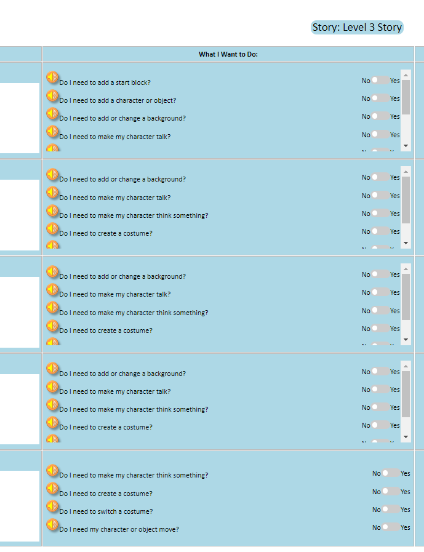
Level 3 in Coco
Do I need to add a start block?
Do I need to add a character or object?
Do I need to add or change a background?
Do I need to make my character talk?
Do I need to make my character think something?
Do I need to create a costume?
Do I need to switch a costume?
Do I need my character or object move?
Do I need my character or object to turn and then move?
Notes:
In level 3 of Coco, you will be introduced to some new ways to use Scratch to animate your explanatory writing. In this level, you have more options for how you will animate your writing in Scratch. Let’s look at these new questions together. These questions are from our very first row in Coco. (Read questions) In level 2, you did not need to decide what happened in the first row but in level 3 you will. Remember, you will always need to add a start block or your code will not work!

Slide 7
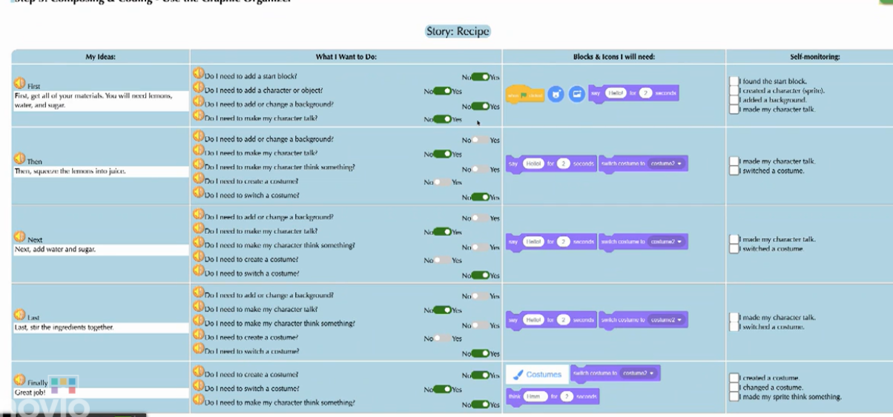
Video Model
Video on CoCo level 3 and Scratch

Slide 8
Did you add your writing to coco column 1?

Slide 9
Instructions
Add your writing to CoCo column 1
Plan your animation
Use CoCo to pick Scratch blocks for your animation

Slide 10
Get ready to create!
Notes:
Now that you’ve got more Scratch commands in your toolkit, we are going to start planning out what we are going to do in Coco and, eventually Scratch, to animate our explanatory writing from last time. We are going to use another graphic organizer to plan.
In a moment, your teacher will give you a planning document to start planning out each step. It includes a list of the options in CoCo’s “What I want to do” column because this tool will help you keep track of your commands as you begin working in Scratch.

Slide 11
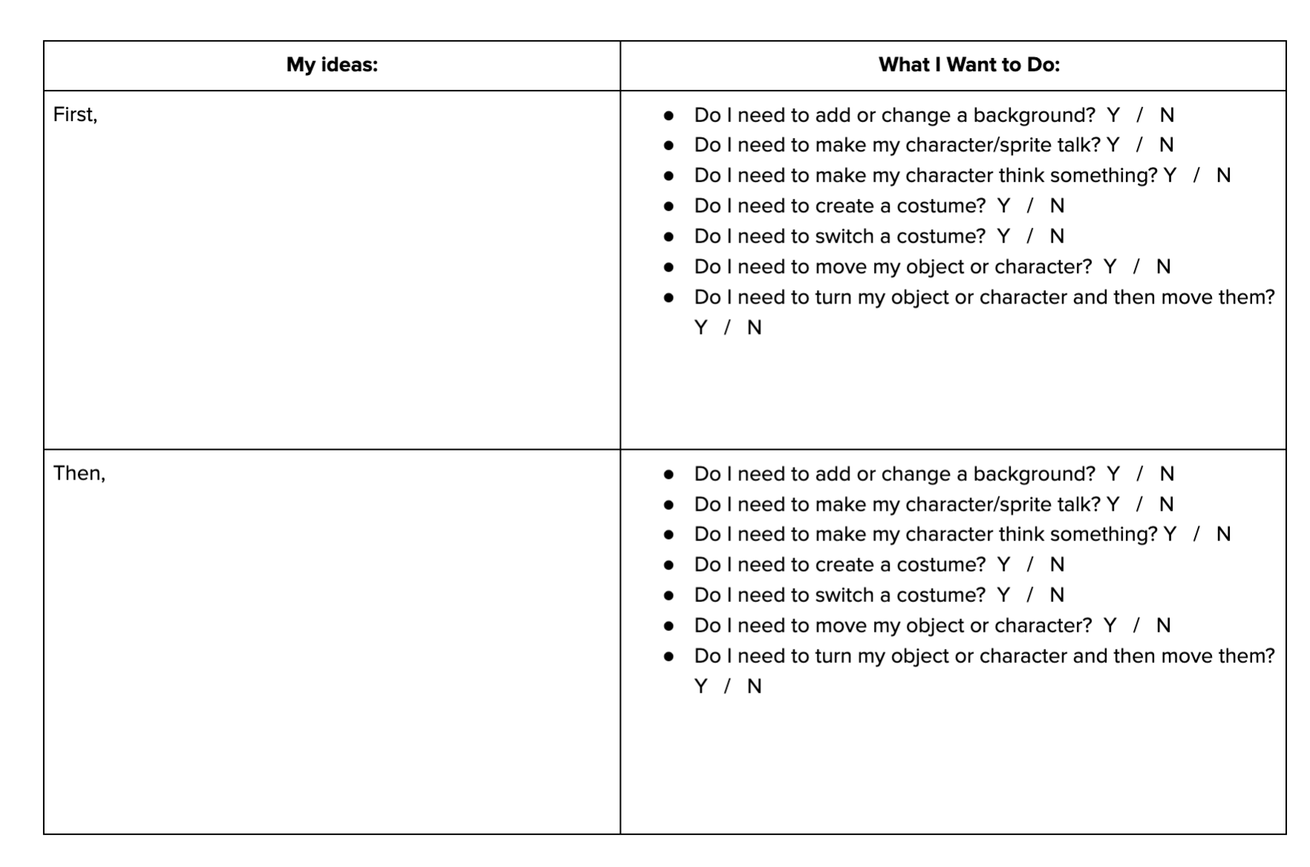
How to use the Planning Document
Instructions
Use this document to plan your Scratch animation.
In each box below, draw a picture of how you’d like to illustrate each part of the story you’ve written.
But remember: use only the Scratch blocks in CoCo. They are:
Add or change a background
Make my character/sprite talk
Make my character think something
Create a costume
Switch a costume
Move my object or character
Turn my object or character and then move them
Notes:
To use the planner, you will draw out what you want to happen in each step of your writing. Then, think about what you will need to accomplish this step.
Link: https://www.dropbox.com/s/i8e3s7zz5e01a88/U3L2_Storyboard%20for%20Scratch%20Animation.docx?dl=0

Slide 12
Pause here and work on your Planner
Notes:
storyboarding!

Slide 13
Great Job!
Notes:
Great job! Hopefully you were able to complete your planner and you have a good idea how your animation might look in scratch.

Slide 14
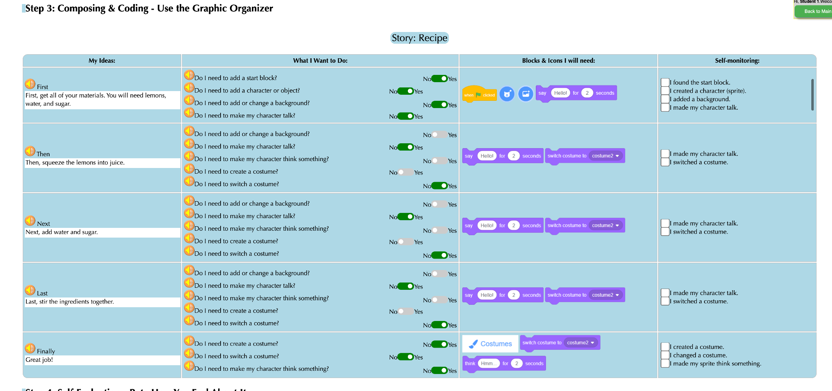
Plan your animation in Coco
Notes:
Now that you’ve got a vision for how you want your animation to look, use CoCo to find the right Scratch blocks. But remember! Make sure your animation closely matches your writing.

Slide 15
Before you begin to code….
Make sure you have a topic sentence
Match your animation to your writing
Be consistent
Match your visuals to your text
Notes:
In Unit 1, we learned that we want to a) match your animation to your writing, b) be consistent, and c) make sure all the visuals in the frame make sense given what you have written in your text.

Slide 16
You can use Scratch to enhance your animation
aLL ADDITIONAL DETAILS MUST BE RELEVANT!
Notes:
Remember how we searched for unique sprites and backdrops? And we also learned how to upload our own sprites and sounds. So there are many ways we can use Scratch to enhance our animations, or make them more exciting! We can add more details to our animations as long as we make sure that the details are relevant.

Slide 17
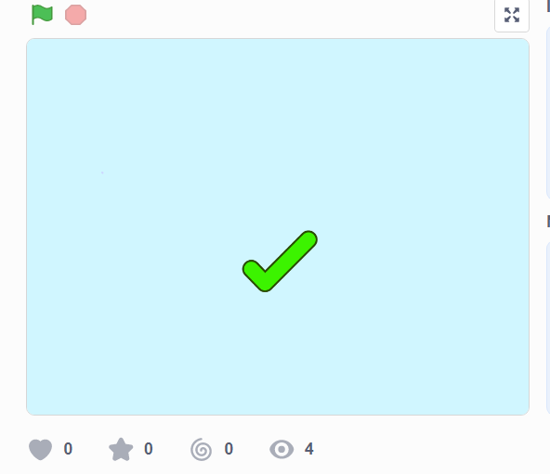
Like this:
https://www.dropbox.com/s/jlist1zaujjpc8e/Screen%20Recording%202023-09-18%20at%209.21.46%20PM.mov?dl=0
Notes:
For example, here’s an animation of the hot chocolate recipe that does a really great job enhancing the recipe with additional details to help the viewer imagine a person actually making hot chocolate! Let’s take a look and see what they did.
[play/run scratch project]
The first thing we notice is that this computer scientist added images of real-life materials rather than cartoons. This detail enhances the animation but does not change the meaning. They also drew an arrow to show where the mix would go into the cup. FInally, they coded the objects to move and simulate the actual “making” of the drink. But nothing about the meaning changed! And it was not distracting.

Slide 18
However!
Too many visuals can be confusing
Notes:
Let’s look at another example, where the additional details were not relevant and thus confusing…..

Slide 19
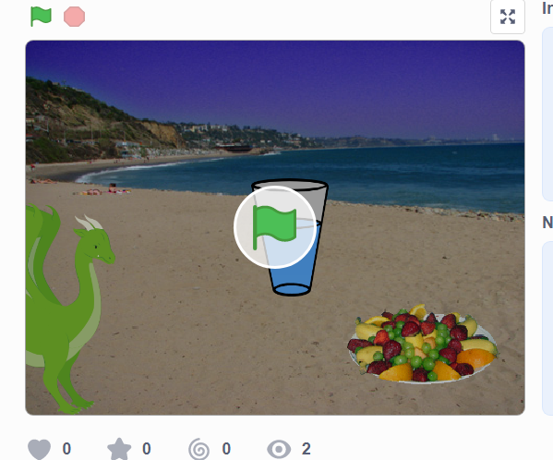
Not like this
https://www.dropbox.com/s/jlist1zaujjpc8e/Screen%20Recording%202023-09-18%20at%209.21.46%20PM.mov?dl=0
Notes:
All the written text is the same but the images don’t match the text. For example, why is there a dragon in the screen? Why are they at the beach? And why does it show a glass of water instead of hot chocolate? It may seem funny but to a new viewer, it would be very confusing. We dont want that.

Slide 20
Continue planning in Coco and Code in Scratch,
Check your self-Monitoring Checklist
Notes:
With that in mind, continue using CoCo to plan your animation. Please be creative but make sure your details are relevant and enhancing! Not confusing.

Slide 21
Optional Instructions
Watch this video on how to add a back drop, sprite, and other information from first row of CoCo
Add content from the first row of CoCo to Scratch as practice
Watch this video about how to transfer the remaining content from CoCo to Scratch and use the self-monitoring column
Transfer the rest of your content from CoCo to Scratch.

Slide 22
Last step, Self Evaluation
Notes:
Pause here and work! (20-30 minutes)?

Slide 23
Video Model
Self-Evaluation Tutorial

Slide 24
Share your work:
Find a partner and share your animation.
Share what you learned and something you might want to try differently.
Pause and share

Slide 25
Revise your writing & Scratch Project
Notes:
Based on your peer’s feedback!

Slide 26
Sharing your .sb3 file from CS First to CoCo
Create the file in CS First
In the Scratch editor, find the word “File” in the top-left corner.
Click on “File” menu and you’ll see some choices pop down.
Choose “Save to your computer.” This will download your Scratch project.
Look in your “Downloads” folder. That’s where your saved project might be.
Go to the CoCo website and log in to your account. https://wego.gmu.edu/scratchgo/login.php
Click proceed on the correct story in CoCo.
Navigate to the section of CoCo where you can upload your project. (only sb3 type and 10Mb max).
Click “Save”.
Notes:
Model how students can share Scratch creations to their teacher’s studio

Slide 27
Here is an optional video to learn how to share your project in Scratch.
Pause here.
Notes:
Video modeling how students can share Scratch creations to their teacher’s studio
Scratch - Imagine, Program, Share

Slide 28
Scratch Checklist
I logged into scratch
I shared my project
I added my project to my teacher’s studio

Slide 29
Careers in Tech

