Slide 1
Student slides
Lesson 1
Lesson created by the GMU-ODU CSforAll Team. For more information about
this lesson and our CSforAll initiative, contact Dr. Amy Hutchison at ahutchison1@ua.edu

Slide 2
Create a Rhythmic pattern!
Find a partner
Create a musical pattern using only sounds your body can make!
Stomp your feet
Clap your hands
Snap your fingers
Pat your stomach
Click your tongue
The pattern must have three steps and repeat at least twice.
Example: clap-snap-clap clap-snap-clap
(Optional) Find another partner group. Learn their dance and teach them yours!

Slide 3
Scratch Introductions
Navigate to Scratch at scratch.mit.edu or CS First
Code a short animation introducing yourself
Please include (at minimum):
a sprite to represent yourself,
a fitting backdrop,
An explanation of your name, age, and hobbies.
Get creative with the Scratch blocks and play around with new ones to see what they do!
When you’re done, share your scratch project with a partner who has also finished and to our class Scratch studio.
Pause and work (10-15 minutes)

Slide 4
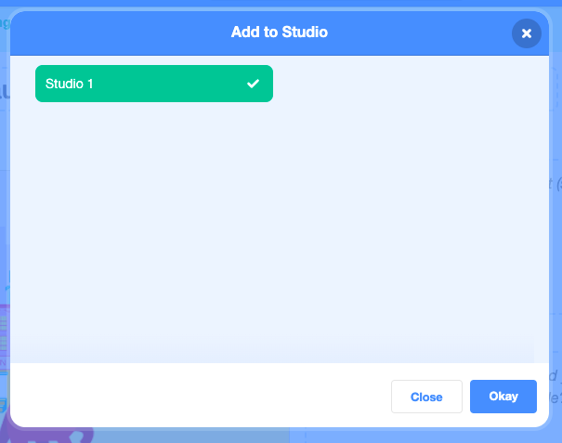
Sharing your Scratch creation to Your Teacher’s studio
Click “Share” when you are done with your project.
Choose “+ Add to Studio”.
Pick the designated Studio for the Unit.
Click “Okay”.
Share
✅
+
Okay

Slide 5
Here is an optional video to learn how to share your project in Scratch.
Pause here.

Slide 6
Student slides
Lesson 2
Lesson created by the GMU-ODU CSforAll Team. For more information about
this lesson and our CSforAll initiative, contact Dr. Amy Hutchison at achutchison1@ua.edu

Slide 7
Try it out!
Navigate to Scratch at scratch.mit.edu or CS First
Make a sprite
Change the sprite’s costume at least twice
Notes:
Your turn to try out the change costume block!

Slide 8
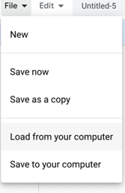
Independent Practice:
First, open a new window in your browser.
Next, download the .sb3 file from the following link: https://bit.ly/3rkIjBQ
Then, go to the following CS First Scratch Link: https://bit.ly/3PexYzB and open the Coco link that was shared by your teacher and click on Level 1.
Next, Click Sign in on CS First and Choose “I’m a student”
Then, Click “File” menu and Choose “Load from your computer”
Next, use the story and code you see in each row of CoCo Level 1 to put your jumbled code into the correct sequence in CS First. NOTE: if you do not see any code in CS First, be sure to scroll up and down.
Last, play your animation in Scratch by pressing the green flag.
Finally, correct any mistakes you made by fixing your code!
Pause here. (10-15 minutes)
Notes:
Ok, here is the sequence of steps to complete you independent practice. Your teacher is going to share two links with you that you will need to open on your computer.
Pause here.

Slide 9
Student slides
Lesson 3
Lesson created by the GMU-ODU CSforAll Team. For more information about
this lesson and our CSforAll initiative, contact Dr. Amy Hutchison at achutchison1@ua.edu

Slide 10
Patterns & sequencing review activity
Warm up with this activity.
Answer each question
Review answers as a class!

Slide 11
Code a polygon

Slide 12
My polygon is ________________ and it has ______ sides

Slide 13
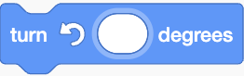
What blocks will you need to create your polygon? Drag the blocks you will need over to the right.
I will need:

Slide 14
An Example: How to Code a square
Then you would repeat this pattern in the following sequence:
If you wanted to write a pattern for a square, you could use the following blocks:
2
2
2
2
2

Slide 15
Your Turn! Using the blocks here, drag them into the correct pattern and sequence to create your polygon. You and your partner should try them out to see if they make sense. Be sure to add degrees and number of steps!
TIP: If you need to create more blocks, copy and paste the image.

Slide 16
Try out your polygon algorithm!
On paper or standing up and walking, try to follow your sequence to see if you can create the entire polygon!

Slide 17
Independent practice
Write a recipe for making a drink using this graphic organizer.
You may choose to write about lemonade, Koolaid, or another drink of your choice!
Notes:
In a moment, you will navigate to your student slide deck. In the deck is an outline for you. You will choose whether you want to write instructions for making lemonade or tea. Then you will type you instructions in. There is also a link to this document in the handouts, for the option to hand write your instructions. Your teacher will let you know what to do next.

Slide 18
Student slides
Lesson 4
Lesson created by the GMU-ODU CSforAll Team. For more information about
this lesson and our CSforAll initiative, contact Dr. Amy Hutchison at achutchison1@ua.edu

Slide 19
Warm up
Open your slide deck and navigate to activity slide.
Visit scratch.mit.edu to figure out how to do each task.
Drag the blue box to the correct item.
Pause here (10 minutes)

Slide 20
Supercoders, move the blue boxes to the right answer.
Which one of these is the start block?
Which one of these is the wait block?
Is the think block purple?
True
False
Which one of these is the choose a sprite block?
Is the move block colored yellow, purple, or blue?
yellow
purple
blue
Which block allows you to switch to a new costume?
Notes:
Acknowledgments: Adapted from CS+Fables

Slide 21
Student slides
Lesson 5
Lesson created by the GMU-ODU CSforAll Team. For more information about
this lesson and our CSforAll initiative, contact Dr. Amy Hutchison at achutchison1@ua.edu

Slide 22
Optional Debugging Activity
ASSISTANCE NEEDED! CAN YOU DEBUG THESE CODING PROJECTS?
In this activity, you will examine the problem and find a solution for each of the debugging challenges

Slide 23
Tips
There are often multiple solutions to a problem.
Make a list of possible bugs in the program.
Break the program into smaller, manageable pieces.
Test the program out first to identify the problem.
Keep track of your work! This can be a useful reminder of what you have already tried and point you toward what to try next.
Share and compare your problem finding and problem solving approaches with a neighbor until you find something that works for you!
Notes:
Adopted from Debug it! And Scratch debugging strategies

Slide 24
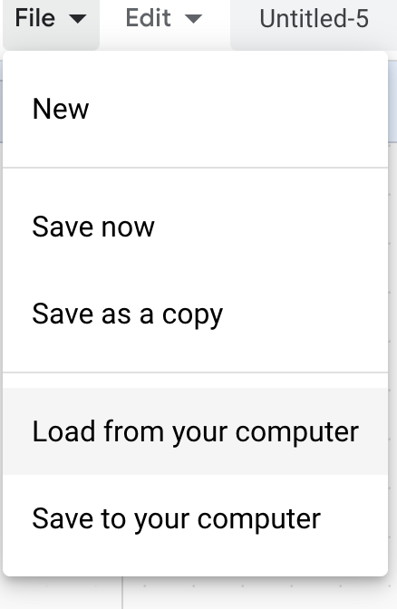
Debugging Challenge 1:
To debug, download the .sb3 file from the following link: https://bit.ly/3RcpLyo
Next, go to the following CS First Scratch Link: https://bit.ly/3PexYzB
Click Sign in and Choose “I’m a student”
Click “File” menu and Choose “Load from your computer”
Now you can start debugging!!! Have fun!!!
Challenge: In this project, when the green flag is clicked, firstly Coco should say ‘’Hello, World! I'm Coco." in a speech bubble and next Pascal should say "Hello, World! I'm Pascal." in a speech bubble. However, both Coco and Pascal's speech bubbles appear at the same time. How can we debug this?
Notes:
https://drive.google.com/uc?id=101Dm_z5Q4ey2P-jLWdat31g_4bLJcXDR&export=download

Slide 25
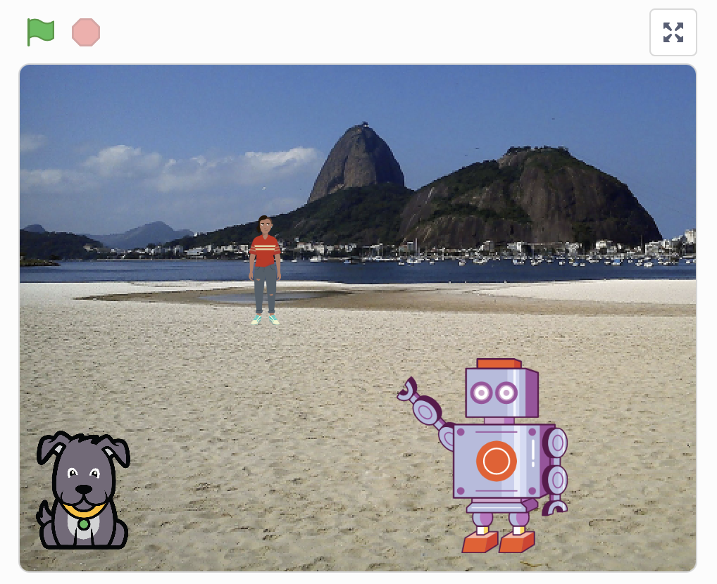
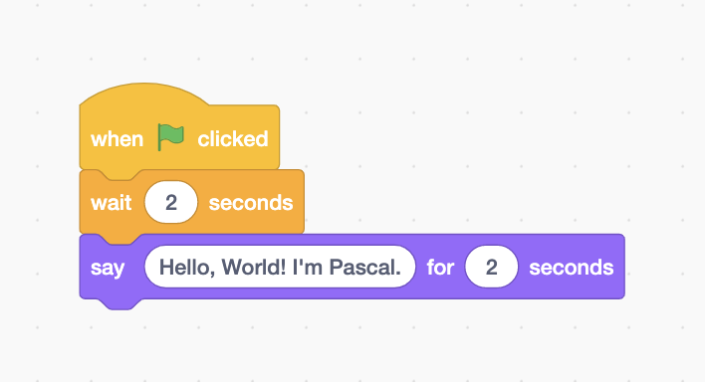
Debugging Challenge 1 Answer Key
After you have tried to debug this challenge, check out this project for a sample solution using https://bit.ly/3Lm6Ey7
Possible Solution:

Slide 26
Debugging Challenge 2:
To debug, download the .sb3 file from the following link: https://bit.ly/460mk1Y
Next, go to the following CS First Scratch Link: https://bit.ly/3PexYzB
Click Sign in and Choose “I’m a student”
Click “File” menu and Choose “Load from your computer”
Now you can start debugging!!! Have fun!!!
Challenge: In this project, when the green flag is clicked, Coco firstly should say ‘’Woof! Woof!" in a speech bubble and next as a sound. But the sound happens before the speech bubble- and Coco only makes one ‘Woof!’ sound! How can we debug this?
Notes:
https://drive.google.com/file/d/1fq0EiEv5HhEhYSBLjXUyWVfoFNLPU9b5/view?usp=sharing
https://drive.google.com/uc?id=1fq0EiEv5HhEhYSBLjXUyWVfoFNLPU9b5&export=download
https://bit.ly/460mk1Y

Slide 27
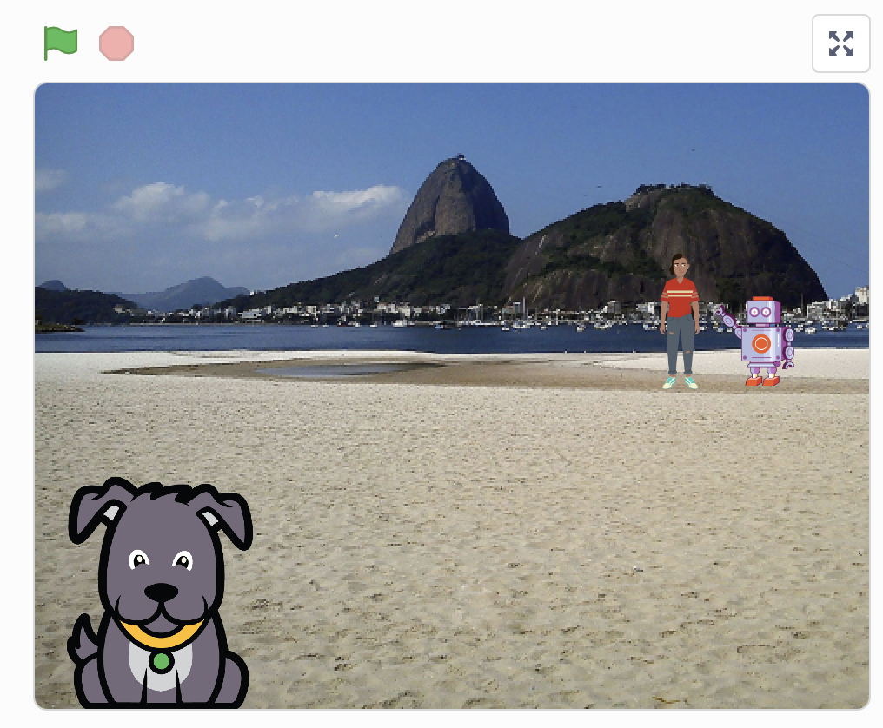
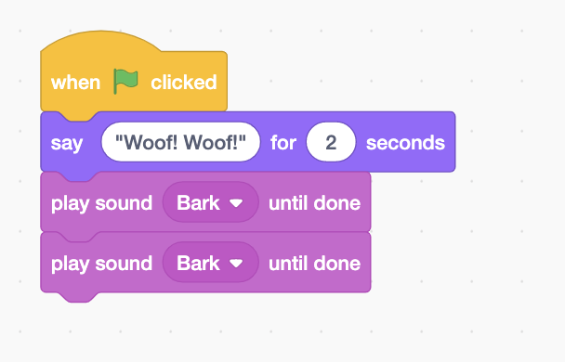
Debugging Challenge 2 Answer Key
After you have tried to debug this challenge, check out this project for a sample solution using https://bit.ly/3RriBGq
Possible Solution:
Notes:
https://drive.google.com/file/d/1TyH_8Q3-0yiFlIkQov59p_TlgqKcrmMN/view?usp=sharing
https://drive.google.com/uc?id=1TyH_8Q3-0yiFlIkQov59p_TlgqKcrmMN&export=download
https://bit.ly/3RriBGq

Slide 28
Debugging Challenge 3:
To debug, download the .sb3 file from the following link: https://bit.ly/3RfWliX
Next, go to the following CS First Scratch Link: https://bit.ly/3PexYzB
Click Sign in and Choose “I’m a student”
Click “File” menu and Choose “Load from your computer”
Now you can start debugging!!! Have fun!!!
Challenge: When the green flag is clicked, both Coco and Pascal should respond to Pearl and say "Hi, Pearl!". But only Pascal responds and says "Hi, Pearl!". How do we fix the program?
Notes:
https://drive.google.com/file/d/1Wx4EdU4qF_y7CAPnmUP86OepZeCY5a1O/view?usp=sharing
https://drive.google.com/uc?id=1Wx4EdU4qF_y7CAPnmUP86OepZeCY5a1O&export=download
https://bit.ly/3RfWliX

Slide 29
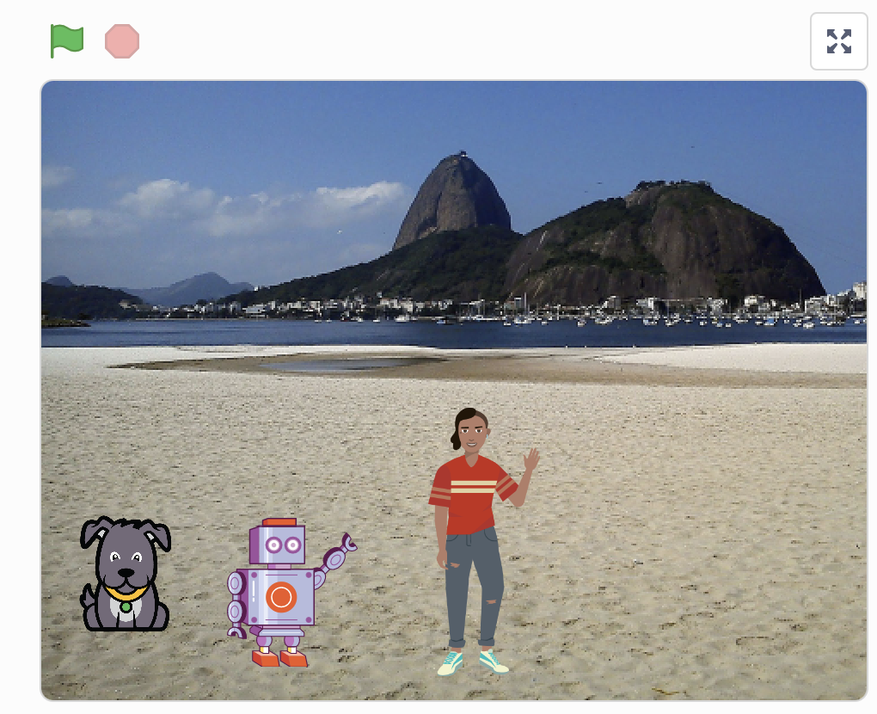
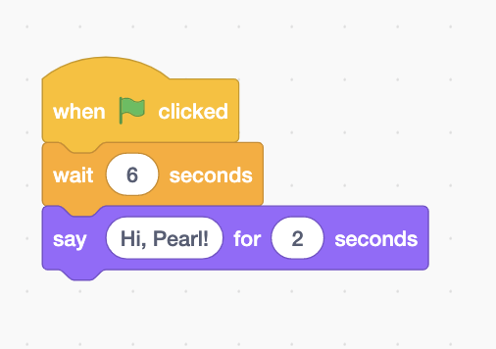
Debugging Challenge 3 Answer Key
After you have tried to debug this challenge, check out this project for a sample solution using https://bit.ly/3RmSlNw
Possible Solution:
Notes:
https://drive.google.com/file/d/1yCUpHkIS0JDOAN860UF0LwgWZheCzlAK/view?usp=sharing
https://drive.google.com/uc?id=1yCUpHkIS0JDOAN860UF0LwgWZheCzlAK&export=download
https://bit.ly/3RmSlNw

Slide 30
Finished!
Discuss your testing and debugging practices with a partner. Make note of the similarities and differences in your strategies.
Add code commentary by right clicking on blocks in your scripts. This can help others understand different parts of your program!
Help a neighbor!
Notes:
Adopted from Debug it!

Slide 31
Acknowledgments:
Activities were adapted from ScratchEdTeam and Impact Conectar!

