Slide 1
Unit 3, lesson 1
Algorithms and debugging
3rd & 4th Grade
Lesson created by the GMU-ODU CSforAll Team. For more information about
this lesson and our CSforAll initiative, contact Dr. Amy Hutchison at achutchison1@ua.edu

Slide 2
Summary and Standards
Summary:
In this lesson, students will identify algorithms and brainstorm and write a new explanatory writing piece.
ELA Standards
The student will write in a variety of forms to include narrative, descriptive, opinion, and expository.
a) Engage in writing as a process.
b) Identify audience and purpose.
c) Use a variety of prewriting strategies.
d) Use organizational strategies to structure writing according to type.
g) Use transition words to vary sentence structure.
CS Standards:
The student will analyze, correct, and improve (debug) an algorithm that includes sequencing, events, and loops.
Notes:
Today, we are moving on to Unit 3 where we will learn about something called algorithms and debugging, a key process you will use in both computer science and writing.

Slide 3
Materials and resources needed for this lesson:
Reminder:
In this lesson, every student should be assigned a story in CoCo using Level 3.
The story should be titled “Unit 3 Story.”
Each student should save their work using this naming strategy: “Student Name + Unit # + Descriptor”, for example, “Johnny Unit 3 Story”
Chromebook/Laptop
Internet Access
Teacher Unit 3, Lesson 1 slide deck
CoCo Link
Explanatory text graphic organizer & storyboard
Blank paper for brainstorming
Notes:
You will need….[read slide]

Slide 4
Code:
The language that computer scientists create and use to tell a computer what to do.
Notes:
Code is the language that computer scientists create and use to tell a computer what to do. Code is how we can give instructions to a computer.

Slide 5
But what if….
Notes:
Ok, but what happens if we miss a step or make a mistake in writing our algorithm? Well, the computer or the human who is reading the instructions will not be able to accomplish the task! These mistakes are called….

Slide 6
Bugs: An error in a code that prevents the program from running as expected.
Notes:
"Bugs...but not the creepy, crawly critter that you might think of at first when you hear the word "bug." "Bugs" in computer science are errors in a code...." A bug is an error or mistake in your code that prevents the program from running as expected. It is like when you write something incorrect in your instructions and someone else can’t follow them because they are confused. When this happens in your writing you have to fix your mistake.

Slide 7
Debugging: looking for and fixing the errors in your code
Notes:
When you need to fix your error in your code we call that debugging. This means you are looking for your mistake and then fixing it. Everyone makes mistakes, even professionals!

Slide 8
Remember: To debug an algorithm, we…
Describe your problem.
Hunt for bugs (what is it in your code causing the problem).
Try out some solutions and test.
Remember what you learned from the bug.
Notes:
Whenever we realize that we have a bug, here are the steps for debugging. We [read slide]. Debugging happens all the time while we are coding!
Debugging Recipe from Code.org (select full link, copy, and paste): https://code.org/curriculum/docs/k-5/DebuggingTeacher.pdf

Slide 9
What is explanatory writing?
Notes:
Now that we have reviewed the CS vocabulary let's think about another type of algorithm we have used: explanatory writing. Can anyone share an example of explanatory writing?

Slide 10
Explanatory Writing
Notes:
explanatory writing. This is a type of writing to explain or inform someone else. Think of some examples of explanatory writing that we have done so far….

Slide 11
Notes:
That’s right–we’ve written instructions for how to do lots of things! Most of these have been recipes, a set of written instructions for how to make a food or drink. For example, we’ve read and written recipes for:
–how to make hot chocolate
–how to make a yummy treat
–how to make a chocolate, vanilla, or chocolate milkshake!
–how to make koolaid
–how to make lemonade

Slide 12
What is explanatory writing?
Explanatory writing:
Explains something to someone or helps them understand how to do something. So it is important to provide many details!
Is written in a specific order or sequence
A sequence is a set of things that follow each other in a particular order, where order matters!
Often uses sequencing words such as first, then, next, and last to communicate the correct order of steps, also known as their sequence
Notes:
So, explanatory writing is when we write to inform or explain! Remember {Read slide}

Slide 13
Can you think of other examples of explanatory writing?
We may wish to write about how to….
Get somewhere (directions)
To the cafeteria
The park in your neighborhood
Do something (instructions)
Build a fort in your living room
Do a dance
Shoot a basketball or kick a soccer ball
Create a craft
Explain something
How your family celebrates the holidays
About someone important to you or someone famous
How something happens, such as photosynthesis or the water cycle
Notes:
There are lots of times when you may wish to explain something to someone! [read slide]

Slide 14
Lesson Objectives: I can…
Review algorithms and explanatory writing
Identify the characteristics of an explanatory text
Write a sequence of instructions for a new explanatory text
Plan out my animation on paper
Notes:
Let’s go over today’s lesson’s objectives: [read slide]

Slide 15
Guided practice
Notes:
Now, let’s think about other types of explanatory writing together.

Slide 16
Algorithm: A list of steps to finish a task
Notes:
Remember: An Algorithm is a list of steps or commands to finish a task.

Slide 17
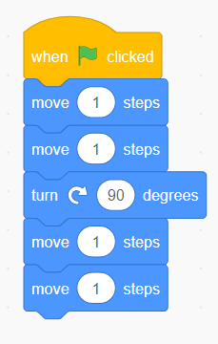
Algorithms and Explanatory Writing
Use the correct sequence
Be clear and precise
Just like an algorithm, explanatory writing explains the steps or instructions for doing something.
Explanatory writing is also written in a specific order or sequence, just like an algorithm.
First
Next
Notes:
Algorithms must be written in the correct sequence so that others, humans or a computer, can follow the orders to complete a task. This task can be anything, so long as you can give clear instructions for it. Think about an algorithm for getting your shoes on in the morning, you must put on your socks before you put on your shoes!

Slide 18
How to write an explanatory text
Brainstorm: What do you want to share?
Plan: What does your reader need to know? How should you organize your information?
Graphic Organizers can help (Coco)
Write!
Be clear and specific
Use transition words
Debug and Edit
Look for mistakes or things that don’t make sense.
Fix your mistakes

Slide 19
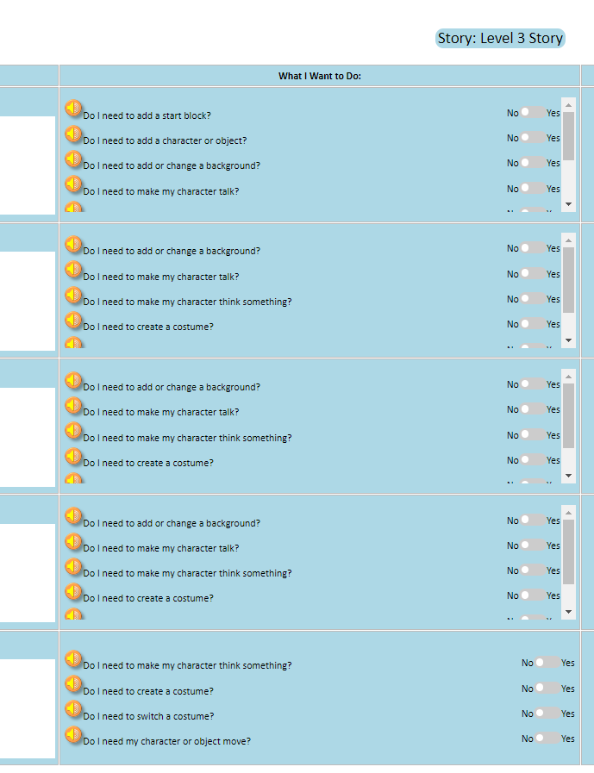
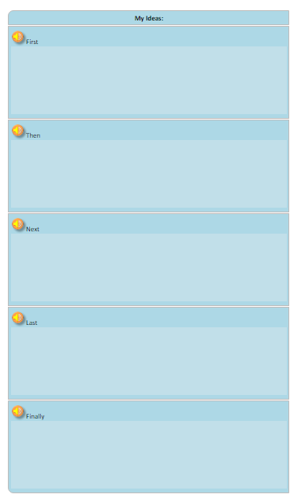
CoCo is a graphic Organizer
CoCo helps us organize our writing and plan out our animation in Scratch.
Notes:
One great graphic organizer you have already learned about is Coco. Coco is also helpful because it not only helps us plan our writing but also how we are going to share our writing virtually in a Scratch animation!

Slide 20
How to write an explanatory text
Brainstorm: What do you want to share?
Plan: What does your reader need to know? How should you organize your information?
Graphic Organizers can help (Coco)
Write!
Be clear and specific
Use transition words
Debug and Edit
Look for mistakes or things that don’t make sense.
Fix your mistakes
Notes:
The next two steps are to write and then debug and edit our writing. When we write we need to be clear and specific and use our transition words. When we debug, we are looking for and fixing mistakes.
Ok, now it is time to get started!

Slide 21
Brainstorm
Notes:
Pause here and make sure you have your idea ready to go. Take a few moments to pause here and to think about what you want to write about. I might want to explain how to get to the park from my house, or how knit a sweater, or maybe the steps to feeding my goldfish.
Teacher may also provide a prompt of their choice.

Slide 22
Turn & Talk
Notes:
Take a moment to share your thoughts with your next door neighbor. Take turns sharing your ideas. Pause the video here to turn and talk about your ideas for your explanatory writing.

Slide 23
Independent practice

Slide 24
Plan & Write
Finish brainstorming.
Open the graphic organizer your teacher has shared.
Write!
Plan your animation!
Pause here (15-20 minutes)
Notes:
Now it is time to plan out our writing. You need to think about: What does your reader need to know? How should you organize your information?
Graphic organizers, like we have used before, can be a huge help with this step. We need to think about the important details our readers will need. Today will be using a graphic organizer for our writing and for planning our animation.
Pause the here and working on planning and writing your new explanatory writing into your graphic organizer. When you are done with your writing, use the boxes on the right to plan how you will animate each step in Scratch.

Slide 25
Wrap up
Notes:
Great job!

Slide 26
Wrap up: Algorithms and Explanatory Writing
Use the correct sequence
Be clear and precise
Just like an algorithm, explanatory writing explains the steps or instructions for doing something.
Explanatory writing is also written in a specific order or sequence, just like an algorithm.
First
Next
Notes:
Remember: Algorithms and explanatory writing are very similar. They both explain a sequence of steps or events. And they both need to be clear so that others, people or computers, can follow those steps.

Slide 27
next time…
Notes:
Great job today, make sure you save your planning graphic organizer for next time, when we will be working in CoCo

