Slide 1
Debugging with Coco
ASSISTANCE NEEDED! CAN YOU DEBUG THESE CODING PROJECTS?
In this activity, you will examine the problem and find a solution for each of the debugging challenges

Slide 2
Tips
There are often multiple solutions to a problem.
Make a list of possible bugs in the program.
Break the program into smaller, manageable pieces.
Test the program out first to identify the problem.
Keep track of your work! This can be a useful reminder of what you have already tried and point you toward what to try next.
Share and compare your problem finding and problem solving approaches with a neighbor until you find something that works for you!
Notes:
Adopted from Debug it! And Scratch debugging strategies

Slide 3
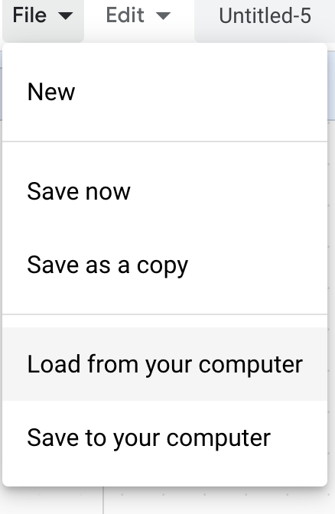
Debugging Challenge 1:
To debug, download the .sb3 file from the following link: https://bit.ly/3RcpLyo
Next, go to the following CS First Scratch Link: https://bit.ly/3PexYzB
Click Sign in and Choose “I’m a student”
Click “File” menu and Choose “Load from your computer”
Now you can start debugging!!! Have fun!!!
Challenge: In this project, when the green flag is clicked, firstly Coco should say ‘’Hello, World! I'm Coco." in a speech bubble and next Pascal should say "Hello, World! I'm Pascal." in a speech bubble. However, both Coco and Pascal's speech bubbles appear at the same time. How can we debug this?
Notes:
Please use this dropbox link to access the file if you cannot open the Scratch link
Debug .sb3 file dropbox link:
https://www.dropbox.com/scl/fi/x3u206zoyww3aklyf35v3/Hello-World-Coco-Pascal-Debugging.sb3?rlkey=nd6wq116o0nr8xydlxa8c6ju3&dl=0

Slide 4
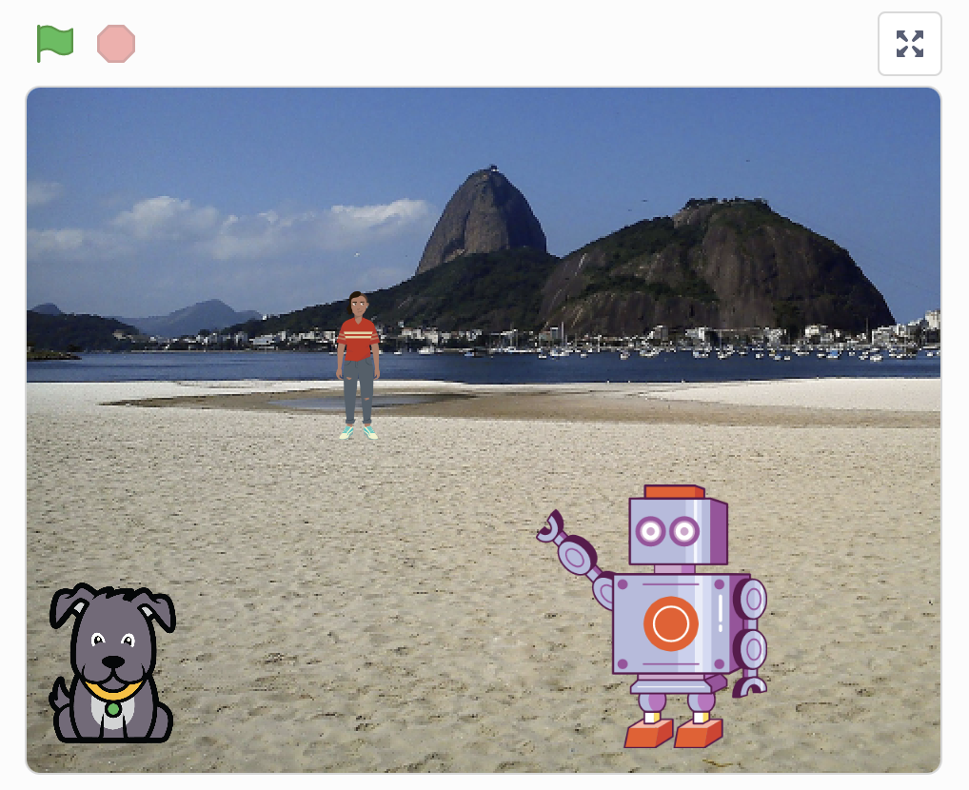
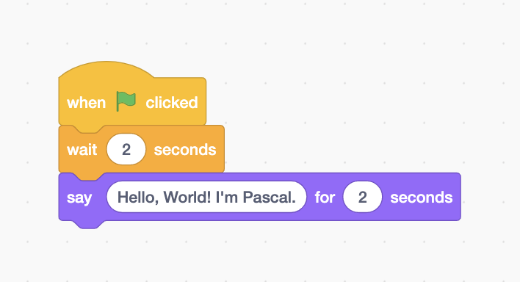
Debugging Challenge 1 Answer Key
After you have tried to debug this challenge, check out this project for a sample solution using https://bit.ly/3qiowQx
Possible Solution:

Slide 5
Debugging Challenge 2:
To debug, download the .sb3 file from the following link: https://bit.ly/460mk1Y
Next, go to the following CS First Scratch Link: https://bit.ly/3PexYzB
Click Sign in and Choose “I’m a student”
Click “File” menu and Choose “Load from your computer”
Now you can start debugging!!! Have fun!!!
Challenge: In this project, when the green flag is clicked, Coco firstly should say ‘’Woof! Woof!" in a speech bubble and next as a sound. But the sound happens before the speech bubble- and Coco only makes one ‘Woof!’ sound! How can we debug this?
Notes:
Debug .sb3 file dropbox link:
https://www.dropbox.com/scl/fi/9064hqcmicagr79mr1kgs/Coco-Debugging-Woof.sb3?rlkey=ebzjz1lfxknmrxv28zvi0tg6a&dl=0

Slide 6
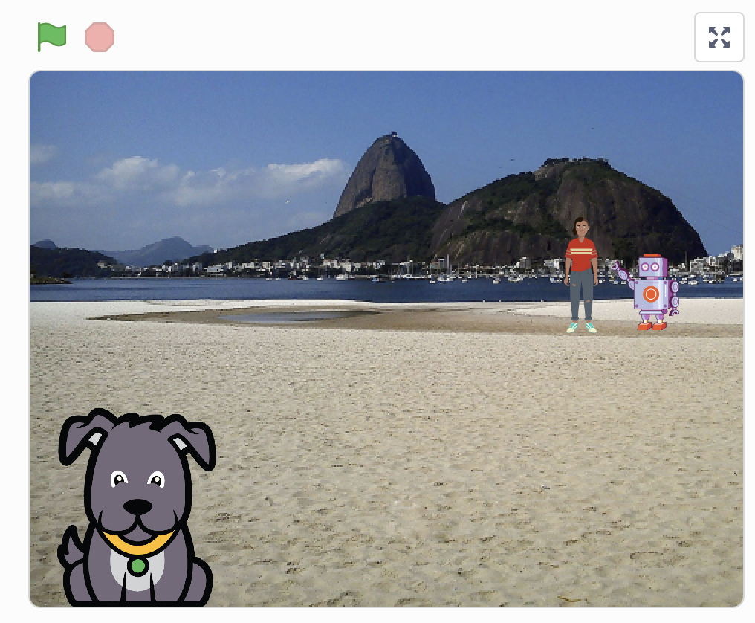
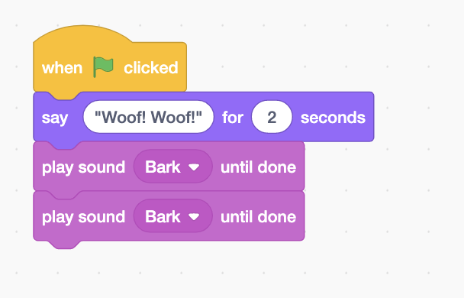
Debugging Challenge 2 Answer Key
After you have tried to debug this challenge, check out this project for a sample solution using https://bit.ly/3RriBGq
Possible Solution:
Notes:
Dropbox link:
https://www.dropbox.com/scl/fi/7ho9xv03bye892n82ow4u/Coco-Debugging-Woof-Solution.sb3?rlkey=owgk022jej1yo2o5y7dzxpf8j&dl=0

Slide 7
Debugging Challenge 3:
To debug, download the .sb3 file from the following link: https://bit.ly/3RfWliX
Next, go to the following CS First Scratch Link: https://bit.ly/3PexYzB
Click Sign in and Choose “I’m a student”
Click “File” menu and Choose “Load from your computer”
Now you can start debugging!!! Have fun!!!
Challenge: When the green flag is clicked, both Coco and Pascal should respond to Pearl and say "Hi, Pearl!". But only Pascal responds and says "Hi, Pearl!". How do we fix the program?
Notes:
Dropbox link:
https://www.dropbox.com/scl/fi/8kv373sx0d6g9xm827srm/Coco-Pascal-Pearl-Debugging-Hi.sb3?rlkey=03secq4nslcq2uxs0jizy7er4&dl=0

Slide 8
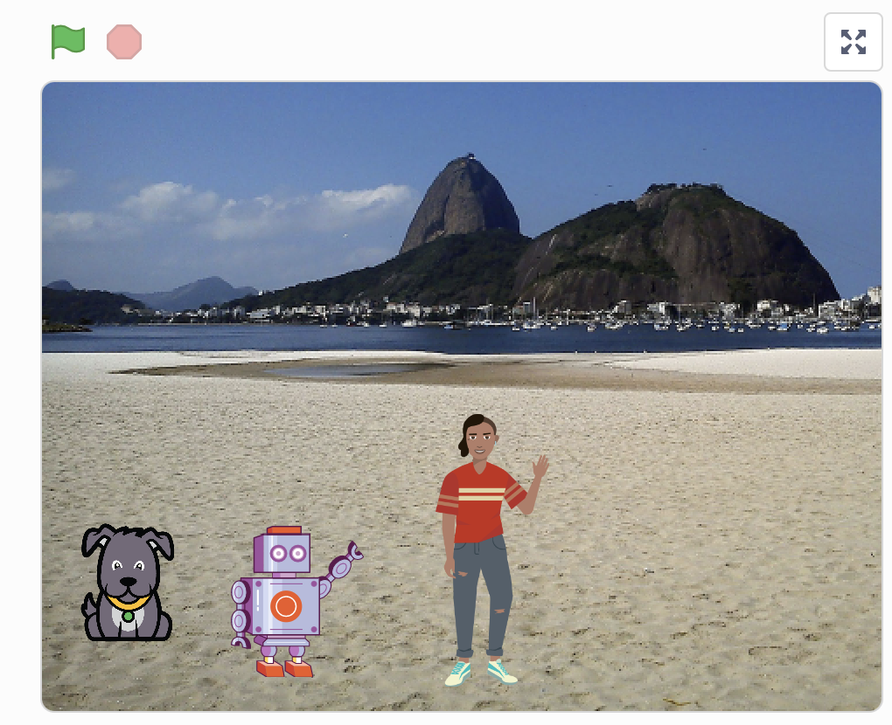
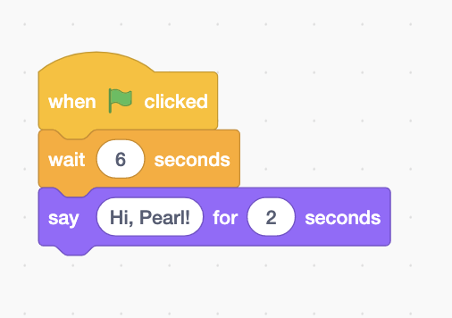
Debugging Challenge 3 Answer Key
After you have tried to debug this challenge, check out this project for a sample solution using https://bit.ly/31Ezar0
Possible Solution:
Notes:
Dropbox link:
https://www.dropbox.com/scl/fi/om9w7e9waww1f475oce9u/Coco-Pascal-Pearl-Debugging-Hi-Solution.sb3?rlkey=4jwapb07x3vu4zobyog4wa64c&dl=0

Slide 9
Debugging Challenge 4 - Bonus
To debug, visit the following link: https://bit.ly/3HI5NmX
Next, click on
Challenge: When green flag is clicked, Coco should start on top of bed. Can you reset?

Slide 10
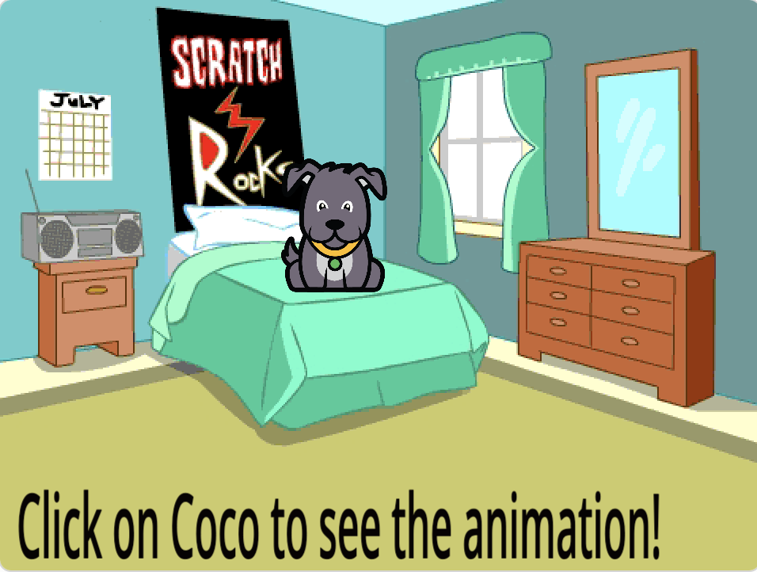
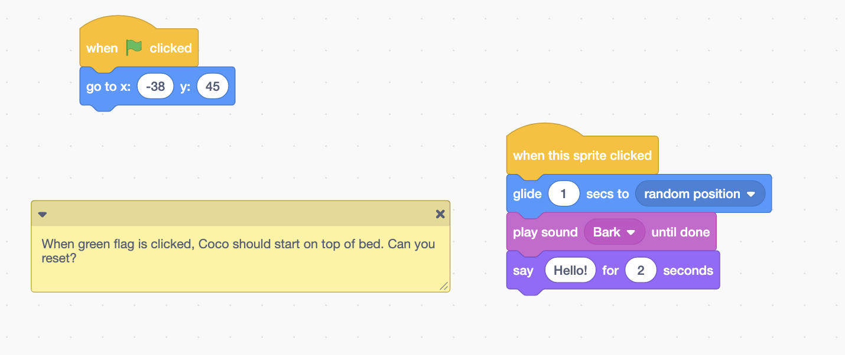
Bonus Debugging Challenge 4 Answer Key
After you have tried to debug this challenge, check out this project for a sample solution using https://bit.ly/32Ti2yu
Possible Solution:

Slide 11
Debugging Challenge 5: Bonus
To debug, visit the following link: https://bit.ly/3qPnaLT
Next, click on
Challenge:
(1) I do not want Coco to think, "Hello! I'm Coco. " I want Coco to say, "Hi, my name is Coco."
(2) I do not want Coco to move 200 steps. I want Coco to move 100 steps.
(3) Also, I want Coco to go back to the center of the stage when I click the green flag.
(4) Also, I do not want Coco to meow, I want Coco to bark when I click the green flag.
What should I do? Can you help?

Slide 12
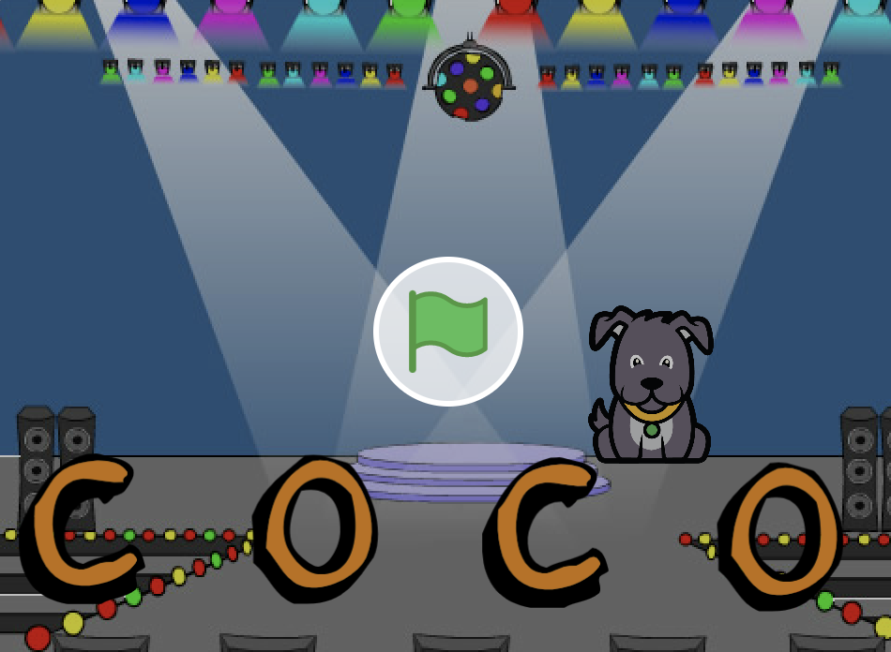
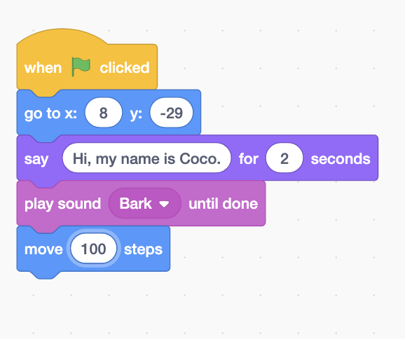
Debugging Challenge 5 Answer Key
After you have tried to debug this challenge, check out this project for a sample solution using https:/bit.ly/3zuSHXw
Possible Solution:

Slide 13
Debugging Challenge 6: Bonus
Hint: Pay attention to “Wait” blocks
To debug, visit the following link: https://bit.ly/3EYeGr4
Next, click on
Challenge: In this project, Coco wants to show you a dance. When you click on the green flag, she should do a dance while the dance music plays along with her. However, as soon as she starts to dance she stops but the dance beat continues without her! How can we fix this program?

Slide 14
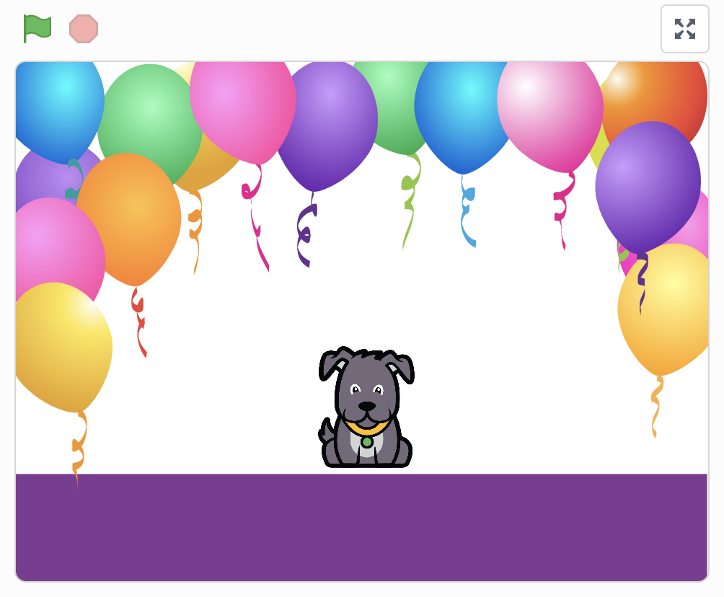
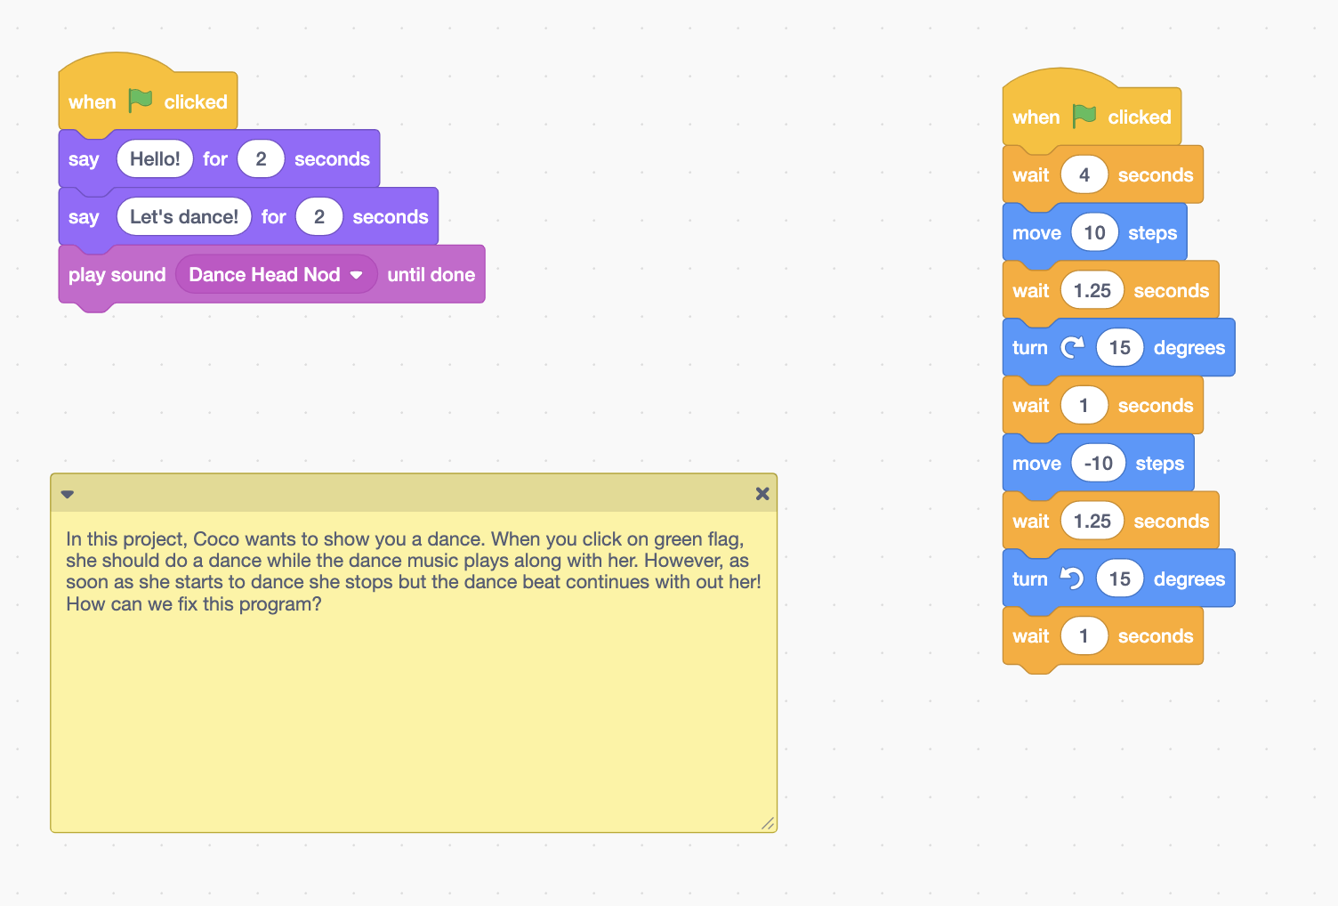
Bonus Debugging Challenge 6 Answer Key
After you have tried to debug this challenge, check out this project for a sample solution using https://bit.ly/3JDZUZU
Possible Solution:

Slide 15
Finished!
Discuss your testing and debugging practices with a partner. Make note of the similarities and differences in your strategies.
Add code commentary by right clicking on blocks in your scripts. This can help others understand different parts of your program!
Help a neighbor!
Notes:
Adopted from Debug it!

Slide 16
Acknowledgments:
Activities were adapted from ScratchEdTeam and Impact Conectar!

