Slide 1
Optional Pre-Unit Lesson
3rd/4th Grade
Preparing for Coding in Scratch
3rd & 4th Grade
Lesson created by the GMU-ODU CSforAll Team. For more information about
this lesson and our CSforAll initiative, contact Dr. Amy Hutchison at ahutchi9@gmu.edu

Slide 2
Summary and Standards
Summary:
In this lesson, students will explore what Computer Science is and the basics of Scratch.
ELA Standards:
The student will read and demonstrate comprehension of nonfiction texts.
The student will write in a variety of forms to include narrative, descriptive, opinion, and expository.
a)Engage in writing as a process.
c) Use a variety of prewriting strategies.
d) Use organizational strategies to structure writing according to type
g)Use transition words to vary sentence structure
CS Standards:
The student will construct sets of step-by-step instructions (algorithms), both independently and collaboratively
a) using sequencing;
b) using events.
Notes:
Optional: Introduce lesson, learning goals, and resources (Slides # 2-4)

Slide 3
Materials and resources needed for this lesson:
Chromebook/Laptop
Internet Access
Link to Scratch tutorial
Student Unit 1 slide deck
Notes:
Optional: Introduce lesson, learning goals, and resources (Slides # 2-4)

Slide 4
Lesson Objectives: I can…
Identify objects in Scratch (add Sprites, add backdrops)
Recognize that commands in Scratch are represented by blocks
Describe characteristics of Computer Science (CS)
Explore Scratch
Log into Scratch and practice adding a project to a teacher’s studio
Notes:
Optional: Introduce lesson, learning goals, and resources (Slides # 2-4)

Slide 5
Vocabulary
Commands
Code
Computer Science
Sprite
Backdrop

Slide 6
Computer Science?
What do you know about…
Notes:
Ask students to share what they know about the following words: Computer Science

Slide 7
Coding?
What do you know about…
Notes:
Ask students to share what they know about the following words: Coding

Slide 8
Programming?
What do you know about…
Notes:
Ask students to share what they know about the following words: Programming

Slide 9
We are going to learn more about computer science!
Notes:
Next, explain that we are going to be learning more about Computer Science and share the video (Watch until 1:09) (slide #9)

Slide 10
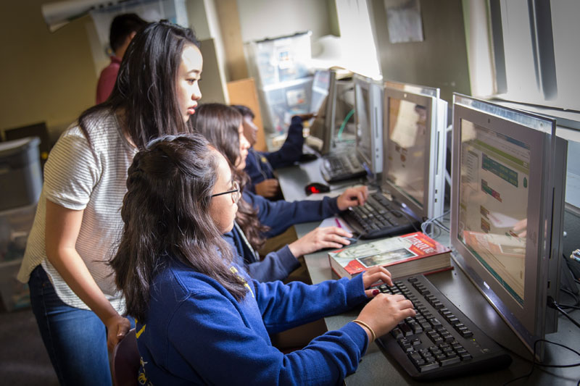
Computer Scientists
Computer scientist (n): a person who studies computers and how they can be used to solve problems.
Notes:
Introduce what a computer scientist does (slide 10)

Slide 11
Commands:
tell a person or computer what to do
Notes:
Introduce vocabulary slides: Commands

Slide 12
Code:
The language that computer scientists create and use to tell a computer what to do.
Notes:
Introduce vocabulary slides: Code

Slide 13
We can write code in Scratch
Notes:
Introduce Scratch - Explain that Scratch is a program that you can use to code and create interactive stories, games, and animations.

Slide 14
Click here for an optional video about Scratch (must have access to Scratch).
Pause here.
Notes:
First, let’s learn a little more about Scratch
Scratch - Imagine, Program, Share

Slide 15
Guided practice

Slide 16
Coding in Scratch

Slide 17
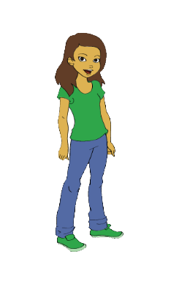
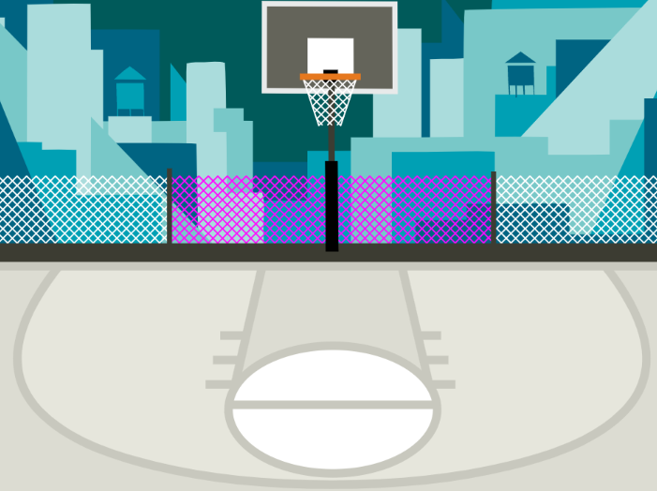
Terms used in Scratch
Block(s): commands in Scratch
Sprite: characters in Scratch
Backdrop: background

Slide 18
Computer commands
Notes:
“Has anyone seen these types of pieces anywhere before? (from warm up) These pieces are actually computer “commands.” Commands tell a person or a computer what to do.

Slide 19
Computer commands
Notes:
Lets look closely at these blocks again and what they say-
Click "switch,
Click “think,
Click “turn
“these are commands" written in Scratch code, which is the kind we will be working with. We put these commands together in Scratch by snapping the together the blocks so they hook onto each other like puzzle pieces. This allows us to code multiple commands in a single set of instructions.

Slide 20
Computer commands
Hi!
2
Notes:
For example, these Scratch commands have been put in the correct order from top to bottom you have created a sequence of instructions. This would tell the computer to say Hi for 2 seconds then turn right 90 degrees.

Slide 21
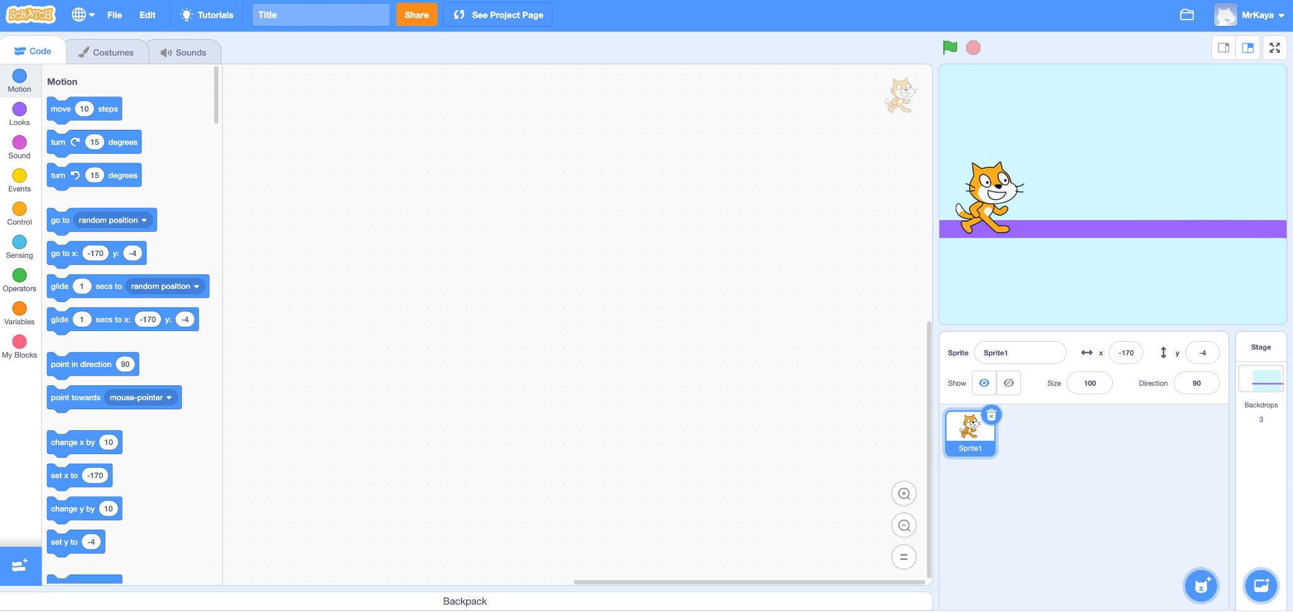
Notes:
Guide Students through the main areas of the Scratch page
“When you open Scratch, your screen should look like this.”

Slide 22
Script Area
Notes:
Guide Students through the main areas of the Scratch page
“This main area in the center of your screen is the script area. This is where you drag you command block and join them to build your algorithm. You will find your command blocks on the left side of the screen and drag them to the center. If you decide that you do not want a certain block, drag it back to the left. We will learn more about this in a moment.”

Slide 23
Sprite
Notes:
Introduce and explain to create/add Sprites and Backdrops
“In SCRATCH, an object, author, or character in a story is called a Sprite. The sprite you can see right now is Scratch the cat. The box here is blue because this is the sprite that is currently being coded. If this box is not blue, you will not be able to add any command blocks for your sprite.”

Slide 24
Choose a Sprite
Notes:
Introduce and explain to create/add Sprites and Backdrops
“If you want to add another sprite or change sprites, you can click here, the small circle with the cat image and plus sign. The new sprites you add will appear in this box. But you can only add code for the sprite that is selected and is in the blue box.”

Slide 25
Stage
Notes:
Introduce and explain to create/add Sprites and Backdrops
“You can see scratch the cat here on the stage. When you run your code, this is where you can see the action.”

Slide 26
Choose a backdrop
Notes:
Introduce and explain to create/add Sprites and Backdrops
“If you want to change your background or your backdrop, as it is called in scratch, you can click here. It looks like a small picture with a plus sign.”

Slide 27
Code, Costumes, and Sounds
Notes:
Guide Students through the main areas of the Scratch page
“In the upper left, you can see three different tabs. Code, Costumes, Sounds. Choose the code tab to build code from command blocks. Choose the costumes tab to change how your sprite looks. Or you can add new sounds to sprites here.”

Slide 28
Block categories
Notes:
Guide Students through the main areas of the Scratch page
“Let’s look closer at the code blocks. On the far left you can see several colored dots (some also call it categories palette). These are the different types of code you might want. You can choose motion, looks, sound, events..they are all different colors to help you. You can choose just one block category.”

Slide 29
Code Blocks
Notes:
Guide Students through the main areas of the Scratch page
“Once you choose your category, the code blocks will appear here and you can find the specific command that you would like to give your sprite. Once you drag your code to the stage and click them together, you are ready to try it out.”

Slide 30
Changing sprites & Backdrops

Slide 31
Sprite
Notes:
Okay, remember that in SCRATCH, an object, author, or character in a story is called a Sprite. The sprite you can see right now is Scratch the cat. What if we wanted to change our sprite to another animal?

Slide 32
Notes:
Okay, remember that in SCRATCH, an object, author, or character in a story is called a Sprite. The sprite you can see right now is Scratch the cat. What if we wanted to change our sprite to another animal?
First, we would click on the sprite icon.

Slide 33
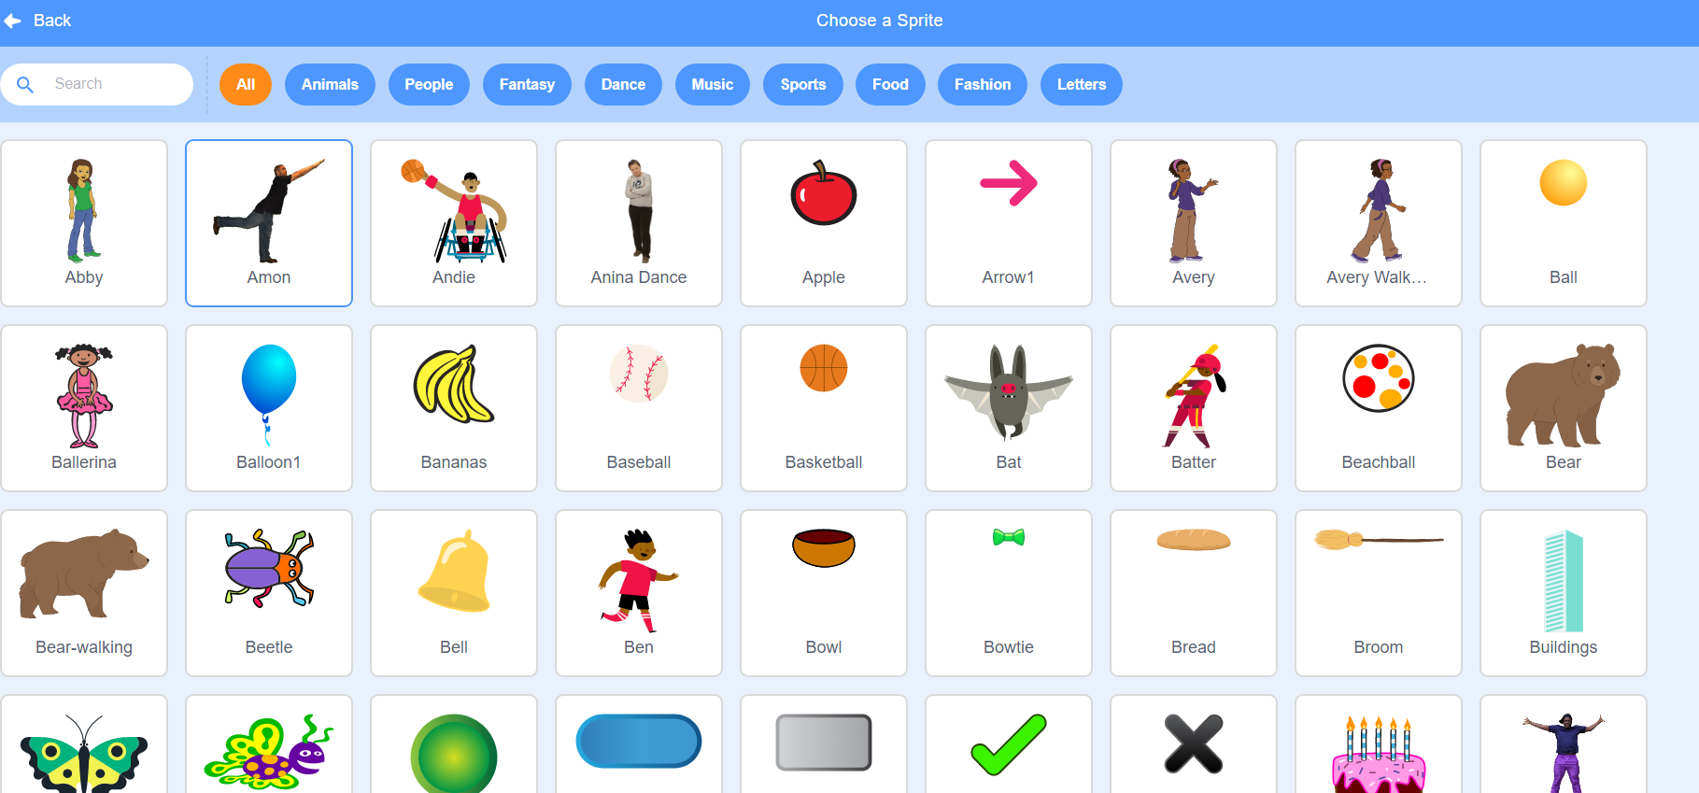
Notes:
Then, we would have ALL these sprites to choose from.

Slide 34
Notes:
We change our sprite by clicking the one we want.

Slide 35
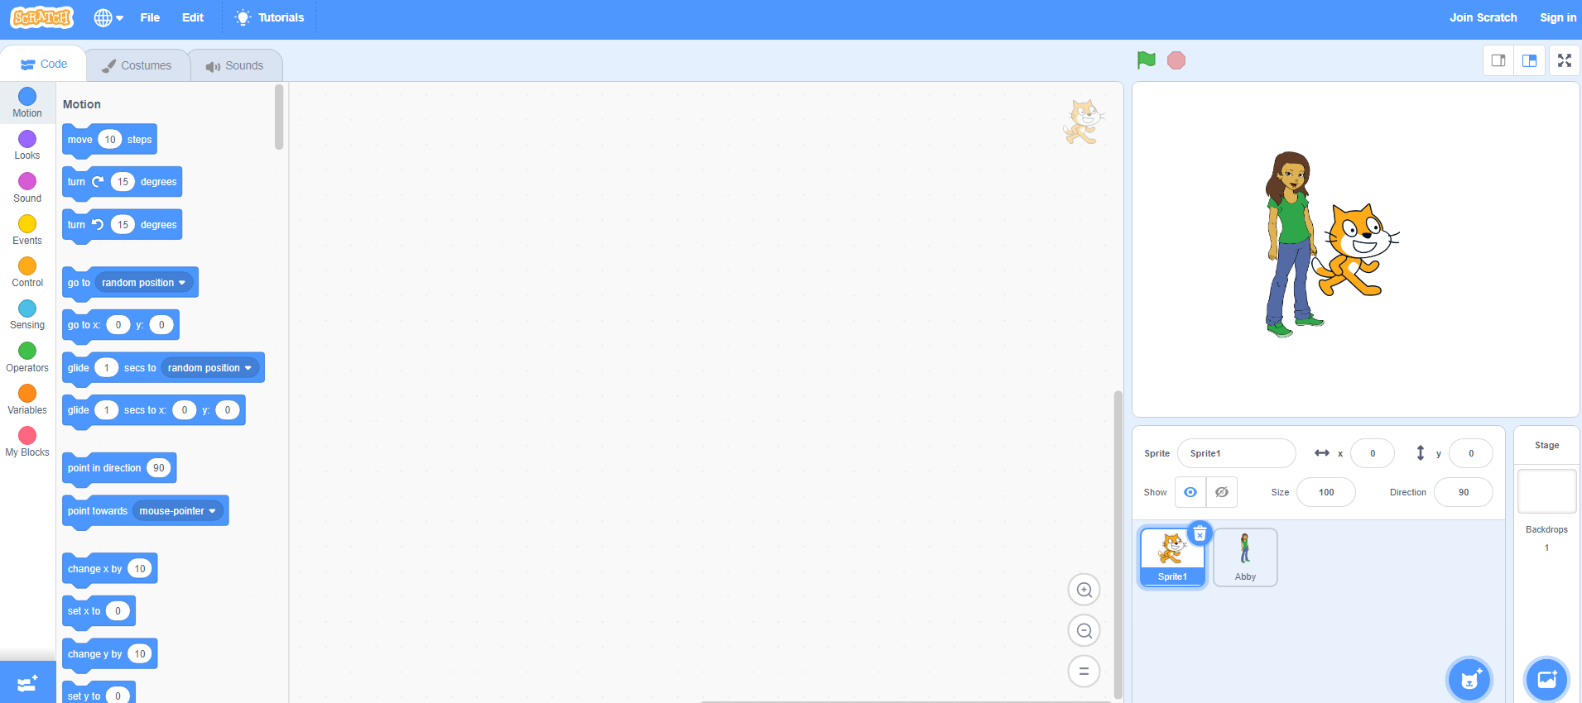
Notes:
But don’t forget to delete the other sprite! So you have only the one you want.

Slide 36
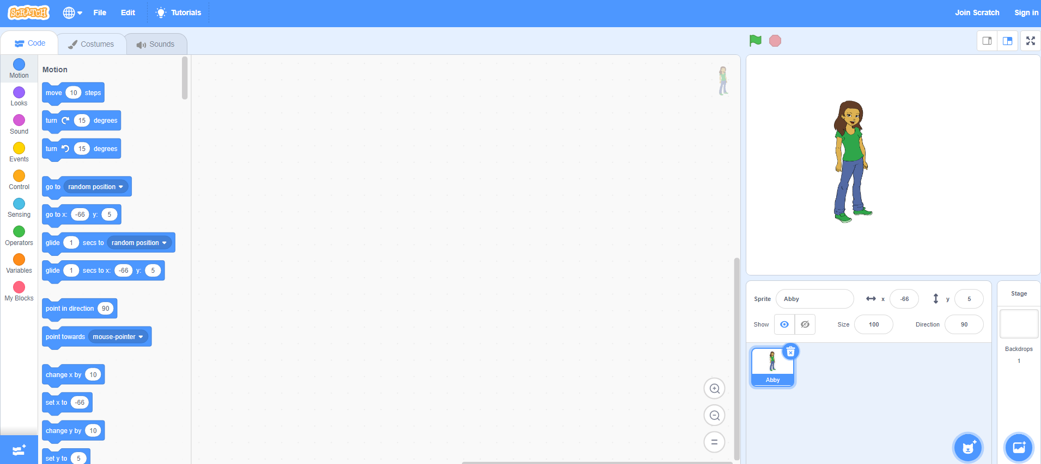
Notes:
But don’t forget to delete the other sprite! So you have only the one you want.

Slide 37
Notes:
To add your own backdrop, follow the same steps but click this icon instead. You’ll see lots of options to choose from appear.

Slide 38
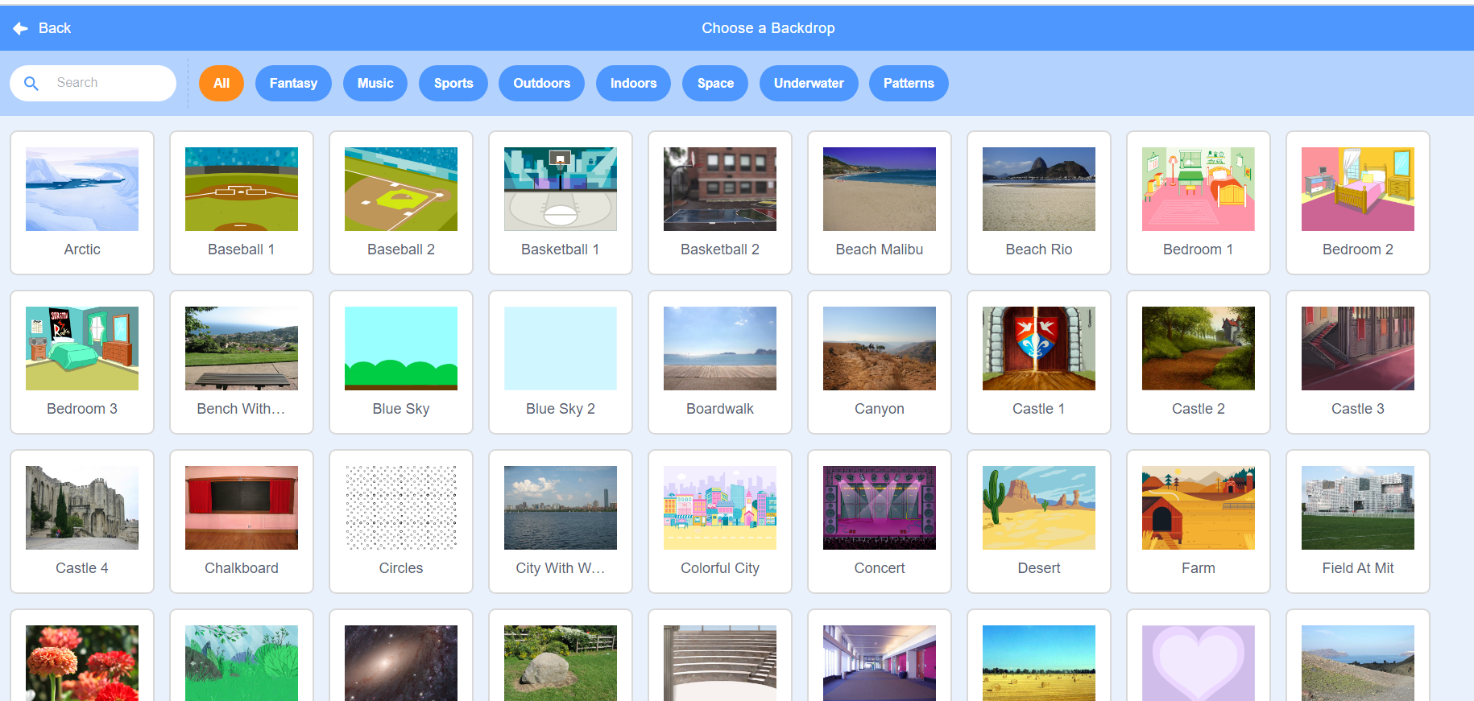
Notes:
To add your own backdrop, follow the same steps but click this icon instead. You’ll see lots of options to choose from appear.

Slide 39
Sharing your .sb3 file from CS First to CoCo
Create the file in CS First
In the Scratch editor, find the word “File” in the top-left corner.
Click on “File” menu and you’ll see some choices pop down.
Choose “Save to your computer.” This will download your Scratch project.
Look in your “Downloads” folder. That’s where your saved project might be.
Go to the CoCo website and log in to your account. https://wego.gmu.edu/scratchgo/login.php
Click proceed on the correct story in CoCo.
Navigate to the section of CoCo where you can upload your project. (only sb3 type and 10Mb max).
Click “Save”.
Notes:
Model how students can share Scratch creations to their teacher’s studio

Slide 40
Here is an optional video to learn how to share your project in Scratch.
Pause here.
Notes:
Video modeling how students can share Scratch creations to their teacher’s studio
Scratch - Imagine, Program, Share

Slide 41
Independent practice
Log into Scratch.
Add a sprite and a backdrop.
Share your project with your teacher’s studio.
Notes:
Students will practice logging into Scratch and adding a Sprite and Backdrop
Students should also practice sharing their Scratch project with their teacher’s studio
Teacher should monitor and check for correct sequencing during the independent practice activity.

Slide 42
Anyone can be a computer scientist!
Notes:
Share the “Careers in Tech” Video and remind students that anyone can be a computer scientist!

