Slide 1
Unit 4, lesson 2
Decomposition
5th & 6th grade
Lesson created by the GMU-ODU CSforAll Team. For more information about
this lesson and our CSforAll initiative, contact Dr. Amy Hutchison at ahutchison1@ua.edu

Slide 2
Summary and Standards
Summary:
In this lesson, students will be guided through Level 5 of Coco and new features and blocks in Scratch.
ELA Standards
The student will write in a variety of forms to include narrative, descriptive, opinion, and expository.
a) Engage in writing as a process.
b) Identify audience and purpose.
c) Use a variety of prewriting strategies.
d) Use organizational strategies to structure
writing according to type.
e) Use transition words to vary sentence structure.
CS Standards:
The student will construct sets of step-by-step instructions (algorithms) both independently and collaboratively using sequencing and using loops.
The student will construct programs to accomplish a task as a means of creative expression using a block or text based programming language, both independently and collaboratively using sequencing and using loops.
The student will analyze, correct, and improve (debug) an algorithm that includes sequencing, events, loops and variables.
Notes:
Today

Slide 3
Materials and resources needed for this lesson:
Reminder:
In this lesson, every student should be assigned a story in CoCo using Level 5.
The story should be titled “Unit 4 Summary.”
Each student should save their work using this naming strategy: “Student Name + Unit # + Descriptor”, for example, “Johnny Unit 4 Summary.”
Chromebook/Laptop
Internet Access
Teacher Unit 4, Lesson 2 slide deck
Coco Link
Teacher should have assigned story in CoCo, using naming strategy “Unit 4 Summary”
Scratch link
Notes:
You will need….[read slide]

Slide 4
Lesson Objectives: I can…
Identify and use NEW BLOCKS
Write, review, and edit a summary in Coco Level 5 (Column 1)
Plan and self-monitor in Coco Level 5 (Columns 2, 3, 4)
Share my plan with a partner and modify plan based on feedback
Notes:
Let’s go over today’s lesson’s objectives: [read slide]

Slide 5
Decompose: to Break a problem down into smaller pieces
Decomposition (dee-comp–uh-zi–shun): breaking a large problem into smaller parts
Notes:
Computer scientists have to solve coding problems and need to make think about what steps they need to take and what order to do them in.
Sometimes the problem is so big or complex, it can be hard to know where to start.
Decomposition is when we break a problem down into smaller parts to make it easier to tackle.
It has many advantages. It helps us manage large projects and makes the process of solving a complex problem less scary and much easier to take on.
This Unit, we’re going to learn more about decomposition, our final computational thinking concept. Decomposition is going to be key in helping us to animate our new stories in Scratch with more Scratch blocks.”

Slide 6
SUMMARY: restates the main ideas of a story in your own words
Notes:
A summary restates the main ideas of a story in your own words. You have probably done this quite often after you have read or listened to a story. We don’t want to retell everything that happens in the story, we just want to share the main idea

Slide 7
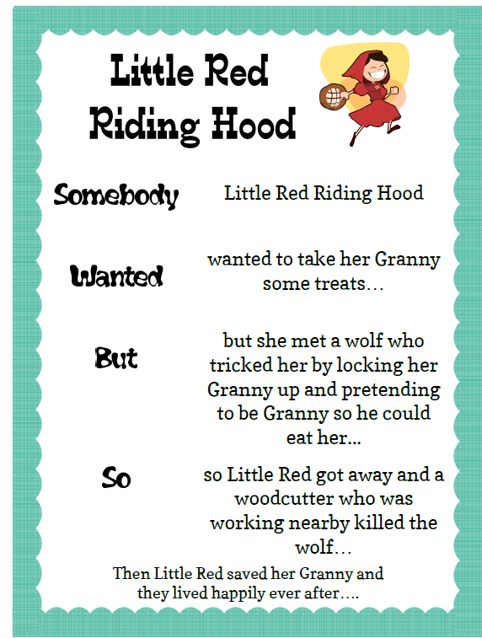
Somebody… wanted…but….so…. Then
Somebody: Character
Wanted: Goal/motivation
But: Conflict/problem
So: Resolution
Then: How does it end?
Notes:
There are several ways that we can decompose a story, but Today, we’re going to review one great strategy for summarizing. This strategy uses these anchor words to help us create a summary: “Somebody Wanted But So Then” {Read Slide}
Let’s see how this strategy can help use decompose the familiar story of Little Red Riding Hood. To do this, we can use Coco, our favorite graphic organizer, to help us. Today, we are briefly going to be introduced to Level 4 of Coco, where we can record our summaries. Let me show you how.

Slide 8
Share with a partner
Instructions:
Identify a story to summarize.
Answer the following questions:
What are the main ideas of the story?
What details from the story are important to include in your summary?
What details from the story are not that important to the main idea?

Slide 9
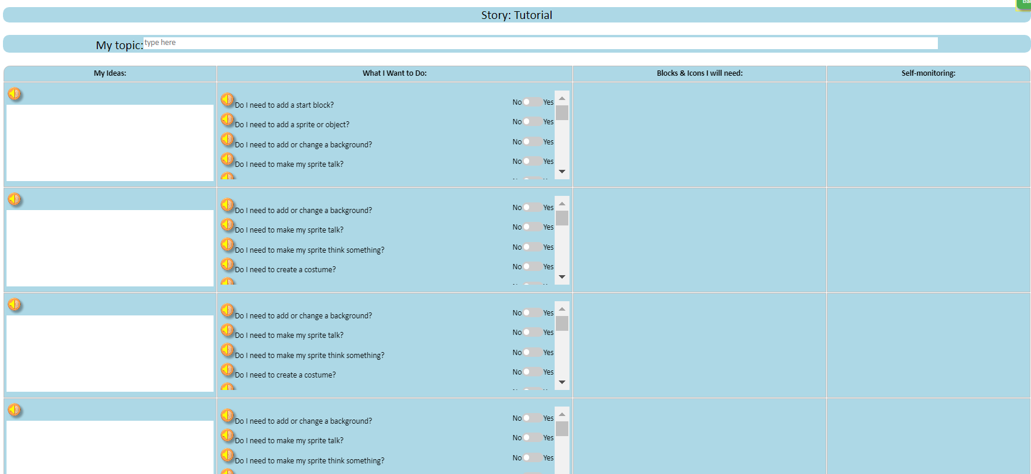
Summarize in CoCo LEvel 5: Column 1, our writing
Notes:
Remember, there are four columns in CoCo to complete. For now, we are going to add our writing into Column 1. Under, “My Ideas”

Slide 10
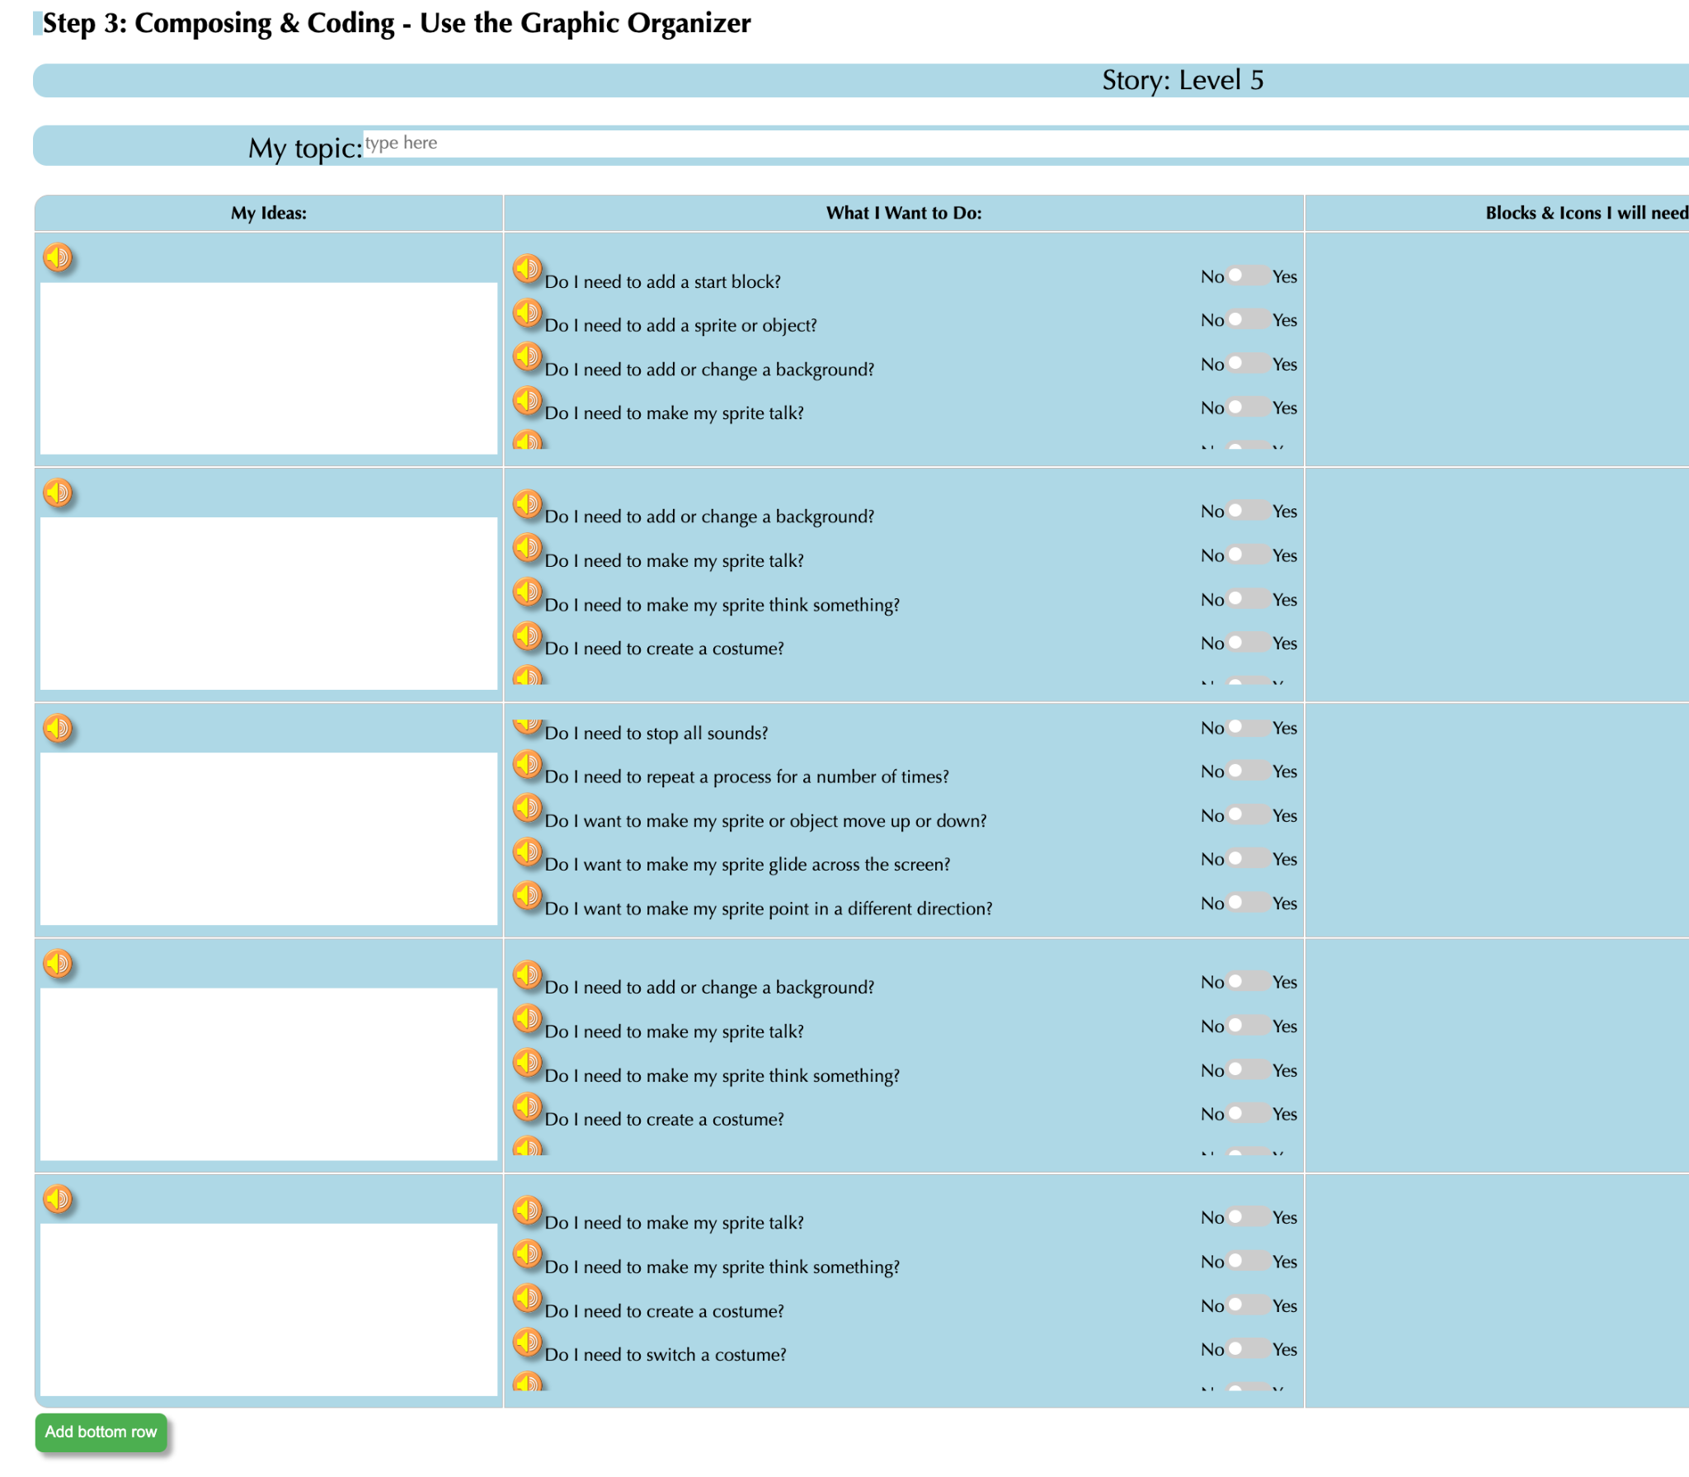
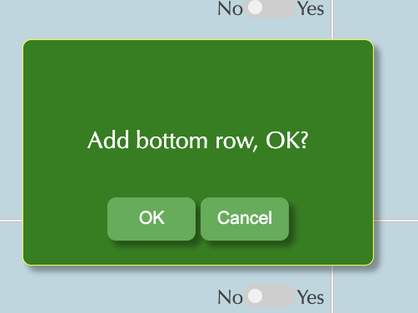
Adding More Rows to CoCo level 5
Notes:
One change in level 5 is that you can add more rows to CoCo. Click on the green button that says “Add Bottom Row” and then click “OK” and a new row will appear.

Slide 11
Complete Column 1 in CoCo
Make sure you are using CoCo!
Notes:
Pause here and students should fill in CoCo with their writing in CoCo Column 1 from their paper graphic organizer from last time

Slide 12
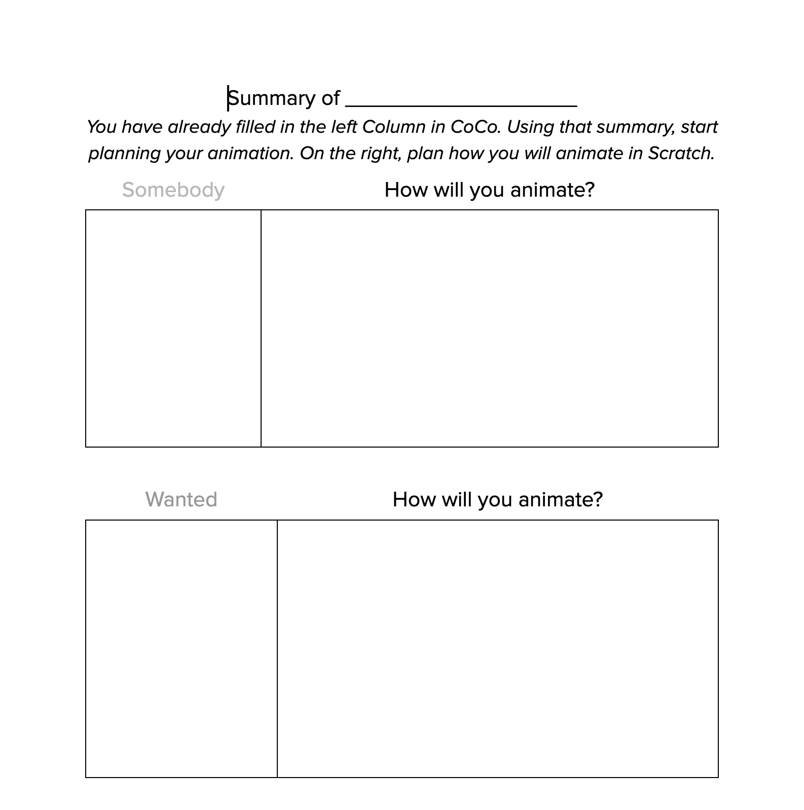
Plan your Animation graphic organizer
Now, plan how you will animate each part of your summary in Scratch using the graphic organizer your teacher provides.
Note, you do not need to write your summary again, but make sure your planning matches what you wrote in CoCo.

Slide 13
Summarize in CoCo LEvel 5: Column 2 & 3, Our Scratch Plan
Notes:
Next, students should use the paper graphic organizer to plan and select blocks for Scratch in CoCo columns 2 & 3, based on their planned animation

Slide 14
Complete Columns 2 & 3 in CoCo
Make sure you are using CoCo!
Notes:
Pause here and students should fill in CoCo with their writing in CoCo Columns 2 & 3from their paper graphic organizer from last time

Slide 15
Edit & revise with a friend
Notes:
.Have students share their plan with a partner and offer suggestions for enhancing or modifying their plan and/or writing.

Slide 16
Event Blocks
Notes:
Review

Slide 17
Conditional control blocks
Notes:
Today, we will learn about the “create clone” block
Cloning is a feature that allows a sprite to create a copy of itself while the project is running. Each clone has the same costumes, sounds, scripts, and variables as the original but is otherwise independent.
Cloning is commonly used when a project has many similar sprites doing similar things. Because clones are created by the project rather than the user, cloning prevents the user from needing to make the same changes to each of many sprites.
Today we will use the “Create a Clone” block, which clones the sprite selected

Slide 18
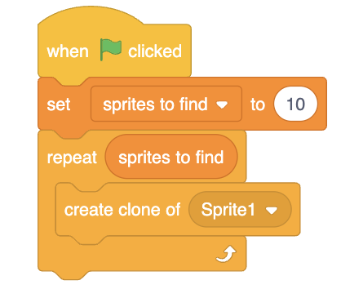
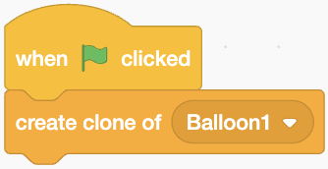
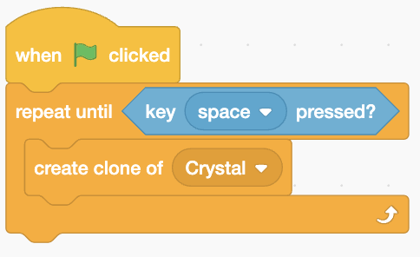
Create clone Block (VIDEO)
Cloning is often used when a sprite must make copies of itself. Here are some examples.

Slide 19
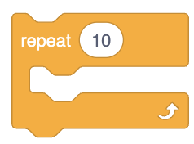
Your turn: Pause here and Try out “Create clone” block
Using the following blocks, create an artistic animation of your name:
Notes:
Using the “Create a Clone” block, create an animation where you create a clone of

Slide 20
Wrap up: Which block are you most excited to use for animating your summary? Why?
Notes:
“Next time, we will be animating our summaries in Scratch. Turn and talk to a partner about which blocks you may want to try to use in Scratch and why.”

