Slide 1


Student slides
Lesson 1
3rd & 4th Grade
Lesson created by the GMU-ODU CSforAll Team. For more information about
this lesson and our CSforAll initiative, contact Dr. Amy Hutchison at achutchison1@ua.edu

Slide 2
Lesson Objectives: I can…
Review familiar patterns and sequences
Review Scratch objects and blocks
Identify and use the start block, speak block, think block
Select and drag Scratch blocks to sequence a code (unplugged)

Slide 3







Scratch block Warm up: Pattern 1
Use this space to create your pattern digitally! You can use the space on this slide to copy, paste, and move around the blocks to create your pattern.

Slide 4
Scratch block Warm up: Pattern 2
Use this space for your second pattern (if you have one!)

Slide 5

Pair Programming
https://www.dropbox.com/scl/fi/mbqb1i88iulbi5pbl18ih/Pair-Programming-1080p.mp4?rlkey=bdnmsj9rwfu2p81qsxwg9n2vw&st=rj6ki4sl&dl=0
Notes:
Watch this video if working in pairs.

Slide 6




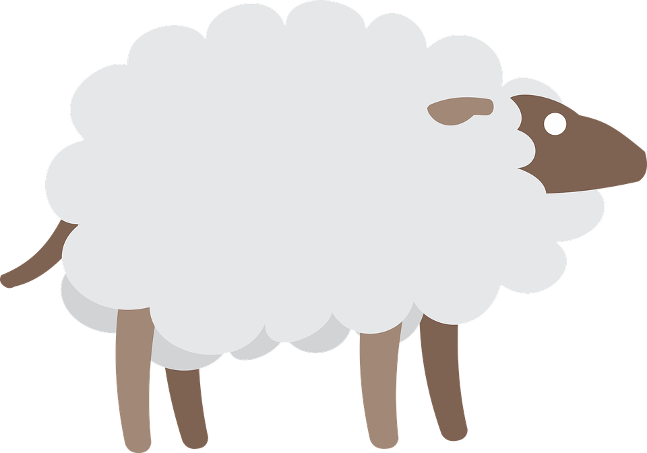


Put the blocks in the correct order to help the sheep find the grass.
1
90
90
Each square equals to a single step
Drag the blocks from the middle column to the right column to solve the puzzle.
1
1

Slide 7
Put the blocks in the correct order to help the sheep find the grass.
1
1
90
1
90
Drag the blocks from the middle column to the right column to solve the puzzle (Only use the provided blocks).
1
There is an extra block that is not needed in the solution.

Slide 8
Put the blocks in the correct order to help the sheep find the grass.
1
1
90
1
1
90
Drag the blocks from the middle column to the right column to solve the puzzle.
90

Slide 9
Now it is your turn to create puzzles and ask your friends to solve them based on the challenges you provided.
1
90
90
1
1

Slide 10
Great job!

Slide 11
Student slides
Lesson 2
3rd & 4th Grade
Lesson created by the GMU-ODU CSforAll Team. For more information about
this lesson and our CSforAll initiative, contact Dr. Amy Hutchison at ahutchi9@gmu.edu

Slide 12
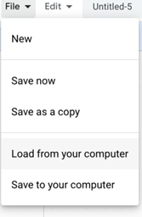

Independent Practice:
First, open a new window in your browser.
Next, download the .sb3 file from the following link: https://bit.ly/3rkIjBQ
Then, go to the following CS First Scratch Link: https://bit.ly/3PexYzB and open the Coco link that was shared by your teacher and click on Level 1.
Next, Click Sign in on CS First and Choose “I’m a student”
Then, Click “File” menu and Choose “Load from your computer”
Next, use the story and code you see in each row of CoCo Level 1 to put your jumbled code into the correct sequence in CS First. NOTE: if you do not see any code in CS First, be sure to scroll up and down.
Last, play your animation in Scratch by pressing the green flag.
Finally, correct any mistakes you made by fixing your code!
Pause here. (10-15 minutes)
Notes:
Ok, here is the sequence of steps to complete you independent practice. Your teacher is going to share two links with you that you will need to open on your computer.
Pause here.

Slide 13
Student slides
Lesson 3
3rd & 4th Grade
Lesson created by the GMU-ODU CSforAll Team. For more information about
this lesson and our CSforAll initiative, contact Dr. Amy Hutchison at ahutchi9@gmu.edu
Lesson created by the GMU-ODU CSforAll Team. For more information about
this lesson and our CSforAll initiative, contact Dr. Amy Hutchison at ahutchi9@gmu.edu

Slide 14
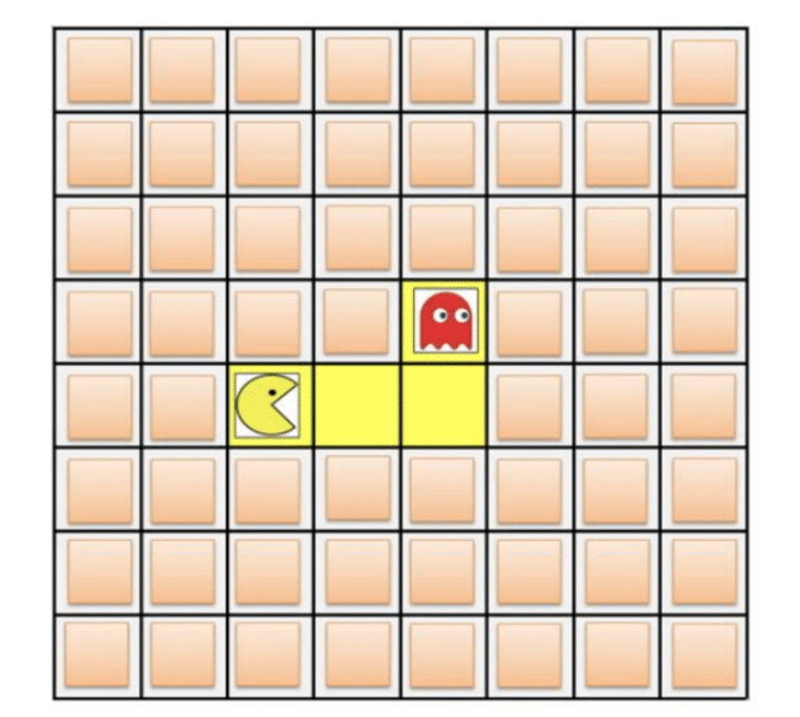
Patterns & sequencing review activity
Warm up with this activity.
Answer each question
Review answers as a class!

Slide 15


Independent practice
Write a recipe for making a drink.
You may choose to write about lemonade, Koolaid, or another drink of your choice!
https://www.dropbox.com/scl/fi/qf1j67ajoq6tu0gacc460/Lemonade-or-Koolaid-recipe.docx.docx?dl=0&rlkey=4vm66w2jppnter0oqmgmw8i2t
Notes:
In a moment, you will navigate to your student slide deck. In the deck is an outline for you. You will choose whether you want to write instructions for making lemonade or tea. Then you will type you instructions in. There is also a link to this document in the handouts, for the option to hand write your instructions. Your teacher will let you know what to do next.

Slide 16
Student slides
Lesson 4
Lesson created by the GMU-ODU CSforAll Team. For more information about
this lesson and our CSforAll initiative, contact Dr. Amy Hutchison at ahutchi9@gmu.edu
Lesson created by the GMU-ODU CSforAll Team. For more information about
this lesson and our CSforAll initiative, contact Dr. Amy Hutchison at ahutchi9@gmu.edu

Slide 17
Warm up
Open your slide deck and navigate to activity slide.
Visit scratch.mit.edu to figure out how to do each task.
Drag the blue box to the correct item.
Pause here (10 minutes)
Notes:
Ok, so you will [read slide]
Pause here while you work

Slide 18




Supercoders, move the blue boxes to the right answer.
Which one of these is the start block?
Which one of these is the wait block?
Is the think block purple?
True
False
Which one of these is the choose a sprite block?
Is the move block colored yellow, purple, or blue?
yellow
purple
blue
Which block allows you to switch to a new costume?
Notes:
In a moment, your teacher will share the slide deck with you and you will see a screen like this. You will drag the blue box to the correct answer. You may also want to navigate to Scratch on your device if you can’t remember how to do some of these things in Scratch. Once you are done, we will go over the answers together!
Acknowledgments: Adapted from CS+Fables

Slide 19
Student slides
Lesson 5
Lesson created by the GMU-ODU CSforAll Team. For more information about
this lesson and our CSforAll initiative, contact Dr. Amy Hutchison at ahutchi9@gmu.edu
Lesson created by the GMU-ODU CSforAll Team. For more information about
this lesson and our CSforAll initiative, contact Dr. Amy Hutchison at ahutchi9@gmu.edu

Slide 20

Optional Debugging Activity
ASSISTANCE NEEDED! CAN YOU DEBUG THESE CODING PROJECTS?
In this activity, you will examine the problem and find a solution for each of the debugging challenges

Slide 21
Tips
There are often multiple solutions to a problem.
Make a list of possible bugs in the program.
Break the program into smaller, manageable pieces.
Test the program out first to identify the problem.
Keep track of your work! This can be a useful reminder of what you have already tried and point you toward what to try next.
Share and compare your problem finding and problem solving approaches with a neighbor until you find something that works for you!
Notes:
Adopted from Debug it! And Scratch debugging strategies

Slide 22

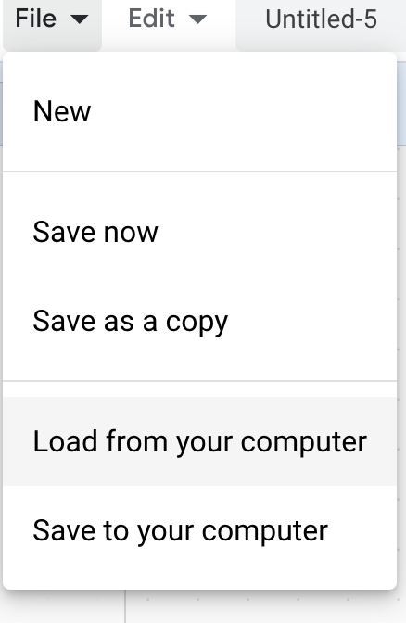
Debugging Challenge 1:
To debug, download the .sb3 file from the following link: https://bit.ly/3RcpLyo
Next, go to the following CS First Scratch Link: https://bit.ly/3PexYzB
Click Sign in and Choose “I’m a student”
Click “File” menu and Choose “Load from your computer”
Now you can start debugging!!! Have fun!!!
Challenge: In this project, when the green flag is clicked, firstly Coco should say ‘’Hello, World! I'm Coco." in a speech bubble and next Pascal should say "Hello, World! I'm Pascal." in a speech bubble. However, both Coco and Pascal's speech bubbles appear at the same time. How can we debug this?
Notes:
https://drive.google.com/uc?id=101Dm_z5Q4ey2P-jLWdat31g_4bLJcXDR&export=download

Slide 23
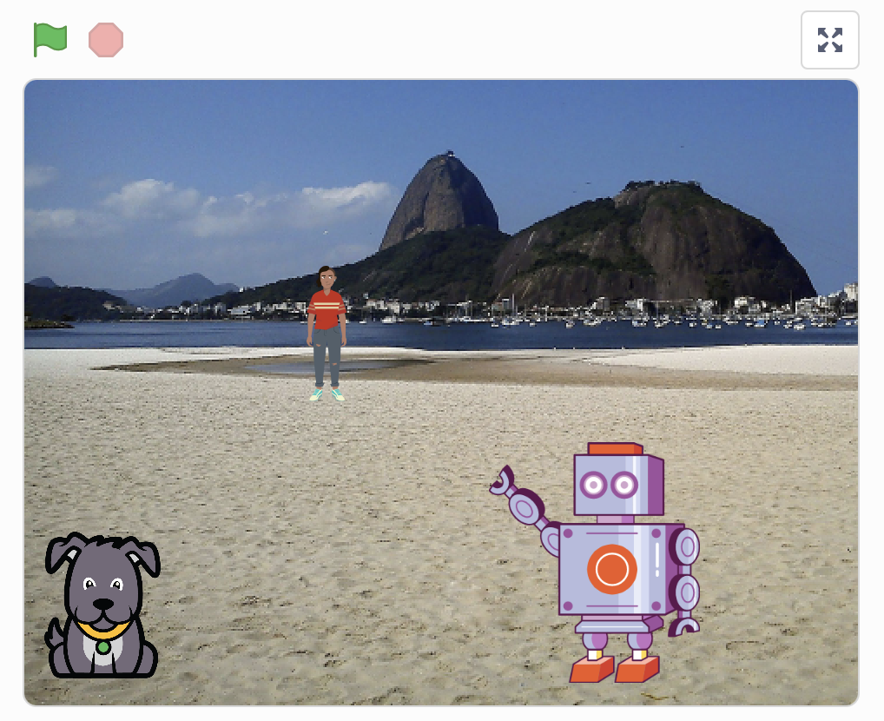
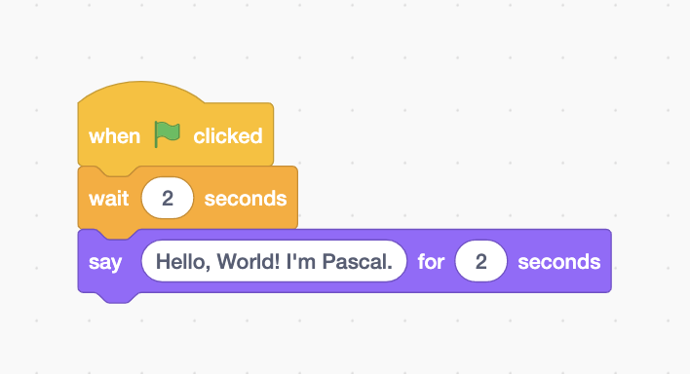
Debugging Challenge 1 Answer Key
After you have tried to debug this challenge, check out this project for a sample solution using https://bit.ly/3Lm6Ey7
Possible Solution:

Slide 24
Debugging Challenge 2:
To debug, download the .sb3 file from the following link: https://bit.ly/460mk1Y
Next, go to the following CS First Scratch Link: https://bit.ly/3PexYzB
Click Sign in and Choose “I’m a student”
Click “File” menu and Choose “Load from your computer”
Now you can start debugging!!! Have fun!!!
Challenge: In this project, when the green flag is clicked, Coco firstly should say ‘’Woof! Woof!" in a speech bubble and next as a sound. But the sound happens before the speech bubble- and Coco only makes one ‘Woof!’ sound! How can we debug this?
Notes:
https://drive.google.com/file/d/1fq0EiEv5HhEhYSBLjXUyWVfoFNLPU9b5/view?usp=sharing
https://drive.google.com/uc?id=1fq0EiEv5HhEhYSBLjXUyWVfoFNLPU9b5&export=download
https://bit.ly/460mk1Y

Slide 25
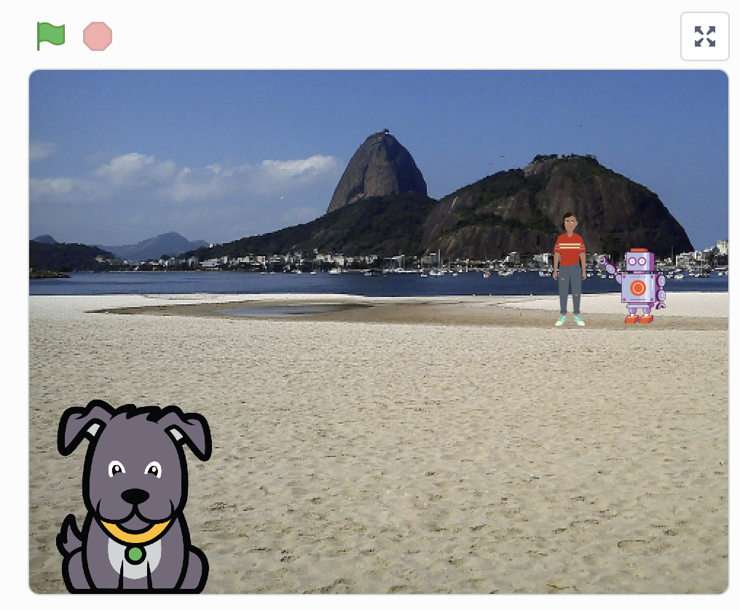
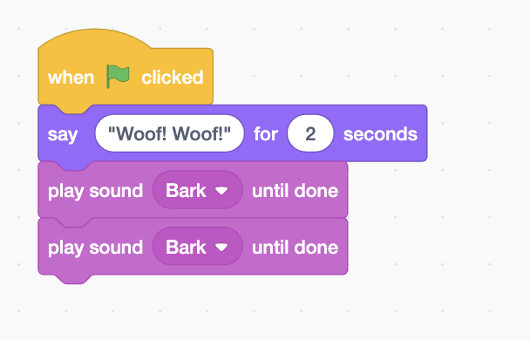
Debugging Challenge 2 Answer Key
After you have tried to debug this challenge, check out this project for a sample solution using https://bit.ly/3RriBGq
Possible Solution:
Notes:
https://drive.google.com/file/d/1TyH_8Q3-0yiFlIkQov59p_TlgqKcrmMN/view?usp=sharing
https://drive.google.com/uc?id=1TyH_8Q3-0yiFlIkQov59p_TlgqKcrmMN&export=download
https://bit.ly/3RriBGq

Slide 26
Debugging Challenge 3:
To debug, download the .sb3 file from the following link: https://bit.ly/3RfWliX
Next, go to the following CS First Scratch Link: https://bit.ly/3PexYzB
Click Sign in and Choose “I’m a student”
Click “File” menu and Choose “Load from your computer”
Now you can start debugging!!! Have fun!!!
Challenge: When the green flag is clicked, both Coco and Pascal should respond to Pearl and say "Hi, Pearl!". But only Pascal responds and says "Hi, Pearl!". How do we fix the program?
Notes:
https://drive.google.com/file/d/1Wx4EdU4qF_y7CAPnmUP86OepZeCY5a1O/view?usp=sharing
https://drive.google.com/uc?id=1Wx4EdU4qF_y7CAPnmUP86OepZeCY5a1O&export=download
https://bit.ly/3RfWliX

Slide 27
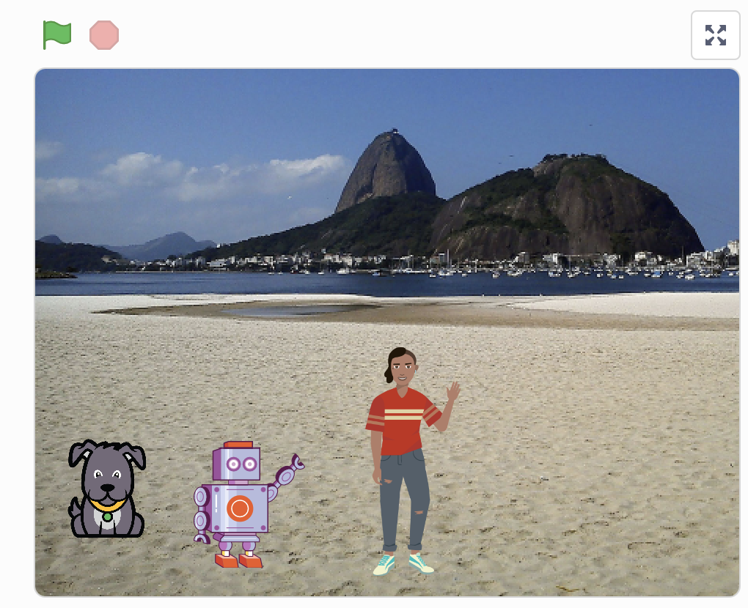
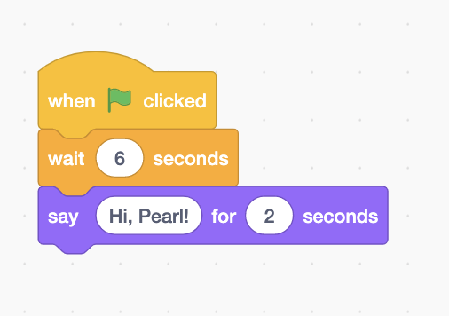
Debugging Challenge 3 Answer Key
After you have tried to debug this challenge, check out this project for a sample solution using https://bit.ly/3RmSlNw
Possible Solution:
Notes:
https://drive.google.com/file/d/1yCUpHkIS0JDOAN860UF0LwgWZheCzlAK/view?usp=sharing
https://drive.google.com/uc?id=1yCUpHkIS0JDOAN860UF0LwgWZheCzlAK&export=download
https://bit.ly/3RmSlNw

Slide 28

Debugging Challenge 4 - Bonus
To debug, visit the following link: https://bit.ly/3HI5NmX
Next, click on
Challenge: When green flag is clicked, Coco should start on top of bed. Can you reset?

Slide 29
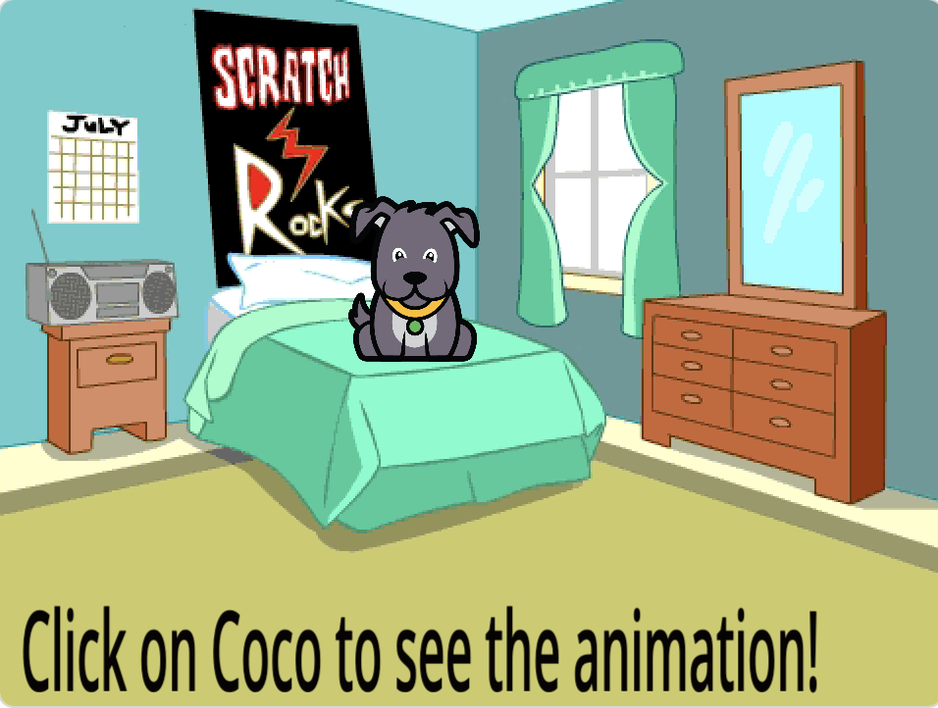
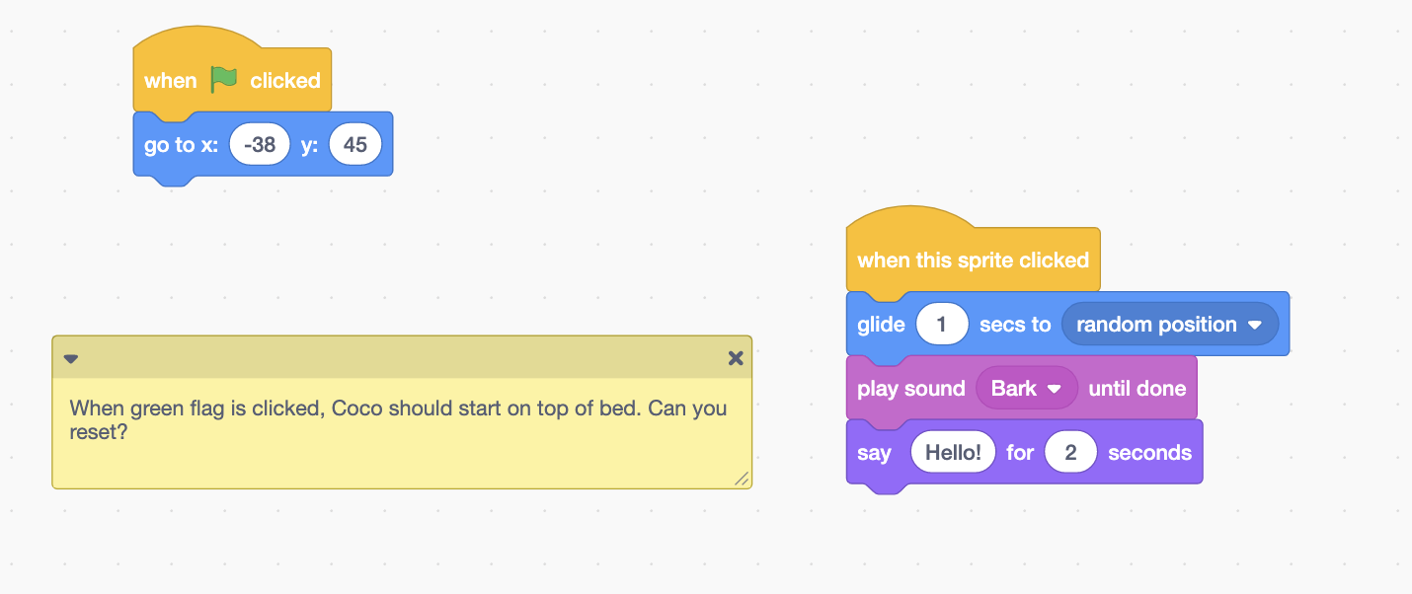
Bonus Debugging Challenge 4 Answer Key
After you have tried to debug this challenge, check out this project for a sample solution using https://bit.ly/32Ti2yu
Possible Solution:

Slide 30
Debugging Challenge 5: Bonus
To debug, visit the following link: https://bit.ly/3qPnaLT
Next, click on
Challenge:
(1) I do not want Coco to think, "Hello! I'm Coco. " I want Coco to say, "Hi, my name is Coco."
(2) I do not want Coco to move 200 steps. I want Coco to move 100 steps.
(3) Also, I want Coco to go back to the center of the stage when I click the green flag.
(4) Also, I do not want Coco to meow, I want Coco to bark when I click the green flag.
What should I do? Can you help?

Slide 31
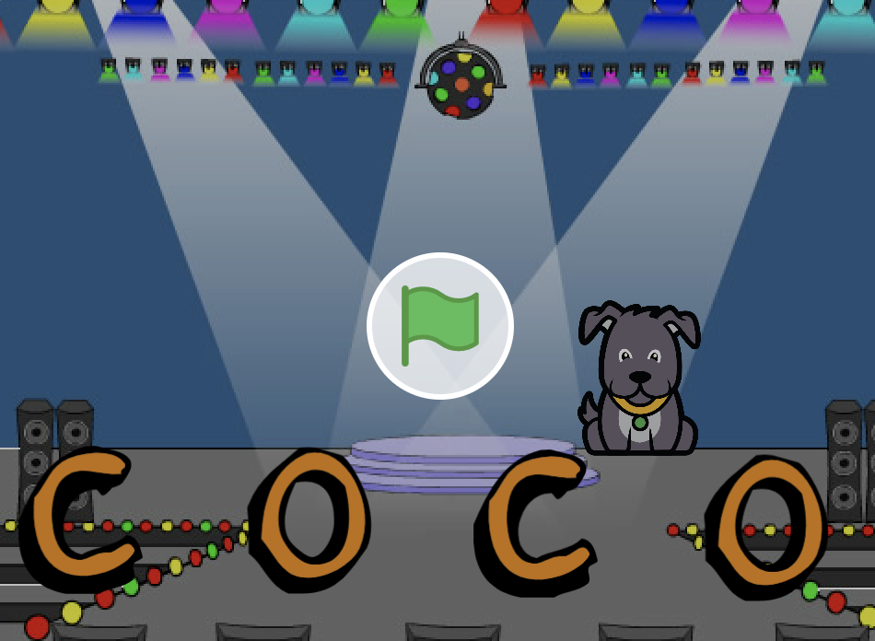
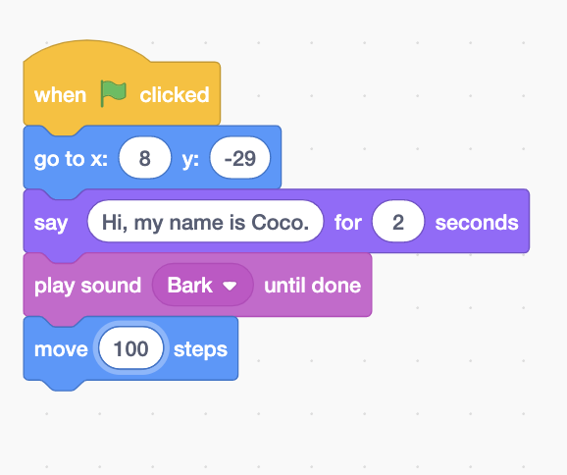
Debugging Challenge 5 Answer Key
After you have tried to debug this challenge, check out this project for a sample solution using https:/bit.ly/3zuSHXw
Possible Solution:

Slide 32
Debugging Challenge 6: Bonus
Hint: Pay attention to “Wait” blocks
To debug, visit the following link: https://bit.ly/3EYeGr4
Next, click on
Challenge: In this project, Coco wants to show you a dance. When you click on the green flag, she should do a dance while the dance music plays along with her. However, as soon as she starts to dance she stops but the dance beat continues without her! How can we fix this program?

Slide 33
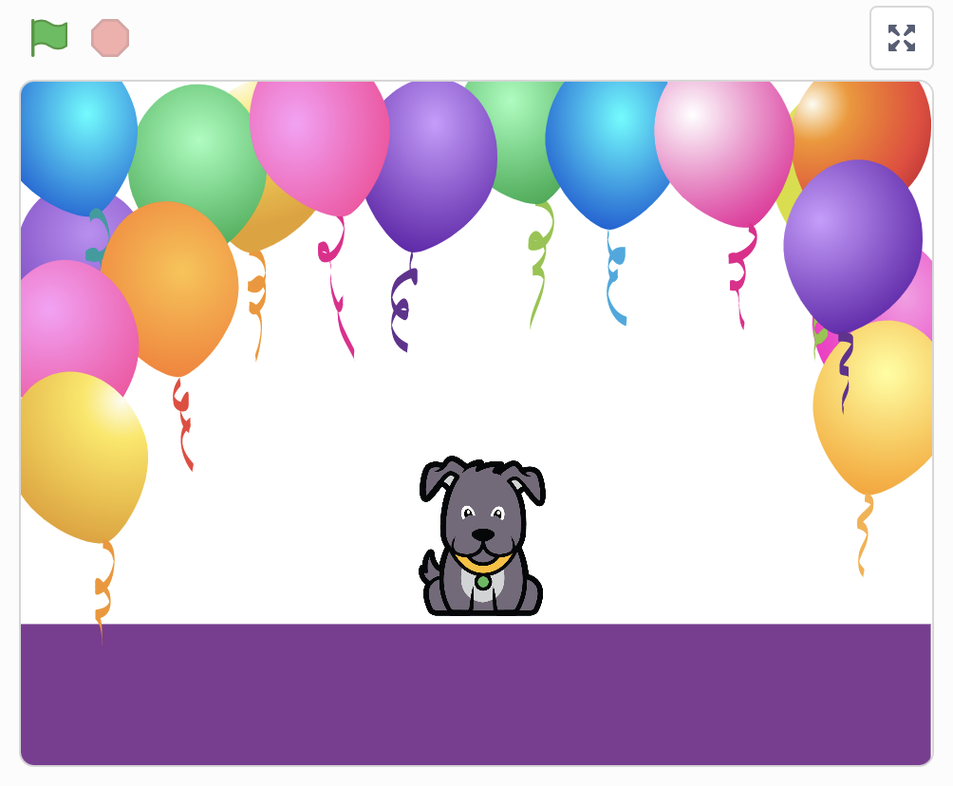
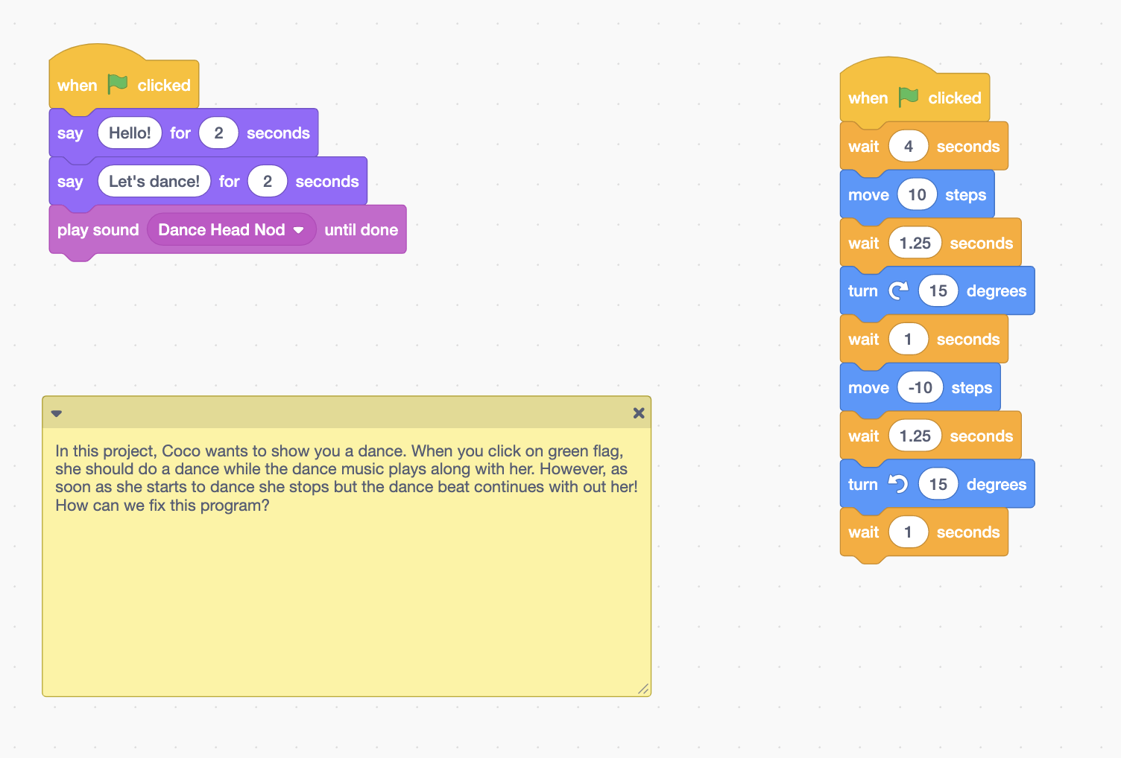
Bonus Debugging Challenge 6 Answer Key
After you have tried to debug this challenge, check out this project for a sample solution using https://bit.ly/3JDZUZU
Possible Solution:

Slide 34
Finished!
Discuss your testing and debugging practices with a partner. Make note of the similarities and differences in your strategies.
Add code commentary by right clicking on blocks in your scripts. This can help others understand different parts of your program!
Help a neighbor!
Notes:
Adopted from Debug it!

Slide 35
Acknowledgments:
Activities were adapted from ScratchEdTeam and Impact Conectar!

