Slide 1
Student slides
Lesson 1
Lesson created by the GMU-ODU CSforAll Team. For more information about
this lesson and our CSforAll initiative, contact Dr. Amy Hutchison at ahutchi9@gmu.edu
Notes:
Hello! My name is Britt Miller. Well done on finishing Unit 1 on patterns and sequencing. I am excited to continue learning with you about Computer Science and Literacy!

Slide 2
Review: Sequence puzzles
Solve the puzzles by dragging the Scratch blocks in the correct order
When you’re done, switch with a partner and check each other’s work
Raise your hand if you have any questions!

Slide 3
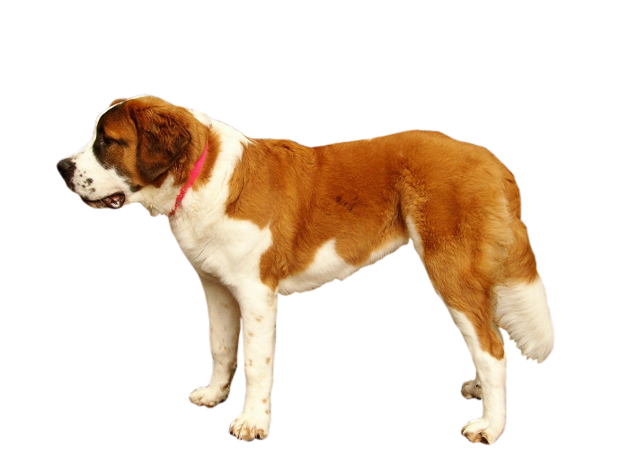
Put the blocks in the correct order to help the dog find the first aid box.
1
90
1
Each square equals to a single step
Drag the blocks from the middle column to the right column to solve the puzzle.
1
90

Slide 4
Put the blocks in the correct order to help the dog find the first aid box.
1
90
1
Each square equals to a single step
Drag the blocks from the middle column to the right column to solve the puzzle.
1

Slide 5
Put the blocks in the correct order to help the dog find the first aid box.
1
1
90
1
90
Each square equals to a single step
Drag the blocks from the middle column to the right column to solve the puzzle (Only use the provided blocks).
1
There is an extra block that is not needed in the solution.

Slide 6
Put the blocks in the correct order to help the dog find the first aid box.
1
1
90
1
1
1
There are extra blocks that are not needed in a correct solution.
90
Each square equals to a single step
Drag the blocks from the middle column to the right column to solve the puzzle.
90
1

Slide 7
Independent practice
Write a set of instructions by using the template.
Note: you will continue working with this set of instructions, so be creative!

Slide 8
Student slides
Lesson 2
Lesson created by the GMU-ODU CSforAll Team. For more information about
this lesson and our CSforAll initiative, contact Dr. Amy Hutchison at ahutchi9@gmu.edu

Slide 9
Code an animation of a word
Steps:
Open your browser and go to https://scratch.mit.edu/
Choose your backdrop
Remove the cat sprite
Add the letters of your initials, word, or name–one sprite per letter!
Pick a sound and look block for each letter
Challenge: change the pitch effect on at least ONE of your letters
Optional tutorial video: https://scratch.mit.edu/projects/editor/?tutorial=name

