Slide 1
Debugging with Coco
ASSISTANCE NEEDED! CAN YOU DEBUG THESE CODING PROJECTS?
In this activity, you will examine the problem and find a solution for each of the debugging challenges

Slide 2
Tips
There are often multiple solutions to a problem.
Make a list of possible bugs in the program.
Break the program into smaller, manageable pieces.
Test the program out first to identify the problem.
Keep track of your work! This can be a useful reminder of what you have already tried and point you toward what to try next.
Share and compare your problem finding and problem solving approaches with a neighbor until you find something that works for you!
Notes:
Adopted from Debug it! And Scratch debugging strategies

Slide 3
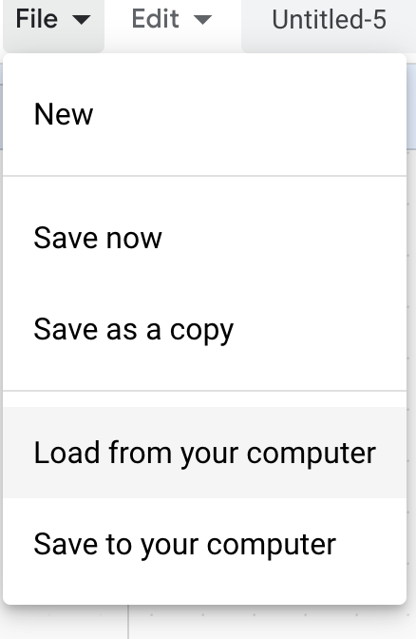
Debugging Challenge 1:
To debug, download the .sb3 file from the following link: https://bit.ly/3RcpLyo
Next, go to the following CS First Scratch Link: https://bit.ly/3PexYzB
Click Sign in and Choose “I’m a student”
Click “File” menu and Choose “Load from your computer”
Now you can start debugging!!! Have fun!!!
Challenge: In this project, when the green flag is clicked, firstly Coco should say ‘’Hello, World! I'm Coco." in a speech bubble and next Pascal should say "Hello, World! I'm Pascal." in a speech bubble. However, both Coco and Pascal's speech bubbles appear at the same time. How can we debug this?
Notes:
https://drive.google.com/uc?id=101Dm_z5Q4ey2P-jLWdat31g_4bLJcXDR&export=download

Slide 4
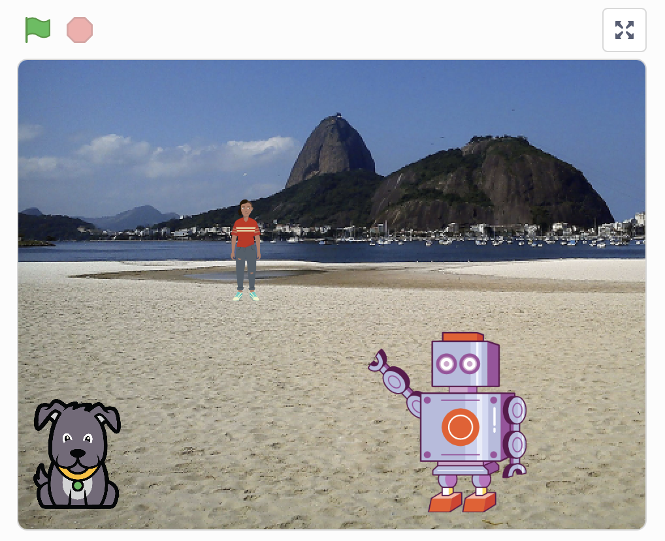
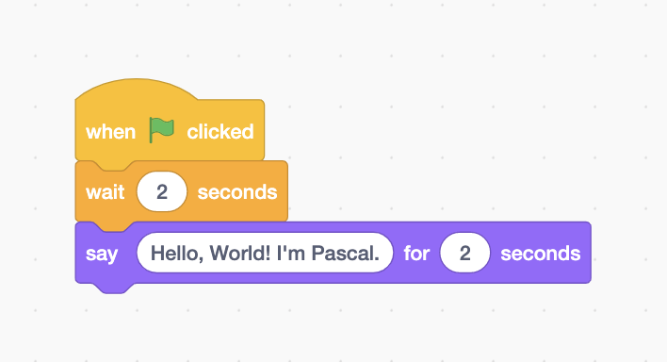
Debugging Challenge 1 Answer Key
After you have tried to debug this challenge, check out this project for a sample solution using https://bit.ly/3Lm6Ey7
Possible Solution:

Slide 5
Debugging Challenge 2:
To debug, download the .sb3 file from the following link: https://bit.ly/460mk1Y
Next, go to the following CS First Scratch Link: https://bit.ly/3PexYzB
Click Sign in and Choose “I’m a student”
Click “File” menu and Choose “Load from your computer”
Now you can start debugging!!! Have fun!!!
Challenge: In this project, when the green flag is clicked, Coco firstly should say ‘’Woof! Woof!" in a speech bubble and next as a sound. But the sound happens before the speech bubble- and Coco only makes one ‘Woof!’ sound! How can we debug this?
Notes:
https://drive.google.com/file/d/1fq0EiEv5HhEhYSBLjXUyWVfoFNLPU9b5/view?usp=sharing
https://drive.google.com/uc?id=1fq0EiEv5HhEhYSBLjXUyWVfoFNLPU9b5&export=download
https://bit.ly/460mk1Y

Slide 6
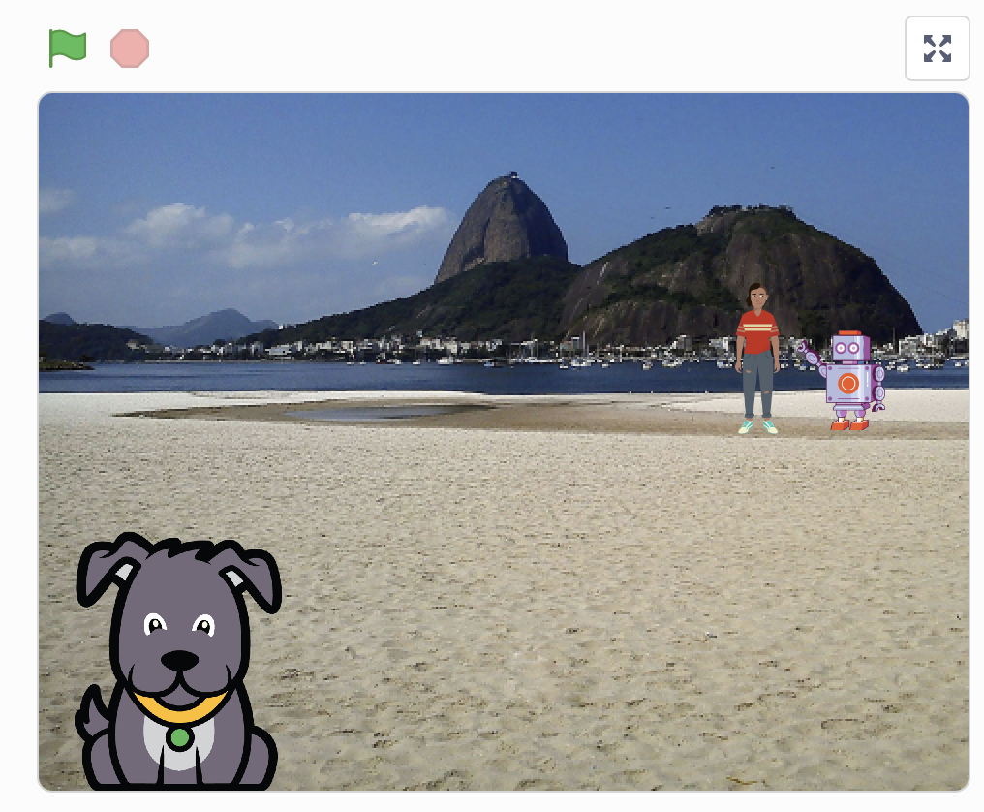
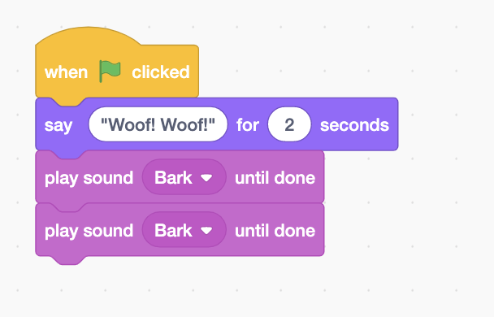
Debugging Challenge 2 Answer Key
After you have tried to debug this challenge, check out this project for a sample solution using https://bit.ly/3RriBGq
Possible Solution:
Notes:
https://drive.google.com/file/d/1TyH_8Q3-0yiFlIkQov59p_TlgqKcrmMN/view?usp=sharing
https://drive.google.com/uc?id=1TyH_8Q3-0yiFlIkQov59p_TlgqKcrmMN&export=download
https://bit.ly/3RriBGq

Slide 7
Debugging Challenge 3:
To debug, download the .sb3 file from the following link: https://bit.ly/3RfWliX
Next, go to the following CS First Scratch Link: https://bit.ly/3PexYzB
Click Sign in and Choose “I’m a student”
Click “File” menu and Choose “Load from your computer”
Now you can start debugging!!! Have fun!!!
Challenge: When the green flag is clicked, both Coco and Pascal should respond to Pearl and say "Hi, Pearl!". But only Pascal responds and says "Hi, Pearl!". How do we fix the program?
Notes:
https://drive.google.com/file/d/1Wx4EdU4qF_y7CAPnmUP86OepZeCY5a1O/view?usp=sharing
https://drive.google.com/uc?id=1Wx4EdU4qF_y7CAPnmUP86OepZeCY5a1O&export=download
https://bit.ly/3RfWliX

Slide 8
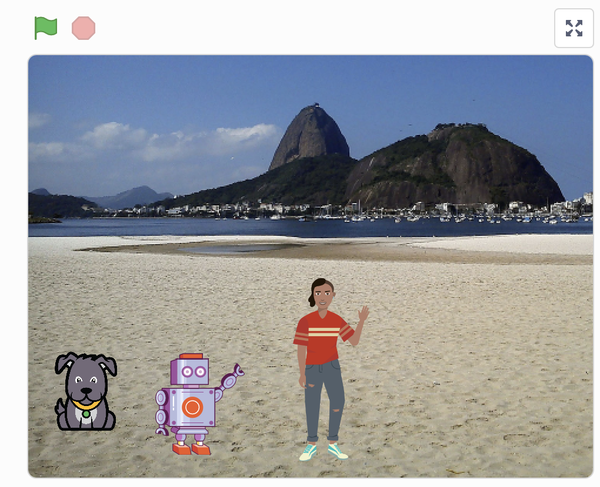
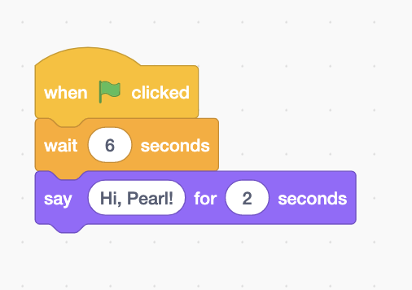
Debugging Challenge 3 Answer Key
After you have tried to debug this challenge, check out this project for a sample solution using https://bit.ly/3RmSlNw
Possible Solution:
Notes:
https://drive.google.com/file/d/1yCUpHkIS0JDOAN860UF0LwgWZheCzlAK/view?usp=sharing
https://drive.google.com/uc?id=1yCUpHkIS0JDOAN860UF0LwgWZheCzlAK&export=download
https://bit.ly/3RmSlNw

Slide 9
Finished!
Discuss your testing and debugging practices with a partner. Make note of the similarities and differences in your strategies.
Add code commentary by right clicking on blocks in your scripts. This can help others understand different parts of your program!
Help a neighbor!
Notes:
Adopted from Debug it!

Slide 10
Acknowledgments:
Activities were adapted from ScratchEdTeam and Impact Conectar!

