Slide 1


Lesson 4
Planning an animation
Grades 5 & 6
Lesson created by the GMU-ODU CSforAll Team. For more information about
this lesson and our CSforAll initiative, contact Dr. Amy Hutchison at achutchison1@ua.edu

Slide 2
Summary and Standards
Summary:
In this lesson, students will plan and code an animation in Scratch with the help of the CoCo graphic organizer. They will be introduced to the concept of debugging and new sound blocks in Scratch, as well as discuss what makes for a good animation of their writing.
ELA Standards
The student will write in a variety of forms to include narrative, descriptive, opinion, and expository.
a) Engage in writing as a process.
b) Identify audience and purpose.
c) Use a variety of prewriting strategies.
d) Use organizational strategies to structure
writing according to type.
e) Use transition words to vary sentence structure.
CS Standards:
-The student will construct sets of step-by-step instructions (algorithms) both independently and collaboratively using sequencing and using loops.
-The student will construct programs to accomplish a task as a means of creative expression using a block or text based programming language, both independently and collaboratively using sequencing and using loops.
-The student will analyze, correct, and improve (debug) an algorithm that includes sequencing, events, loops and variables.
Notes:
Today we will learn about debugging, a key process you will use in both computer science and writing.

Slide 3


Materials and resources needed for this lesson:
Reminder:
In this lesson, every student should be assigned a story in CoCo using Level 4.
The story should be titled “Lesson 4 Story.”
Each student should save their work using this naming strategy: “Student Name + Lesson # + Descriptor”, for example, “Johnny Lesson 4 Story”
Chromebook/Laptop
Internet Access
Teacher slide deck
Scratch Link
Student slides
CoCo Link
Written recipe from last lesson
Blank paper for brainstorming
Notes:
You will need….[read slide]

Slide 4
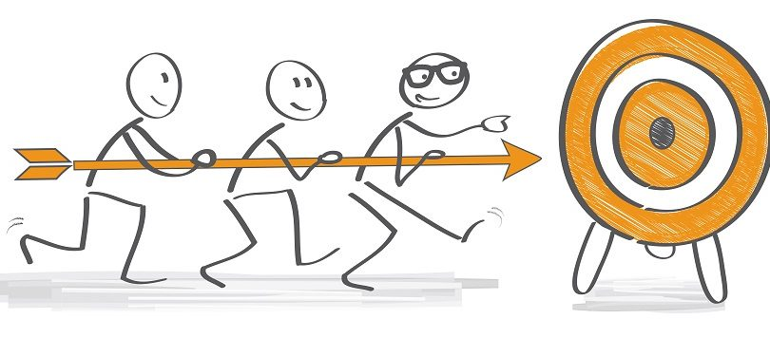
Lesson Objectives: I can…
Review familiar Scratch blocks with a scavenger hunt
Identify new Scratch sound blocks: play sound, record/upload a sound, change the pitch effect of a sound, stop all sounds
Practice using Scratch sound blocks
Define code, bugs, and debugging
Understand how to debug an algorithm
Discuss and understand the features of a good animation
Finish animating my recipe in Scratch
Evaluate my work
Share my animation with a partner
Notes:
Optional: Introduce lesson, learning goals, and resources (Slides # 2-4)

Slide 5
wARM UP: Scratch Scavenger HUnt
Notes:
Let’s warm-up with a scavenger hunt in Scratch to remember some things in scratch. You will use your student slide deck to work on this while you are looking for things in scratch.

Slide 6
Warm up
Open your slide deck and navigate to the last slide.
Visit scratch.mit.edu or Scratch for CS First to figure out how to do each task.
Drag the blue box to the correct item.
Pause here (10 minutes)
Notes:
Ok, so you will [read slide]
Pause here while you work

Slide 7

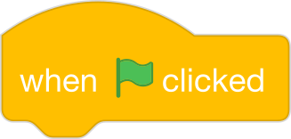
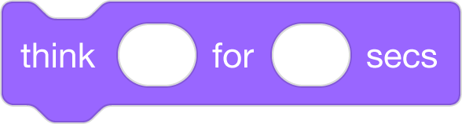

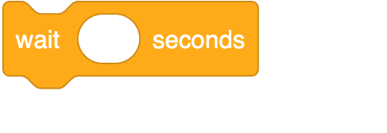

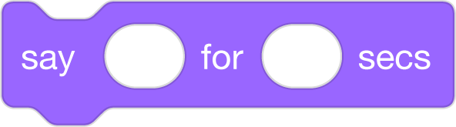
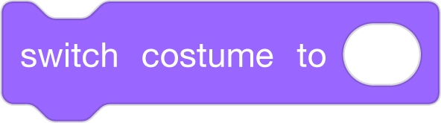
Supercoders, move the blue boxes to the right answer.
Which one of these is the start block?
Which one of these is the wait block?
Is the think block purple?
True
False
Which one of these is the choose a sprite block?
Is the move block colored yellow, purple, or blue?
yellow
purple
blue
Which block allows you to switch to a new costume?
Notes:
In a moment, I will share the slide deck with you and you will see a screen like this. You will drag the blue box to the correct answer. You may also want to navigate to Scratch on your device if you can’t remember how to do some of these things in Scratch. Once you are done, we will go over the answers together!
Acknowledgments: Adapted from CS+Fables

Slide 8
Answer Key:
Which one of these is the start block?
Which one of these is the wait block?
Is the think block purple?
True
False
Which one of these is the choose a sprite block?
Is the move block colored yellow, purple, or blue?
yellow
purple
blue
Which block allows you to switch to a new costume?
Notes:
Check to see if your answers were correct.

Slide 9
Lesson Objectives: I can…
Review familiar Scratch blocks with a scavenger hunt
Identify new Scratch sound blocks: play sound, record/upload a sound, change the pitch effect of a sound, stop all sounds
Practice using Scratch sound blocks
Define code, bugs, and debugging
Understand how to debug an algorithm
Discuss and understand the features of a good animation
Finish animating my recipe in Scratch
Evaluate my work
Share my animation with a partner
Notes:
Optional: Introduce lesson, learning goals, and resources (Slides # 2-4)

Slide 10
Introducing Scratch sound blocks

Slide 11
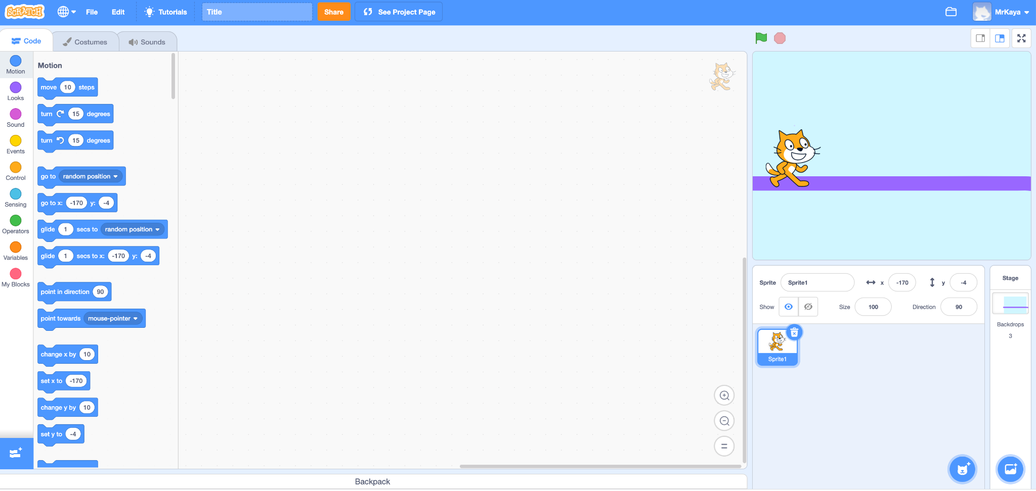
Introducing Scratch Sound blocks
Block categories
Notes:
Remember that on the far lefthand side of our page, we see a color palette. Each color corresponds to a different type of block. Today, we’ll focus on sound blocks, which are PINK.

Slide 12
Sound blocks
Do I need to play a sound?
Do I need to choose, upload, or record a sound?
Do I need to change the pitch effect of the sound?
Do I need to stop all sounds?
Notes:
For today, I am going to show you how to use two types of blocks you will see in level 4. You will see these questions in Coco{Read questions}. These are all related to the pink sound blocks in scratch. Let me show you how to use these blocks!

Slide 13


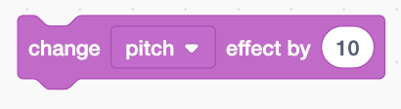

Sound Blocks:
Do I need to play a sound?
Do I need to choose, upload, or record a sound?
Do I need to change the pitch effect of the sound?
Do I need to stop all sounds?
Notes:
For these questions, you will use these blocks…read slide.

Slide 14
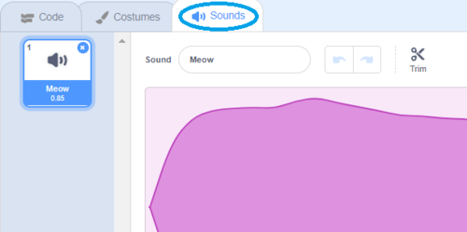

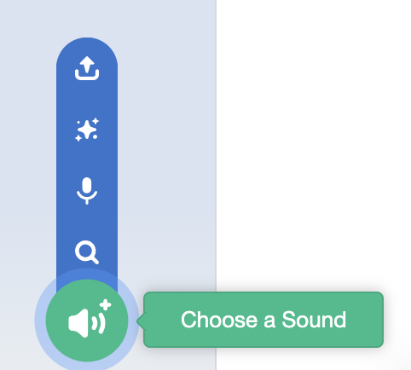
Sound Blocks: Do I need to choose, upload, or record a sound?
How to record or upload a sound:
1.
2.
3.
Notes:
But for this question, you will need to choose WHAT sound you are using. You can choose one from Scratch or upload or record your own sound!
In Scratch you will click on the Sounds tab at the top, then click the blue speaker with a plus sign, this will allow you to choose a sound.

Slide 15
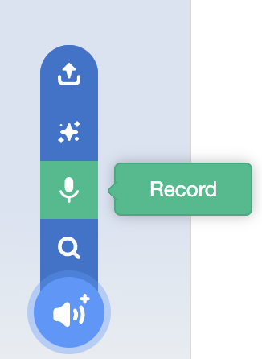
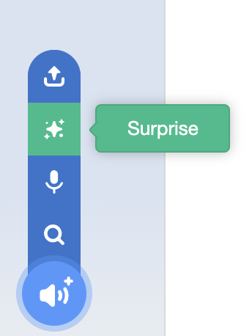
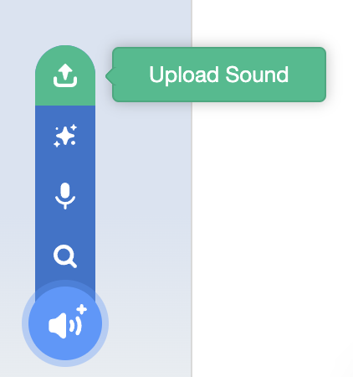
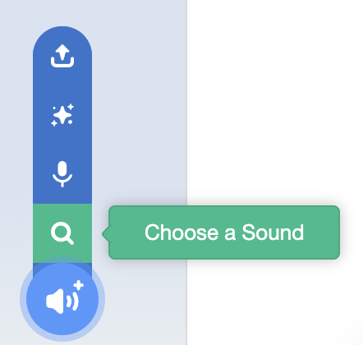
Sound Blocks: Do I need to choose, upload, or record a sound?
Notes:
Then you can decide how you want to choose your sound. Choose from the options in Scratch, record your own, let scratch choose, randomly, or you can upload a sound. Let me show you!

Slide 16
Your turn: Practice Using Scratch sound blocks
Steps:
Choose a new sprite (any animal that is not a cat!)
Change the sound of your sprite
Voice record your sprite to say at least one line of your written instructions

Slide 17
Pause to Work in Scratch

Slide 18
Lesson Objectives: I can…
Review familiar Scratch blocks with a scavenger hunt
Identify new Scratch sound blocks: play sound, record/upload a sound, change the pitch effect of a sound, stop all sounds
Practice using Scratch sound blocks
Define code, bugs, and debugging
Understand how to debug an algorithm
Discuss and understand the features of a good animation
Finish animating my recipe in Scratch
Evaluate my work
Share my animation with a partner
Notes:
Check off objectives as lesson proceeds.

Slide 19
Guided instruction

Slide 20
Code:
The language that computer scientists create and use to tell a computer what to do.
Notes:
Remember: code is the language that computer scientists create and use to tell a computer what to do. Code is how we can give instructions to a computer.

Slide 21
But what if….
Notes:
Ok, but what happens if we miss a step or make a mistake in writing our algorithm? Well, the computer or the human who is reading the instructions will not be able to accomplish the task! These mistakes are called….

Slide 22
Bugs: An error in a code that prevents the program from running as expected.
Notes:
"Bugs...but not the creepy, crawly critter that you might think of at first when you hear the word "bug." "Bugs" in computer science are errors in a code...." A bug is an error or mistake in your code that prevents the program from running as expected. It is like when you write something incorrect in your instructions and someone else can’t follow them because they are confused. When this happens in your writing you have to fix your mistake.

Slide 23
Debugging: looking for and fixing the errors in your code
Notes:
When you need to fix your error in your code we call that debugging. This means you are looking for your mistake and then fixing it. Everyone makes mistakes, even professionals!

Slide 24

To debug an algorithm, we…
Describe your problem.
Hunt for bugs (what is it in your code causing the problem).
Try out some solutions and test.
Remember what you learned from the bug.
Notes:
Whenever we realize that we have a bug, here are the steps for debugging. We [read slide]. Debugging happens all the time while we are coding! Let’s practice this process with some debugging challenges.
Debugging Recipe from Code.org: https://code.org/curriculum/docs/k-5/DebuggingTeacher.pdf
Let’s try this out!

Slide 25

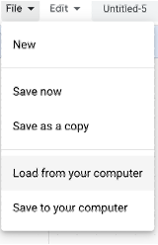
Debugging Challenge 1:
To debug, download the .sb3 file from the following link: https://bit.ly/3RcpLyo
Next, go to the following CS First Scratch Link: https://bit.ly/3PexYzB
Click Sign in and Choose “I’m a student”
Click “File” menu and Choose “Load from your computer”
Now you can start debugging!!! Have fun!!!
Challenge: In this project, when the green flag is clicked, firstly Coco should say ‘’Hello, World! I'm Coco." in a speech bubble and next Pascal should say "Hello, World! I'm Pascal." in a speech bubble. However, both Coco and Pascal's speech bubbles appear at the same time. How can we debug this?

Slide 26
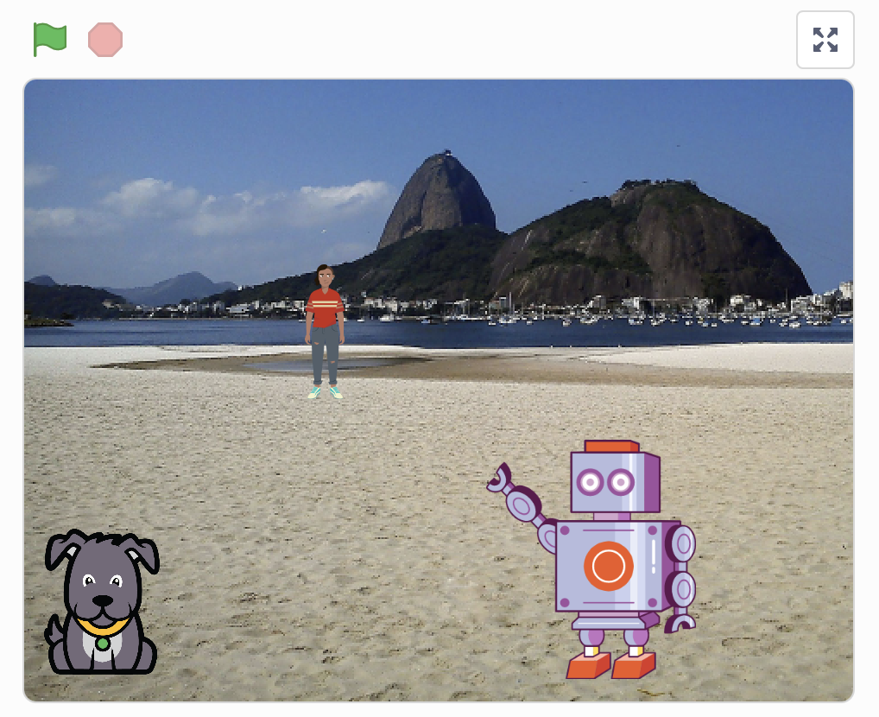
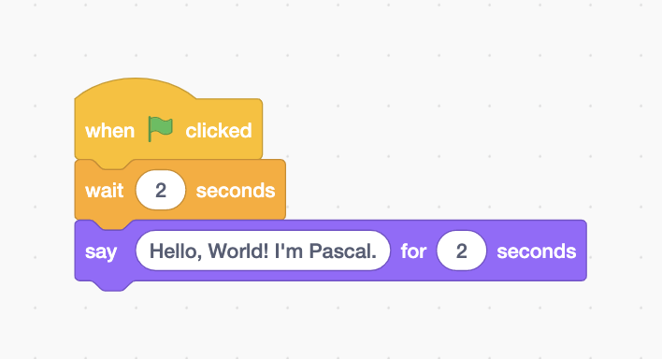
Debugging Challenge 1 Answer Key
After you have tried to debug this challenge, check out this project for a sample solution using https://bit.ly/3qiowQx
Possible Solution:

Slide 27
Debugging Challenge 2:
To debug, download the .sb3 file from the following link: https://bit.ly/460mk1Y
Next, go to the following CS First Scratch Link: https://bit.ly/3PexYzB
Click Sign in and Choose “I’m a student”
Click “File” menu and Choose “Load from your computer”
Now you can start debugging!!! Have fun!!!
Challenge: In this project, when the green flag is clicked, Coco firstly should say ‘’Woof! Woof!" in a speech bubble and next as a sound. But the sound happens before the speech bubble- and Coco only makes one ‘Woof!’ sound! How can we debug this?
Notes:
Debug .sb3 file dropbox link:
https://www.dropbox.com/scl/fi/9064hqcmicagr79mr1kgs/Coco-Debugging-Woof.sb3?rlkey=ebzjz1lfxknmrxv28zvi0tg6a&dl=0

Slide 28
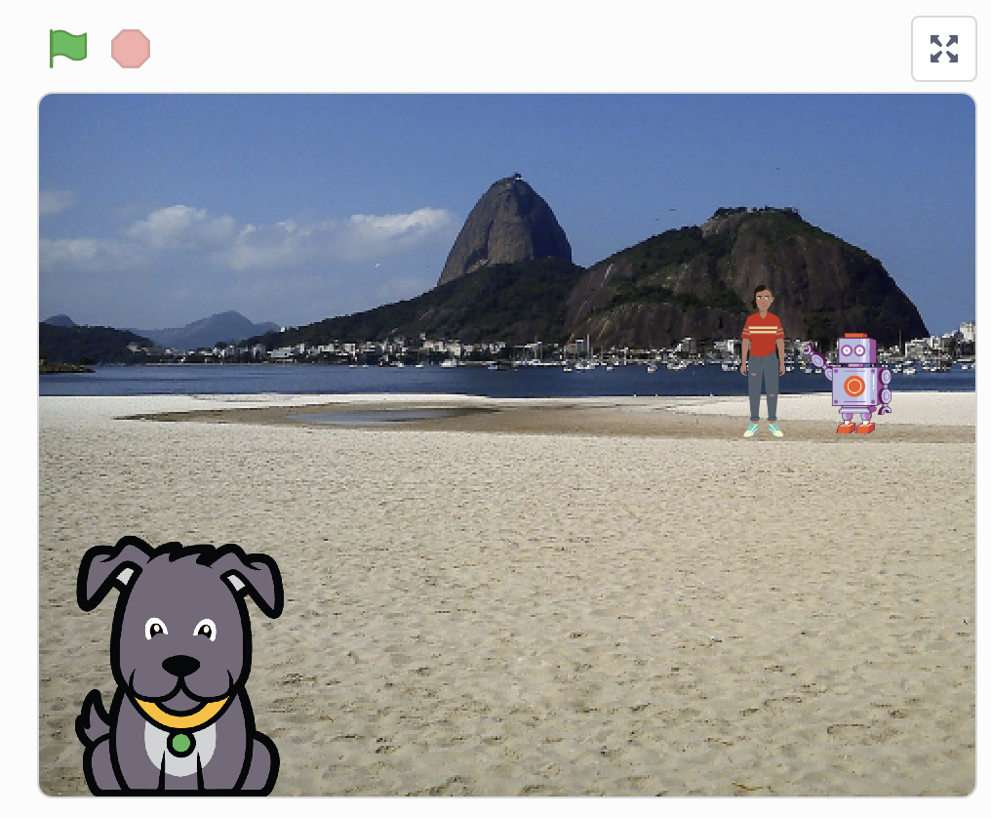
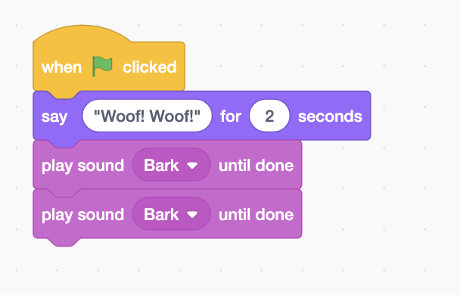
Debugging Challenge 2 Answer Key
After you have tried to debug this challenge, check out this project for a sample solution using https://bit.ly/3RriBGq
Possible Solution:
Notes:
Dropbox link:
https://www.dropbox.com/scl/fi/7ho9xv03bye892n82ow4u/Coco-Debugging-Woof-Solution.sb3?rlkey=owgk022jej1yo2o5y7dzxpf8j&dl=0

Slide 29
Debugging Challenge 3:
To debug, download the .sb3 file from the following link: https://bit.ly/3RfWliX
Next, go to the following CS First Scratch Link: https://bit.ly/3PexYzB
Click Sign in and Choose “I’m a student”
Click “File” menu and Choose “Load from your computer”
Now you can start debugging!!! Have fun!!!
Challenge: When the green flag is clicked, both Coco and Pascal should respond to Pearl and say "Hi, Pearl!". But only Pascal responds and says "Hi, Pearl!". How do we fix the program?
Notes:
Dropbox link:
https://www.dropbox.com/scl/fi/8kv373sx0d6g9xm827srm/Coco-Pascal-Pearl-Debugging-Hi.sb3?rlkey=03secq4nslcq2uxs0jizy7er4&dl=0

Slide 30
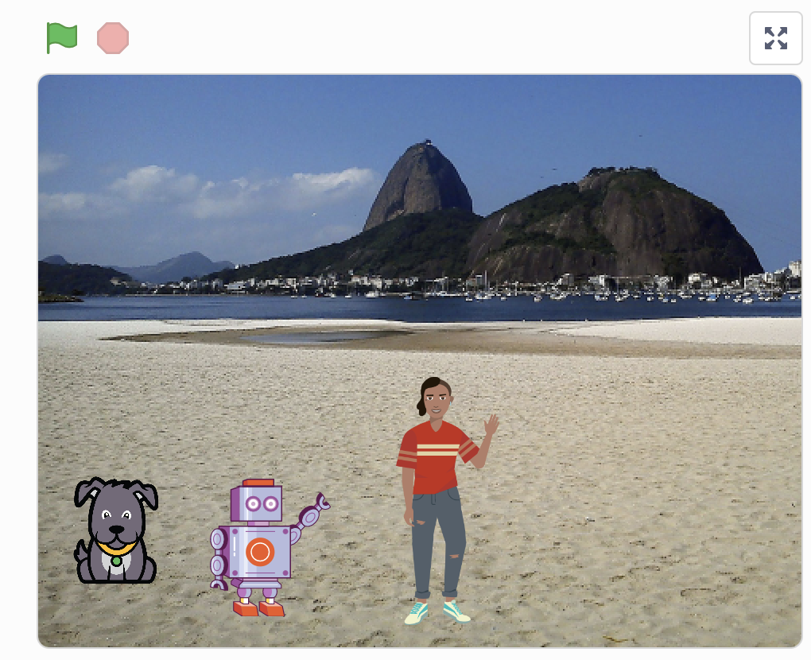
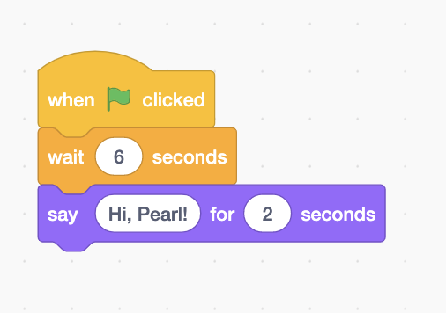
Debugging Challenge 3 Answer Key
After you have tried to debug this challenge, check out this project for a sample solution using https://bit.ly/31Ezar0
Possible Solution:

Slide 31
Lesson Objectives: I can…
Review familiar Scratch blocks with a scavenger hunt
Identify new Scratch sound blocks: play sound, record/upload a sound, change the pitch effect of a sound, stop all sounds
Practice using Scratch sound blocks
Define code, bugs, and debugging
Understand how to debug an algorithm
Discuss and understand the features of a good animation
Finish animating my recipe in Scratch
Evaluate my work
Share my animation with a partner
Notes:
Check off objectives as lesson proceeds.

Slide 32
Today’s objective
Plan and code an animation to illustrate our writing using CoCo and Scratch.
Discuss: what makes a good animation?
Notes:
We’ve covered how to write and code algorithms in CoCo and Scratch; and we’ve discussed how to fix our mistakes. Before we jump into animating, let’s discuss as a class: “what makes a good animation?”

Slide 33
When you code in Scratch….
Include a topic sentence
Match your animation to your writing
Be consistent
Match your visuals to your text
Notes:
I’ve got a few tips to share with you as you’re coding in Scratch.
You want to a) match your animation to your writing, b) be consistent, and c) make sure all the visuals in the frame make sense given what you have written in your text.

Slide 34
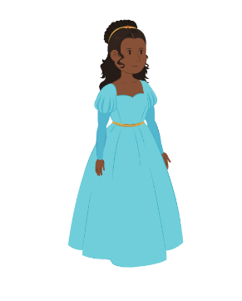
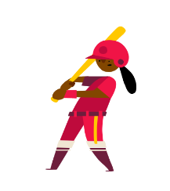
“Once upon a time there lived a princess…”
Notes:
For example, if I was writing a story about “Once upon a time there lived a princess….” which one of these sprites would make more sense?

Slide 35
“Once upon a time there lived a princess…”
Notes:
For example, if I was writing a story about “Once upon a time there lived a princess….” which one of these sprites would make more sense? Probably this one. Although, if our princess played baseball later in the story, you could switch it up!

Slide 36
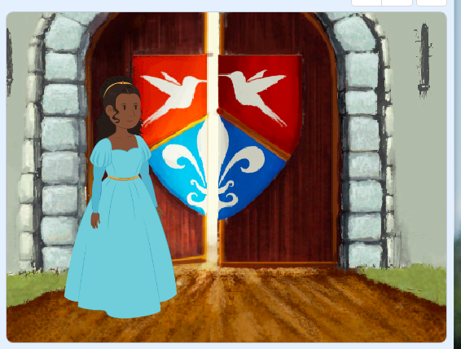
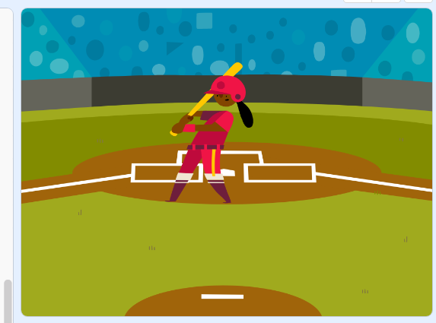
“Once upon a time there lived a princess in a castle.”
Notes:
Now, if I was writing a story about a princess who lived in a castle, this backdrop would make more sense.

Slide 37
“Once upon a time there lived a princess who played baseball.”
Notes:
But if I wrote about a princess who played baseball, this one could also work!

Slide 38
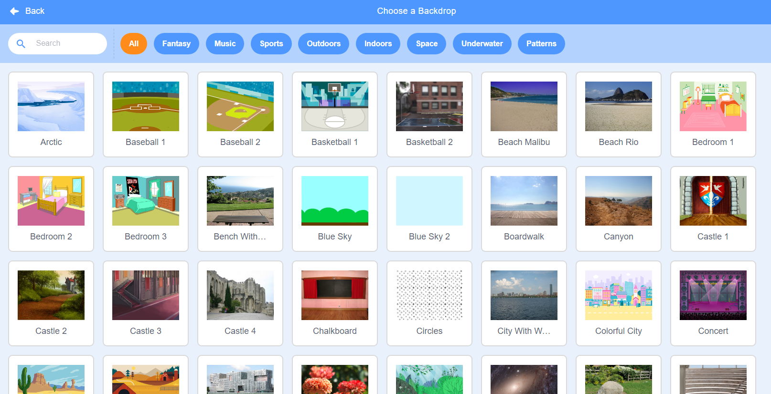
Notes:
Here’s another Scratch tip: when looking for sprites and backdrops, you can enter words into the “search” bar and see if any of the results match what you’re looking for.

Slide 39
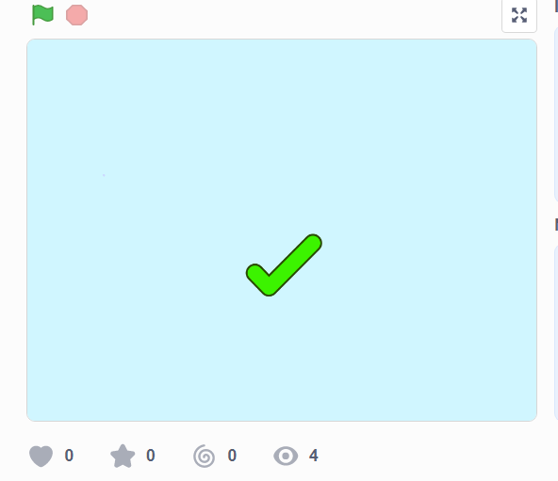
Like
this
https://www.dropbox.com/s/nh93dmdkphd4n0z/Screen%20Recording%202023-09-19%20at%201.45.13%20AM.mov?dl=0
Notes:
Let’s look at this example of a scratch project that is consistent, matches its text, and whose visuals make sense. This is using the “how to make hot chocolate” recipe we’ve seen before.

Slide 40
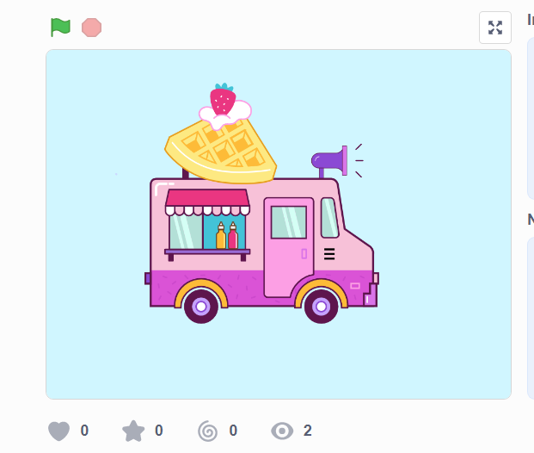
Not like this
https://www.dropbox.com/s/o7aaphbglzvswkr/Screen%20Recording%202023-09-19%20at%201.52.23%20AM.mov?dl=0
Notes:
Now, let’s look at the same video but where the visuals don’t match the text. Hmm, what went wrong here?

Slide 41
Lesson Objectives: I can…
Review familiar Scratch blocks with a scavenger hunt
Identify new Scratch sound blocks: play sound, record/upload a sound, change the pitch effect of a sound, stop all sounds
Practice using Scratch sound blocks
Define code, bugs, and debugging
Understand how to debug an algorithm
Discuss and understand the features of a good animation
Finish animating my recipe in Scratch
Evaluate my work
Share my animation with a partner
Notes:
Check off objectives as lesson proceeds.

Slide 42
Brainstorm with a partner: How will you animate your recipe in scratch?
Notes:
Turn and talk with a neighbor, discuss how you will animate your lemonade or tea recipes in Scratch. What visuals will you use? How will you select a backdrop? Why?

Slide 43
CoCo continues to help us!
Today, you will use Coco to help you code your instructional animation in Scratch!
Open a tab with Coco
Open a tab with Scratch
Use column 3 of Coco to find the blocks in Scratch we need for each step.
After you’ve found the blocks in Scratch, check off each row’s self-monitoring before moving to the next step.
Notes:
Don’t worry, CoCo is here to support you. Let’s open CoCo and Scratch to finish planning our animations. [read slide]

Slide 44
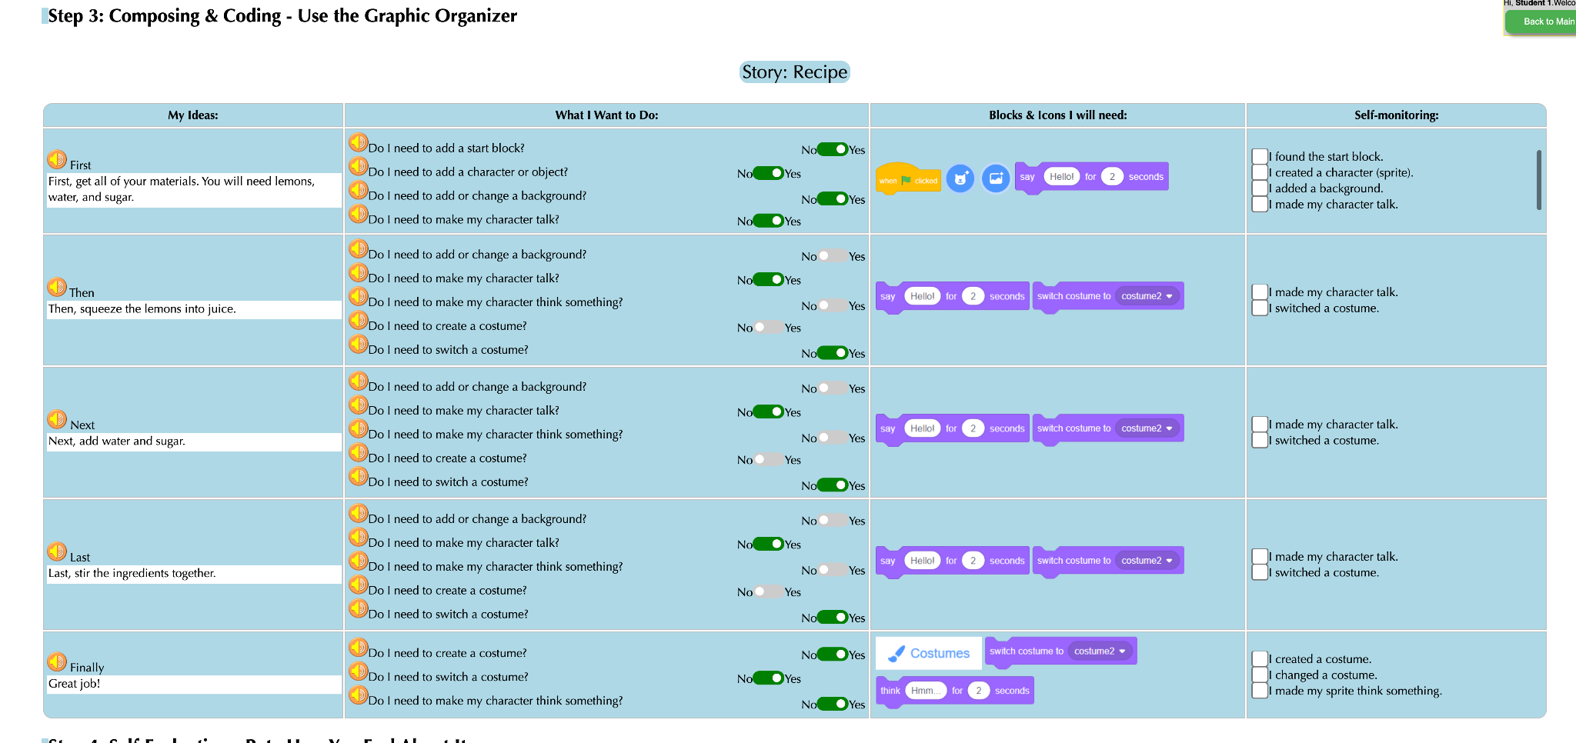
log into Coco and complete columns 2 & 3
Notes:
Pause while students work in CoCo and Scratch.

Slide 45
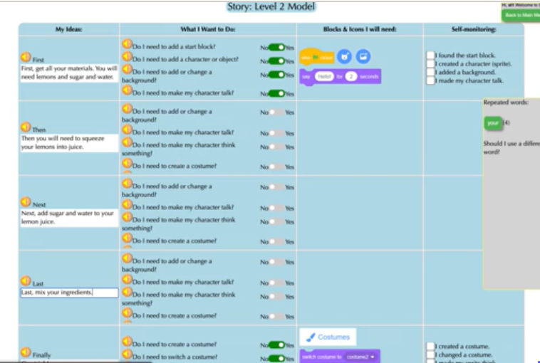
Video Model
How to Choose Animation Blocks in Scratch Tutorial
Note to teachers: in the video, the first row is already preselected for students.
Since your students are working in level 4, they will need to decide what they want to animate and choose the corresponding Scratch blocks.
Notes:
Optional video on how to choose animation blocks
Note to teachers: in the video, the first row is already preselected for students.
Since your students are working in level 4, they will need to decide what they want to animate and choose the corresponding Scratch blocks.

Slide 46
Pause here and Code in Scratch,
check your self Monitoring
Notes:
Remember to check off your self-monitoring column as you work!

Slide 47
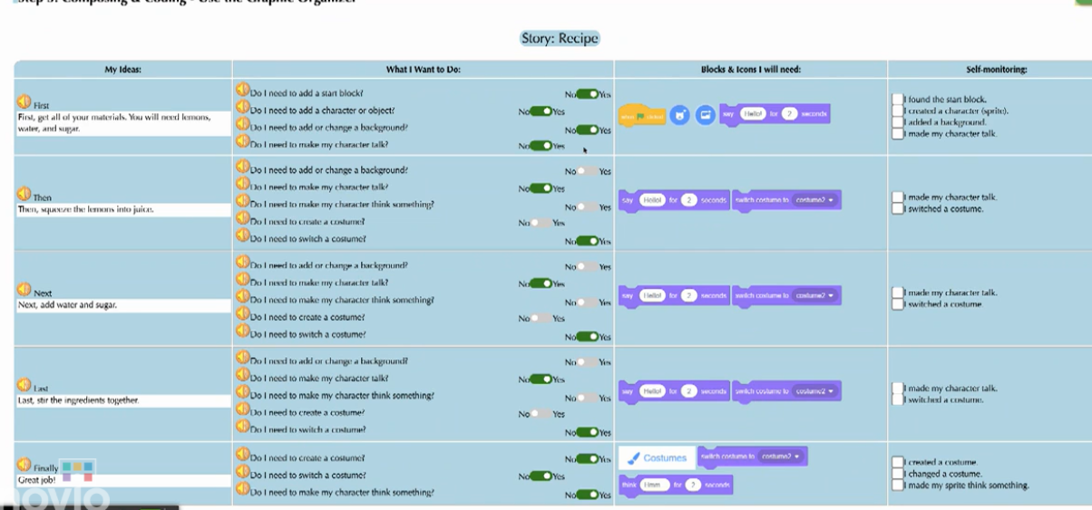
Video Model
Video on how to add content from first row to CoCo to Scratch
Note: to jump straight to toggling between Scratch and CoCo, skip to 2:35
Notes:
If you need it, here is a short video on how to move between CoCo and Scratch. Remember we will be toggling back and forth!
For students who benefit from additional scaffolding: Let’s make sure we all get the hang of it by starting with adding the blocks from ONLY OUR FIRST ROW into Scratch. Pause and look at me when you’re done.

Slide 48
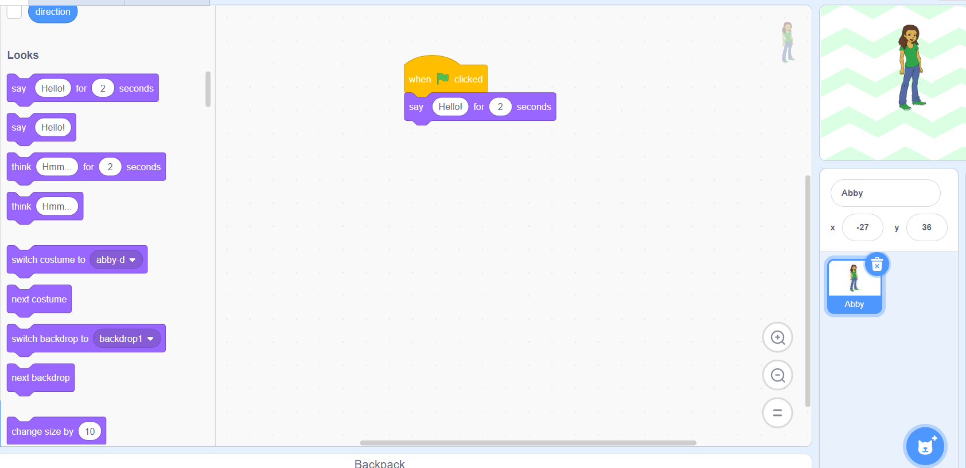
Video Model
Video on transferring the rest of your work from CoCo to Scratch and monitoring your progress
Notes:
Once you get the hang of it, transfer the content from the rest of your rows to Scratch.

Slide 49
Lesson Objectives: I can…
Review familiar Scratch blocks with a scavenger hunt
Identify new Scratch sound blocks: play sound, record/upload a sound, change the pitch effect of a sound, stop all sounds
Practice using Scratch sound blocks
Define code, bugs, and debugging
Understand how to debug an algorithm
Discuss and understand the features of a good animation
Finish animating my recipe in Scratch
Evaluate my work
Share my animation with a partner
Notes:
Check off objectives as lesson proceeds.

Slide 50
But wait!
Did you debug any errors?
Does your Scratch animation match what you planned and wrote in CoCo?
Notes:
Either in pairs or by yourself, review and debug your code. Make sure the animation matches what you planned and wrote in CoCo! [read slide]

Slide 51
Ask yourself:
Does my animation in Scratch convey what I planned? Does it match my writing?
Have I enhanced my writing in any way in Scratch?
Is there anything distracting or unnecessary in my animation that I should remove?
Is there anything in my animation that would make it harder for a viewer to understand my purpose?
Notes:
Additional questions that can help you assess your animation include [read slide]

Slide 52
Last step, Self Evaluation
Notes:
And remember, self-evaluation is a crucial last step!

Slide 53
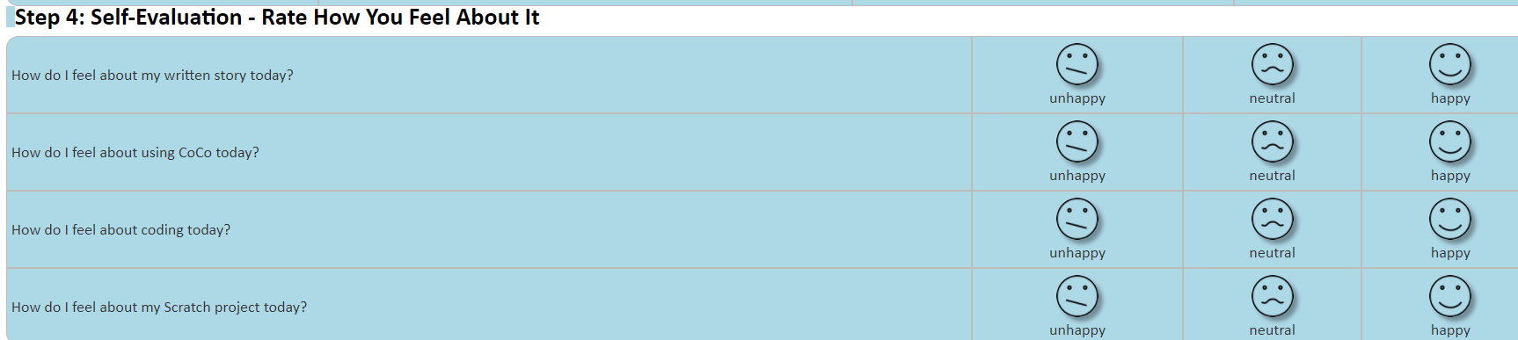
Video Model
Self-Evaluation Tutorial
Notes:
Here’s a tutorial on how to complete that portion of CoCo (if needed)

Slide 54
Lesson Objectives: I can…
Review familiar Scratch blocks with a scavenger hunt
Identify new Scratch sound blocks: play sound, record/upload a sound, change the pitch effect of a sound, stop all sounds
Practice using Scratch sound blocks
Define code, bugs, and debugging
Understand how to debug an algorithm
Discuss and understand the features of a good animation
Finish animating my recipe in Scratch
Evaluate my work
Share my animation with a partner
Notes:
Check off objectives as lesson proceeds.

Slide 55
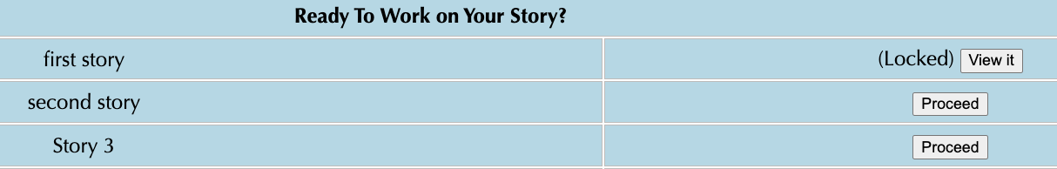
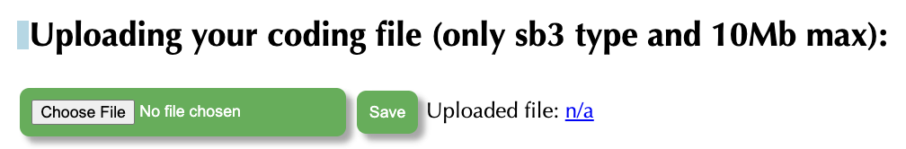

Sharing your .sb3 file from CS First to CoCo
Create the file in CS First
In the Scratch editor, find the word “File” in the top-left corner.
Click on “File” menu and you’ll see some choices pop down.
Choose “Save to your computer.” This will download your Scratch project.
Look in your “Downloads” folder. That’s where your saved project might be.
Go to the CoCo website and log in to your account. https://wego.gmu.edu/scratchgo/login.php
Click proceed on the correct story in CoCo.
Navigate to the section of CoCo where you can upload your project. (only sb3 type and 10Mb max).
Click “Save”.
Notes:
Model how students can share Scratch creations to their teacher’s studio

Slide 56
Share your work:
Find a partner and share your animation.
Share what you learned and something you might want to try differently.
Pause and share
Notes:
To wrap up, share your animation with a partner. Is there anything you learned or want to do differently next time?

Slide 57
Lesson Objectives: I can…
Review familiar Scratch blocks with a scavenger hunt
Identify new Scratch sound blocks: play sound, record/upload a sound, change the pitch effect of a sound, stop all sounds
Practice using Scratch sound blocks
Define code, bugs, and debugging
Understand how to debug an algorithm
Discuss and understand the features of a good animation
Finish animating my recipe in Scratch
Evaluate my work
Share my animation with a partner
Notes:
Check off objectives as lesson proceeds.

