Slide 1
Unit 1 Lesson 1
Introduction to Patterns, Sequencing, and Coding
3rd & 4th Grade
5th & 6th grade
Lesson created by the GMU-ODU CSforAll Team. For more information about
this lesson and our CSforAll initiative, contact Dr. Amy Hutchison at ahutchison1@ua.edu

Slide 2
Summary and Standards
Summary:
In this lesson, students will be introduced to the basic commands of Scratch and sequencing a code.
Content Standards:
The student will use effective communication skills in group activities.
a) Listen attentively by making eye contact, facing the speaker, asking questions, and summarizing what is said.
b) Ask and respond to questions from teachers and other group members.
c) Explain what has been learned.
d) Use language appropriate for context.
e) Increase listening and speaking vocabularies.
CS Standards:
The student will construct sets of step-by-step instructions (algorithms), both independently and collaboratively
a) using sequencing;
b) using events.

Slide 3
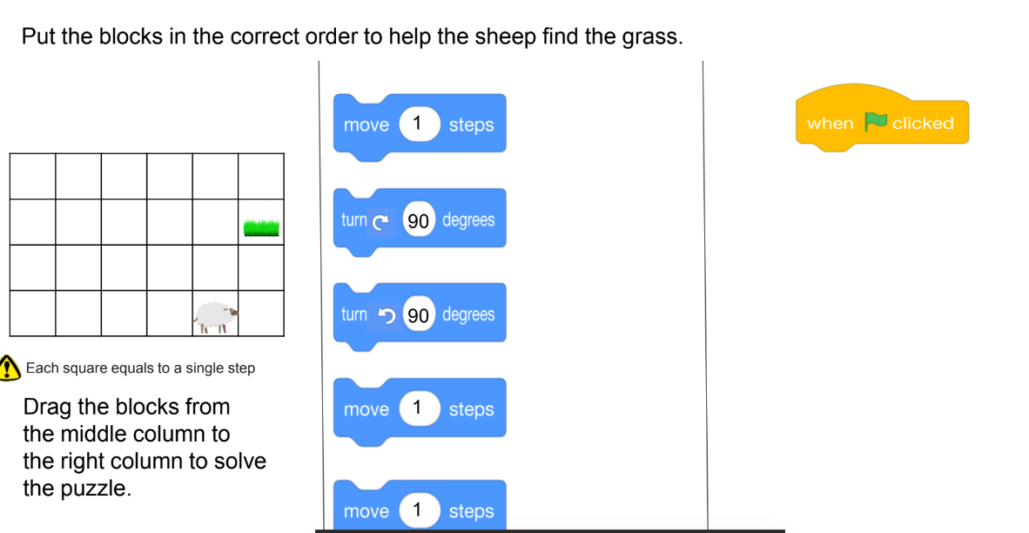
Materials and resources needed for this lesson:
Teacher slide deck
Student slide deck
Teachers: Remember to create a new Scratch Studio for CoCo projects! (Instructions for students on slides 32-33)

Slide 4
Turn & Talk: what do the words “pattern” and “sequence” mean? In computer science or in other contexts?

Slide 5
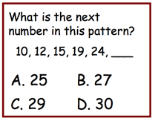
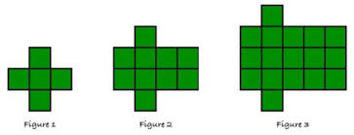
Pattern: a repeated way in which something happens
Notes:
Today we are going to learn more about how patterns are used in nearly everything we do. A pattern is a thing that repeats, or a repeated way in which something happens.
Patterns can be found in many places in our lives. For example, there are patterns in weather such as seasons, days of the week, months of the year, moon cycle, and patterns on a leaf. [You can provide familiar everyday patterns that YOUR students may be familiar with!]. We even use patterns in our writing.

Slide 6
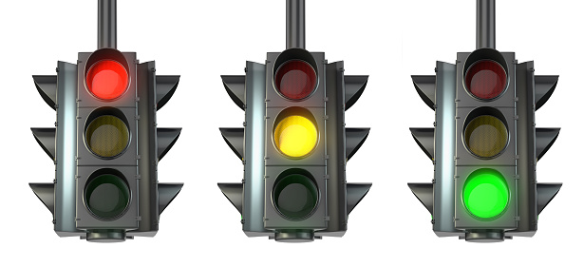
Introduction: examples of patterns --things that repeat--in real life
Notes:
Read slide

Slide 7
Sequence: an ordered set of instructions
Notes:
Another new vocabulary word is sequence: it refers to an ordered set of instructions. In order for a pattern to make sense, it must be in the correct sequence.

Slide 8
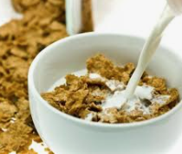
Sequence for making a bowl of cereal
1
2
3
Notes:
For example, here’s a sequence for making a bowl of cereal. If we did these steps out of order, we would not be happy!

Slide 9
Let’s make a Rhythmic pattern

Slide 10
Create a Rhythmic pattern!
Find a partner
Create a musical pattern using only sounds your body can make! (Optional: see examples on next slide)
Stomp your feet
Clap your hands
Snap your fingers
Pat your stomach
Click your tongue
The pattern must have three steps and repeat at least twice.
Example: clap-snap-clap clap-snap-clap
(Optional) Find another partner group. Learn their dance and teach them yours!

Slide 11
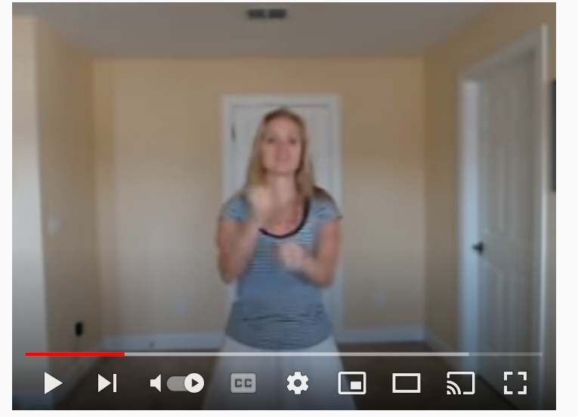
Examples of rhythmic and dance patterns:
Hand jive
Tutting

Slide 12
Lesson Objectives: I can…
Review familiar patterns and sequences
Review Scratch objects and blocks
Identify and use the start block, speak block, think block
Select and drag Scratch blocks to sequence a code (unplugged)

Slide 13
Vocabulary

Slide 14
Commands: tell a person or computer what to do
Notes:
Ok, we have some vocabulary we need to make sure we understand:
Commands tell a person or a computer what to do. “I command you to give yourself a pat on the back” (pat my own back).

Slide 15
Computer commands
Notes:
“Has anyone seen these types of pieces anywhere before? (from warm up) These pieces are actually computer “commands.” Commands tell a person or a computer what to do.

Slide 16
Code:
The language that computer scientists create and use to tell a computer what to do.
Notes:
Code is the language that computer scientists create and use to tell a computer what to do. Code is how we can give instructions to a computer.

Slide 17
Computer commands
Notes:
Lets look closely at these blocks again and what they say-
Click "switch,
Click “think,
Click “turn
“these are commands" written in Scratch code, which is the kind we will be working with. When we put commands together and give the computer a set of instructions, that is called an “algorithm.”

Slide 18
Algorithm: A list of steps to finish a task
Notes:
An Algorithm is a list of steps or commands to finish a task.

Slide 19
Coding an algorithm
This algorithm tells the computer to make the sprite say “Hi!” for 2 seconds then turn right 90 degrees.
Hi!
2
Notes:
Here’s an example of an algorithm. We’ve taken Scratch commands and put them in the correct order from top to bottom you have created a sequence of instructions. This would tell the computer to say Hi for 2 seconds then turn right 90 degrees.

Slide 20
Commands: tell a person or computer what to do
Algorithm: A list of steps to finish a task
Code: The language that computer scientists create and use to tell a computer what to do.
Notes:
Ok, let’s review...
Commands tell a person or a computer what to do. “I command you to give yourself a pat on the back” (pat my own back).
An Algorithm is a list of steps or commands to finish a task. So if I told you to pat yourself on the back, then wiggle your ears, I am putting two commands together in a particular sequence I want you to follow. This is a really simple example of an algorithm. (Model, pat back, wiggle ears)
So a command is an instruction and we can create commands for the computer. When you put commands together you create an algorithm or a list of steps just like Pearl did. But how do you give computers instructions?
We use code! Code is the instruction that computer scientist create and use to tell a computer what to do.
Writing code is like writing the commands for a computer. When you know how to write code, you can tell computers what to do. We'll learn how to write code in Scratch.

Slide 21
Commands must be in the correct sequence
Notes:
So remember: When we write instructions or when we write code, the order in which we put the commands is called the sequence. It is important that you put your commands in the correct order. Just like when you get ready for school. It is important that you put on your socks BEFORE you put on your shoes. It would not look quite right (and be very uncomfortable) if you put your shoes on THEN put on your socks! The same is true when we give computers commands in code. Putting commands in the correct sequence is VERY IMPORTANT!”

Slide 22
Commands must be in the correct sequence
Notes:
So remember: When we write instructions or when we write code, the order in which we put the commands is called the sequence. It is important that you put your commands in the correct order. Just like when you get ready for school. It is important that you put on your socks BEFORE you put on your shoes. It would not look quite right (and be very uncomfortable) if you put your shoes on THEN put on your socks! The same is true when we give computers commands in code. Putting commands in the correct sequence is VERY IMPORTANT!”

Slide 23
Commands must be in the correct sequence
Notes:
So remember: When we write instructions or when we write code, the order in which we put the commands is called the sequence. It is important that you put your commands in the correct order. Just like when you get ready for school. It is important that you put on your socks BEFORE you put on your shoes. It would not look quite right (and be very uncomfortable) if you put your shoes on THEN put on your socks! The same is true when we give computers commands in code. Putting commands in the correct sequence is VERY IMPORTANT!”

Slide 24
Why do patterns and sequences matter in computer science (CS)?
Notes:
“If you do not follow the correct sequence of commands, your recipe will not turn out correct.
The same thing happens when you don’t identify patterns and follow the correct sequence when writing a code...things will not turn out like you wanted them to!
When you write a set of instructions or a procedure, you have to be very clear so that others can follow your instructions without getting confused. This is a lot like what computer scientists do: they write instructions for computers. They have to be very clear and careful, because a computer is just a machine and will do exactly what it is told. No matter if you’re writing for a human or a computer, the instructions have to be in the right order, or the right sequence, or else they would make no sense!

Slide 25
We can write code in Scratch
Pause and share
(1-2 minutes)
Notes:
We can use a program called Scratch to write code and tell our computer what to do.
Scratch uses these command blocks to create an algorithm or list of instructions. This is what some of the command blocks look like, what do you think these blocks might do? Pause here and share with your teacher.

Slide 26
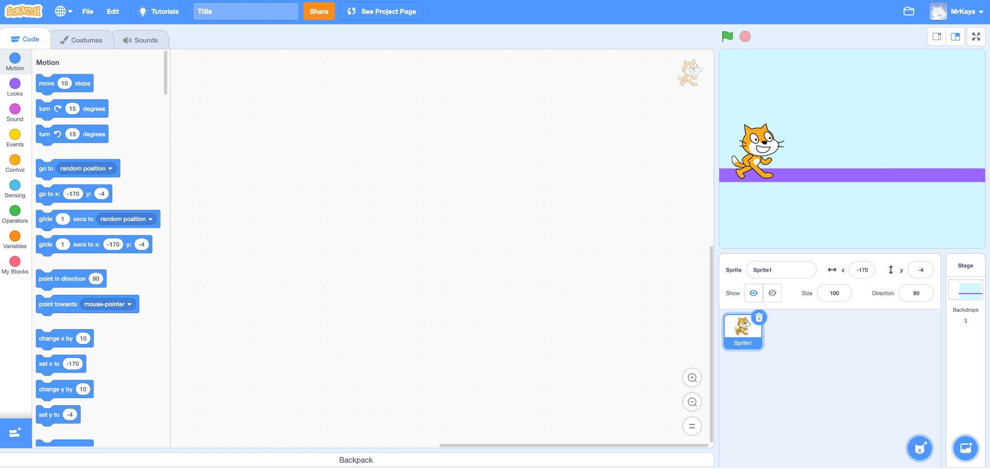
Start Block (explainer video)
Tells your code to run when you click the green flag in Scratch.
Notes:
Play the video and click “see inside” to show students how the start block initiates actions in Scratch.

Slide 27
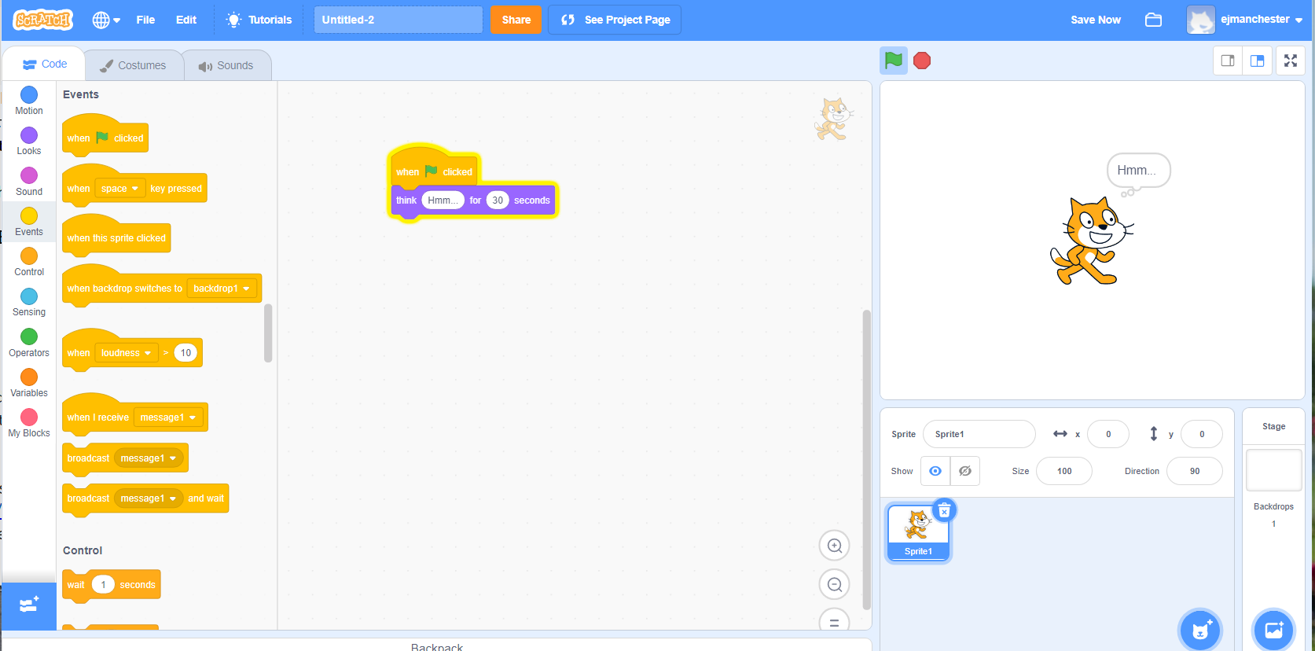
Think block (explainer video)
Makes your sprite “think” something
Notes:
Play the video to show students how the think block works: https://www.dropbox.com/s/xgv1w5kl8wvrby4/ThinkCoCo_Nov16.mp4?dl=0

Slide 28
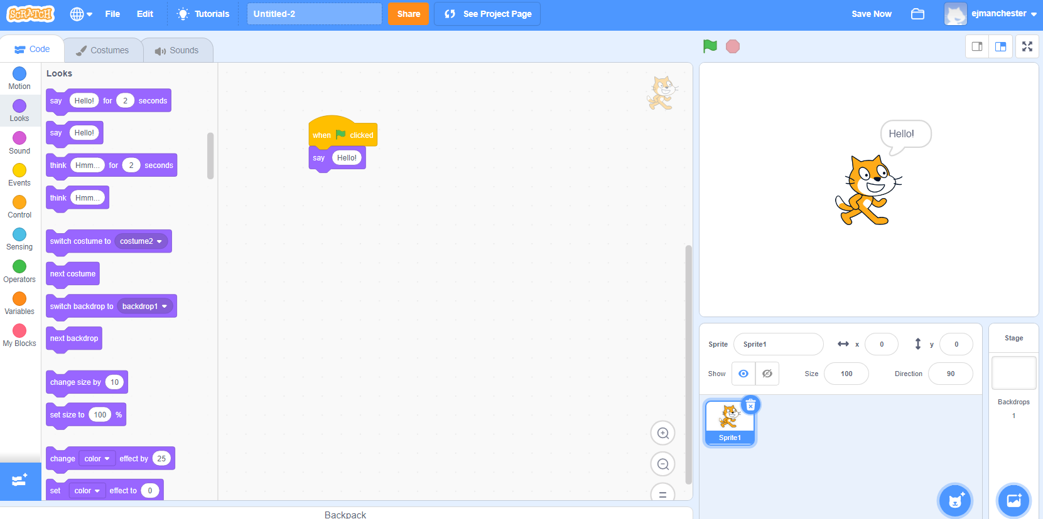
Speak/Say block (explainer video)
Codes your sprite to say something
Notes:
Play the video to show students how the say block works: https://www.dropbox.com/s/1xakgwx6g8lwp3y/SayForSecondsCoCo_Nov16.mp4?dl=0

Slide 29
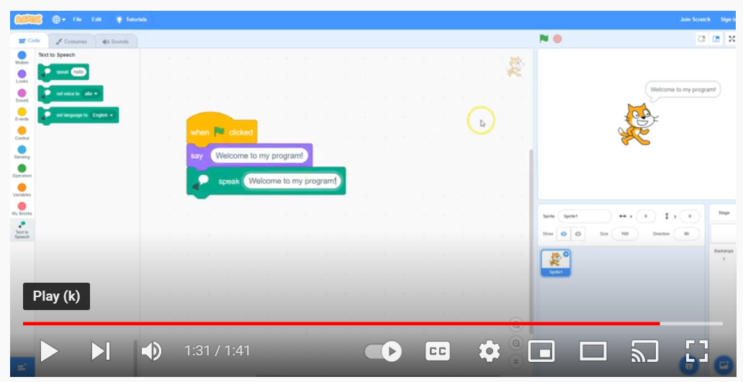
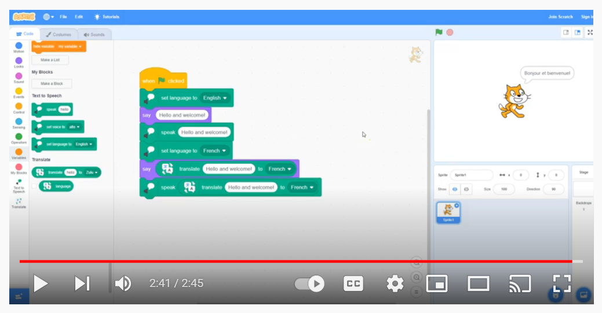
Adding the Text to speech extension
(VIdeo here)
Adding the Translate extension and set language to block
(Video here)

Slide 30
Independent practice

Slide 31
Scratch Introductions
Navigate to Scratch at scratch.mit.edu
Code a short animation introducing yourself
Please include (at minimum):
a sprite to represent yourself,
a fitting backdrop,
An explanation of your name, age, and hobbies.
Get creative with the Scratch blocks and play around with new ones to see what they do!
When you’re done, share your scratch project with a partner who has also finished and to our class Scratch studio.
Pause and work (10-15 minutes)
Notes:
Ok, let’s get started. Pause here and leave this screen up so that you can check on your goals. Please navigate to Scartch.mit.edu in your web browser.
This is just to get familiar with scratch, so don’t worry about making mistakes. Just try a few things and see what happens! If you get stuck, take a deep breath and try again. You can do it!
Note to teacher: as students are working, Review how Scratch blocks can be used to create a pattern and sequence.

Slide 32
Sharing your .sb3 file from CS First to CoCo
Create the file in CS First
In the Scratch editor, find the word “File” in the top-left corner.
Click on “File” menu and you’ll see some choices pop down.
Choose “Save to your computer.” This will download your Scratch project.
Look in your “Downloads” folder. That’s where your saved project might be.
Go to the CoCo website and log in to your account. https://wego.gmu.edu/scratchgo/login.php
Click proceed on the correct story in CoCo.
Navigate to the section of CoCo where you can upload your project. (only sb3 type and 10Mb max).
Click “Save”.
Notes:
Model how students can share Scratch creations to their teacher’s studio

Slide 33
Here is an optional video to learn how to share your project in Scratch.
Pause here.
Notes:
Video modeling how students can share Scratch creations to their teacher’s studio
Scratch - Imagine, Program, Share

Slide 34
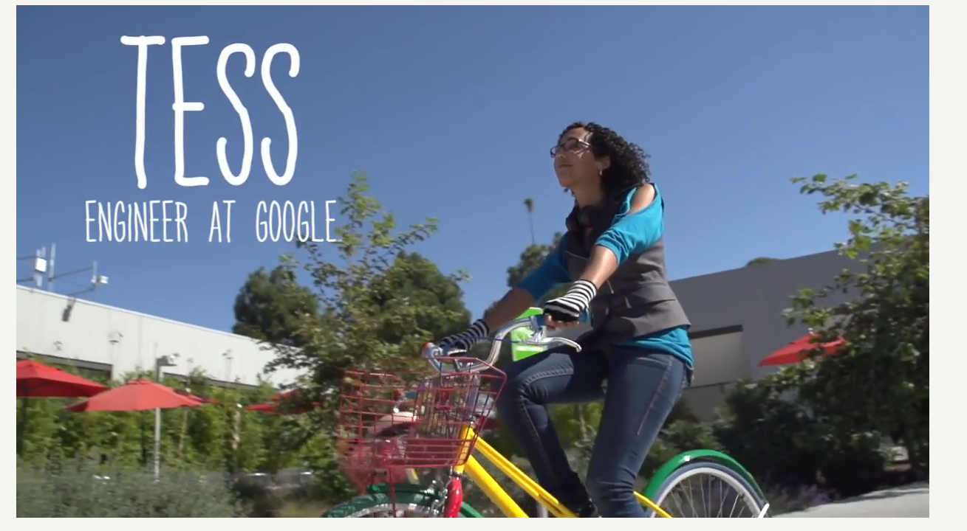
Today’s Career in Tech: Meet TESS
Notes:
Play video

Slide 35
And remember….ANYone in the world can be a computer scientist!

