Slide 1


Unit 4, lesson 3
Decomposition
5th & 6th grade
Lesson created by the GMU-ODU CSforAll Team. For more information about
this lesson and our CSforAll initiative, contact Dr. Amy Hutchison at ahutchison1@ua.edu

Slide 2
Summary and Standards
Summary:
In this lesson, students will use Coco and Scratch to write and animate a summary of a story.
ELA Standards
The student will write in a variety of forms to include narrative, descriptive, opinion, and expository.
a) Engage in writing as a process.
b) Identify audience and purpose.
c) Use a variety of prewriting strategies.
d) Use organizational strategies to structure writing
according to type.
e) Use transition words to vary sentence structure.
CS Standards:
The student will break down (decompose) a larger problem into smaller sub-problems, independently or collaboratively.
The student will construct programs to accomplish tasks as a means of creative expression using a block or text based programming language, both independently and collaboratively
a. using sequencing;
b. using loops (a wide variety of patterns such as repeating patterns or growing patterns); and
c. identifying events.

Slide 3


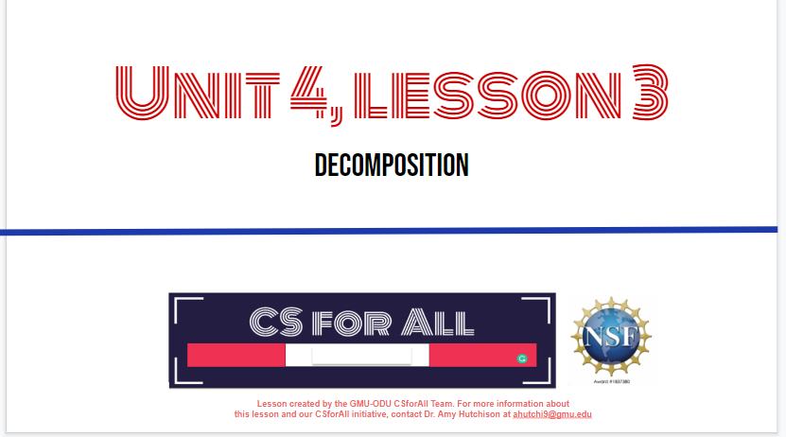
Materials and resources needed for this lesson:
Reminder:
In this lesson, every student should be assigned a story in CoCo using Level 5.
The story should be titled “Unit 4 Summary.”
Each student should save their work using this naming strategy: “Student Name + Unit # + Descriptor”, for example, “Johnny Unit 4 Summary.”
Chromebook/Laptop
Internet Access
Teacher Unit 4, Lesson 3 slide deck
Coco Link
Scratch link
Notes:
You will need….[read slide]

Slide 4
Lesson Objectives: I can…
Review new blocks
Code and run your animation in Scratch Debug, as needed
With a partner, check that your writing and animation match
Self-evaluate in Coco
Notes:
Let’s go over today’s lesson’s objectives: [read slide]

Slide 5
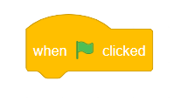


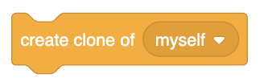
New Blocks
Notes:
Review

Slide 6
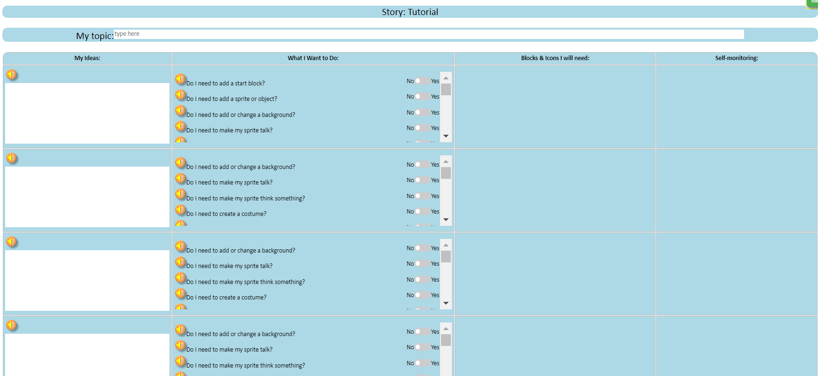
Review: CoCo level 5

Slide 7
Before you begin to code….
Make sure you have a topic sentence
Match your animation to your writing
Be consistent
Match your visuals to your text
Notes:
In Unit 1, we learned that we want to a) match your animation to your writing, b) be consistent, and c) make sure all the visuals in the frame make sense given what you have written in your text.

Slide 8
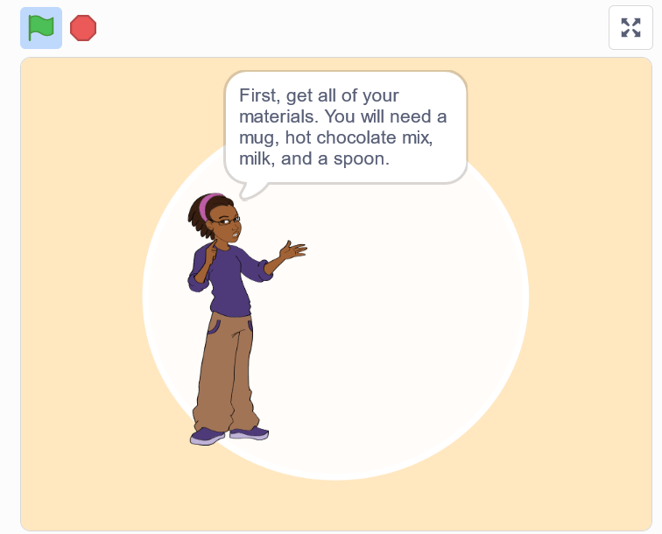
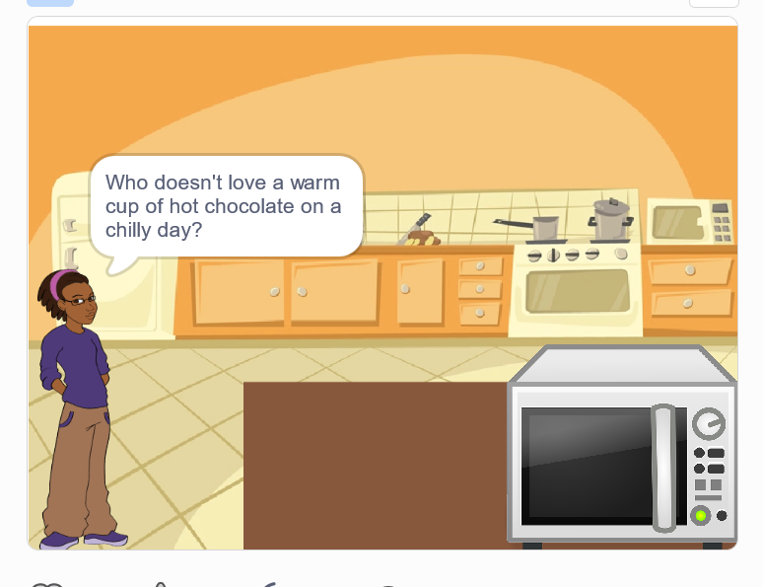
Good animations can be simple or complex!
https://www.dropbox.com/s/jlist1zaujjpc8e/Screen%20Recording%202023-09-18%20at%209.21.46%20PM.mov?dl=0
https://www.dropbox.com/s/nh93dmdkphd4n0z/Screen%20Recording%202023-09-19%20at%201.45.13%20AM.mov?dl=0
Notes:
Good animations that follow these guidelines can be as simple as https://www.dropbox.com/s/jlist1zaujjpc8e/Screen%20Recording%202023-09-18%20at%209.21.46%20PM.mov?dl=0
or as complex as https://www.dropbox.com/s/nh93dmdkphd4n0z/Screen%20Recording%202023-09-19%20at%201.45.13%20AM.mov?dl=0
so long as they clearly convey the message to the reader visually and verbally!

Slide 9
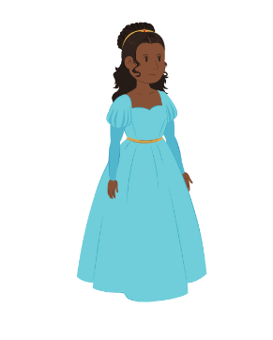
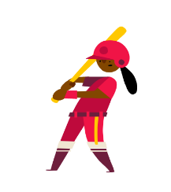
“Once upon a time there lived a princess…”
Notes:
For example, if I was writing a story about “Once upon a time there lived a princess….” which one of these sprites would make more sense?

Slide 10
“Once upon a time there lived a princess…”
Notes:
This one would probably make more sense. Although, if our princess played baseball later in the story, you could switch it up!

Slide 11
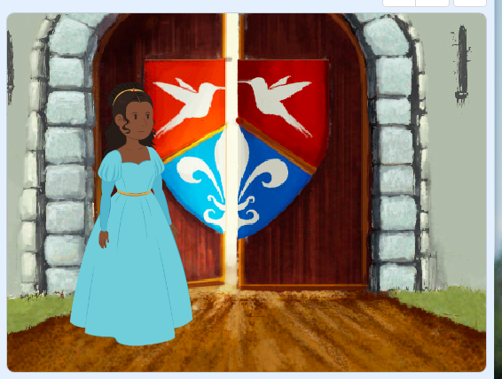
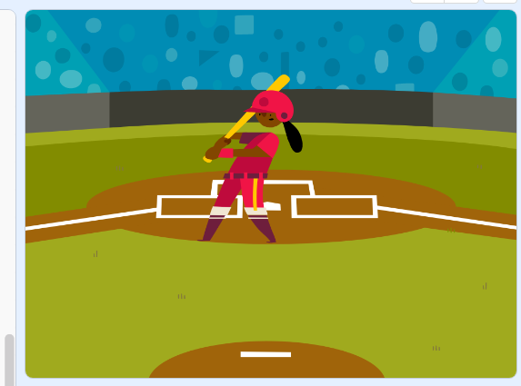
“Once upon a time there lived a princess in a castle.”
Notes:
Now, if I was writing a story about a princess who lived in a castle, this backdrop would make more sense.

Slide 12
“Once upon a time there lived a princess who played baseball.”
Notes:
But if I wrote about a princess who played baseball, this one could also work!

Slide 13
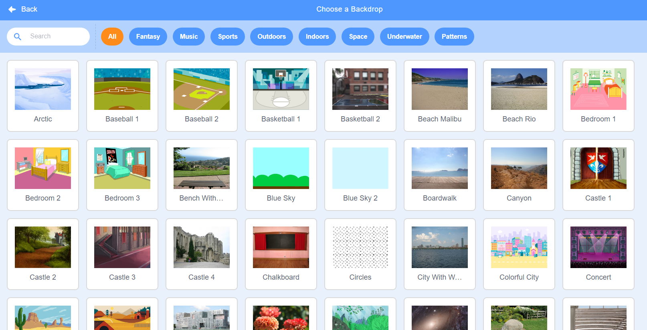
Notes:
Here’s another Scratch tip: when looking for sprites and backdrops, you can enter words into the “search” bar and see if any of the results match what you’re looking for.

Slide 14
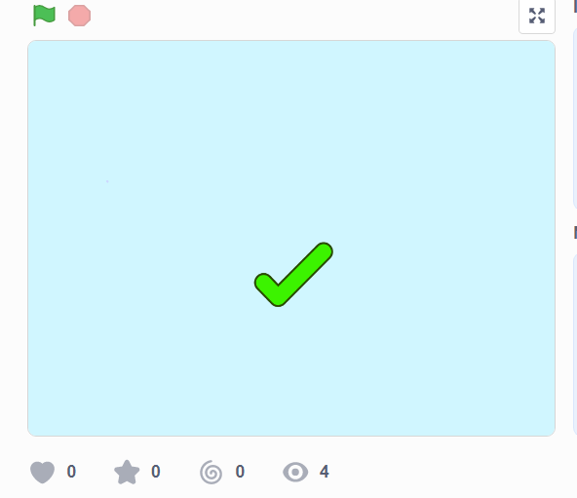
Like
this
https://www.dropbox.com/s/o7aaphbglzvswkr/Screen%20Recording%202023-09-19%20at%201.52.23%20AM.mov?dl=0
Notes:
Let’s look at this example of a scratch project that is consistent, matches its text, and whose visuals make sense. This is using the “how to make hot chocolate” recipe we’ve seen before.

Slide 15
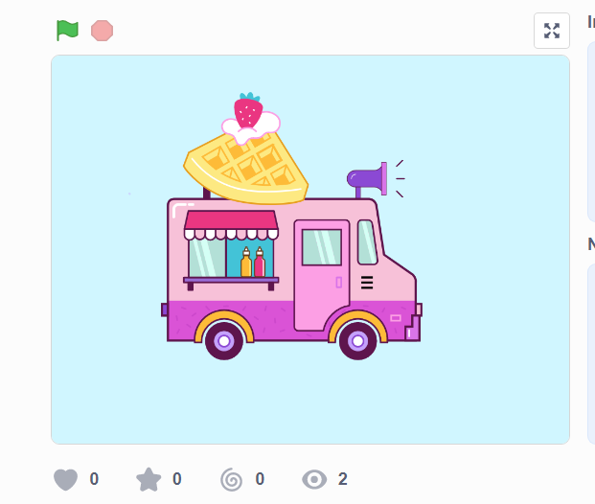
Not like this
https://www.dropbox.com/s/jlist1zaujjpc8e/Screen%20Recording%202023-09-18%20at%209.21.46%20PM.mov?dl=0
Notes:
Now, let’s look at the same video but where the visuals don’t match the text. Hmm, what went wrong here?

Slide 16
You can use Scratch to enhance your animation
aLL ADDITIONAL DETAILS MUST BE RELEVANT!
Notes:
Remember how we searched for unique sprites and backdrops? And we also learned how to upload our own sprites and sounds. So there are many ways we can use Scratch to enhance our animations, or make them more exciting! We can add more details to our animations as long as we make sure that the details are relevant.

Slide 17
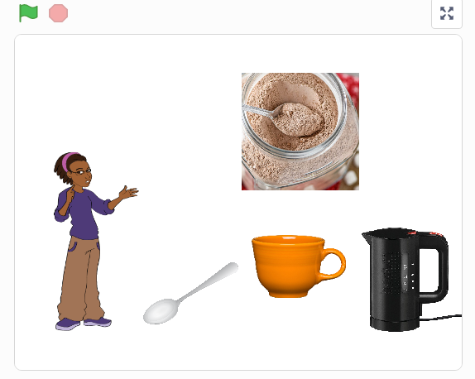
Like this:
https://www.dropbox.com/s/jlist1zaujjpc8e/Screen%20Recording%202023-09-18%20at%209.21.46%20PM.mov?dl=0
Notes:
For example, here’s an animation of the hot chocolate recipe that does a really great job enhancing the recipe with additional details to help the viewer imagine a person actually making hot chocolate! Let’s take a look and see what they did.
[play/run scratch project]
The first thing we notice is that this computer scientist added images of real-life materials rather than cartoons. This detail enhances the animation but does not change the meaning. They also drew an arrow to show where the mix would go into the cup. FInally, they coded the objects to move and simulate the actual “making” of the drink. But nothing about the meaning changed! And it was not distracting.

Slide 18
However!
Too many visuals can be confusing
Notes:
Let’s look at another example, where the additional details were not relevant and thus confusing…..

Slide 19
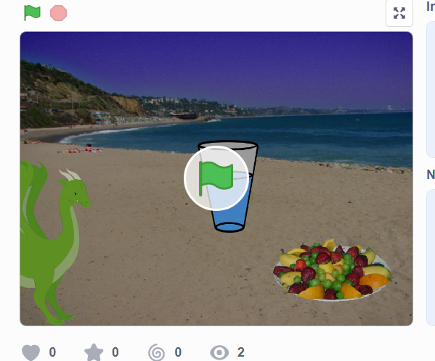
Not like this
https://www.dropbox.com/s/jlist1zaujjpc8e/Screen%20Recording%202023-09-18%20at%209.21.46%20PM.mov?dl=0
Notes:
All the written text is the same but the images don’t match the text. For example, why is there a dragon in the screen? Why are they at the beach? And why does it show a glass of water instead of hot chocolate? It may seem funny but to a new viewer, it would be very confusing. We dont want that.

Slide 20
Naming your Scratch Animation
When you create your animation in Scratch, please name it using the following formula:
Your Name + Unit # + Topic
For example:
  “Johnny Unit 4 Summary”

Slide 21
Independent Practice:
Make sure you are using CoCo!
Open Scratch on one tab, CoCo on another
Use CoCo to code your Scratch animation
Don’t forget to self-monitor as you go!
Pause here. (5-10 minutes)

Slide 22
Ask yourself and a Partner:
Does my topic sentence orient my reader and help set the scene?
Does my animation in Scratch convey what I planned? Does it match my writing?
Have I enhanced my writing in any way in Scratch?
Is there anything distracting or unnecessary in my animation that I should remove?
Is there anything in my animation that would make it harder for a viewer to understand my purpose?

Slide 23
Wrap up: Scratch Publishing Party
Notes:
We have one last task, to share our animation!
A scratch publishing party! It is time to share your animation with others! In a moment, your teacher will let you know how you are going to share your animation. You may just be sharing with a partner or doing a gallery walk.

Slide 24



By receiving feedback on your Explanatory Writing Scratch project, you can make it better.
A. Share your screen with your elbow partner.
B. Ask them to name two things they about your Explanatory Writing project.
The part I liked best was…
I like the way... because...
You should
keep doing...
C. Request feedback on one aspect of your Scratch project you could improve
How about if you…
You might want to consider…
You might want to try…
D. Switch Roles
Pause here (10 minutes)
Notes:
Here are some suggestions for sharing your work and getting feedback. Feedback can help us learn and make our work better in the future. [Read Slide]
Adapted from Getting Unstuck

Slide 25
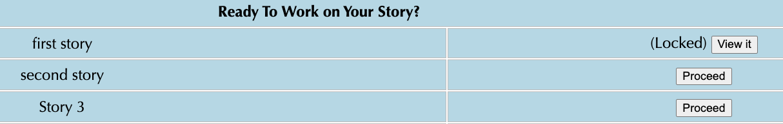
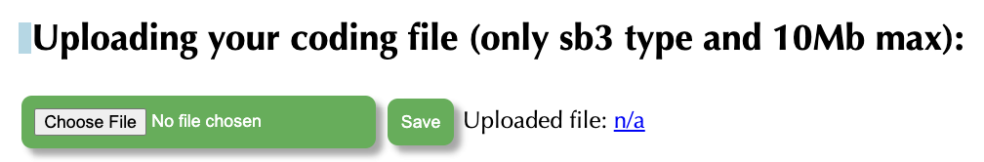

Sharing your .sb3 file from CS First to CoCo
Create the file in CS First
In the Scratch editor, find the word “File” in the top-left corner.
Click on “File” menu and you’ll see some choices pop down.
Choose “Save to your computer.” This will download your Scratch project.
Look in your “Downloads” folder. That’s where your saved project might be.
Go to the CoCo website and log in to your account. https://wego.gmu.edu/scratchgo/login.php
Click proceed on the correct story in CoCo.
Navigate to the section of CoCo where you can upload your project. (only sb3 type and 10Mb max).
Click “Save”.
Notes:
Model how students can share sb3 file from CS First to CoCo

Slide 26
Here is an optional video to learn how to share your project in Scratch.
Pause here.
Notes:
Video modeling how students can share Scratch creations to their teacher’s studio

Slide 27
Anyone can be a Computer Scientist
Notes:
Thank you for working with me today! Remember, anyone can be a computer scientist. See you soon!

Slide 28

Careers in Computing

