Slide 1
Unit 1 Lesson 2
Scratch and CoCo Level 1
3rd & 4th Grade
5th & 6th grade
Lesson created by the GMU-ODU CSforAll Team. For more information about
this lesson and our CSforAll initiative, contact Dr. Amy Hutchison at ahutchison1@ua.edu

Slide 2
Summary and Standards
Summary:
In this lesson, students will learn about CoCo, a graphic organizer to help plan writing and coding and unscramble code for a Scratch project.
Content Standards:
The student will write in a variety of forms:
a) Engage in writing as a process
b) Identify audience and purpose
c) Use a variety of pre-writing strategies
CS Standards:
The student will construct sets of step-by-step instructions (algorithms), both independently and collaboratively
a) using sequencing;
b) using events.

Slide 3
Materials and resources needed for this lesson:
Reminder:
In this lesson, every student should be assigned a story in CoCo using Level 1.
The story should be titled “Unit 1, How to Make Hot Chocolate”
Each student should save their work using this naming strategy: “Student Name + Unit # + Descriptor”, for example, “Johnny Unit 1, How to Make Hot Chocolate”
Teacher slide deck
Student slide deck
Chromebook/Laptop
Internet Access
Independent practice: Link to “How to Make Hot Chocolate” Scratch project
Solution video: https://scratch.mit.edu/projects/833988634
Optional Video: Introduction to CoCo https://www.dropbox.com/s/encmn6pah86qzj9/CoCo%20Introduction.mp4?dl=0

Slide 4
Warm up: Review Scratch Blocks!
Notes:
Ok, let’s start with a warm-up. We are going to review some of the scratch block we learned about last time.

Slide 5
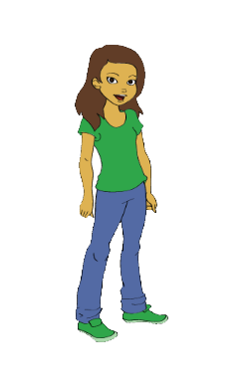
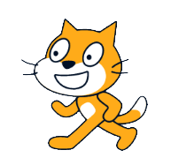
Review Scratch Objects
Block(s): commands in Scratch
Sprite: characters in Scratch
Backdrop: background

Slide 6
Review Scratch Blocks
Notes:
Lets look closely at these blocks again and what they say-
Click "switch,
Click “think,
Click “turn
“these are commands".

Slide 7
Which command means “go” or “start”?
?
1
2
3
4
hmmm
5
6
Notes:
Look at the blocks on the bottom of the screen, which block is the command that means GO or start in Scratch?
(Read out blocks?)

Slide 8
Which command means “go” or “start”?
?
1
2
3
4
hmmm
5
6
Notes:
Right! The orange block that has a green flag and says “when ‘green flag’ clicked.” This will start or run our code!

Slide 9
Which command would make our sprite move?
?
1
2
3
4
hmmm
5
6
Notes:
Which command will make our sprite MOVE?

Slide 10
Which command would make our sprite move?
?
1
2
3
4
hmmm
5
6
Notes:
Correct, the blue block that says, “move ___ Steps” You would enter a number in the blank white oval to tell the sprite how many steps to move!

Slide 11
Which command would make our sprite talk or make noise?
?
1
2
3
4
hmmm
5
6
Notes:
Which command would make our sprite talk or make noise?

Slide 12
Which command would make our sprite talk or make noise?
?
1
2
3
4
hmmm
5
6
Notes:
Right! The purple “Say ____ for ____ secs” will tell your sprite to “say something. You would need to type in the text you want your sprite to say in the first space and the amount of “seconds” you want the sprite to speak in the next space.

Slide 13
Which command would make our sprite think?
?
1
2
3
4
hmmm
5
6
Notes:
Which command would make our sprite think?

Slide 14
Which command would make our sprite think?
?
1
2
3
4
hmmm
5
6
Notes:
Right! The purple “Say ____ for ____ secs” will tell your sprite to “say something. You would need to type in the text you want your sprite to say in the first space and the amount of “seconds” you want the sprite to speak in the next space.

Slide 15
Warm up: Review CS Vocabulary
Code: The instructions that computer scientists create and use to tell a computer what to do.
Commands: tell a person or computer what to do
Sequence: an ordered set of instructions
Algorithm: A list of steps to finish a task
Notes:
Read slide

Slide 16
Lesson Objectives: I can…
Review Scratch and CS Vocabulary
Identify the purpose of Coco (planning tool for coding & writing)
Locate features within Coco Level 1
Identify and operate change costume block
Select and drag blocks to unscramble a code in Scratch (plugged)

Slide 17
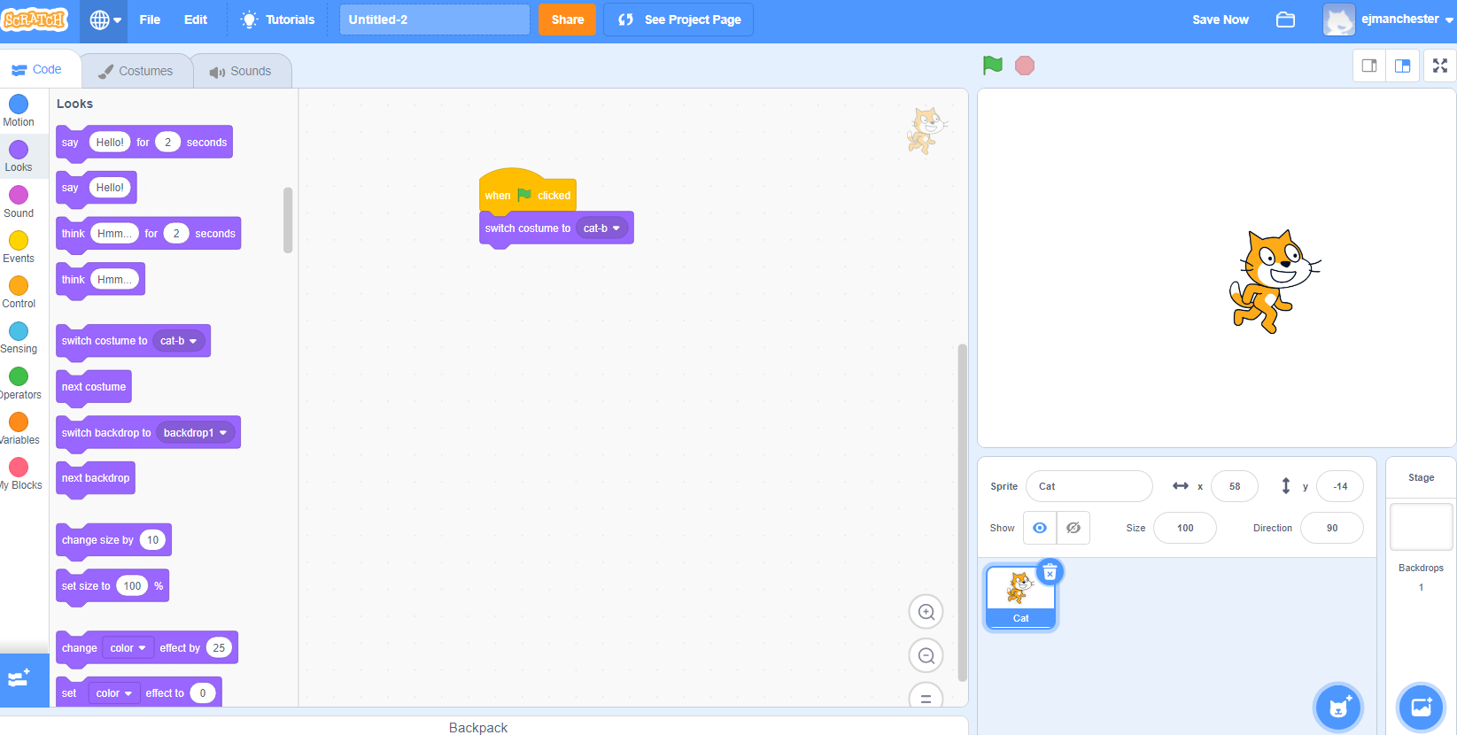
Switch costume block (explainer video)
Changes the appearance of your sprite.
Notes:
Play Video, and explain: It may not be obvious but this cat looks different from the one automatically in scratch. This one looks like it’s running. The “change costume” block in Scratch changes the appearance of your sprite. You can use it to change the appearance of your sprite. This block makes things simpler because we want have to use as many sprites in our project.
Video link: https://www.dropbox.com/s/jdt70o0l0neyk8c/SwitchCostumeCoCo_Nov16.mp4?dl=0

Slide 18
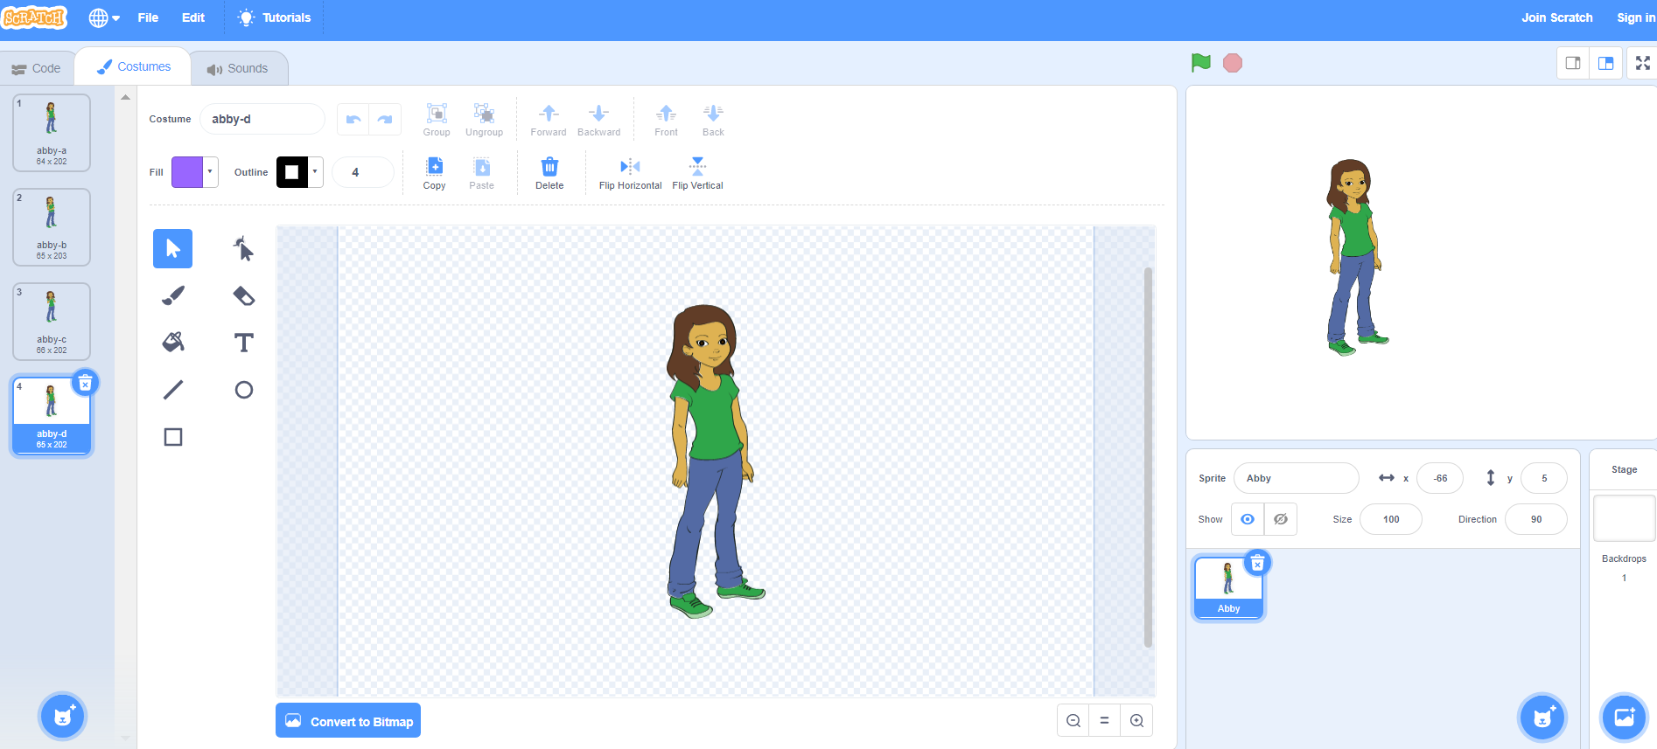
Notes:
Lots of sprites in Scratch come pre-loaded with multiple costumes. So changing the costume is as easy and choosing one of these four looks.

Slide 19
Other ways of changing costume
→ Upload: a file saved on your computer
→ “Surprise” : the computer chooses a random costume for you
→ Paint: draw your own sprite!
Notes:
However, it is also possible to upload your OWN costume by using a photo you already have saved on your computer.

Slide 20
Try it out!
Navigate to Scratch at scratch.mit.edu or to CS First
Make a sprite
Change the sprite’s costume at least twice
Notes:
Your turn to try out the change costume block!

Slide 21
Guided practice: Introduce CoCo (level 1)

Slide 22
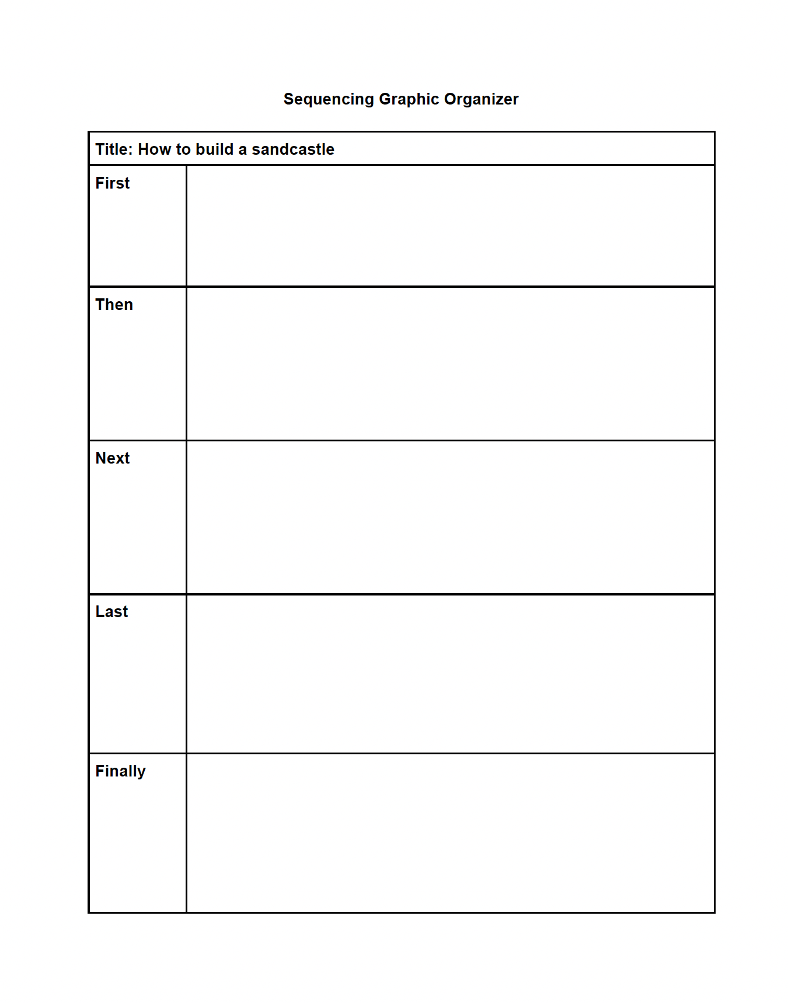
Graphic Organizers for writing
Notes:
Explain that when you are planning to code or to write, there are certain pattern of steps that we may follow each time.
We can use a graphic organizer to help us.
The graphic organizers you have used before helped you brainstorm and eventually write. But now you are going to use a graphic organizer to help take your writing one step further to the final step of the writing process: to present and publish your writing with Scratch! Using Scratch to animate your writing is one way to publish, or share, your work.

Slide 23
Meet Coco
Notes:
Today you are going to learn how to use Coco, a new graphic organizer to organize your thoughts, write instructions, and present your ideas in a coding project/

Slide 24
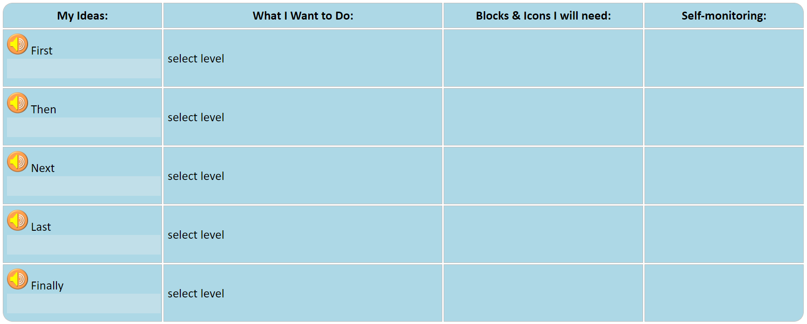
Notes:
Coco looks a lot like the graphic organizer we used earlier. Before Coco is filled in with your writing and ideas, it will look like this.

Slide 25
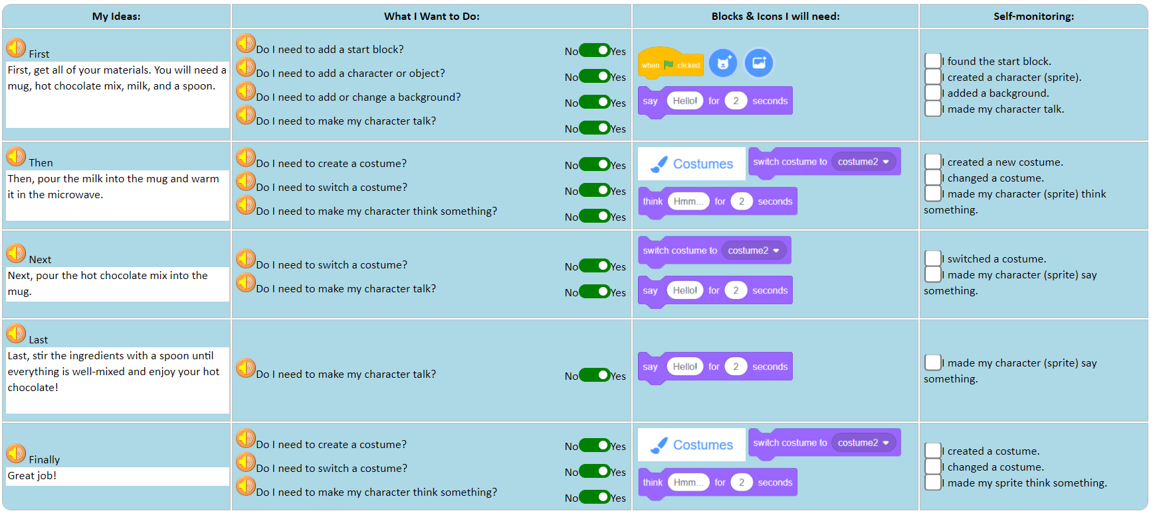
Notes:
Now let’s look at Coco with writing from the paragraph we just read. Do you see that the far left column already has words in it? These are instructions for making hot chocolate.
This is what level 1 of Coco looks like. It is completely filled out. As you become more familiar with Coco, you may move onto other levels that will allow you to change more and make more decisions.

Slide 26
Notes:
My ideas is where your writing will go. Let’s read the recipe for hot chocolate aloud. [have students take turns or you can read aloud or you can ask students to put on their headsets and listen to CoCo read the text to them.]

Slide 27
Notes:
In the column, “What i want to do” You will be asked a number of questions about what you want to do in scratch based on your writing. Again for level one you will not have to decide these things!

Slide 28
Notes:
In column 3, called blocks and icons I will need, you will see the blocks you need in scratch based on the decisions you made in column 2.

Slide 29
Notes:
In the final column called self-monitoring, you will see a list of statements that you need to check before you move on. These statements will help you check and make sure that you have found everything you need to code in scratch.

Slide 30
Notes:
For now, you won’t have to plan and write a new set of instructions--we’re going to use what is already here in CoCo to show us how we would publish our writing as an animation. We’re all going to code a Scratch program about “How to Make Hot Chocolate.”

Slide 31
Video of how to toggle and unscramble
Notes:
Video link: https://www.dropbox.com/s/qatn0edg0mctsiz/How%20to%20Toggle%20.webm?dl=0

Slide 32
Independent practice

Slide 33
Student Activity: debug some scrambled code
First, students should open the student slide deck PowerPoint (see website). Go to the Lesson 2 slides.
When you open Scratch, your code will not be in the correct sequence, look carefully!
You will need to fix your code by putting it in the same order as the instructions in Column 1 of CoCo.
Use CoCo and your transition words to help you!

Slide 34
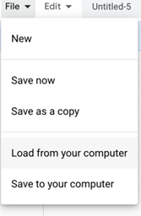
Independent Practice:
First, open a new window in your browser.
Next, download the .sb3 file from the following link: https://bit.ly/3rkIjBQ
Then, go to the following CS First Scratch Link: https://bit.ly/3PexYzB and open the Coco link that was shared by your teacher and click on Level 1.
Next, Click Sign in on CS First and Choose “I’m a student”
Then, Click “File” menu and Choose “Load from your computer”
Next, use the story and code you see in each row of CoCo Level 1 to put your jumbled code into the correct sequence in CS First. NOTE: if you do not see any code in CS First, be sure to scroll up and down.
Last, play your animation in Scratch by pressing the green flag.
Finally, correct any mistakes you made by fixing your code!
Pause here. (10-15 minutes)
Notes:
Ok, here is the sequence of steps to complete you independent practice. Your teacher is going to share two links with you that you will need to open on your computer.
Pause here.

Slide 35
Tips
When you open Scratch, your code will not be in the correct sequence, look carefully!
You will need to fix your code by putting it in the same order as the instructions in Column 1.
Use CoCo and your transition words to help you!
Notes:
Using blocks recommended in Coco level 1 to unscramble the code in Scratch

Slide 36
Solution Video See if your code is in the correct order
1.First, open a new window in your browser.
2.Next, download the .sb3 file from the following link: https://bit.ly/3Zg1Ksc
3.Then, go to the following CS First Scratch Link: https://bit.ly/3PexYzB
4.Next, Click Sign in and Choose “I’m a student”
5.Then, Click “File” menu and Choose “Load from your computer”
6.Last, play your animation by pressing the green flag!
Notes:
How did you do? Were you able to make your animation work? Did you run into any problems?

Slide 37
Optional
If you finish early, try changing the costumes in a different way!

Slide 38
Wrap up: Partner up, review code, and fix any errors
Notes:
Students should work with a partner to check their code for errors and fix were necessary. Bonus challenge: Can students change a costume again?

