Slide 1


Student slides
Lesson 1
Lesson created by the GMU-ODU CSforAll Team. For more information about
this lesson and our CSforAll initiative, contact Dr. Amy Hutchison at achutchi9@gmu.edu
Notes:
Hello! My name is Britt Miller. Well done on finishing Unit 1 on patterns and sequencing. I am excited to continue learning with you about Computer Science and Literacy!

Slide 2
Review: Sequence puzzles
Solve the puzzles by dragging the Scratch blocks in the correct order to help the dog find the first aid box WITHOUT landing on any black box!
When you’re done, switch with a partner and check each other’s work
Raise your hand if you have any questions!

Slide 3
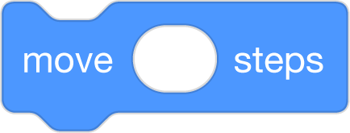




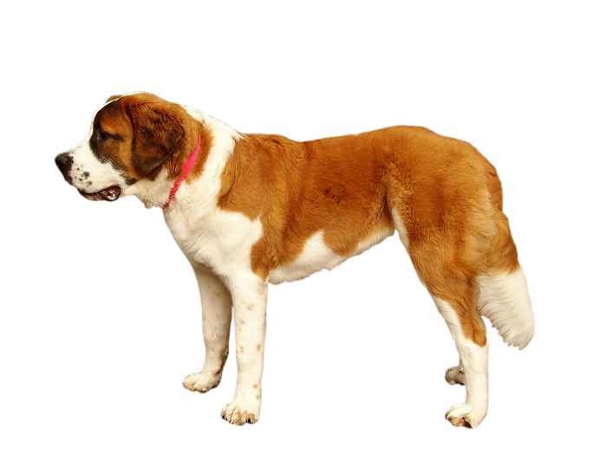

Put the blocks in the correct order to help the dog find the first aid box. Remember: you must AVOID any black boxes!
1
90
1
Each square equals to a single step
Drag the blocks from the middle column to the right column to solve the puzzle.
1

Slide 4

Put the blocks in the correct order to help the dog find the first aid box. Remember: you must AVOID any black boxes!
1
90
1
Each square equals to a single step
Drag the blocks from the middle column to the right column to solve the puzzle.
1
90

Slide 5
Put the blocks in the correct order to help the dog find the first aid box. Remember: you must AVOID any black boxes!
1
1
90
1
90
Each square equals to a single step
Drag the blocks from the middle column to the right column to solve the puzzle (Only use the provided blocks).
1
There is an extra block that is not needed in the solution.

Slide 6
Put the blocks in the correct order to help the dog find the first aid box. Remember: you must AVOID any black boxes!
1
1
90
1
1
1
There are extra blocks that are not needed in a correct solution.
90
Each square equals to a single step
Drag the blocks from the middle column to the right column to solve the puzzle.
90
1

Slide 7
Independent practice
Write a set of instructions by using the template.
Note: you will continue working with this set of instructions, so be creative!

Slide 8
Student slides
Lesson 2
Lesson created by the GMU-ODU CSforAll Team. For more information about
this lesson and our CSforAll initiative, contact Dr. Amy Hutchison at achutchi9@gmu.edu

Slide 9
Code an animation of a word
Steps:
Open your browser and go to https://scratch.mit.edu/ or Scratch for CS First
Choose your backdrop
Remove the cat sprite
Add the letters of your initials, word, or name–one sprite per letter!
Pick a sound and look block for each letter
Challenge: change the pitch effect on at least ONE of your letters
Optional tutorial video: https://scratch.mit.edu/projects/editor/?tutorial=name

Slide 10
Optional “Change sIZE” activity

Slide 11

Change Size
Play the video on the left by right-clicking the link and pasting it into your browser.
Go to the next slide
Place the blocks under the green flag in the correct order by moving them from left to right.
Once the code matches the video, you are done!
You can check your answer by seeing the solution image or clicking the solution link.

Slide 12
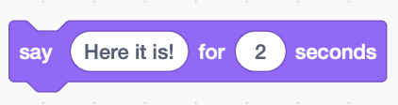


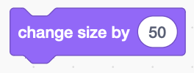
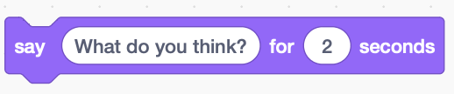
Mixed Code
Your Answer

