Slide 1
Student slides : Lesson 4
Algorithms
2nd Grade
1st Grade
Lesson created by the GMU-ODU CSforAll Team. For more information about
this lesson and our CSforAll initiative, contact Dr. Amy Hutchison at achutchison1@ua.edu

Slide 2
Instructions: Big Bad wolf’s algorithm
Write an algorithm to guide the Big Bad Wolf to visit each of the three little pigs’ houses following the sequence in the story.
You may choose to use either words or coding blocks to write your algorithm.
BONUS: can you find a way to abstract any steps in your algorithm to make it shorter and more efficient?

Slide 3
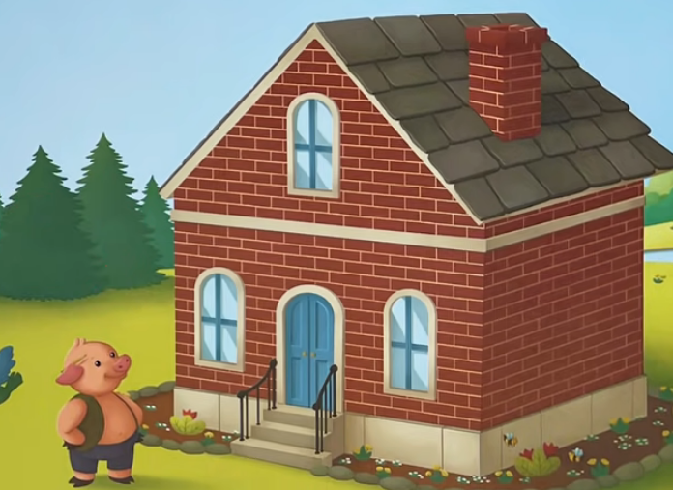
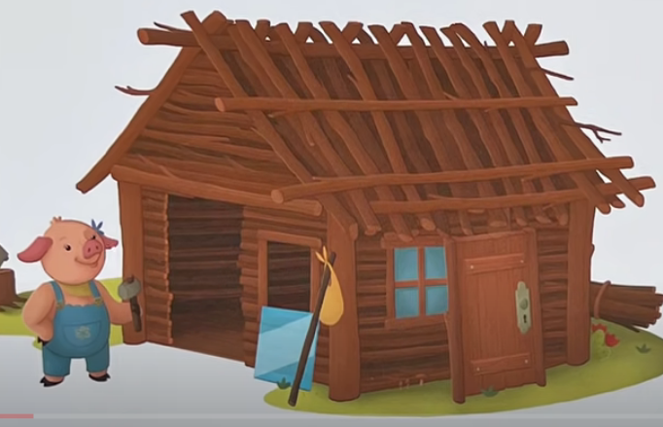
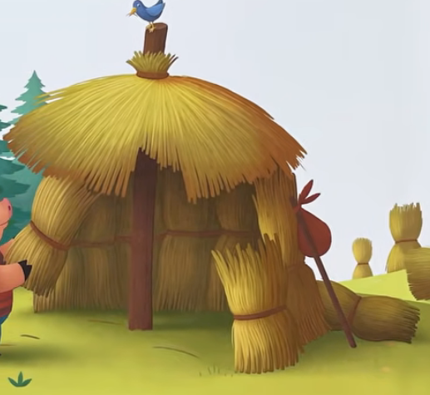
Start here!
Each square equals a single step

Slide 4
Word & Code banks
Code bank:
Word bank:
Move left one step
Move right one step
Move up one step
Move down one step
Turn right one time
Turn left one time

