Slide 1
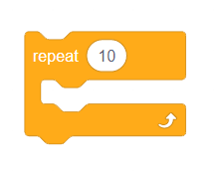
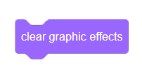
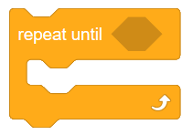
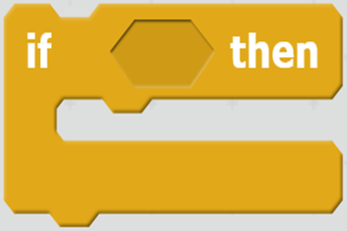
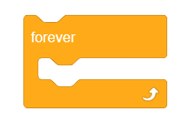
Scratch Block Choice Board
Hide character
Go to block
When this sprite clicked
Change size
Create clone
Repeat X number of times
Clear graphic effects
Change color
Repeat until
Ask () and wait
When any key pressed
If…then
Repeat forever
Show character
Set size

