Slide 1


Unit 2, lesson 1
ABSTRACTION
3rd & 4th Grade
5th & 6th grade
Lesson created by the GMU-ODU CSforAll Team. For more information about
this lesson and our CSforAll initiative, contact Dr. Amy Hutchison at ahutchison1@ua.edu

Slide 2
Summary and Standards
Summary:
In this lesson, students will be introduced to abstraction in computer science and instructional writing. They will practice abstraction in writing by filling in a graphic organizer.
2017 VDOE ELA Standards
The student will use effective communication skills in a variety of settings.
Use active listening strategies including but not limited to making eye contact, facing the speaker, asking questions, and summarizing.
b) Orally summarize information expressing ideas clearly.
The student will read and demonstrate comprehension of nonfiction texts
The student will write in a variety of forms to include narrative, descriptive, opinion, and expository
CS Standards:
The student will construct sets of step-by-step instructions (algorithms), both independently and collaboratively
a) using sequencing;
b) using events.
Notes:
Today, we are moving on to Unit 2, where we will learn about something called abstraction, a key process you will use in both computer science and writing.

Slide 3



Materials and resources needed for this lesson:
Chromebook/Laptop
Internet Access
Teacher Slide Deck
Student Slide Deck
Explanatory text graphic organizer
Notes:
You will need….[read slide]

Slide 4
Review: Sequence puzzles
Open your student slides
Solve the puzzles by dragging the Scratch blocks in the correct order
When you’re done, switch with a partner and check each other’s work
Raise your hand if you have any questions!
Pause here (10 minutes)
Notes:
Before we learn about our new vocabulary word for this lesson, we need to review what we’ve already learned. In a moment, you are going to open your student copy of the slides and work through some coding puzzles in your slide deck, these are going to look similar to ones you have done before. But this time, when you are done, you are going to look at another student's puzzle and check each other’s work.
Pause the video here to work through your sequence puzzles. We recommend about 10 minutes.

Slide 5
Great Job!
Notes:
Great job working on those sequence puzzles, now let’s look at the answers.

Slide 6







Put the blocks in the correct order to help the dog find the first aid box.
1
90
1
Each square equals to a single step
Drag the blocks from the middle column to the right column to solve the puzzle.
1
Notes:
Ok, for the first puzzle, your block should look like this. You need to move your dog 1 step forward, turn 90 degrees, move 1 step forward, move 1 step forward. Remember, that is our sequence!

Slide 7

Put the blocks in the correct order to help the dog find the first aid box.
90
1
1
Each square equals to a single step
Drag the blocks from the middle column to the right column to solve the puzzle.
90
1
Notes:
For this second puzzle, you must turn your dog first! Then move 1 step, 1 step, turn again to the left and move 1 step. That was our sequence of instructions.

Slide 8
Put the blocks in the correct order to help the dog find the first aid box.
1
1
90
90
Each square equals to a single step
Drag the blocks from the middle column to the right column to solve the puzzle (Only use the provided blocks).
1
There is an extra block that is not needed in the solution.
1
Notes:
Now, for puzzle 3 there was a tricky block in there that you didn’t need! Our sequence was...

Slide 9
Put the blocks in the correct order to help the dog find the first aid box.
1
90
1
There are extra blocks that are not needed in a correct solution.
90
Each square equals to a single step
Drag the blocks from the middle column to the right column to solve the puzzle.
1
90
1
1
1
Notes:
For the last puzzle, there were two blocks. Our final sequence was:
Whether we are writing a sequence of instructions for a person or an algorithm for a computer, we have to make sure we are clear and put things in the right order!

Slide 10
Abstraction
Notes:
Now that we have reviewed sequencing and coding, let’s learn about a new word in computer science. Abstraction!
"now that we have reviewed sequencing and coding, we can learn how to be smart at making and using our codes. Let's work smarter!

Slide 11
abstraction (Ab-Strac-SHUN) is identifying what
is important and leaving out information we do not need.
Notes:
Abstraction sounds like a really complicated word, but it just means identifying what is important and leaving out information that we do not need. Computer scientists are efficient, which means they look for the simplest solutions to problems.

Slide 12

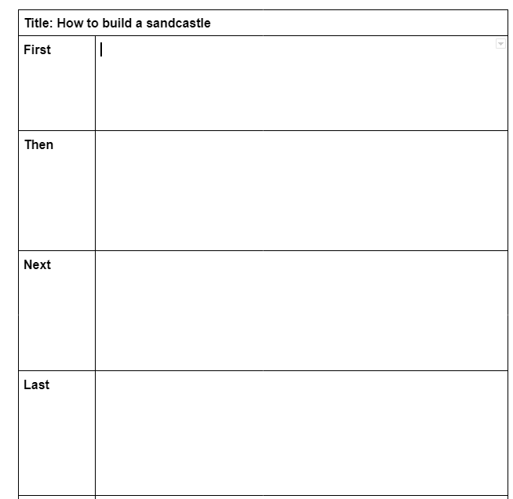
Notes:
Another common example of abstraction is in our writing when we plan our writing with an outline or a graphic organizer. In order to write clearly, we have to identify the most important details BEFORE we start writing.

Slide 13

Play Video
Notes:
Video link: https://www.youtube.com/watch?v=UXo7HMopEyk&t=1s

Slide 14

Notes:
Remember that graphic organizers are examples of abstraction. Graphic organizers are templates we often use to help us organize our writing. This helps us to plan our writing more efficiently. We can use these words for a variety of different types of writing and purposes. This helps us be more efficient.
For example, even though we filled in this graphic organizer for “how to build a sandcastle” we could use it to write a set of instructions for…..

Slide 15
Lego starship
Notes:
How to build something OTHER than a sandcastle. Like a Lego star ship! Nothing else about the graphic organizer needs to change but your instructions would be very different.

Slide 16
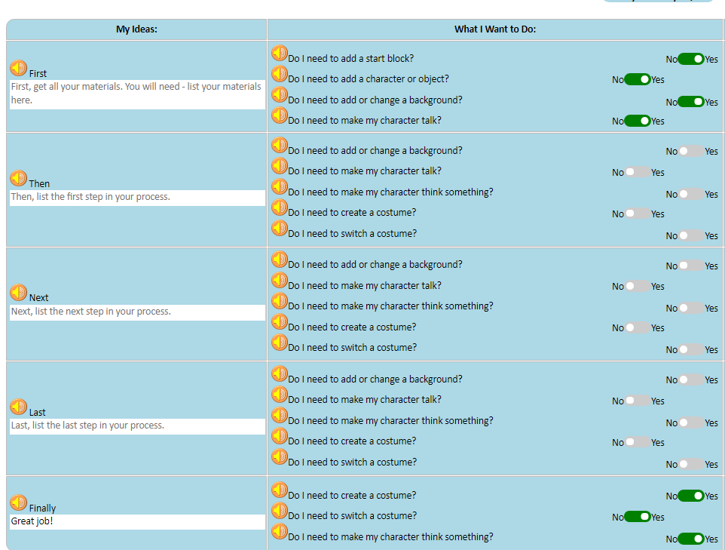
Notes:
Does anyone recognize this?
That’s right--CoCo itself is an example of abstraction in action! Not only does it allow you to abstract your entire piece of writing into discernible parts. It also helps us to break apart each of the frames of our animation into its most important parts. Remember last time when we worked to match our planning in CoCo to our code in Scratch? We got to choose our own sprites and backdrops. CoCo doesn’t show us EVERY single option of sprite to choose from. Instead, it reminds us of only the most important thing to remember: that we must add a sprite if we want to have a character in our animation!
Lastly, we can use CoCo to write many kinds of texts. As we go through our lessons, you’ll see that you can use or...reuse CoCo to write instructions for more than just how to make or do something. When you do this, you’re applying abstraction.

Slide 17
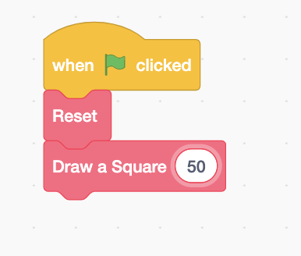
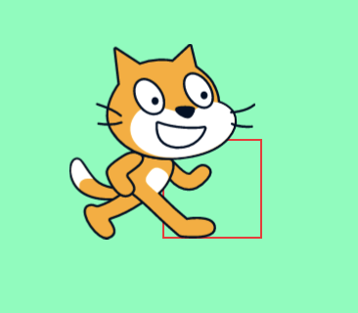
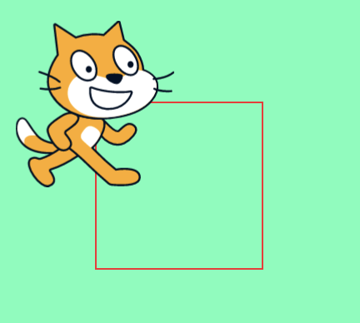
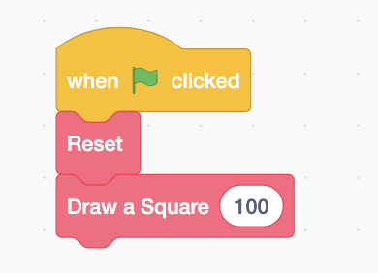
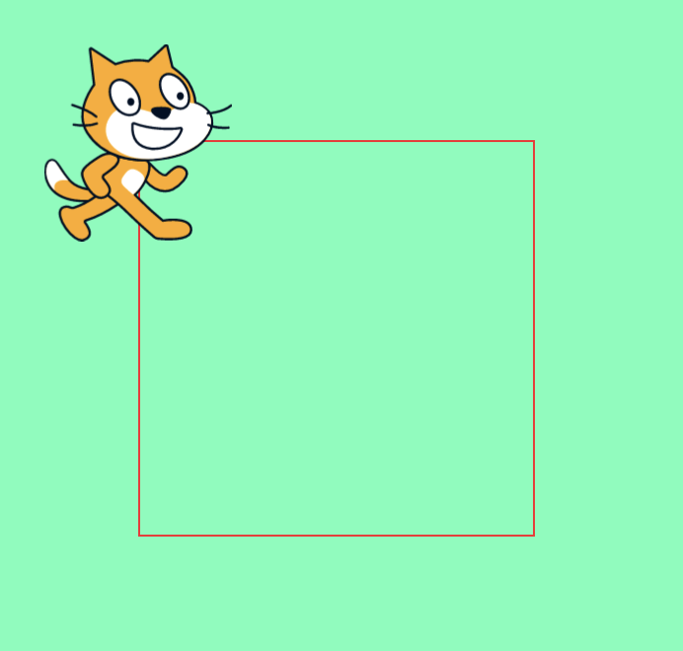
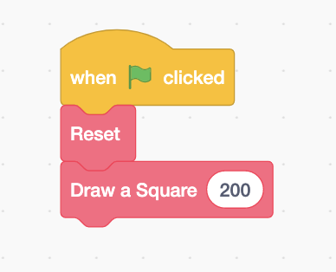
Small square
Big square
Notes:
In computer science, we use abstraction when we create code that we can reuse and when that code is written in the most efficient way possible. Remember when we tried to draw a polygon? We could have made that algorithm more efficient if we had taken two steps at a time instead of one. Well, we can use abstraction to reuse that pattern efficiently. We can just change the number of steps and create different size squares.
The same is true in Scratch. Do you see how the first the first square says 50, 100, and then 200. This would create different size squares using the same sequence. We only have to change the number of steps and our square can change size!
Scratch link: https://scratch.mit.edu/projects/599143669

Slide 18
Independent practice
Open your student slides.
Write a set of instructions for how to do anything you choose by using the template.
Note: you will continue working with this set of instructions, so be creative!
Notes:
In a moment, you will navigate to your student slide deck. In the deck is an outline for you. You can write a set of instructions for anything you want. It could be a recipe, how to play your favorite game, or how to get ready for school. Type your instructions into the graphic organizer.
There is also a link to this document in the handouts, for the option to hand write your instructions. Your teacher will let you know what to do next.

Slide 19
Pause here to complete your independent practice (15-20 minutes).

Slide 20
Introducing Scratch sound blocks

Slide 21
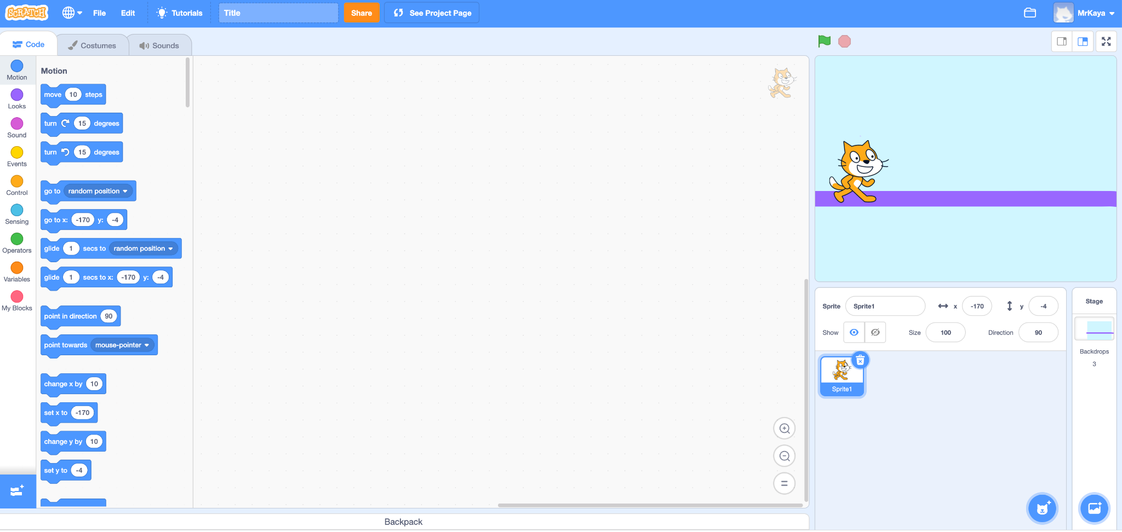
Introducing Scratch Sound blocks
Block categories
Notes:
Remember that on the far lefthand side of our page, we see a color palette. Each color corresponds to a different type of block. Today, we’ll focus on sound blocks, which are PINK.

Slide 22
Sound blocks
Do I need to play a sound?
Do I need to choose, upload, or record a sound?
Do I need to change the pitch effect of the sound?
Do I need to stop all sounds?
Notes:
Today, I am going to show you how to use two types of blocks you will see in level 4 of CoCo. These questions on the screen are all related to the pink sound blocks in scratch. Let me show you how to use these blocks!

Slide 23




Sound Blocks: click on each block to play a video to see what each block does
Do I need to play a sound?
Do I need to choose, upload, or record a sound?
Do I need to change the pitch effect of the sound?
Do I need to stop all sounds?
Notes:
Play the videos linked next to each block in the slide and explain: If you answer yes to any of these questions, you will use the blocks that you see next to each question to create that effect in Scratch.

Slide 24
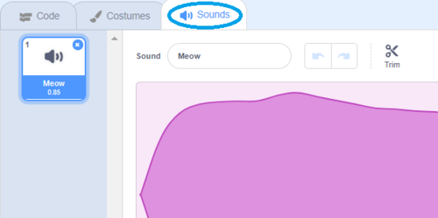

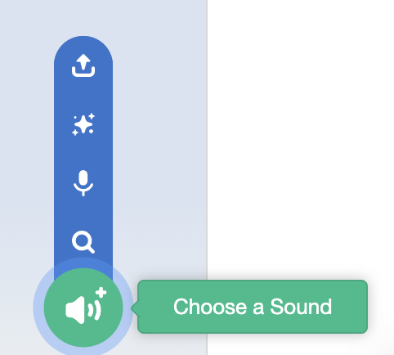
Sound Blocks: Do I need to choose, upload, or record a sound?
How to record or upload a sound:
1.
2.
3.
Notes:
But for this question, you will need to choose WHAT sound you are using. You can choose one from Scratch or upload or record your own sound!
In Scratch you will click on the Sounds tab at the top, then click the blue speaker with a plus sign, this will allow you to choose a sound.

Slide 25
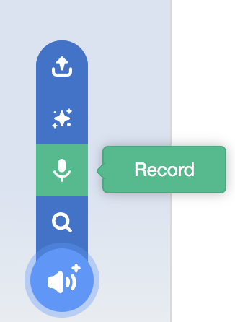
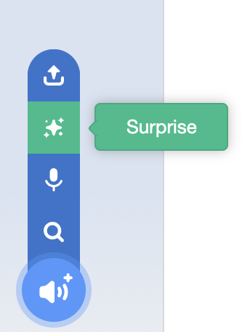
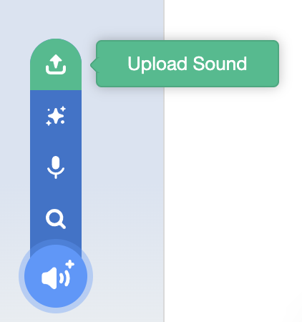
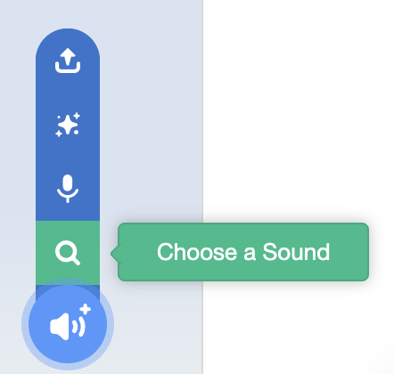
Sound Blocks: Do I need to choose, upload, or record a sound?
Notes:
Then you can decide how you want to choose your sound. Choose from the options in Scratch, record your own, let scratch choose, randomly, or you can upload a sound. Let me show you!

Slide 26
Your turn: Practice Using Scratch sound blocks
Instructions:
Create an animation with at least two sprites
Code each sprite to give at least one line of directions from the instructions written earlier
Use each of the sound blocks just introduced at least once

Slide 27
Pause to Work in Scratch

Slide 28
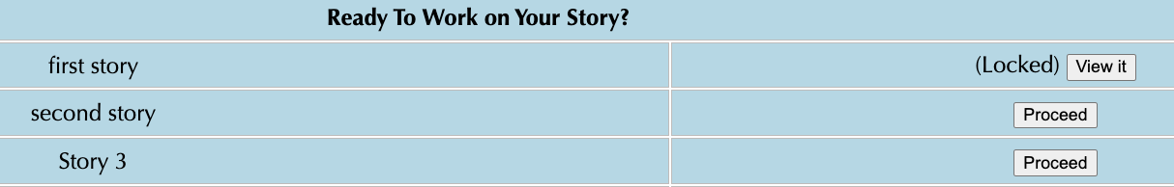


Sharing your .sb3 file from CS First to CoCo
Create the file in CS First
In the Scratch editor, find the word “File” in the top-left corner.
Click on “File” menu and you’ll see some choices pop down.
Choose “Save to your computer.” This will download your Scratch project.
Look in your “Downloads” folder. That’s where your saved project might be.
Go to the CoCo website and log in to your account. https://wego.gmu.edu/scratchgo/login.php
Click proceed on the correct story in CoCo.
Navigate to the section of CoCo where you can upload your project. (only sb3 type and 10Mb max).
Click “Save”.
Notes:
Model how students can share Scratch creations to their teacher’s studio

Slide 29
Here is an optional video to learn how to share your project in Scratch.
Pause here.
Notes:
Video modeling how students can share Scratch creations to their teacher’s studio
Scratch - Imagine, Program, Share

Slide 30
Scratch Checklist
I logged into scratch
I shared my project
I added my project to my teacher’s studio

