Slide 1
How to Code a Sandcastle:
Scratch Review

Slide 2
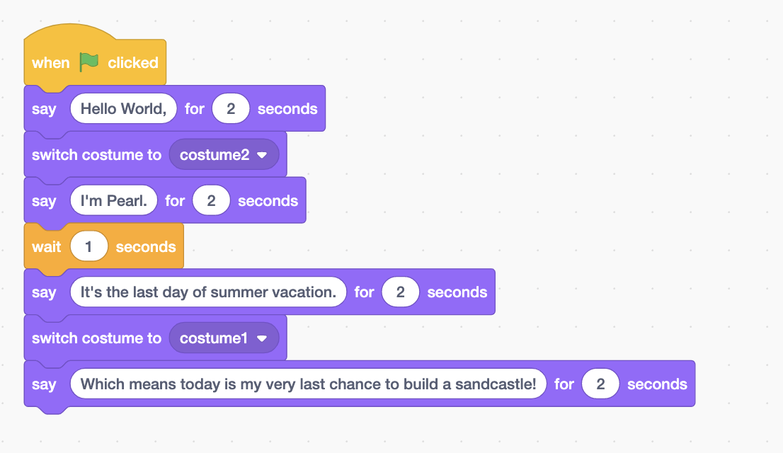
According to the given code below, select the Say block that will run second
Place the blue rectangle around the correct block

Slide 3
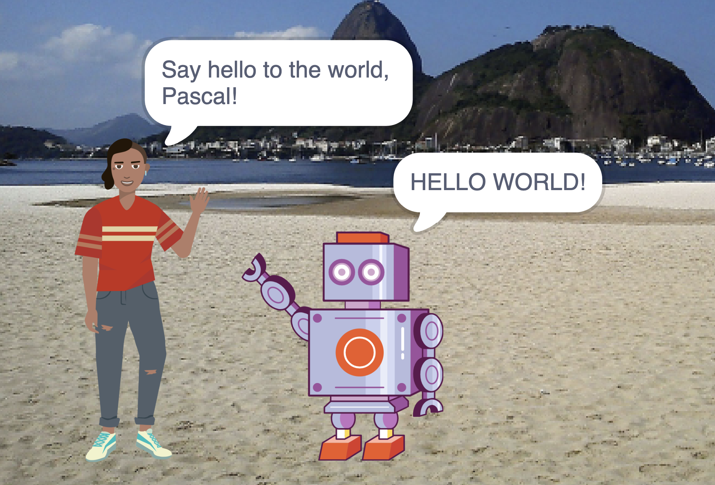
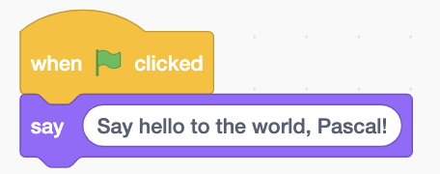
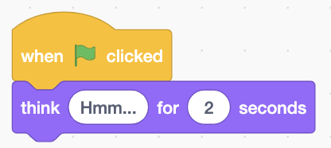
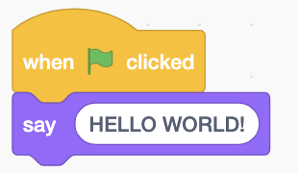
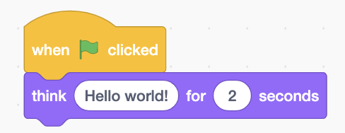
When the Green Flag is clicked, this appears on stage:
Select the script that ran for the girl.

Slide 4
When the Green Flag is clicked, this appears on stage:
Select the script that ran for the robot.

Slide 5
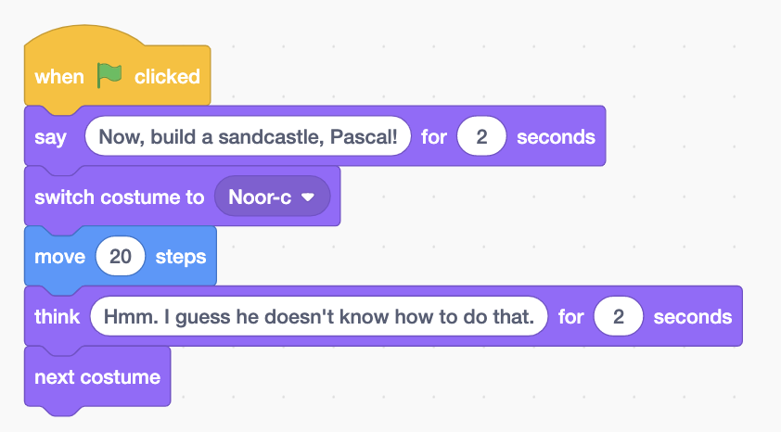
How will the girl act when the green flag is clicked?
First, the girl ____________
Switches costume to Noor-c
Switches to next costume
Moves 20 steps
Thinks Hmm. I guess he doesn’t know how to do that. for 2 seconds
Says Now, build a sandcastle, Pascal! for 2 seconds

Slide 6
How will the girl act when the green flag is clicked?
Next, the girl ____________
Switches costume to Noor-c
Switches to next costume
Moves 20 steps
Thinks Hmm. I guess he doesn’t know how to do that. for 2 seconds
Says Now, build a sandcastle, Pascal! for 2 seconds

Slide 7
How will the girl act when the green flag is clicked?
Then, the girl ____________
Switches costume to Noor-c
Switches to next costume
Moves 20 steps
Thinks Hmm. I guess he doesn’t know how to do that. for 2 seconds
Says Now, build a sandcastle, Pascal! for 2 seconds

Slide 8
How will the girl act when the green flag is clicked?
Last, the girl ____________
Switches costume to Noor-c
Switches to next costume
Moves 20 steps
Thinks Hmm. I guess he doesn’t know how to do that. for 2 seconds
Says Now, build a sandcastle, Pascal! for 2 seconds

Slide 9
How will the girl act when the green flag is clicked?
Finally, the girl ____________
Switches costume to Noor-c
Switches to next costume
Moves 20 steps
Thinks Hmm. I guess he doesn’t know how to do that. for 2 seconds
Says Now, build a sandcastle, Pascal! for 2 seconds

Slide 10
Solutions

Slide 11
According to the given code below, select the Say block that will run second
Place the blue rectangle around the correct block

Slide 12
When the Green Flag is clicked, this appears on stage:
Select the script that ran for the girl.

Slide 13
When the Green Flag is clicked, this appears on stage:
Select the script that ran for the robot.

Slide 14
How will the girl act when the green flag is clicked?
First, the girl ____________
Switches costume to Noor-c
Switches to next costume
Moves 20 steps
Thinks Hmm. I guess he doesn’t know how to do that. for 2 seconds
Says Now, build a sandcastle, Pascal! for 2 seconds

Slide 15
How will the girl act when the green flag is clicked?
Next, the girl ____________
Switches costume to Noor-c
Switches to next costume
Moves 20 steps
Thinks Hmm. I guess he doesn’t know how to do that. for 2 seconds
Says Now, build a sandcastle, Pascal! for 2 seconds

Slide 16
How will the girl act when the green flag is clicked?
Then, the girl ____________
Switches costume to Noor-c
Switches to next costume
Moves 20 steps
Thinks Hmm. I guess he doesn’t know how to do that. for 2 seconds
Says Now, build a sandcastle, Pascal! for 2 seconds

Slide 17
How will the girl act when the green flag is clicked?
Last, the girl ____________
Switches costume to Noor-c
Switches to next costume
Moves 20 steps
Thinks Hmm. I guess he doesn’t know how to do that. for 2 seconds
Says Now, build a sandcastle, Pascal! for 2 seconds

Slide 18
How will the girl act when the green flag is clicked?
Finally, the girl ____________
Switches costume to Noor-c
Switches to next costume
Moves 20 steps
Thinks Hmm. I guess he doesn’t know how to do that. for 2 seconds
Says Now, build a sandcastle, Pascal! for 2 seconds

